Slide 1
Software Engineering
Lecture 03 – Software Processes
© 2015 Dr. Florian Echtler
Bauhaus University Weimar
<florian.echtler@uni-weimar.de>
This work is licensed under a Creative Commons Attribution-NonCommercial-ShareAlike 4.0 International License.

Slide 2
Software Processes
SPs are “activities involved in producing a software system”
SP models are “abstract representations of these processes”
(Definitions from [Sommerville2011])
There is no ideal process.
One size does not fit all.

Slide 3
Fundamental Activities
4 fundamental activities – software …
  Specification
  Design & Implementation
  Validation
  Evolution
Major components:
  Products (= outcomes of an activity)
  Roles (= responsibilities of people involved)
  Pre- and post-conditions

Slide 4
Software Specification
Defines functionality of/constrains on the software product
Also known as requirements engineering
Nearly always the initial step
Sub-activities:
  Feasibility study
  Requirements elicitation/analysis
  Requirements specification
  Requirements validation

Slide 5
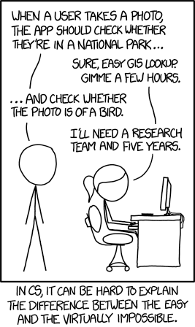
Software Specification
Image source (FU): Sommerville, Software Engineering, Chapter 2, https://xkcd.com/1425/
Feasibility
study
Requirements
elicitation and
analysis
Requirements
specification
Feasibility
report
Requirements
validation
System
models
User and system
requirements
Requirements
document

Slide 6
Requirements Specification
User requirements: (“Lastenheft”)
  Statements in natural language (+ diagrams)
  What services is the system expected to provide?
  What constraints is it expected to observe?
  Often part of the call for bids (“Ausschreibung”)
System requirements: (“Pflichtenheft”)
  Detailed description of functions/services
  Defines exactly what is to be implemented
  Often part of the contract

Slide 7
User requirements
“Lastenheft” → customer's view
Clear, rigid structure, e.g. from [Balzert2009]
    Zielbestimmung
    Einsatz
    Funktionen
    Daten
    (Zusatz-)Leistungen
    Qualitätsanforderungen
    Ergänzungen

Slide 8
System requirements
“Pflichtenheft” → developer's view
Extension of UR with additional sections
    Zielbestimmung
    Einsatz
    Produktumgebung
    Funktionen
    Daten
    (Zusatz-)Leistungen
    Qualitätsziele
    Testszenarien/-fälle
    Entwicklungsumgebung
    Ergänzungen

Slide 9
Requirements Specification (2)
Source (FU): Sommerville, Software Engineering, Chapter 4
User requirements example (“feature wishes”)
  The patient management system shall generate monthly management reports showing the cost of drugs prescribed by each clinic during that month.
System requirements example (“testable”)
  On the last working day of each month, a summary of the drugs prescribed, their cost, and the prescribing clinics shall be generated.
  The system shall automatically generate the report for printing after 17:30 on the last working day of the month.
  A report shall be created for each clinic and shall list the individual drug names, the total number of prescriptions, the number of doses prescribed, and the total cost of the prescribed drugs.
  If drugs are available in different dose units (e.g., 10 mg, 20 mg) separate reports shall be created for each dose unit.
  Access to all cost reports shall be restricted to authorized users listed on a management access control list.

Slide 10
Requirements Specification (3)
Functional requirements
  What should the system (not) do?
  E.g. “A user shall be able to search the appointment lists for all clinics.”
Non-functional requirements
  Reliability, response time, security, ease of use …
  E.g. “The system shall be available during normal working hours (Mo-Fr, 8:30 – 17:30). Downtime during NWH shall not exceed 5 sec. per day.”
  “The system shall conform to ISO Standard XYZ.”

Slide 11
Software Design & Implementation
Conversion from system specification to executable system
Sub-activities:
  Design
    e.g. architecture, interface, component, database, …
    Often involves graphical models, UML
  Implementation
    Often interleaved with design (depending on SPM)
    Also involves testing & debugging

Slide 12
Software Design & Implementation
Image source (FU): Sommerville, Software Engineering, Chapter 2
Requirements
specification
Design activities
Architectural
design
Abstract
specification
Interface
design
Component
design
Data structure
design
Algorithm
design
System
architecture
Software
specification
Interface
specification
Component
specification
Data structure
specification
Algorithm
specification
Design products

Slide 13
Software Validation
Verification and validation (V&V)
Validation → “Are we building the right product?” [Boehm79]
  User testing
  Acceptance testing (with user-supplied data)
Verification → “Are we building the product right?” [Boehm79]
  Unit testing (with developer-supplied data)
  System testing

Slide 14
Software Validation
Image source (FU): Sommerville, Software Engineering, Chapter 2
Requirements
specification
System
specification
System
design
Detailed
design
Acceptance
test plan
System
integration
test plan
Sub-system
integration
test plan
Module and
unit tests
Service
Acceptance
test
System
integration test
Sub-system
integration test

Slide 15
Software Evolution
Also known as software maintenance
Often higher costs than initial development
Integral part of the entire software process

Slide 16
Software Evolution
Image source (FU): Sommerville, Software Engineering, Chapter 2
Beware of “not-invented-here” (NIH) syndrome
Requirements
specification
Evaluate
existing systems
Propose system
changes
Modify
systems
New
system
Existing
systems

Slide 17
“Plan-driven” vs. “Agile”
Plan-driven processes:
  All steps/activities planned in advance
  Progress measured against this plan
Agile processes:
  Incremental planning
  Easier adaptation to change
  More difficult to measure progress
Many hybrid methods

Slide 18
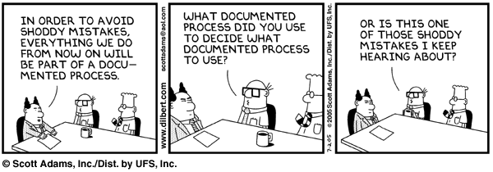
Example Software Processes
Waterfall model
Other “traditional” models
Incremental development
Reuse-oriented development

Slide 19
Waterfall Model
Requirements
specification
System and
software design
Implementation
and unit testing
Integration/
System testing
Operation/
maintenance

Slide 20
Waterfall Model
Derived from general systems engineering
Phases …
  have clear lifetimes (plan-driven)
  end with “sign-off” on specific documents → iterations are expensive
Used in formal development (proof-driven, for safety-critical systems)
Very inflexible

Slide 21
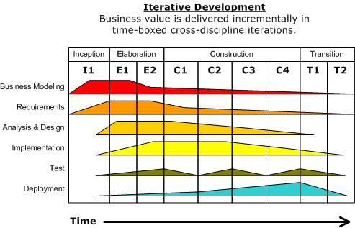
Other “traditional” models
Image source (CC): https://en.wikipedia.org/wiki/Rational_Unified_Process
Rational Unified Process (RUP) [Krutchen03]
Derived from work on UML
Focus on business perspective
Focus on iteration

Slide 22
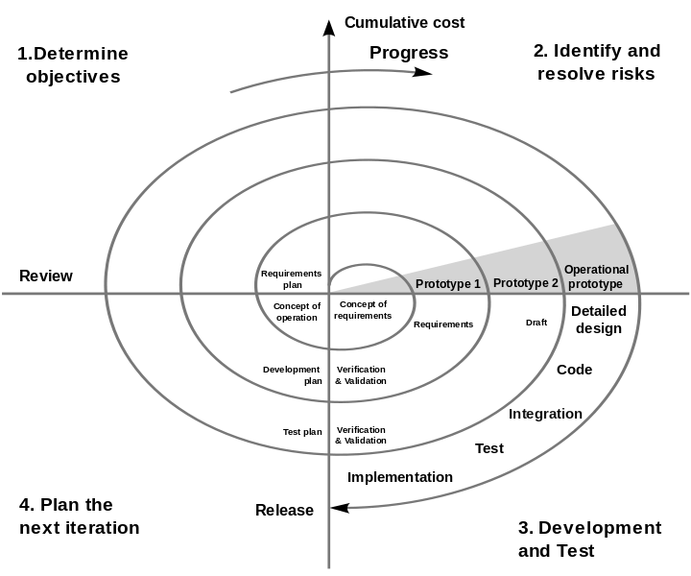
Other “traditional” models
Image source (PD): https://en.wikipedia.org/wiki/Spiral_model
Spiral Model [Boehm88]
4 sectors for each cycle
Focus on risk assessment

Slide 23
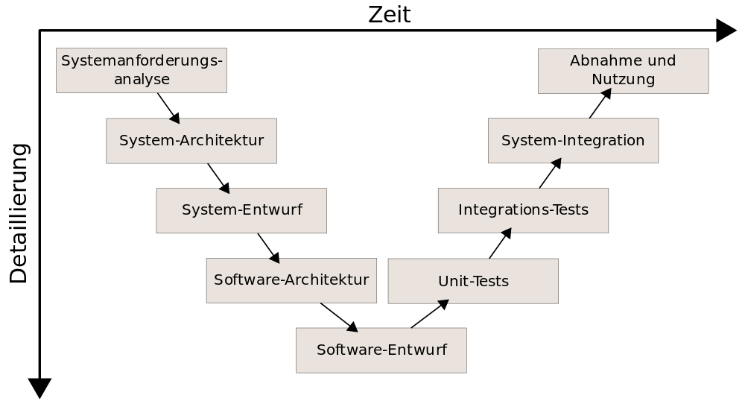
Other “traditional” models
Image source (CC): https://de.wikipedia.org/wiki/V-Modell
V Model [Boehm79], based on Waterfall
Often used by German government
Current variant: “V-Modell XT”

Slide 24
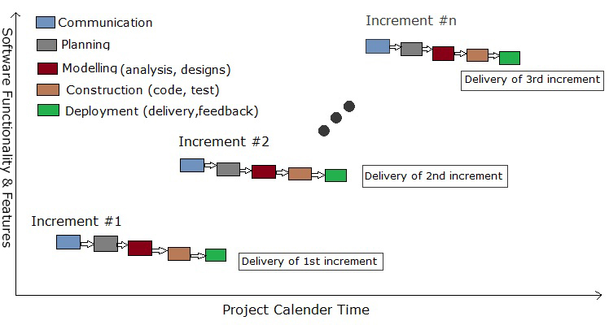
Incremental Development
Image source (CC): https://en.wikipedia.org/wiki/Incremental_build_model

Slide 25
Incremental Development
Also known as evolutionary development
Basis for many agile processes
Quickly develop multiple prototypes
Test with end users, refine, repeat
Very useful for GUI applications

Slide 26
Reuse-oriented Development
Image source (FU): Sommerville, Software Engineering, Chapter 2
Focus on reuse/adaptation of existing components
Needs requirement compromises
Often used in Web context (e.g. LAMP stack)
Requirements
specification
Component
analysis
Requirements
modification
System
validation
Development/
Integration
System design
with reuse

Slide 27
Reacting to Change
Change will happen during the SP
Two strategies for coping with change:
  Change avoidance → Prototyping
  Change tolerance → Incremental Delivery

Slide 28
Prototyping
Quickly create prototypes and expose to users
Useful during all phases
Initial prototypes may not even contain code (e.g. paper prototypes, mockups, Wizard-of-Oz)
Be prepared to throw entire prototypes away

Slide 29
Incremental Delivery
Image source (FU): Sommerville, Software Engineering, Chapter 2
Order functionality by importance
Deliver most important functions to the end user first
Either plan-driven (increments defined in advance) or agile (inc. defined on-the-fly)
Define outline
requirements
Define
increments
Design system
architecture
Develop
increment
Validate
increment
Integrate
increment
Validate
system
Final
system
System incomplete

Slide 30
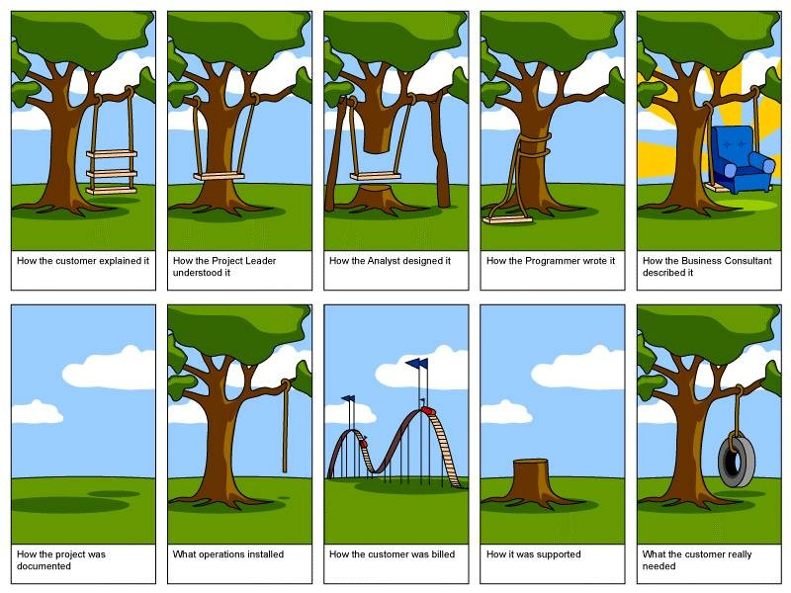
Questions?
Image source (FU): http://www.paragoninnovations.com/ng4/guide.shtml
Thanks for listening!

