Slide 1
Software Engineering
Lecture 05 – Design Patterns:
Introduction
© 2015 Dr. Florian Echtler
Bauhaus University Weimar
<florian.echtler@uni-weimar.de>
This work is licensed under a Creative Commons Attribution-NonCommercial-ShareAlike 4.0 International License.

Slide 2
Design Patterns
“Recipes” for common problems
Available on different levels (e.g. system architecture, user interface, implementation)
Usually without any code, at most UML
Often just “box-and-line”-diagrams, esp. for architectural patterns

Slide 3
Description of a Design Pattern
Problem
  Motivation/application area
Solution
  Structure (class diagram)
  Pieces (names of classes or operations)
  Object interaction (e.g. sequence diagram)
Discussion
  Advantages, disadvantages, dependencies
  Constraints, special cases, known uses

Slide 4
Design Patterns: History
Originally from architecture and construction
“A Pattern Language: Towns, Buildings, Construction”, Christopher Alexander, 1977
  “Each pattern describes a problem which occurs over and over again in our environment, and then describes the core of the solution to that problem, in such a way that you can use this solution a million times over, without ever doing it the same way twice.”

Slide 5
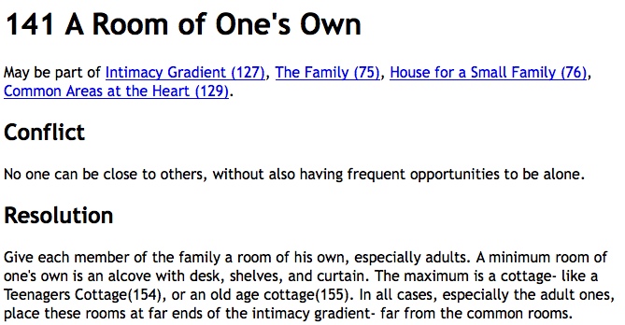
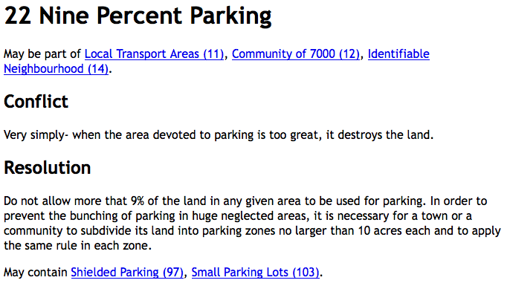
“A Pattern Language” examples
Image source (FU): “A Pattern Language”, C. Alexander

Slide 6
Architecture Patterns
High-level patterns: view of entire system
Multiple overlapping views possible
Examples:
  Model-View-Controller
  Client-Server architecture
  Layered architecture
  Repository pattern
  Pipe-and-Filter architecture

Slide 7
Model-View-Controller (MVC)
Suitable for UI applications
3 logical components:
  Model: manages data & associated operations
  View: defines/manages presentation to user
  Controller: manages user interaction
Advantages:
  Data can change independently from presentation
Disadvantages:
  Can cause extra complexity for simple data models

Slide 8
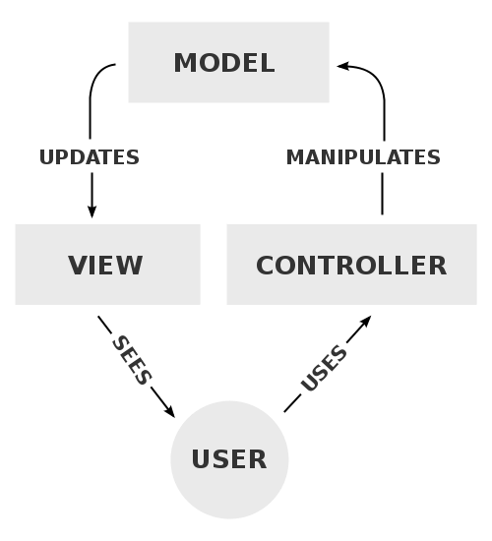
Model-View-Controller
Image source (PD): https://en.wikipedia.org/wiki/Model%E2%80%93view%E2%80%93controller
e.g.
data-
base
e.g.
web
browser
e.g.
PHP
app

Slide 9
Client-server architecture
Functionality split into services
Every service provided by one (logical) server
  Accessing shared data from multiple locations
  Load balancing → replicate servers
Advantages:
  Distributed, network-transparent architecture
Disadvantages:
  Every server → single point of failure
  Network performance unpredictable

Slide 10
Client-server architecture
Image source (FU): Sommerville, Software Engineering, Chapter 6
Client 1
Client 2
Client 3
...
Network
Network
Network
Network
Network
Catalogue
server
Video
server
Image
server
Web
server

Slide 11
Layered architecture
System as a stack of interconnected layers
  Layers only communicate with neighbours
  Increasing complexity from top to bottom
Often used for network protocols
Advantages:
  Individual layers can be replaced
  Clear interface specification built in
Disadvantages:
  Clean separation can be difficult

Slide 12
Example: layered UI architecture
Browser
Web Application
Question: where to put security features?
Database
Support/HAL/OS

Slide 13
ISO/OSI network model
Application
Application
Presentation
Presentation
Session
Session
Transport
Transport
Network
Network
Data Link
Data Link
Physical
Physical

Slide 14
Internet network model
HTTP (HyperText Transfer Protocol)
Application/
Presentation
TLS (Transport Layer Security)
Session
TCP (Transmission Control Protocol)
Transport
IP (Internet Protocol)
Network
802.11* MAC/LLC (WLAN Management)
Data Link
802.11* PHY (Wireless Hardware)
Physical

Slide 15
Internet network model (2)
Layered protocols → nested data packets
Packets consist of header + payload
Payload of protocol 1 = packet of protocol 2
PHY
LLC
IP
TCP
TLS
HTTP
actual payload data

Slide 16
Repository pattern
All data is managed in a central repository/DB
  Components do not interact directly
  Only communicate with the repository
Advantages:
  Components can be independent
  Easy data management (e.g. backups)
Disadvantages:
  Single point of failure, may be inefficient
  Distribution/synchronization difficult

Slide 17
Repository pattern: CASE system
Image source (FU): Sommerville, Software Engineering, Chapter 6
UML
editor
Code
generator
C++
editor
Debugger
Project Repository
Java
editor
Code
analyzer
Compiler
+ linker
CASE = Computer Aided Software Engineering, e.g. Eclipse

Slide 18
Pipe-and-Filter architecture
Suitable for audio/video processing, computer vision, text processing …
  Many components (filters) which provide data transformations
  Data flows through pipes/network of components
Advantages:
  Easy to extend, matches many real-world processes
Disadvantages:
  Requires either common data format or costly conversions

Slide 19
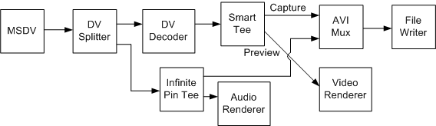
Pipe-and-Filter architecture
Image source (FU): https://msdn.microsoft.com/en-us/library/dd318616%28v=vs.85%29.aspx

Slide 20
Architecture Considerations
Performance – Minimize communications, use large-grained components
Security – use e.g. layered architecture with critical assets in inner layers
Safety – Localize safety-critical features in few subsystems
Availability – Include redundant components
Maintainability – Use small, replaceable components

Slide 21
Design patterns for program code
Reference: “Design Patterns – Elements of Reusable Object-Oriented Software” by Gamma, Helm, Johnson and Vlissides
Also known as Gamma-, “GangOfFour”- or “GoF”-Book
“Distillation” of 23 common patterns from existing code
3 major categories: creational, structural and behavioral patterns

Slide 22
Creational patterns
Used to create other objects
Rules-of-thumb: http://www.vincehuston.org/dp/creational_rules.html
Examples:
  Singleton
  AbstractFactory
  FactoryMethod
  Prototype

Slide 23
Singleton
Common problem: use only a single instance of a certain class (e.g. a Factory)
Creation of additional instances should not be possible
Solution: make class responsible for its own singular instance

Slide 24
Singleton: Code example
Source (FU): http://www.vincehuston.org/dp/singleton.html
class GlobalClass {
private:
int m_value;
static GlobalClass* s_instance;
GlobalClass( int v = 0 ) { m_value = v; }
public:
int get_value() { return m_value; }
void set_value( int v ) { m_value = v; }
static GlobalClass* instance() {
if ( s_instance == NULL )
s_instance = new GlobalClass;
return s_instance;
}
};
// Allocating and initializing GlobalClass's
// static data member. The pointer is being
// allocated here - not the object itself.
GlobalClass* GlobalClass::s_instance = NULL;

Slide 25
AbstractFactory
Use Factory object to delegate object creation
Useful for multiple families of similar objects
Exact type determined by specific factory
Example: different classes of UI elements

Slide 26
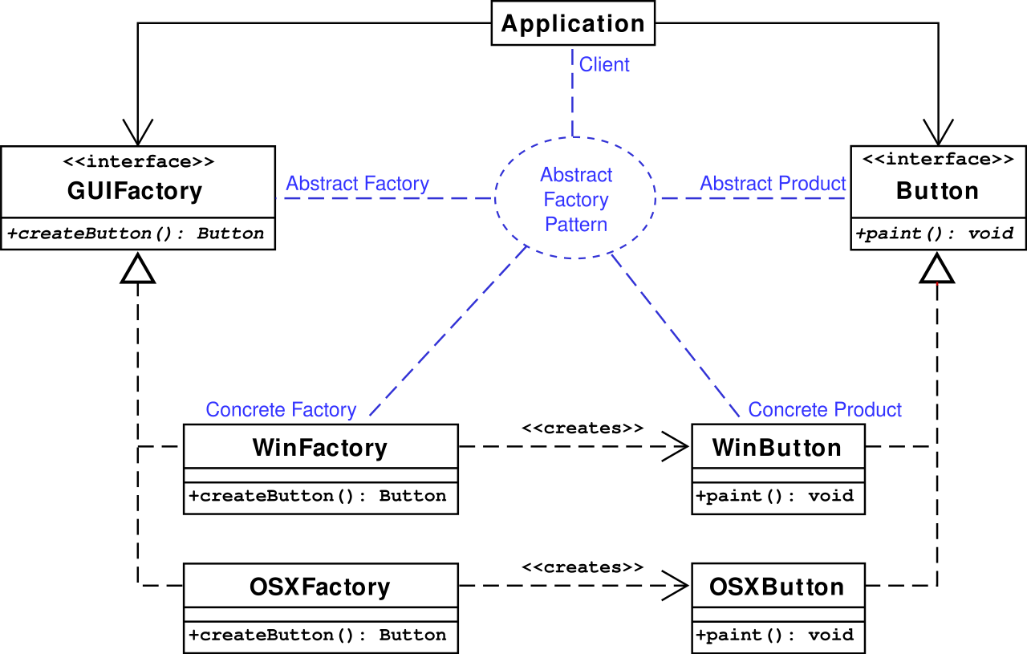
AbstractFactory (2)
Image source (CC): https://en.wikipedia.org/wiki/Abstract_factory_pattern

Slide 27
AbstractFactory: Code example
Source (FU): http://www.vincehuston.org/dp/abstract_factory.html
Before:
After:
void display_window_one() {
#ifdef MOTIF
Widget* w[] = {
new MotifButton,
new MotifMenu
};
#else // PM
Widget* w[] = {
new PMButton,
new PMMenu
};
#endif
w[0]->draw();
w[1]->draw();
}
WidgetFactory* factory;
void display_window_one() {
Widget* w[] = {
factory->create_button(),
factory->create_menu()
};
w[0]->draw();
w[1]->draw();
}

Slide 28
FactoryMethod
Can be used by the AbstractFactory to create new objects
Replaces explicit new(...) with method
Central element: static factory method in base class, e.g. static BaseClass* create();

Slide 29
FactoryMethod: Code example
Source (FU): http://www.vincehuston.org/dp/factory_method.html
class Stooge {
public:
// Factory Method
static Stooge* make_stooge( int choice );
virtual void slap_stick() = 0;
};
class Moe: public Stooge {
public:
void slap_stick() { cout << "Moe: slap head\n"; }
};
[...]
Stooge* Stooge::make_stooge( int choice ) {
if (choice == 1)
return new Larry;
else if (choice == 2)
return new Moe;
else
return new Curly;
}

Slide 30
Prototype
Alternative way for AbstractFactory to create new objects
Central element: virtual clone method in subclasses, e.g. virtual BaseClass* clone();
  Maintain pool of prototype objects
  Call clone() on appropriate prototype

Slide 31
Prototype: Code example
Source (FU): http://www.vincehuston.org/dp/prototype.html
class Stooge {
virtual Stooge* clone() = 0;
virtual void slap_stick() = 0;
};
class Factory {
static Stooge* make_stooge( int choice );
static Stooge* s_prototypes[4];
};
class Moe: public Stooge {
Stooge* clone() { return new Moe; }
void slap_stick() { cout << "Moe: slap head\n"; }
};
Stooge* Factory::s_prototypes[] = {
0, new Larry, new Moe, new Curly
};
Stooge* Factory::make_stooge( int choice ) {
return s_prototypes[choice]->clone();
}

Slide 32
C++ Templates Recap
Template method:
Template class:
template<typename TYPE>
TYPE twice(TYPE data)
{
return data * 2;
}
cout << twice<double>(123);
template<class Type1, class Type2>
class pair
{
Type1 first;
Type2 second;
};
pair<int,double> square_root;

Slide 33
Outlook – Patterns, Part 2
Behavioural patterns, e.g. Iterator
Structural patterns, e.g. Adapter
UI patterns
Antipatterns

Slide 34
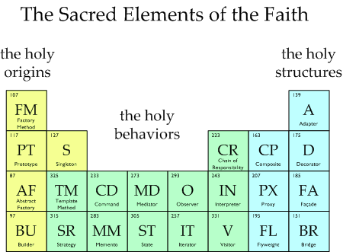
Questions/suggestions?
Image source (FU): http://www.vincehuston.org/dp/

