Slide 1
Software Engineering
Lecture 02 – Git & OOP
© 2015-20 Dr. Florian Echtler
Bauhaus-Universität Weimar
<florian.echtler@uni-weimar.de>
This work is licensed under a Creative Commons Attribution-NonCommercial-ShareAlike 4.0 International License.

Slide 2
Revision Control
Also known as version or source code control
Revision control systems (RCS) maintain …
  a history of changes
  from multiple persons
  to a set of documents.
Mostly designed for plain-text documents (e.g. source code, LaTeX files, …)
Extensions for binary files (e.g. images) possible

Slide 3
Storing history in RCS (1)
Most RCS use numbered revisions
Initial state of the document set is revision 1,
First change is revision 2, second change ...
Important: not necessarily linear
Revisions can have multiple successors
→ overall structure is a tree (with exceptions)

Slide 4
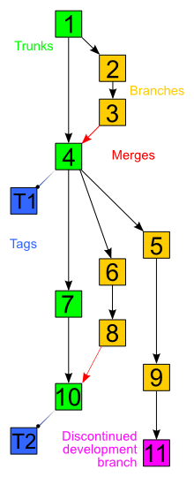
Storing history in RCS (2)
Time
Image source (CC): https://en.wikipedia.org/wiki/Revision_control
Trunk: main development history (often also called master)
Branch: e.g. development of extra features, bugfixes, …
Tags: “bookmarks”, e.g. releases
Merges: combination of 2 or more branches (break pure tree structure)

Slide 5
Storing history in RCS (3)
Time
Image source (CC): https://en.wikipedia.org/wiki/Revision_control
Merges: can lead to conflicts
e.g. what if change sets 6 and 7 edit the same file?
What if it's the same line?
→ may require manual intervention/rewriting

Slide 6
Common RCS terms
Repository (repo): storage for files + history (usually on a remote server)
Working copy: local copy of the files at a specific revision
Common examples: CVS, Subversion (SVN)
working
copy
repo-
sitory

Slide 7
Common RCS operations
checkout: create a local copy
commit: push a set of changes to the repository (atomic operation)
update: integrate new changes from repo into local copy (possibly requiring merge)
working
copy
repo-
sitory
commit
update

Slide 8
Distributed RCS
multiple interconnected repositories (peer-to-peer), no separate working copies
e.g. Bazaar (bzr), Mercurial, git
widely used in open-source context
repo
repo
repo
repo

Slide 9
DRCS operations
clone: create new, complete copy of repo
commit: save changes locally to history
push/pull: transfer to/from remote repo
“upstream”
repo
repo
“downstream”
clone
repo
repo
clone
push
pull

Slide 10
Other RCS ops: diff
diff: view highlighted set of changes
+/- represents added/removed lines
optionally also with changes per word
works best for text docs, e.g. source code
diff --git a/examples/protonect/src/libfreenect2.cpp b/examples/protonect/src/libfreenect2.cpp
index 2d4709b..42e2157 100644
--- a/examples/protonect/src/libfreenect2.cpp
+++ b/examples/protonect/src/libfreenect2.cpp
@@ -422,7 +422,8 @@ bool Freenect2DeviceImpl::open()
if(usb_control_.setVideoTransferFunctionState(UsbControl::Disabled) != UsbControl::Success) ...
- size_t max_iso_packet_size = libusb_get_max_iso_packet_size(usb_device_, 0x84);
+ int max_iso_packet_size;
+ if(usb_control_.getIrMaxIsoPacketSize(max_iso_packet_size) != UsbControl::Success) return false;
...

Slide 11
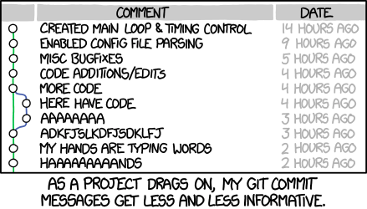
RCS best practices
Keep commits small
Only related changes in one commit
Use meaningful commit messages
Only commit valid code (at least compiles)
RCS is not a backup
Use graphical tools (e.g. tig, gitg)
https://xkcd.com/1296/

Slide 12
General best practices: Workflow
A common git workflow with Github:
  Pull recent changes from upstream repository.
  Check for new issues.
  Create and checkout a new branch.
  Fix an issue in this branch.
  Test and commit the branch locally.
  Push the new branch to your Github repository.
  Create a pull request for the master repository.

Slide 13
General best practices: Workflow
GitHub
linux
linux
owner: torvalds
owner: you
(2) clone
“upstream”
Your PC
linux

Slide 14
Object-Oriented Programming
Classes and Objects
Encapsulation
Inheritance and Polymorphism
Object-Oriented Design

Slide 15
Classes and Objects (1)
A class is a template with …
  Variables (placeholders for data)
  Methods (manipulators for data)
An object is a single instance of that class
  Concrete values for variables
  Many objects of same class can coexist
  Special method (constructor) for initialization

Slide 16
Classes and Objects (2)
Class
A: int
B: string
static C: int
Class is a
template/
blueprint
Object 3
A: 123
B: “baz”
C: 42
Objects are
individual
instances
Normal members have individual values for each object; static members have a single shared value across all objects of one class.
Object 1
A: 12
B: “foo”
C: 42
Object 2
A: 23
B: “bar”
C: 42

Slide 17
Encapsulation (1)
Procedural programming: global state (variables), modified through functions
Hard to keep track of side effects (cf. Toyota)
speed
accelerate()
gear
rpm
shift()
battery
charge()
air_temp

Slide 18
Encapsulation (2)
Core idea of OOP: encapsulate related data
Data is no longer directly accessible
Class provides methods to manipulate data
Car
accelerate()
speed
rpm
shift()
gear
battery
charge(temp)
air_temp

Slide 19
Encapsulation (3)
Data and methods have visibility or scope
Common levels:
  Public: visible/accessible to everyone
  Protected: only visible to subclasses (see below)
  Package (default in Java): visible to package
  Private: only visible to other class members
Rule of thumb: try to avoid public members (otherwise, encapsulation is sidestepped)

Slide 20
Inheritance
Classes can be derived from other classes
Superclass (parent) → Subclass (child)
Class members are inherited from superclass
Subclasses often introduce extra variables/methods (specialization)
Vehicle
This relation is called “is-a”
Car
Bike

Slide 21
Polymorphism
Subclasses can overwrite behaviour
Method with same signature as in superclass
  Signature = name + parameter types
  Actual runtime behaviour depends on subclass
e.g. Vehicle has shift() method
  Bike.shift()/Car.shift() behave differently
  Possible to call shift() on any Vehicle
  Car/Bike can always be upcast to Vehicle

Slide 22
Generics
Can be used to create class “families”
E.g. Container class:
  public class Container<T> { … }
  Can be used as Container<String>, Container<Int>, Container<Other>, …
Advantages:
  Less repetitive code (one container for all types)
  Less runtime errors (Container<String> can only ever contain String objects)

Slide 23
Object-Oriented Design
Goal: modularize a system specification
Decompose/subdivide system by objects which are (supposed to be) manipulated
Question: how to find these objects?
  Data-driven design
  Responsibility-driven design
Important: iterative process!

Slide 24
Data-Driven Design (1)
Focus on the data an object contains
  E.g. Student class has name, id, courses, …
  Course has name, teacher, requirements, …
Classes (usually) match real-world objects
Subclasses match real-world categories
  E.g. Student is a subclass of Person, Lecture is a subclass of Course, …

Slide 25
Data-Driven Design (2)
Problem: where to put actual “business logic”?
  Usually solved by central “manager” class
  (Somewhat) contrary to core OOP concepts
Mostly suited for database-like apps (e.g. store inventory, university management, …)

Slide 26
Responsibility-Driven Design
Focus on the functions an object performs
  Find candidate classes in system architecture
  Determine responsibilities of each class
  Determine collaboration between objects
Classes have less connection to real world, e.g. OrderProcessor, CourseCatalogue
Subclasses now reflect common behaviour

Slide 27
RDD – Finding Candidate Classes
Candidate classes come from nouns …
  in the system specification
  during discussion
  in background knowledge

Slide 28
RDD – Finding Candidate Classes
Source (FU): https://www2.cs.arizona.edu/~mercer/Presentations/OOPD/12-RDD-Jukebox.pdf
The student council wants to install a Jukebox in the student center. The Jukebox must allow students to play a song. No money will be required. Instead, a student will swipe an ID card through a card reader, view the song collection and choose a song. Students will each be allowed to play up to 1500 minutes worth of "free" Jukebox music in their academic careers, but never more than two songs on any given date. No song can be played more than five times a day.

Slide 29
RDD – Finding Candidate Classes
Candidates:
  From spec: student council, jukebox, student center, students, song, money, ID card, card reader, song collection, two songs, 1500 minutes, music, academic career, date, five times a day.
  From context: stereo, amplifier, speaker?

Slide 30
RDD – Finding Candidate Classes
Guidelines:
  One word for one concept: song, music → Song; students, ID card → Account
  Model values of attributes, not attributes themselves: 1500 minutes, two songs, 5 times per day → attributes of Song / Account
  Be wary of adjectives: not applicable here, usually also attributes instead of separate classes
  Focus on the problem domain: student council, student center, money, speaker, … → not applicable

Slide 31
RDD – Determine Responsibilities
Responsibilities are:
  The knowledge a class maintains/provides
  The actions it can perform
Responsibilities == “public services”
  Basic client-server approach
Every class can be …
  A client, using services of other classes
  A server, providing services to other classes

Slide 32
RDD – Determine Responsibilities
E.g. responsibilities of Song:
  Play (but only max. 5 times a day)
Account:
  ChooseSong (but only 2 times a day)
Jukebox:
  Login (if confirmed by ID card)

Slide 33
RDD – Determine Collaborations
Which class needs which other service?
  Jukebox may need AccountManager,
  Song may need DateTime & Database, …
Collaborations reveal control/data flow
Collaborations can uncover missing functions

Slide 34
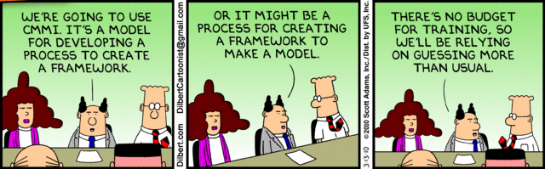
Questions/suggestions?

