Slide 1
Software Engineering
Lecture 07 – Code Quality
© 2015-18 Dr. Florian Echtler
Bauhaus-Universität Weimar
<florian.echtler@uni-weimar.de>
This work is licensed under a Creative Commons Attribution-NonCommercial-ShareAlike 4.0 International License.

Slide 2
Today's topics
Software quality metrics
“Code smells”
Antipatterns

Slide 3
Software quality attributes
Source (FU): Sommerville, Software Engineering, Chapter 24
Safety, Security
Reliability, Resilience, Robustness
Understandability, Learnability, Usability
Reusability, Adaptability, Portability
Modularity, Complexity, Maintainability
Efficiency, Testability

Slide 4
Code quality metrics
Functional quality:
  Compliance to functional requirements/ specifications
  Usually determined by automated tests (= dynamic analysis)
Structural quality
  Compliance to non-functional requirements (robustness, maintainability)
  Determined by “lint” checkers, code review (= static analysis)

Slide 5
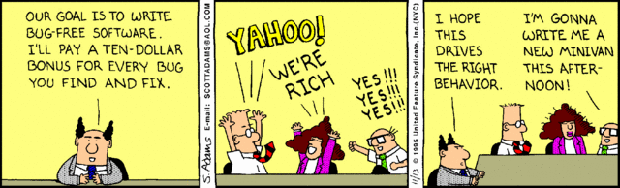
Management issues
Source (FU): http://blog.codinghorror.com/a-visit-from-the-metrics-maid/
"You can't manage it if you can't measure it."
→ overuse of metrics
→ metrics-based incentives
May lead to results which fit the metrics but are not actually better

Slide 6
Metrics: basics
Simple metric: source lines of code (SLOC)
"Measuring software productivity by lines of code is like measuring progress on an airplane by how much it weighs." - Bill Gates
Useful as base for other metrics
“Raw” SLOC include whitespace, comments, …
Often replaced by logical lines of code (LLOC = 1 statement per line)

Slide 7
Useful metrics
Bugs per 1000 LOC (= kLOC)
Fan-in/fan-out
Code (test) coverage
Cyclomatic complexity

Slide 8
Bugs per kLOC
Source (FU): Coverity, Open Source Integrity Report 2012
NASA Software Assurance Technology Center: 0.1 bugs per kLOC (not applicable for everyday use)
Open-source software (45 projects, 37 million lines of code): 0.45 bugs per kLOC
Commercial software (41 projects, 300 million lines of code): 0.64 bugs per kLOC
Note: code size of commercial projects larger by factor ~ 10

Slide 9
Fan-In/Fan-Out
Fan-In for method X: number of functions/ methods that call X
Fan-Out for method X: number of functions/ methods called by X
High fan-in → changes to X may cause extensive secondary changes
High fan-out → X may be overly complex

Slide 10
Code coverage
Hybrid of static and dynamic metrics
Relates to unit/component/system tests
Different variants (in increasing order of complexity): tests cover percentage of …
  Functions (called at least once)
  Statements (executed at least once)
  Branches (executed at least once)
  Conditions (evaluated as true and false)
  Execution paths (executed at least once)

Slide 11
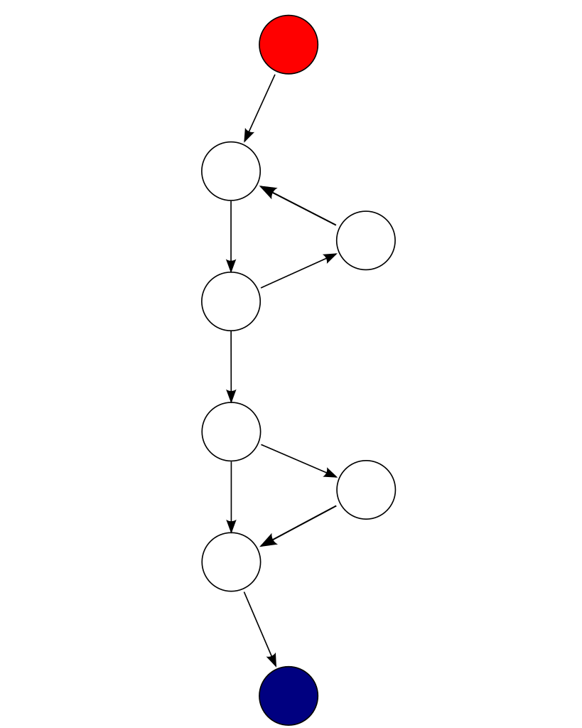
Cyclomatic complexity
Image source (PD): https://en.wikipedia.org/wiki/Cyclomatic_complexity
Number of linearly independent paths through code
Can be calculated from control flow graph
Complexity M = E – N + 2P (edges E, nodes N, graph components P)
Example: M = 9 – 8 + 2*1 = 3
Rule-of-thumb: split a module if M > ~ 10
loop
condition

Slide 12
“Code smells”
Syntactically and functionally correct code
However: “smells” indicate structural problems
May lead to future bugs/maintenance issues
Also known as “lint”, “fuzz”
(Partial) purpose of compiler warnings, e.g. “-Wall” switch in gcc (= enable all warnings)

Slide 13
“Code smells” - Examples
General impact on readability/ understandability:
  Unused variables/code (also increase binary size)
  Long method (longer than ~ 50 SLOC/1 screen)
  Excessive use of literals instead of named constants (so-called “magic values”)
  Depth of conditional nesting

Slide 14
“Code smells” - Examples (2)
General impact on readability/ understandability:
  Excessively short identifiers: int a,b,c,e,x;
  Excessively long identifiers: for (int loopVariable = 0; loopVariable < loopMaximum; loopVariable++) { … }
  Lack/overuse of comments: int x = 0; // set integer variable x to zero

Slide 15
“Code smells” - Examples (3)
Impact on code maintenance:
  Duplicated code: a; b; c; … a; b; c;
  Redundant code: if (x) { … if (x) { … } … }
  Empty statements: if (…) { }
  Side effects in conditions: if (a = b) { … } instead of if (a == b) { … }

Slide 16
“Code smells” - Examples (4)
Too many parameters (more than ~5)
  related to maximum number of items in human short-term memory = 7 ± 2
Too many local variables in method
Too many member variables in class
Overly large class (also known as God Object)

Slide 17
OOP “Code smells”
Excessively deep inheritance structure
“Feature envy”: excessive use of another class
  May happen intentionally in some patterns (which?)
Violation of substitution principle by method overriding: subclass can no longer replace BC
Contrived complexity: overuse of patterns/ templates etc.

Slide 18
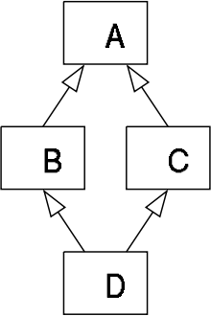
Diamond Problem
Source (PD): https://en.wikipedia.org/wiki/Multiple_inheritance
Multiple inheritance with shared base class (C++ only)
Assume overridden method draw in Label and Button
If draw is called in TextButton: is it Label::draw or Button::draw?
Solvable, but may point to overly complex design
Widget
Label
Button
TextButton

Slide 19
Law of Demeter
Source (CC): https://en.wikipedia.org/wiki/Law_of_Demeter
Goal: decrease coupling between components
“Only talk to your direct friends.” → call only …
  Methods of class itself
  … of parameter objects
  … of objects in instance variables
  … of objects created by class
When disregarded: requires knowledge about internals of other classes

Slide 20
Law of Demeter (2)
Source (CC): https://en.wikipedia.org/wiki/Law_of_Demeter
class Motor {
public void start() { … }
}
class Car {
public Motor motor;
public Car() {
motor = new Motor();
}
}
class Driver {
public void drive() {
Car carToDrive = new Car();
carToDrive.motor.start();
}
}
class Motor {
public void start() { … }
}
class Car {
private Motor motor;
public Car() {
motor = new Motor();
}
public void getReady() {
motor.start();
}
}
class Driver {
public void drive() {
Car carToDrive = new Car();
carToDrive.getReady();
}
}
In Java → “Use only one dot.”

Slide 21
AntiPatterns
Similar to design patterns: simple and widely used solutions to common problems …
… which cause other issues down the road.
http://c2.com/cgi/wiki?AntiPatternsCatalog
  StringWithoutLength
  ParsingHTMLWithRegex
  ZeroMeansNull
  FloatingPointCurrency
  ExceptionFunnel

Slide 22
StringWithoutLength
Source (FU): http://c2.com/cgi/wiki?StringWithoutLength
Store a string without explicit length
Use “marker” (NULL byte) instead
Unfortunately embedded in C Standard Library
Often also used for other types of arrays
Requires constant recalculation of length (e.g. for copy, concatenation, …)
“Proper” solution: store length as separate int (e.g. in std::string)

Slide 23
ParsingHTMLWithRegex
Source (FU): http://c2.com/cgi/wiki?ParsingHtmlWithRegex
Goal: extract information from web page
Use regular expressions to extract data from HTML
Will usually break if page is changed at all
Parsed result may still contain HTML tags
“Proper” solution:
  Use a dedicated data source
  If not possible: use an XML parser

Slide 24
ZeroMeansNull
Source (FU): http://c2.com/cgi/wiki?ZeroMeansNull
Goal: implement an optional field
Use 0 (zero) to represent NULL (empty)
→ Field can never be actually set to zero
Variants: use string “NULL” (there are people who have that name), use value -1 (may lead to overflow errors), …
“Proper” solution:
  Use additional boolean flag
  Use pointer to data object

Slide 25
FloatingPointCurrency
Source (FU): http://wiki.c2.com/?FloatingPointCurrency
Goal: store an amount of money
Use a float (or double), e.g. 1.23f = 1 € 23 cents
Problem: decimal fractions can not be 100% accurately represented in a float/double
→ Rounding errors can accumulate over time
“Proper” solution:
  Use fixed-point math
  Use separate integers

Slide 26
ExceptionFunnel
Source (FU): http://wiki.c2.com/?ExceptionFunnel
Goal: handle errors, but don’t confuse users
Few catch-all blocks that may even throw exceptions away (“catch(Exception e){}”)
Problems:
  No useful debug output at all
  Errors may go unhandled, cause issues later
“Proper” solution:
  Use descriptive exceptions
  Catch and handle them separately

Slide 27
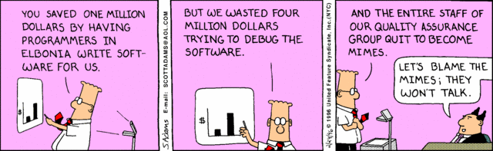
Questions/Comments?

