Slide 1
Software Engineering
Lecture 08 – Build Process
& Debugging
© 2015 Dr. Florian Echtler
Bauhaus University Weimar
<florian.echtler@uni-weimar.de>
This work is licensed under a Creative Commons Attribution-NonCommercial-ShareAlike 4.0 International License.

Slide 2
Today's topics
Preface: from code to binary
  Compilation
  Static & dynamic linking
Build Systems
  Compile & link
  Dependency resolution (internal/external)
  Test management
  Install products
Debugging

Slide 3
Preface: from code to binary
What happens when you type
gcc -o helloworld helloworld.c ?
4 sub-stages:
  Preprocessing
  Compilation
  Assembly
  Linking (static/dynamic)

Slide 4
Preface: from code to binary (2)
C(++)
Source
*.c(pp)
Preproc.
C(++)
*.i
ASM
Source
*.s
Preprocessor
(cpp)
Compiler
(gcc)
Include
Files
*.h(pp)
Binary
Object
File *.o
(compile-time)
Linker (ldd)
Assembler
(gas)
Executable
Libraries
*.so/dll
(run-time)
Linker (ld.so)

Slide 5
Tasks of the linker
Combine multiple objects into binary
  Allows modularization
  Redundant code can be shared
Determine address space/memory layout
  Merge/relocate code blocks from separate objects
Resolve symbolic references
  References to library functions
  References to functions in other objects

Slide 6
Memory Layout
Layout identical for each program (virtual memory)
  Text Segment: executable binary code, read-only
  Data Segment: global variables ((un-)initialized)
  Heap: used for dynamic memory allocation (new())
  Stack: used for local variables & return addrs
Stack
virtual memory addresses
(empty)
Heap
Data segment
Text segment

Slide 7
Linking (static & dynamic)
Static linking: linker tasks performed at compile time, results written to executable
  Good: no incompatibilities possible
  Bad: program size increases
Dynamic linking: linker tasks performed at run time, results loaded into memory
  Good: program can be kept smaller
  Bad: library version conflicts (“DLL hell”)

Slide 8
Linking (static & dynamic) (2)
Both steps usually combined:
  program objects linked statically
  libraries linked dynamically
Examining static linkage: objdump -xd object
Examining dynamic linkage: ldd executable

Slide 9
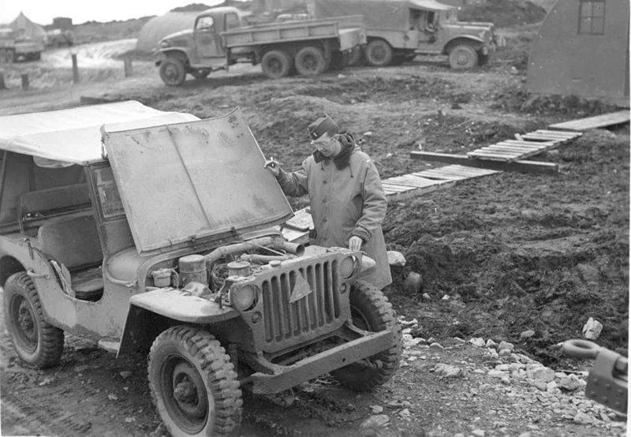
Hello world: under the hood
Image source (PD): https://en.wikipedia.org/...old_jeep_from_world_war_two.jpg

Slide 10
Hello world: under the hood
hello.c → hello.i
#include <stdio.h> → [content copy of stdio.h]
void hello() {
printf("Hello ");
}

Slide 11
Hello world: under the hood
hello.c/hello.i → hello.s
.section .rodata
.LC0:
.string "Hello "
.text
.globl hello
.type hello, @function
hello:
pushq %rbp
movq %rsp, %rbp
movl $.LC0, %edi
movl $0, %eax
call printf
popq %rbp
ret
global read-only data section with “label” .LC0
start of code section with global label “hello”
“setup” code
printf function call with label reference to .LC0
“cleanup” code

Slide 12
Hello world: under the hood
hello.c/hello.i → hello.s → hello.o
Disassembly of section .text:
0000000000000000 <hello>:
0: 55 push %rbp
1: 48 89 e5 mov %rsp,%rbp
4: bf 00 00 00 00 mov $0x0,%edi
5: R_X86_64_32 .rodata
9: b8 00 00 00 00 mov $0x0,%eax
e: e8 00 00 00 00 callq 13 <hello+0x13>
f: R_X86_64_PC32 printf-0x4
13: 5d pop %rbp
14: c3 retq
start address (not yet linked → zero)
Relocations (final addresses are not yet known, will be filled in by linker)

Slide 13
Hello world: under the hood
hello_world.dynamic (after linking)
Disassembly of section .text:
00000000004005a2 <hello>:
4005a2: 55 push %rbp
4005a3: 48 89 e5 mov %rsp,%rbp
4005a6: bf 54 06 40 00 mov $0x400654,%edi
4005ab: b8 00 00 00 00 mov $0x0,%eax
4005b0: e8 ab fe ff ff callq 400460 <printf@plt>
4005b5: 5d pop %rbp
4005b6: c3 retq
start address (determined by linker)
Former relocations (final addresses have been filled in by linker)

Slide 14
Build systems
Compile & link
  See above
Dependency resolution
  Internal: determine dependencies of objects, modules, source code etc. (often via timestamps)
  External: locate/install missing libraries, tools, headers etc.

Slide 15
Build systems (2)
Test management
  Run test suites after (each?) successful compilation
  Provide overview of succeeded/failed tests, test coverage
Install products – e.g. …
  Copy to suitable filesystem locations
  Create archives/packages
  Upload to app store

Slide 16
(Meta-)build systems: examples
Make
Autotools/CMake
SCons/Ant/Gradle
Eclipse/Xcode/Visual Studio

Slide 17
Make
Ancient in computing terms – created 1976
Somewhat obscure syntax (“Makefile”)
Only deals with internal dependencies
Can be extended using external tools/scripts

Slide 18
Autotools
Makefile generator
Widely used in open-source projects
Only available for Unix-like environments
Consists of multiple sub-tools (automake, autoconf, configure) which create a Makefile
Also deals with external dependencies
Very powerful, but also very obtuse

Slide 19
CMake
More modern replacement for autotools
Also generates Makefile or Visual Studio XML
Cross-platform (Windows, Linux, MacOS)
Mostly a standalone scripting language

Slide 20
SCons
Standalone build system
Based on Python → generic scripting possible
Automatic dependency analysis
Cross-platform (Windows, Linux, MacOS)

Slide 21
Ant & Gradle
Standalone build system
Focused on Java projects
XML-based project description files
Cross-platform (Windows, Linux, MacOS)
Often used for Android projects

Slide 22
Eclipse/Xcode/Visual Studio
Integrated Development Environments (IDEs)
Build system, editor, RCS frontend, test manager, UML tools, …
Support multiple languages (usually at least Java/C++)
Typical examples of CASE tools (Computer Aided Software Engineering)

Slide 23
Build systems: Summary
Once again: one size does not fit all
Build system can add lots of complexity
Try to avoid “feature creep”
Most open-source projects focus on CMake

Slide 24
Make: mini HowTo
Commands read from Makefile
Makefile consists of rule blocks
First rule block is executed by default
For other rules/targets: make [target]

Slide 25
Makefile anatomy
# example Makefile rule block
target [target2] …: [prereq1] [prereq2] …
[TAB] command 1
[TAB][command 2]
…
Targets: what files will this rule build?
Prerequisites: what files does this rule need to work?
Commands: what does this rule do to build the targets?
  commands need TAB prefix
  command list aborts after any non-zero exit status

Slide 26
Makefile anatomy (2)
# example for predefined macros
hello: hello.o world.o
  echo “Target name:” $@
  echo “All prerequisites:” $^
  $(CC) -o $@ $^
  # → gcc -o hello hello.o world.o
# example for pattern rules → specify how to build any .o file from any .c file
%.o: %.c
  $(CC) $(CFLAGS) -o $@ -c $^

Slide 27
Makefile anatomy (3)
# example for internal macros & functions
C_FILES = $(wildcard *.c)
hello: $(patsubst %.c, %.o, $(C_FILES))
  $(CC) -o $@ $^
# example for “phony” targets which do not actually create a file, but act as scripts
clean:
  rm hello *.o
.PHONY: clean

Slide 28
Debugging
The “basic” approach: printf() & friends
  Not very flexible, modifiable at compile-time only
  Mental “reverse-engineering” of program state
  Can slow program down (sometimes massively)
  Advantages?
The “smart” approach: debugger
  Stop program at arbitrary point
  Advance execution step-by-step
  View arbitrary variables/objects

Slide 29
Debugger commands
Exact command names differ between debuggers (gdb, VS, XCode, …), functionality remains same
Set Breakpoint
→ Execution stops at specified line or method
Set Watchpoint
→ Execution stops when variable is changed

Slide 30
Debugger commands (2)
Step → Execute a single line of code
  Step Into: enter any called functions
  Step Over: call functions as a whole and stop
Inspect/Watch Variable
→ Value of variable is shown while stepping
Run/Continue
→ Execute until breakpoint/watchpoint hit

Slide 31
Stack frames
Stack: dedicated memory for each program
  keeps track of called functions and their local vars
  grows downward as opposed to heap (malloc, new)
Stack frame: local variables & return address of currently executed function
Debugger can switch to earlier stack frames, i.e. inspect caller's context
List of stack frames = call stack

Slide 32
Call stack
Minimal example with up to 3 stack frames, state when execution paused in line 2
1 int main() {
2 printf(“Hello!”);
3 func1();
4 printf(“Goodbye!”);
5 }
6 void func1() {
7 int i = 1;
8 func2(i);
9 i = 42;
10 }
11 void func2(int a) {
12 int b = a;
13 }
Start of stack:
Frame for main()

Slide 33
Call stack (2)
Minimal example with up to 3 stack frames, state when execution paused in line 7
1 int main() {
2 printf(“Hello!”);
3 func1();
4 printf(“Goodbye!”);
5 }
6 void func1() {
7 int i = 1;
8 func2(i);
9 i = 42;
10 }
11 void func2(int a) {
12 int b = a;
13 }
Start of stack:
Frame for main()
Frame for func1()
Return to main, line 4
Storage for int i

Slide 34
Call stack (3)
Minimal example with up to 3 stack frames, state when execution paused in line 12
1 int main() {
2 printf(“Hello!”);
3 func1();
4 printf(“Goodbye!”);
5 }
6 void func1() {
7 int i = 1;
8 func2(i);
9 i = 42;
10 }
11 void func2(int a) {
12 int b = a;
13 }
Start of stack:
Frame for main()
Frame for func1()
Return to main, line 4
Storage for int i
Frame for func2()
Return to func1, line 9
Storage for int b
Storage for int a

Slide 35
Debugging information
Debugger does not know names of functions, variables etc. → can only show memory addrs
“Human-readable” names must be compiled into executable, e.g. using -g flag (gcc)
Binary grows larger, sometimes slower → usually not enabled for release builds

Slide 36
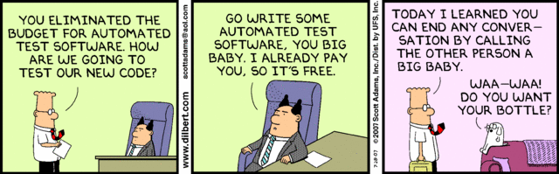
Questions/Comments?

