Slide 1
Software Engineering
Lecture 09 – Requirements Engineering & Exceptions
© 2015 Dr. Florian Echtler
Bauhaus University Weimar
<florian.echtler@uni-weimar.de>
This work is licensed under a Creative Commons Attribution-NonCommercial-ShareAlike 4.0 International License.

Slide 2
Requirements Engineering
Also called software specification
Define functionality of/constrains on the software product
Sub-activities:
  Feasibility study
  Requirements elicitation/analysis
  Requirements specification
  Requirements validation

Slide 3
Software Specification Process
Image source (FU): Sommerville, Software Engineering, Chapter 2
Feasibility
study
Requirements
elicitation and
analysis
Requirements
specification
Feasibility
report
Requirements
validation
System
models
User and system
requirements
Requirements
document

Slide 4
Feasibility study
Short, focused evaluation
3 major questions:
  Does the system contribute to the overall objectives of the organization?
  Can the system be implemented within schedule and budget (*) using current technology?
  Can the system be integrated with other systems that are used?
  (*) definite answer probably impossible

Slide 5
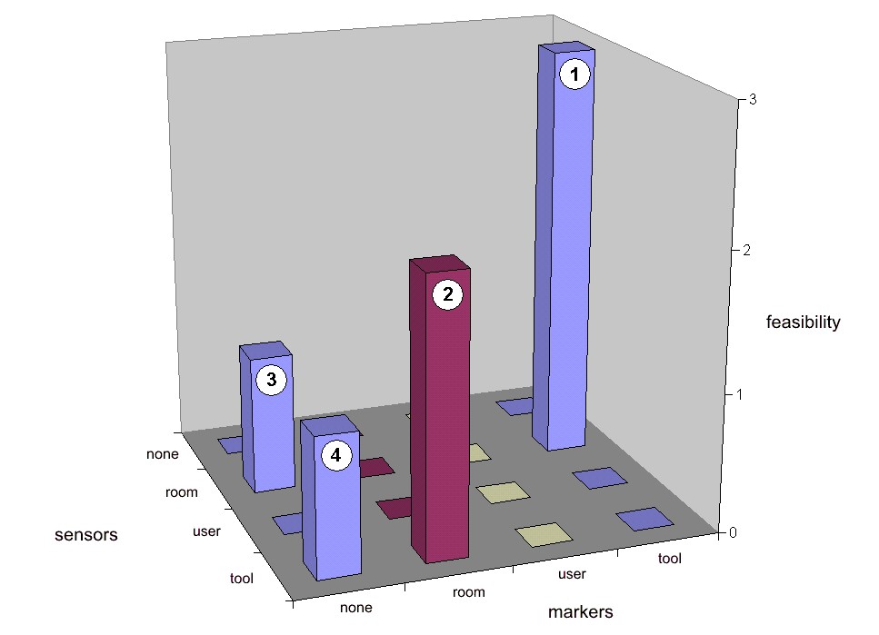
Feasibility study: example
Image source (FU): Echtler et al., “The Intelligent Welding Gun”, 2003
Augmented reality project at BMW
Goal: track welding gun and display bolt positions to operator
Analysis of design space for sensor/ marker placement

Slide 6
Requirements elicitation
User doesn't really know …
  what they actually need
  what is possible
Developer doesn't really know …
  the problem
  the context

Slide 7
Requirements elicitation (2)
Important first steps for developers:
  Identify stakeholders (users, managers, admins, …)
  Learn about fundamental context properties
Iterative process:
  Discovery (e.g. by interviews, ethnography, …)
  Classification & organization (e.g. through model architecture)
  Prioritization & negotiation (conflict resolution between stakeholders)
  Specification & documentation

Slide 8
Example: stakeholders for an ATM?
Bank customers
Bank managers
Counter staff
Database administrators
Security managers
Representatives of other banks
Marketing department
Hardware and software maintenance engineers
Banking regulators

Slide 9
Requirements discovery
Interviews with stakeholders
  Closed/Open (with/without predefined questions)
  Hybrid (semi-structured) → most common
  Not suitable for domain requirements (too familiar for interviewee, not familiar for developer)
Ethnography
  Observational technique, immersion in the work environment/context in which the product is used
  Helps to discover implicit requirements, constraints and social/environmental details

Slide 10
Requirements classification
E.g. using viewpoints
Represent perspectives of different stakeholders
  Interactor viewpoint – persons/systems which interact directly with the product, e.g. users
  Indirect viewpoint – no direct interaction but influence on requirements, e.g. managers
  Domain viewpoint – internal regulations, legal requirements etc.

Slide 11
Requirements classification (2)
Functional requirements
  What should the system (not) do?
Non-functional requirements
  Reliability, response time, security, ease of use …
  May lead to additional functional requirements
Domain requirements (variant of NFR)
  Regulations, laws etc.
  May lead to additional (non-)functional requirements

Slide 12
Requirements classification (3)
Image source (FU): Sommerville, Software Engineering, Chapter 4
Non-functional
requirements
Product
Organizational
External
Efficiency
Dependability
Security
Regulatory
Ethical
Usability
Environmental
Operational
Development
Legislative
Performance
Space
Accounting
Safety/security

Slide 13
Requirements description
Source (FU): Sommerville, Software Engineering, Chapter 4
“It is natural for a system developer to interpret an ambiguous requirement in a way that simplifies its implementation. Often, however, this is not what the customer wants.”
→ path of least resistance
→ requirements must be as precise as possible

Slide 14
Types of requirements description
Sentences in natural language (+ diagrams)
  user/system requirements document (“Lasten-/Pflichtenheft”)
Structured language – natural language using structured template
Design description language/graphical notations, e.g. UML & related notations
Mathematical specifications

Slide 15
Natural language RD
Source (FU): Sommerville, Software Engineering, Chapter 4
Example: insulin pump
Format: 1 sentence requirement + rationale
Mandatory → “shall”, optional → “should”
“The system shall measure the blood sugar and deliver insulin, if required, every 10 minutes. (Changes in blood sugar are relatively slow so more frequent measurement is unnecessary; less frequent measurement could lead to unnecessarily high sugar levels.)”
Still room for interpretation …

Slide 16
Structured language RD
Source (FU): Sommerville, Software Engineering, Chapter 4
Attribute | Description
Function | Compute insulin dose: safe sugar level.
Description | Computes the dose of insulin to be delivered when the current measured sugar level is in the safe zone between 3 and 7 units.
Inputs | Current sugar reading (r2), the previous two readings (r0 and r1).
Source | Current sugar reading from sensor, other readings from memory.
Outputs | CompDose – the dose in insulin to be delivered.
Destination | Main control loop.
Action | CompDose is zero if the sugar level is stable of falling or if the level is increasing but the rate of increase is decreasing. If the level is increasing and the rate of increase is increasing, then CompDose is computed by dividing the difference between the current sugar level and the previous level by 4 and rounding the result. If the result is rounded to zero then CompDose is set to the minimum dose that can be delivered.
Requirements | Two previous readings so that the rate of change of sugar level can be computed.
Pre-condition | The insulin reservoir contains at least the maximum allowed single dose of insulin.
Post-condition | r0 is replaced by r1, then r1 is replaced by r2
Side effects | None.

Slide 17
Mathematical RD
Source (FU): Sommerville, Software Engineering, Chapter 4
Condition | Action
Sugar level falling (r2 < r1) | CompDose := 0
Sugar level stable (r2 = r1) | CompDose := 0
Sugar level increasing (r2 > r1) and rate of increase decreasing ((r2 – r1) < (r1 - r0)) | CompDose := 0
Sugar level increasing (r2 > r1) and rate of increase stable or increasing ((r2 – r1) >= (r1 - r0)) | CompDose := round((r2 – r1) / 4) if CompDose = 0: CompDose := MinimumDose

Slide 18
Requirements Validation
Check document for …
  Validity/Completeness – are all requirements correctly met?
  Consistency – are there conflicts between requirements?
  Realism – can requirements be implemented with given resources?
  Verifiability – can requirements be checked for completion?

Slide 19
Requirements Validation (2)
Check through …
  Reviews – systematic manual analysis, preferably by external reviewers
  Prototyping – create prototypes conforming to current requirements, review with stakeholders
  Test-case generation – create test cases or test procedures for requirements

Slide 20
Requirements Validation (3)
Testing non-functional requirements:
  Speed: transactions/second, response time, …
  Ease of use: training time, size of manual, …
  Reliability: uptime, mean time between failures, …
  Robustness: time to restart after failure, probability of data corruption, …

Slide 21
Relation to software processes
In “traditional” processes
  RE mostly done at the start
  multiple cycles, but finishes with req. document
In agile processes
  interleaved with development
  feasibility study probably still initial step
Hybrid approach: e.g. RE interleaved with prototyping

Slide 22
Exceptions
Goal: better structure for error handling
Examples in C(++), but applicable to most other languages
Exceptions are thrown (error reporting) and caught (error handling)

Slide 23
Error handling in C
somewhat messy, requires lots of clean-up code
errors often indicated through return value
NULL for pointers
value < 0 for int, often stored in global variable errno
int process_files() {
input1 = fopen(“file1”, “r”);
if (input1 == NULL)
return errno;
input2 = fopen(“file2”, “r”);
if (input2 == NULL) {
fclose(input1);
return errno;
}
input3 = fopen(“file3”, “r”);
if (input3 == NULL) {
fclose(input1);
fclose(input2);
return errno;
}
// process files
[ … ]
return 0;
}

Slide 24
Error handling in C (2)
Alternative method using goto
“Goto considered harmful” (E. Dijkstra, 1968)
Code using goto generally harder to read/understand
Possible exception as shown in example
int process_files() {
input1 = fopen(“file1”, “r”);
if (input1 == NULL)
goto error_1;
input2 = fopen(“file2”, “r”);
if (input2 == NULL)
goto error_2;
input3 = fopen(“file3”, “r”);
if (input3 == NULL)
goto error_3;
// process files
[ … ]
return 0;
error_3: fclose(input2);
error_2: fclose(input1);
error_1: return errno;
}

Slide 25
Error handling in C++
Local objects destroyed at end of scope
No need for explicit clean-up if properly implemented in destructor
Difficult with non-local objects
int process_files() {
MyFile input1(“file1”, “r”);
if (!input1.valid())
return -1;
MyFile input2(“file2”, “r”);
if (!input2.valid())
return -1;
MyFile input3(“file3”, “r”);
If (!input3.valid())
return -1;
// process files
[ … ]
return 0;
}

Slide 26
Error handling in C++ (2)
Solution: try/catch blocks for exceptions
Classes from std:: throw derivatives of std::exception
exception.what() provides short text description of error
void process_files() {
try {
std::ifstream input1(“file1”);
std::ifstream input2(“file2”);
std::ifstream input3(“file3”);
// process files
[ … ]
} catch (std::exception& e) {
// display error message
std::cout << e.what() << “\n”;
}
}

Slide 27
Exceptions with throw/try/catch
Any object (including primitive types) can be thrown
Multiple catch blocks for different types are possible
Rule: “Throw by value, catch by reference”
try {
if (index < 0)
throw std::runtime_error(
“Index out of range” );
if (index > 10000)
throw -1;
}
// catch plain integer
catch (int e) {
std::cout << “Error #“;
std::cout << e << “\n”;
}
// catch base class
// of runtime_error
catch (std::exception& e) {
std::cout << e.what() << “\n”;
}

Slide 28
Exception propagation
Exceptions are propagated upwards until they are caught
Use “catch-all” clauses for any type that does not have a specific handler
void throw_something() {
// no try...catch here
throw std::runtime_error();
}
void caller() {
try {
throw_something();
}
// exception caught here
catch (std::exception& e) {
std::cout << e.what() << “\n”;
}
// “catch-all” for any type
catch (...) {
std::cout << “default
exception handler\n”;
}
}

Slide 29
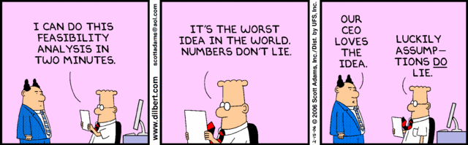
Questions?
Thanks for listening!

