Slide 1
Software Engineering
Lecture 06 – Design Patterns:
Introduction
© 2015-20 Dr. Florian Echtler
Bauhaus-Universität Weimar
<florian.echtler@uni-weimar.de>
This work is licensed under a Creative Commons Attribution-NonCommercial-ShareAlike 4.0 International License.

Slide 2
Design Patterns
“Recipes” for common problems
Available on different levels (e.g. system architecture, user interface, implementation)
Usually without any code, at most UML
Often just “box-and-line”-diagrams, esp. for architectural patterns

Slide 3
Description of a Design Pattern
Problem
  Motivation/application area
Solution
  Structure (class diagram)
  Pieces (names of classes or operations)
  Object interaction (e.g. sequence diagram)
Discussion
  Advantages, disadvantages, dependencies
  Constraints, special cases, known uses

Slide 4
Design Patterns: History
Originally from architecture and construction
“A Pattern Language: Towns, Buildings, Construction”, Christopher Alexander, 1977
  “Each pattern describes a problem which occurs over and over again in our environment, and then describes the core of the solution to that problem, in such a way that you can use this solution a million times over, without ever doing it the same way twice.”

Slide 5
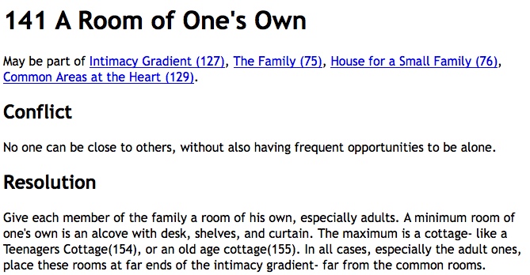
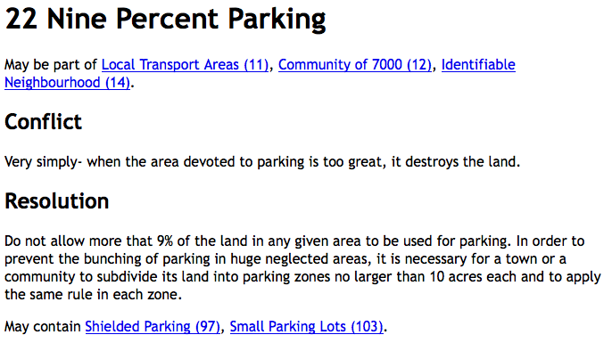
“A Pattern Language” examples
Image source (FU): “A Pattern Language”, C. Alexander

Slide 6
Architecture Patterns
High-level patterns: view of entire system
Multiple overlapping views possible
Examples:
  Model-View-Controller
  Client-Server architecture
  Layered architecture
  Repository pattern
  Pipe-and-Filter architecture

Slide 7
Model-View-Controller (MVC)
Suitable for UI applications
3 logical components:
  Model: manages data & associated operations
  View: defines/manages presentation to user
  Controller: manages user interaction
Advantages:
  Data can change independently from presentation
Disadvantages:
  Can cause extra complexity for simple data models

Slide 8
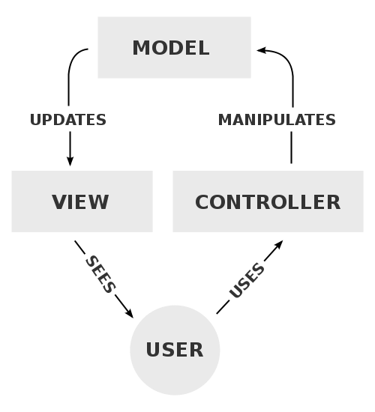
Model-View-Controller
Image source (PD): https://en.wikipedia.org/wiki/Model%E2%80%93view%E2%80%93controller
e.g.
back-
end
e.g.
web
browser
e.g.
web
server

Slide 9
MVC Examples
Website
  HTML ( M ), CSS ( V ), Browser ( C )
Android app:
  Database ( M ), Fragments ( V ), Java code ( C )
Web application:
  Backend ( M ), Browser ( V ), Webserver ( C )
  Database ( M ), Browser ( V ), PHP app ( C )

Slide 10
Client-server architecture
Functionality split into services
Every service provided by one (logical) server
  Accessing shared data from multiple locations
  Load balancing → replicate servers
Advantages:
  Distributed, network-transparent architecture
Disadvantages:
  Every server → single point of failure
  Network performance unpredictable

Slide 11
Client-server architecture
Image source (FU): Sommerville, Software Engineering, Chapter 6
Client 1
Client 2
Client 3
...
Network
Network
Network
Network
Network
Catalogue
server
Video
server
Image
server
Web
server

Slide 12
Layered architecture
System as a stack of interconnected layers
  Layers only communicate with neighbours
  Increasing complexity from top to bottom
Often used for network protocols
Advantages:
  Individual layers can be replaced
  Clear interface specification built in
Disadvantages:
  Clean separation can be difficult

Slide 13
Example: layered UI architecture
Browser
Web Application
Question: where to put security features?
Database
Support/HAL/OS

Slide 14
ISO/OSI network model
Application
Application
Presentation
Presentation
Session
Session
Transport
Transport
Network
Network
Data Link
Data Link
Physical
Physical

Slide 15
Internet network model
HTTP (HyperText Transfer Protocol)
Application/
Presentation
TLS (Transport Layer Security)
Session
TCP (Transmission Control Protocol)
Transport
IP (Internet Protocol)
Network
802.11* MAC/LLC (WLAN Management)
Data Link
802.11* PHY (Wireless Hardware)
Physical

Slide 16
Internet network model (2)
Layered protocols → nested data packets (think of Russian Dolls)
Packets consist of header + payload
Payload of protocol 1 = packet of protocol 2
PHY
LLC
IP
TCP
TLS
HTTP
actual payload data

Slide 17
Repository pattern
All data is managed in a central repository/DB
  Components do not interact directly
  Only communicate with the repository
Advantages:
  Components can be independent
  Easy data management (e.g. backups)
Disadvantages:
  Single point of failure, may be inefficient
  Distribution/synchronization difficult

Slide 18
Repository pattern: CASE system
Image source (FU): Sommerville, Software Engineering, Chapter 6
UML
editor
Code
generator
C++
editor
Debugger
Project Repository
Java
editor
Code
analyzer
Compiler
+ linker
CASE = Computer Aided Software Engineering, e.g. Eclipse

Slide 19
Pipe-and-Filter architecture
Suitable for audio/video processing, computer vision, text processing …
  Many components (filters) which provide data transformations
  Data flows through pipes/network of components
Advantages:
  Easy to extend, matches many real-world processes
Disadvantages:
  Requires either common data format or costly conversions

Slide 20
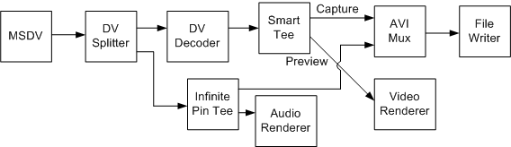
Pipe-and-Filter architecture
Image source (FU): https://msdn.microsoft.com/en-us/library/dd318616%28v=vs.85%29.aspx

Slide 21
Architecture Considerations
Performance – Minimize communications, use large-grained components
Security – use e.g. layered architecture with critical assets in inner layers
Safety – Localize safety-critical features in few subsystems
Availability – Include redundant components
Maintainability – Use small, replaceable components

Slide 22
Design patterns for program code
Reference: “Design Patterns – Elements of Reusable Object-Oriented Software” by Gamma, Helm, Johnson and Vlissides
Also known as Gamma-, “GangOfFour”- or “GoF”-Book
“Distillation” of 23 common patterns from existing code
3 major categories: creational, structural and behavioral patterns

Slide 23
Creational patterns
Used to create other objects
Rules-of-thumb: http://www.vincehuston.org/dp/creational_rules.html
Examples:
  Singleton
  AbstractFactory
  FactoryMethod
  Prototype

Slide 24
Singleton
Common problem: use only a single instance of a certain class (e.g. a Factory)
Creation of additional instances should not be possible
Solution: make class responsible for its own singular instance

Slide 25
Singleton: Code example
Source (FU): http://www.vincehuston.org/dp/singleton.html
public class GlobalClass {
private int m_value;
private static GlobalClass s_instance = null;
protected GlobalClass( int v ) { m_value = v; }
public int get() { return m_value; }
public void set( int v ) { m_value = v; }
public static GlobalClass instance() {
if ( s_instance == null )
s_instance = new GlobalClass(0);
return s_instance;
}
}

Slide 26
AbstractFactory
Use Factory object to delegate object creation
Useful for multiple families of similar objects
Exact type determined by specific factory
Example: different classes of UI elements

Slide 27
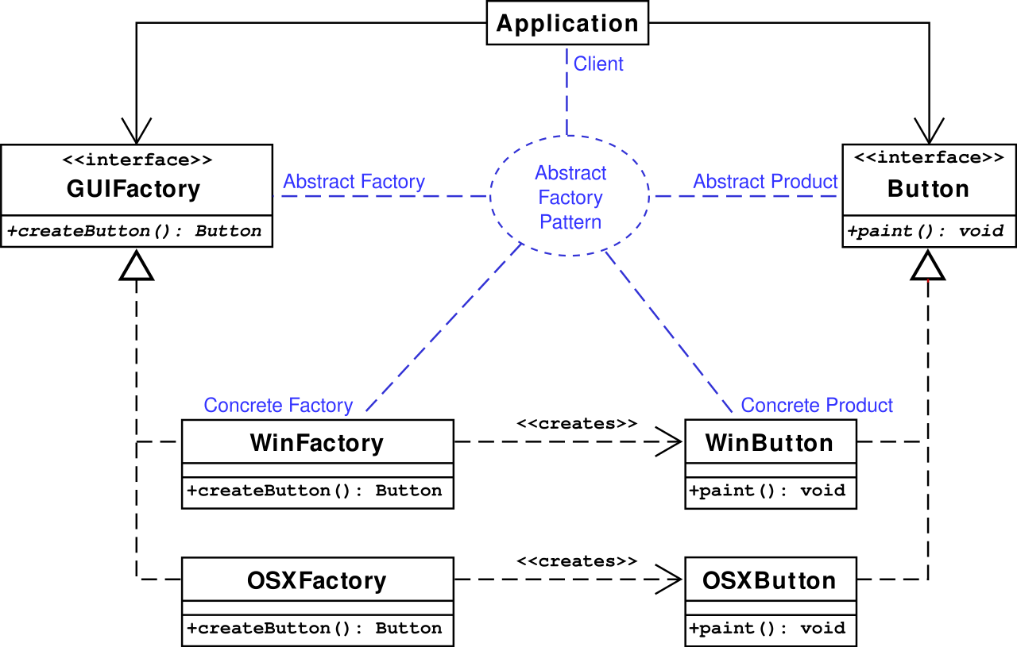
AbstractFactory (2)
Image source (CC): https://en.wikipedia.org/wiki/Abstract_factory_pattern

Slide 28
AbstractFactory: Code example
Source (FU): http://www.vincehuston.org/dp/abstract_factory.html
Before:
After:
void display_window_one() {
if (windows) {
Widget w[] = {
new WinButton(),
new WinMenu()
};
} else if (OSX) {
Widget w[] = {
new OSXButton(),
new OSXMenu()
};
} else if [...]
w[0].paint();
w[1].paint();
}
GUIFactory factory;
if (windows) {
Factory = new WinFactory();
} else if (OSX) { ... }
void display_window_one() {
Widget w[] = {
factory.createButton(),
factory.createMenu()
};
w[0].paint();
w[1].paint();
}

Slide 29
FactoryMethod
Can be used by the AbstractFactory to create new objects
Replaces explicit new(...) with method
Central element: static factory method in base class, e.g. static BaseClass create();

Slide 30
FactoryMethod: Code example
Source (FU): http://www.vincehuston.org/dp/factory_method.html
class Stooge {
// Factory Method
public static Stooge create( int choice ) {
if (choice == 1) return new Larry();
else if (choice == 2) return new Moe();
else if (choice == 3) return new Curly();
else return null;
}
public String slap_stick() { return null; }
}
class Moe extends Stooge {
public String slap_stick() { return "slap head"; }
}
[...]

Slide 31
Prototype
Alternative way for AbstractFactory to create new objects
Central element: virtual clone method in subclasses, e.g. BaseClass clone();
  Maintain pool of prototype objects
  Call clone() on appropriate prototype

Slide 32
Prototype: Code example
Source (FU): http://www.vincehuston.org/dp/prototype.html
interface Stooge {
public Stooge clone();
public String slap_stick();
}
class Factory {
private static Stooge s_prototypes[] = {
null, new Larry(), new Moe(), new Curly()
}
public static Stooge make_stooge( int choice ) {
return s_prototypes[choice].clone();
}
}
class Moe implements Stooge {
public Stooge clone() { return new Moe(); }
[...]

Slide 33
Java Generics Recap
Template class:
Template method:
public class pair<Type1, Type2> {
public Type1 first; public Type2 second;
public pair(Type1 t1, Type2 t2) { first = t1; second = t2; }
}
pair<String,String> translation = new pair<>("foo", "bar");
public static <Type> pair<Type,Type> twice(Type v) {
return new pair<>(v,v);
}
pair<Int,Int> meaning_of_life = twice(new Int(42));

Slide 34
Outlook – Patterns, Part 2
Behavioural patterns, e.g. Iterator
Structural patterns, e.g. Adapter
UI patterns
Antipatterns

Slide 35
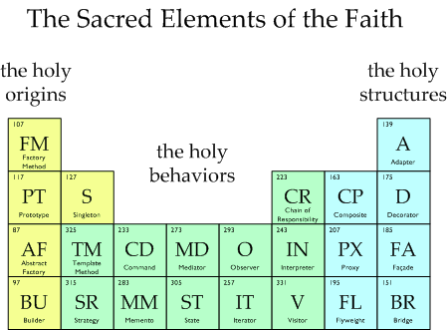
Questions/suggestions?
Image source (FU): http://www.vincehuston.org/dp/
The Periodic Table of Patterns

