Slide 1
Software Engineering
Lecture 07 – Design Patterns:
Part 2
© 2015-20 Dr. Florian Echtler
Bauhaus-Universität Weimar
<florian.echtler@uni-weimar.de>
This work is licensed under a Creative Commons Attribution-NonCommercial-ShareAlike 4.0 International License.

Slide 2
Exercise 4: Clarification
FactoryMethod
AbstractFactory
Converter
public static Converter create() {
return null;
}
ConverterFactory
public Converter create(String);
HashMap<String,Supplier<Converter>>
factory_methods;
MeterToMileConverter
Singleton
public static Converter create() {
return new MeterToMileConverter();
}

Slide 3
Exercise 4: Clarification (2)
Prototype
AbstractFactory
Converter
public Converter clone() {
return null;
}
ConverterFactory
public Converter create(String);
HashMap<String,Converter>
prototypes;
MeterToMileConverter
Singleton
public Converter clone() {
return new MeterToMileConverter();
}

Slide 4
Today's topics
Design Patterns part 2:
  Structural patterns
  Behavioural patterns
UI patterns

Slide 5
Structural patterns
Used to compose/hide/modify objects
Rules-of-thumb:http://www.vincehuston.org/dp/structural_rules.html
Examples:
  Adapter/Facade/Proxy
  Composite
  Decorator

Slide 6
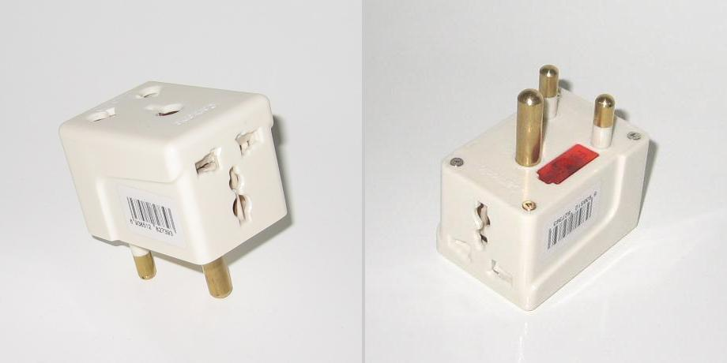
Adapter
Image source (PD): https://en.wikipedia.org/wiki/AC_power_plugs_and_sockets
Adapt existing class interface to alternative/ new interface
Real-world example: see below

Slide 7
Adapter: Code example
Source (FU): http://www.vincehuston.org/dp/adapter.html
class LegacyRectangle {
public void draw( int x, int y, int w, int h ) {
System.out.println("rectangle at (" + x + ',' + y
+ ") with width " + w + " and height " + h);
}
}
// adapter to new Shape interface
class Rectangle extends Shape {
public Rectangle() {
adaptee = new LegacyRectangle();
}
public void draw( int x1, int y1, int x2, int y2 ) {
adaptee.draw( Math.min(x1,x2), Math.min(y1,y2),
Math.abs(x2-x1), Math.abs(y2-y1) );
}
private LegacyRectangle adaptee;
}

Slide 8
Adapter: similar patterns
Facade – provide simplified external interface for complex, interrelated set of objects
Proxy – provide same interface with extra functionality:
  Placeholder for “expensive” objects
  Local representation for remote object
  Protective proxy: access control
  Caching/reference counting (e.g. smart pointer)

Slide 9
Composite
Useful for representation of tree structures
E.g. scene graph, GUI widgets, directories, …
Composite contains components which can be other composites
Component
void traverse() { }
*
Leaf
Composite
void traverse() { … }
void traverse() { … }

Slide 10
Composite: Code example
Source (FU): http://www.vincehuston.org/dp/composite.html
class DirEntry {
public void traverse() { }
protected String m_name;
}
class File extends DirEntry {
public File( String name ) { m_name = name; }
public void traverse() { System.out.println(m_name); }
}
class Directory extends DirEntry {
public Directory( String name ) { m_name = name; }
public void add( DirEntry obj ) { m_entries.add( obj ); }
public void traverse() {
System.out.println(m_name + ”:”);
for (DirEntry entry: m_entries) {
entry.traverse();
}
}
private ArrayList<DirEntry> m_entries;
}

Slide 11
Decorator
Enables adding extra functionality on the fly
Important – decorators can be stacked:
Stream decoratedStream = new GZIPStream( new ASCII7Stream( new FileStream("fileName.gz")));
Can't be used to modify the interface
Structure similar to Composite

Slide 12
Decorator
Coffee
String ingredients() {
return null;
}
BasicCoffee
CoffeeDecorator
String ingredients() {
return “Coffee”;
}
Coffee m_base;
Milk
ExtraEspresso
Milk(Coffee base) {
m_base = base;
}
String ingredients() {
return m_base.ingredients()
+ ”, with milk”;
}
ExtraEspresso(Coffee base) {
m_base = base;
}
String ingredients() {
return m_base.ingredients()
+ ”, with extra Espresso”;
}

Slide 13
Decorator
Coffee coffeeWithMilk = new Milk( new BasicCoffee() );
System.out.println(coffeeWithMilk->ingredients());
→ Coffee, with milk
Coffee doubleShotLatte = new ExtraEspresso(
new ExtraEspresso( coffeeWithMilk ));
System.out.println(doubleShotLatte->ingredients());
→ Coffee, with milk, with extra Espresso, with extra Espresso

Slide 14
Behavioural patterns
Used to control/interact with objects
Rules-of-thumb: http://www.vincehuston.org/dp/behavioral_rules.html
Examples:
  Iterator
  Command
  Visitor
  Observer

Slide 15
Iterator
Goal: traverse a collection
Prominent implementation: Java containers
Decouples data structures from algorithms
Iterator object is returned from data structure
Iterator<Item>
Container<Item>
void first();
void next();
Item current();
bool hasNext();
Iterator<Item>
getIterator();

Slide 16
Command
Promotes method call to object
Command objects can be passed to other methods and invoked later
Command
Target
void execute();
Target m_target;
void func1(int);
void func2(int);
...

Slide 17
Command
Source (FU): http://www.vincehuston.org/dp/command.html
class Target {
public void func1( int param );
public void func2( int param );
}
class Command {
public Command( Consumer<Int> method, int param ) {
m_method = method; m_param = param;
}
public void execute() { m_method.accept(m_param); }
private Consumer<Int> m_method;
private int m_param;
}
Target my_target = new Target();
Command cmd = new Command( my_target::func2, 123 );
[...]
cmd.execute();

Slide 18
Visitor
Visitor applies an operation to all objects of an element hierarchy (often recursively)
Complements the Composite pattern
Allows to add functionality to elements without changing elements themselves

Slide 19
Visitor
HTMLElement
void accept
(Visitor v) { }
Visitor
Visitor
virtual void visit
(DivElement* d);
virtual void visit
(SpanElement* s);
...
void visit
(DivElement d) {}
void visit
(SpanElement s) {}
...
DivElement
void accept(Visitor v){
v.visit( this );
for (HE c: children)
c.accept( v );
}
RenderVisitor
...
SpanElement
void accept(Visitor v){
v.visit( this );
...
}
PlaintextVisitor
...

Slide 20
Observer
Provides a way to notify dependent components if a central state changes
Often used to implement Model-View-Controller architecture

Slide 21
Observer
Source: http://www.vincehuston.org/dp/observer.html
Model
Visitor
View
void register(View);
State getState();
void modify() {
for (View v: views)
v.update();
}
virtual void visit
(DivElement* d);
virtual void visit
(SpanElement* s);
...
View(Model m) {
m.register(this);
}
void update() {}
GraphicalView
TabularView
void update();
void update();

Slide 22
“Mainloop” Pattern
Not object-oriented, common in many GUI/ graphics libraries
Library has internal mainloop
  void mainloop() {
    while (event = getNextEvent() && !quit)
      process(event);
  }
Problem: using multiple libraries?
Possible solution: expose getNextEvent() + process(), write own mainloop()

Slide 23

UI Patterns
Image source (FU): http://designinginterfaces.com/
Patterns can also be applied to GUIs
Don't involve code, but rather layout, colors, widgets, …
Book reference: “Designing Interfaces” by Jenifer Tidwell, O'Reilly Books

Slide 24
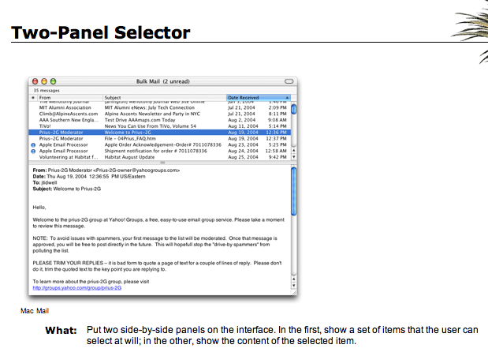
UI Patterns: Two-Panel Selector
Image source (FU): “Designing Interfaces”, Jennifer Tidwell

Slide 25
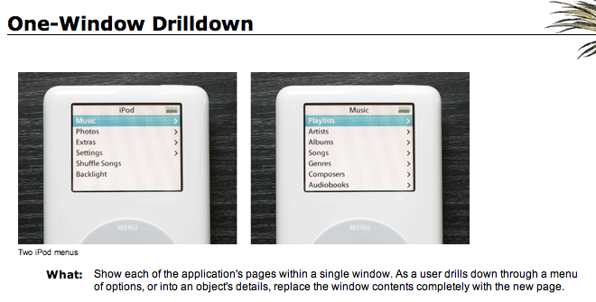
UI Patterns: One-Window Drilldown
Image source (FU): “Designing Interfaces”, Jennifer Tidwell
Alternative to Two-Panel Selector, useful for:
Limited display space
Infrequent usage (e.g. Ubuntu/MacOS settings panel)

Slide 26
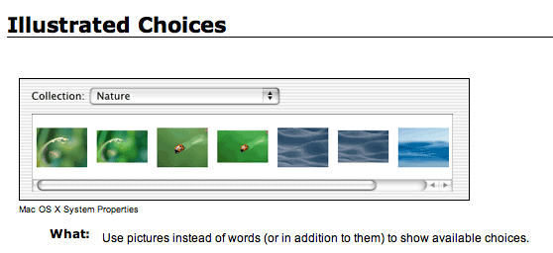
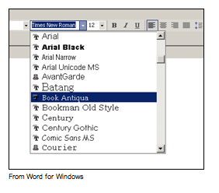
UI Patterns: Illustrated Choices
Image source (FU): “Designing Interfaces”, Jennifer Tidwell
What: use pictures instead of words (or in addition to them) to show available choices.

Slide 27
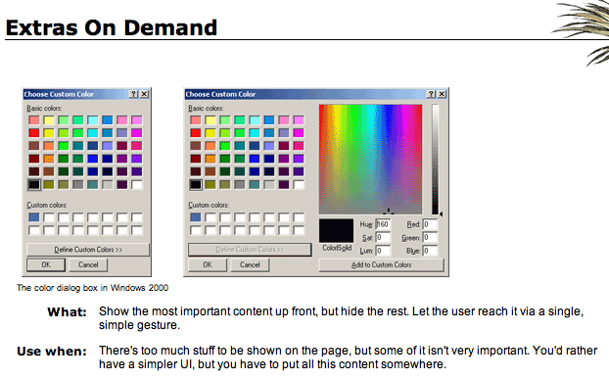
UI Patterns: Extras on Demand
Image source (FU): “Designing Interfaces”, Jennifer Tidwell

Slide 28
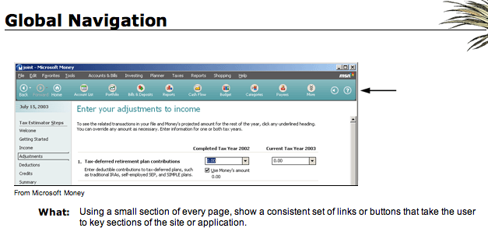
UI Patterns: Global Navigation
Image source (FU): “Designing Interfaces”, Jennifer Tidwell

Slide 29
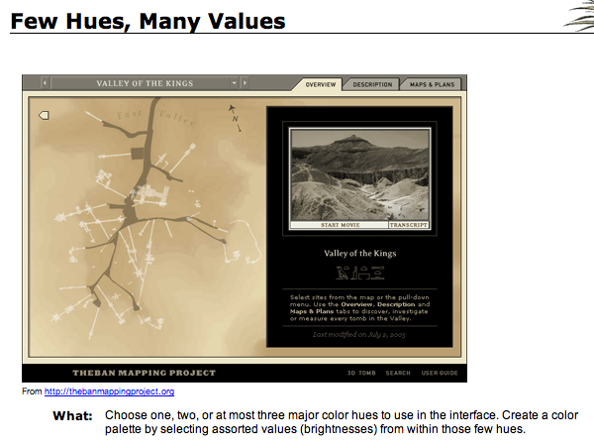
UI Patterns: Few Hues, Many Values
Image source (FU): “Designing Interfaces”, Jennifer Tidwell

Slide 30
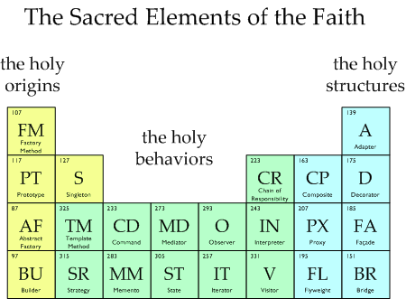
Questions/Comments?
Image source (FU): http://www.vincehuston.org/dp/
The Periodic Table of Patterns

