Slide 1

Configuring Network devices through Kubernetes
59th GoFrm meetup

Slide 2
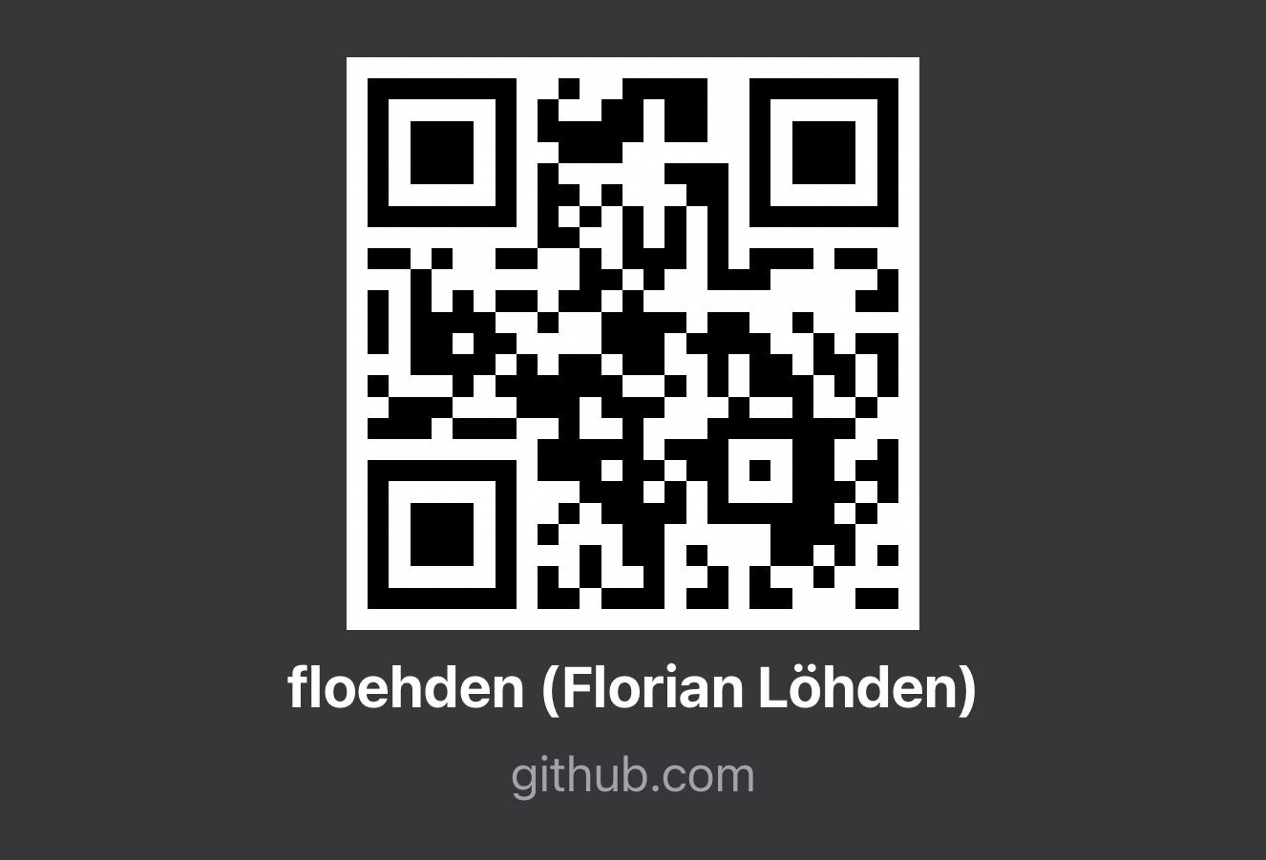
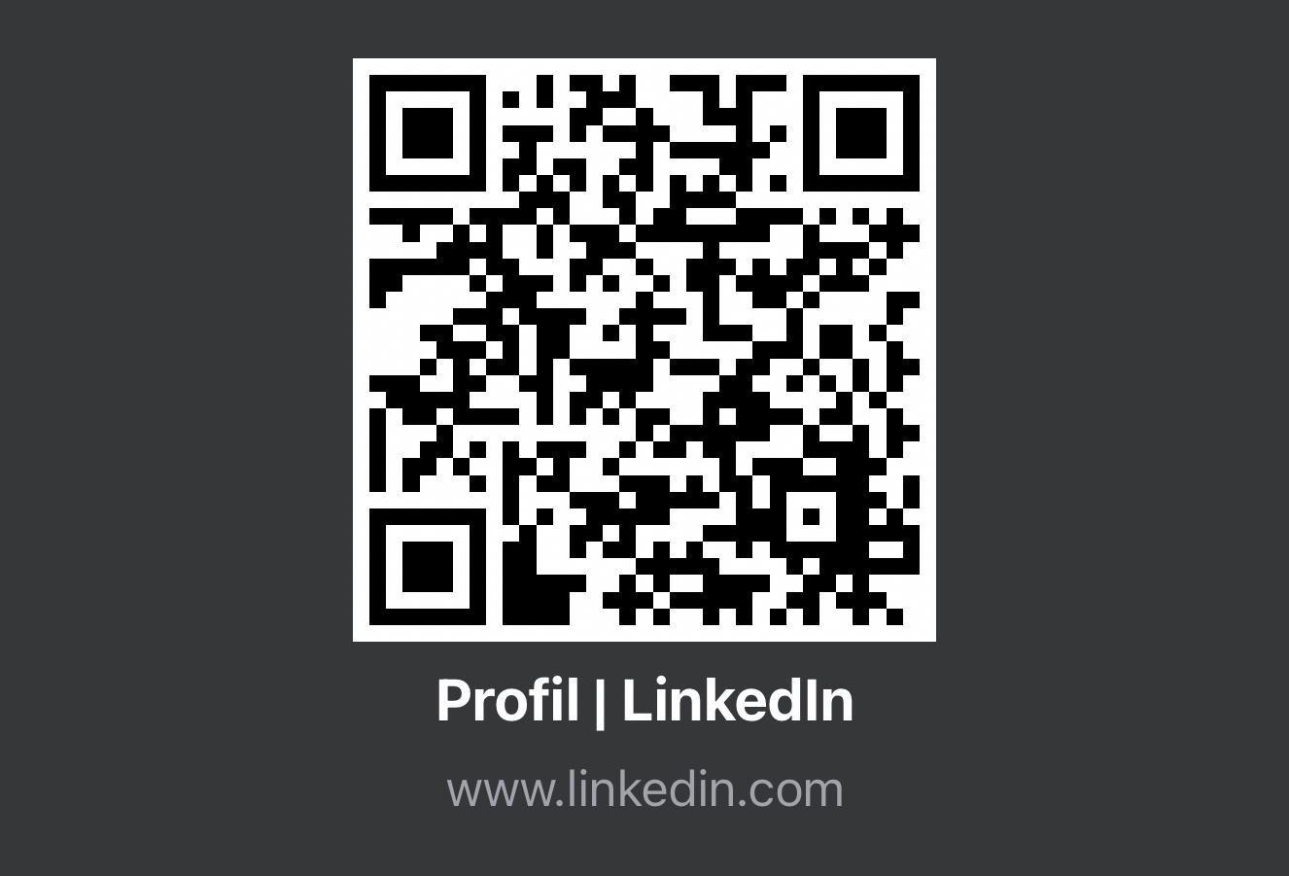
About me
working at Logicalis
over 10 years in Software Engineering
nearly 5 years in DevOps
End of master studies
Enthusiastic about Automation, Containerization and Networks

Slide 3
Agenda
Intro into Kubernetes
Intro into Operator
Demo
Network Automation Group

Slide 4
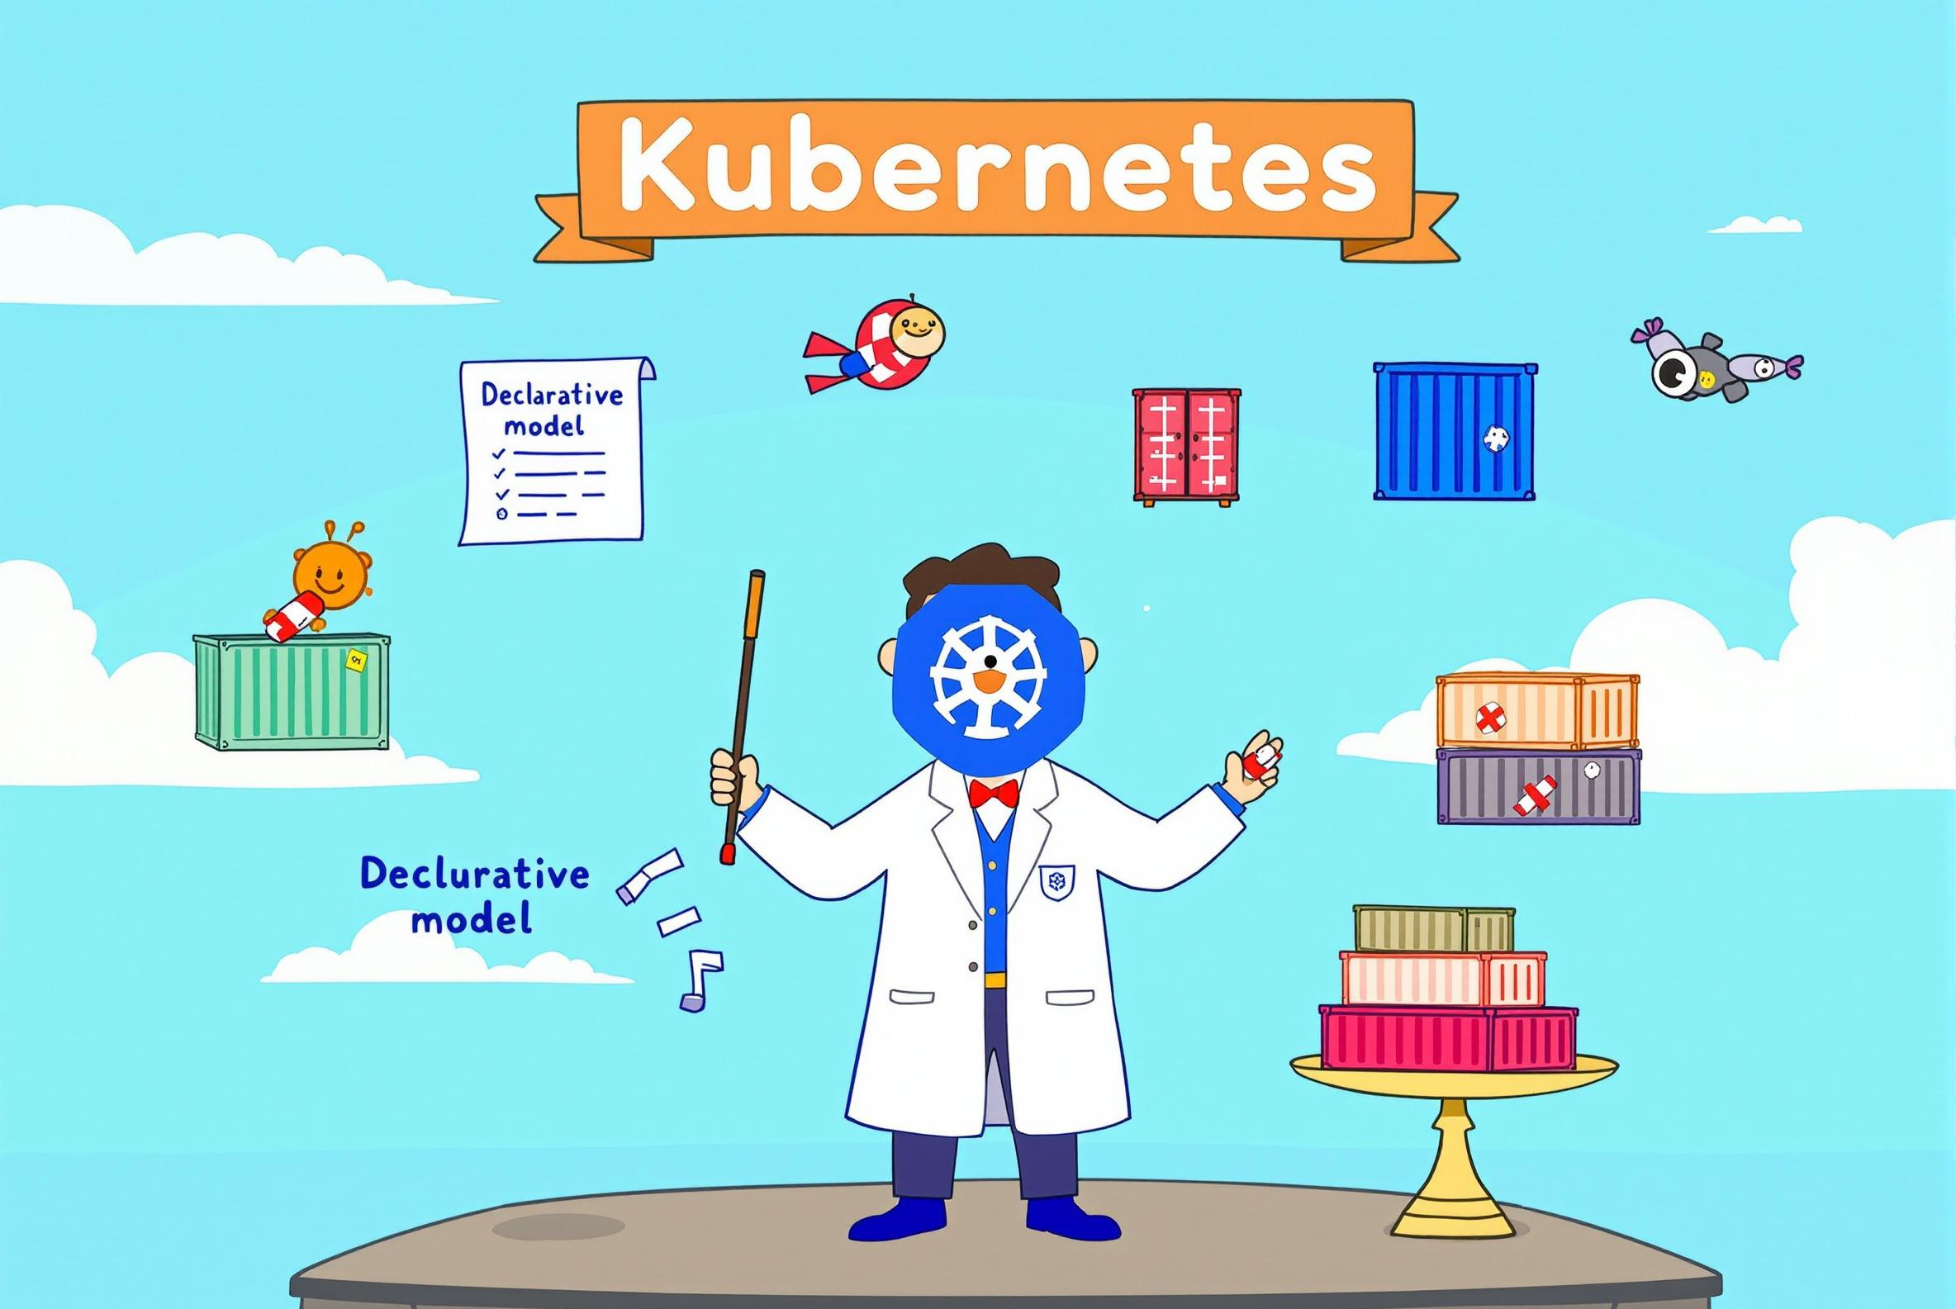
Introduction into Kubernetes
API-Based
REST API
Container orchestration
Not only containerized applications
Declaritive Model
YAML and JSON
Self-healing
Reconciling
High-Availability
Load Balancing

Slide 5
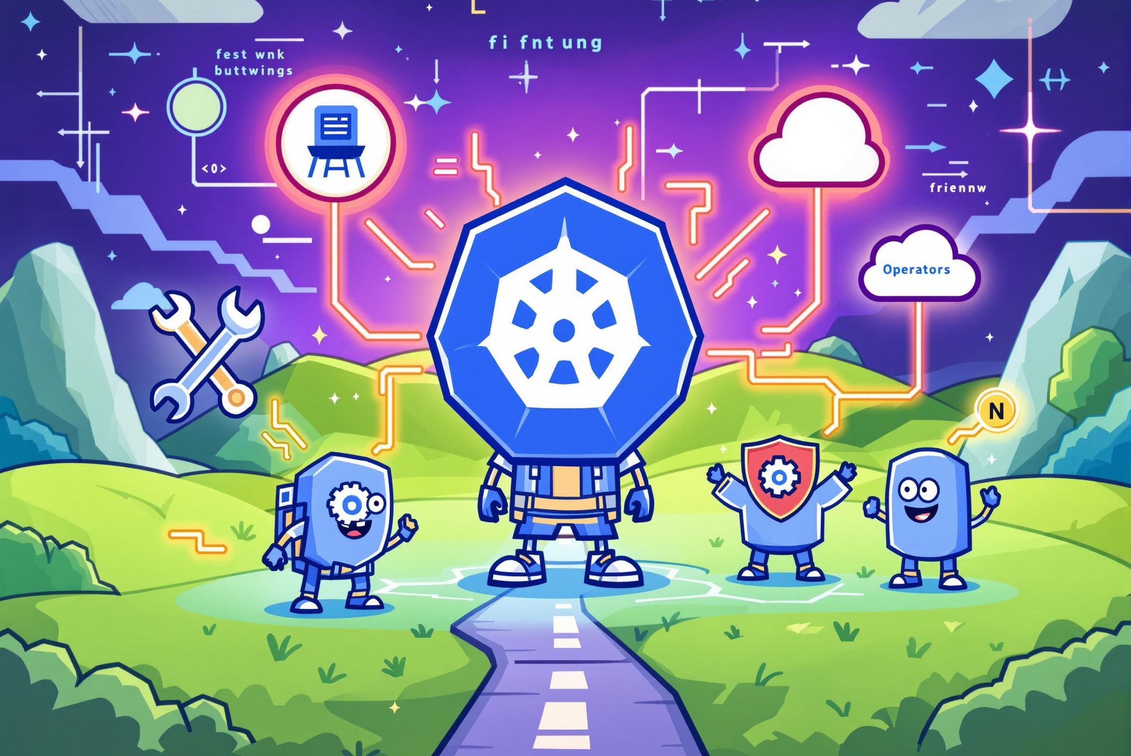
Introduction into operator
Extension of API-Service
Extend Kubernetes on everything that is not already possible
Operator Hub
Source of Thruth, Cloud Providers, Database, Logging, Monitoring

Slide 6
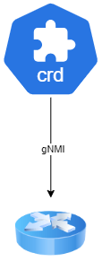
Operator
minimal operator to manage physical devices
gNMI to configure and connect to the device
GET the NAME of the device
SET value in the configuration
(Not possible so far)
DELETE values
SUBSCRIBE to telemetry
Check if the connection is active
Introduction - Background - Approach - Implementation - Evaluation - Conclusion - Future work

Slide 7
DEMO

Slide 8
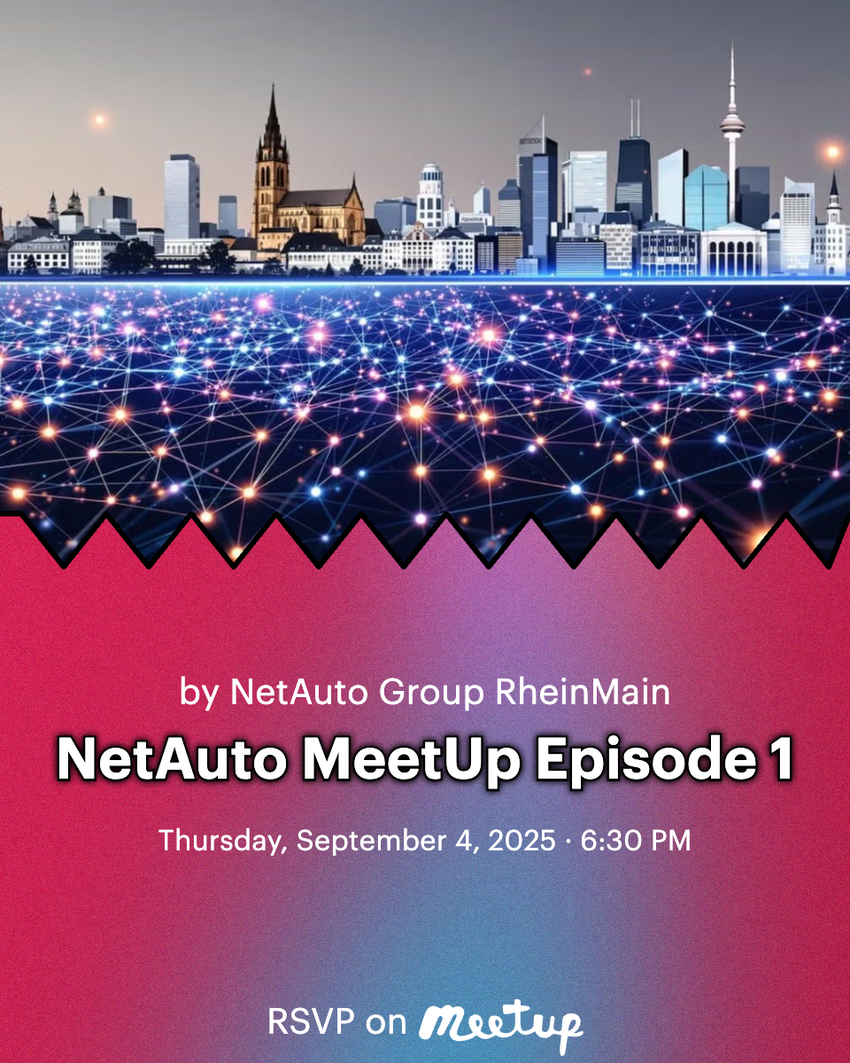
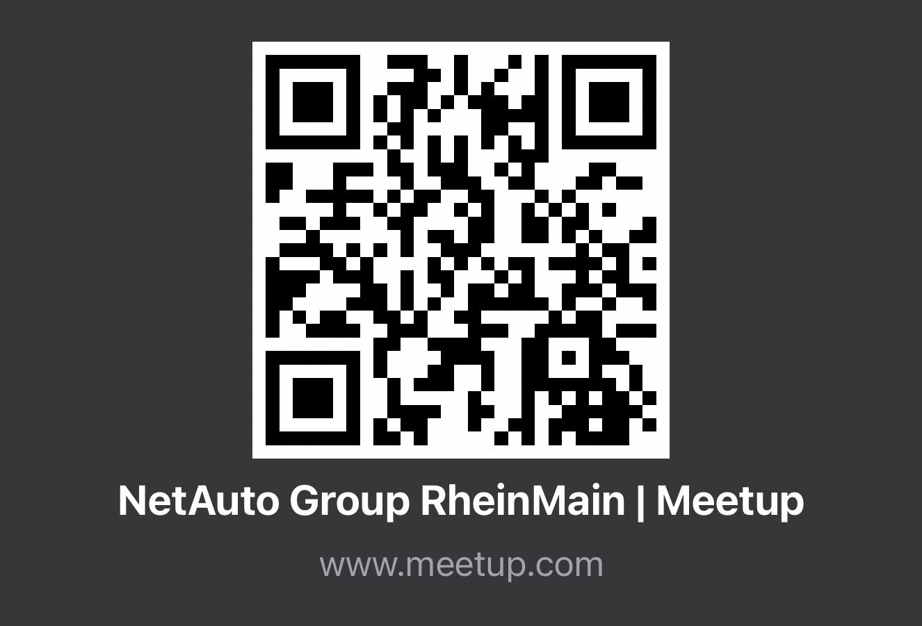
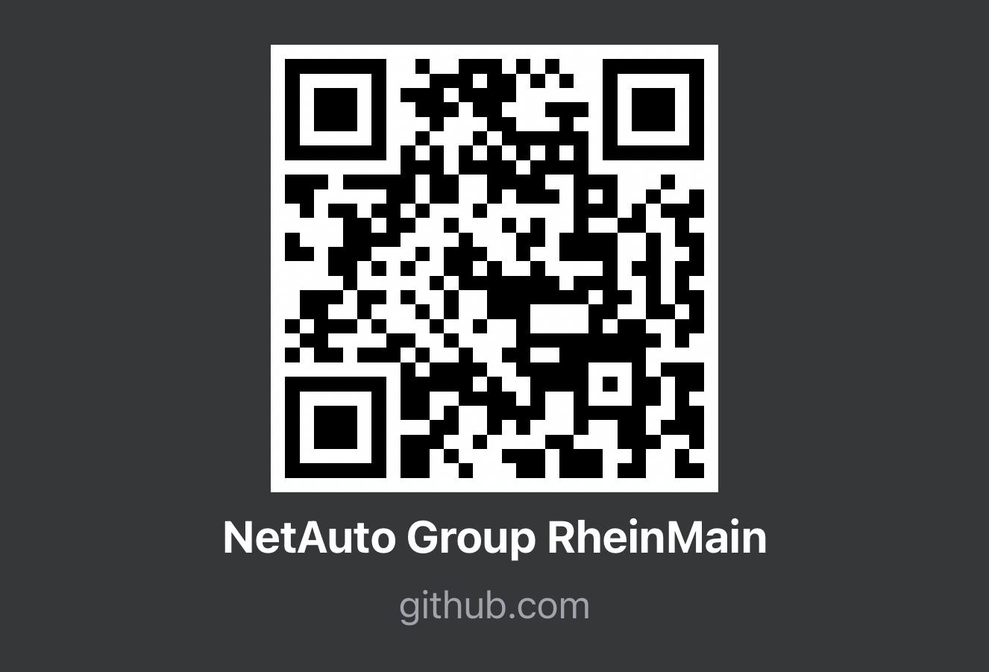
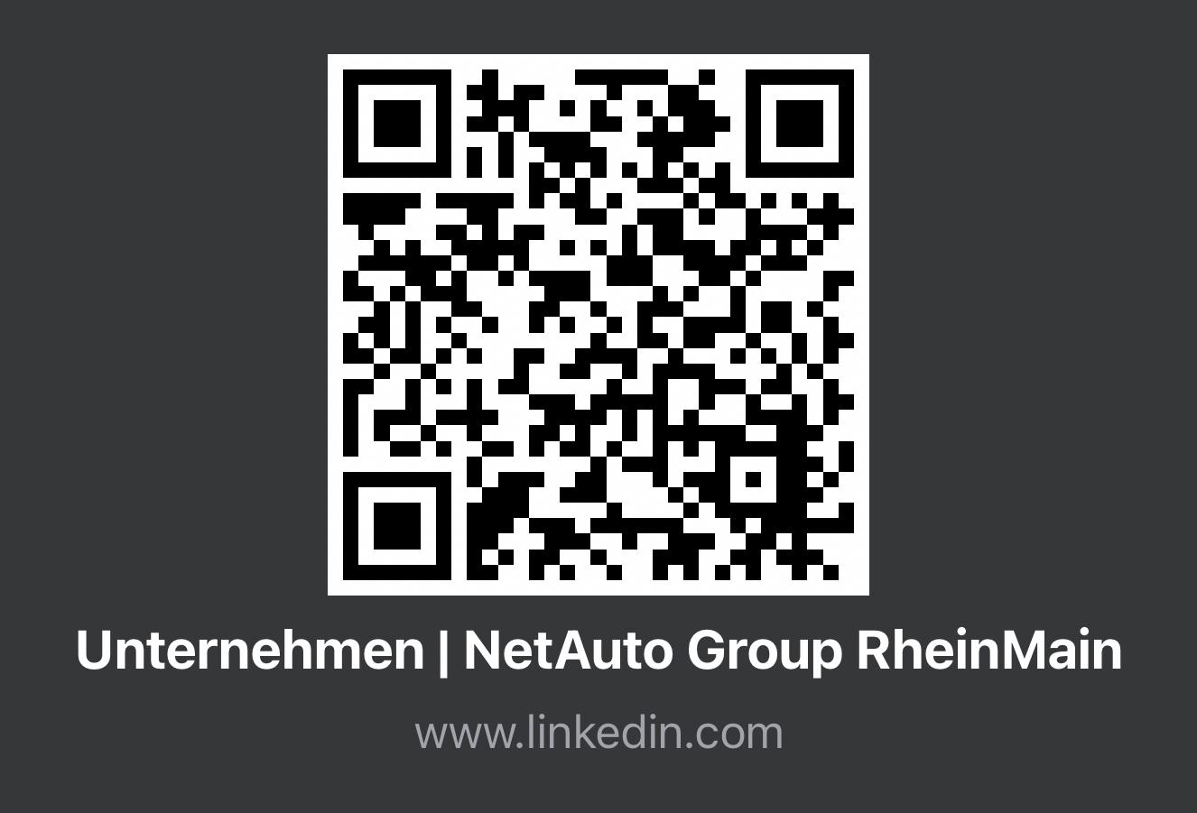
Netauto Group Rheinmain
Interested in Network Automation?
Meeting exciting new people in that area
Food and Drinks
In Neu-Isenburg

Slide 9
Thank you ! Any Questions?
Kubernetes is an API-based services
Kubernetes was originally for containerized Applications
The API is extendible through Custom Resources
Operators have reconciling functions and can do everything that is possible with GO
Connecting via gnmi to the network device
GNMI: GET, REPLACE, DELETE, SUBSCRIBE
https://github.com/floehden/gofrm59

Slide 10
Resources
Kubernetes Course
https://youtu.be/EV47Oxwet6Y?si=OdOLrb1-Unx8srCY
Kubebuilder Documentation
https://book.kubebuilder.io/
Containerlab
https://containerlab.dev/
Arista on gnmi with GO
https://aristanetworks.github.io/openmgmt/examples/golang/
SDC
https://docs.sdcio.dev/
Kubenet
https://learn.kubenet.dev/

