Slide 1
Exercise 2 Random Forest
Lukas Sichert -12114770
Kristof Dadic - 12105475
Florian Engl - 12102619

Slide 2
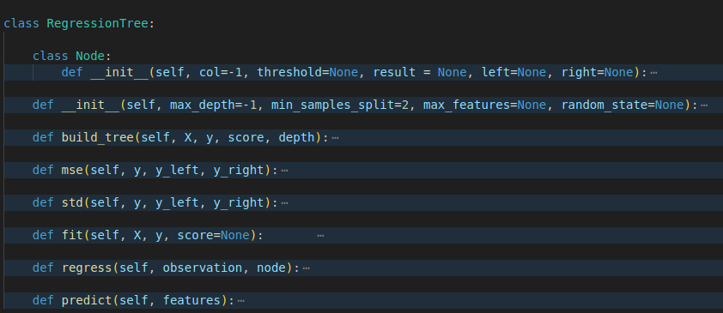
Regression Tree Code Overview

Slide 3
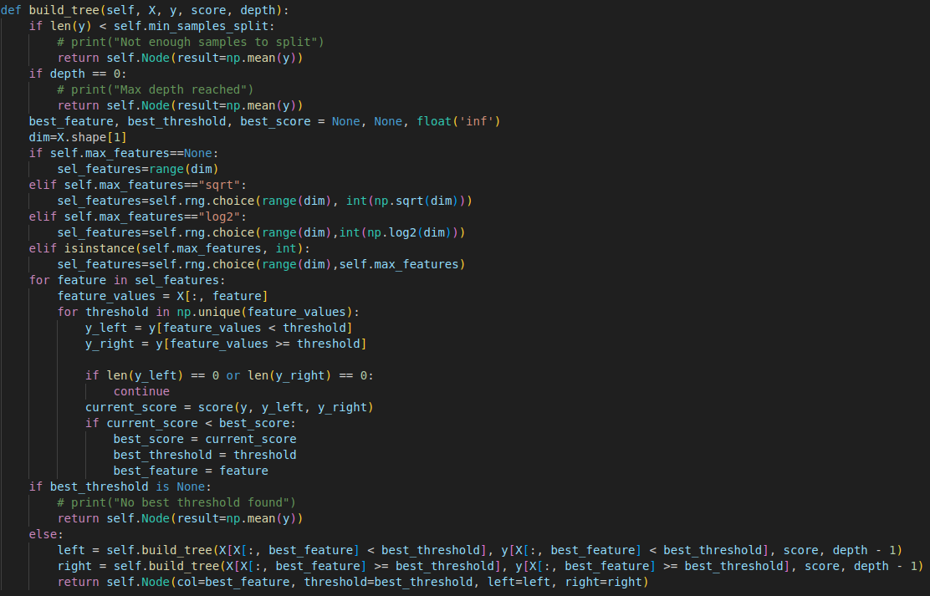
Regression Tree - build_tree function

Slide 4
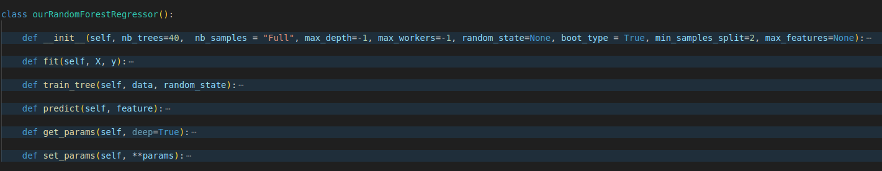
Random Forest Code Overview

Slide 5
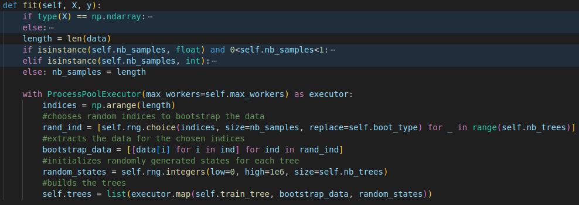
Random Forest - fit function

Slide 6
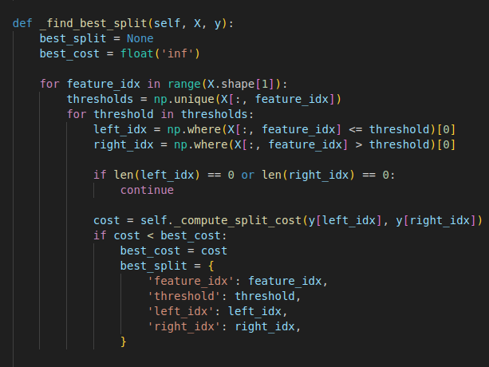
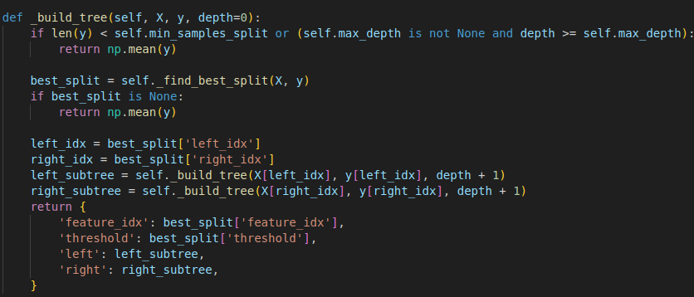
LLM Tree - _build_tree function

Slide 7
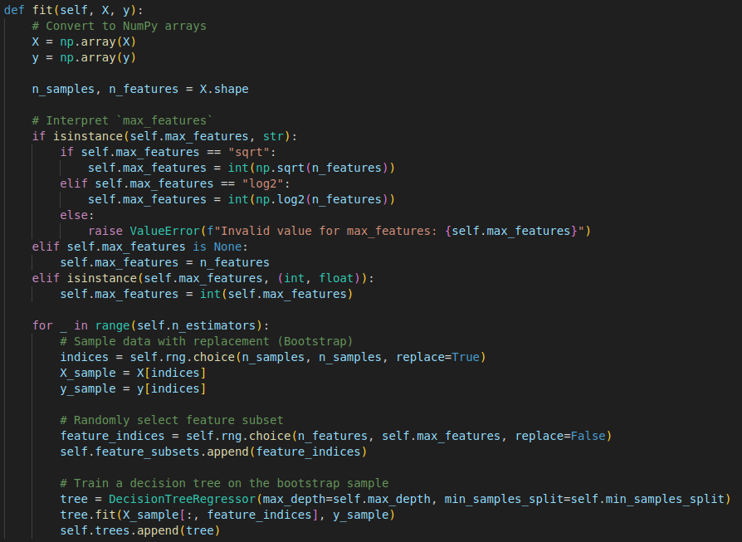
LLM - Random_Forest fit function

Slide 8
Key Differences
random feature selection:
we select a random feature subset at each tree node
LLM selects the random subset once for the whole tree
LLM did not parallelize, leading to worse performance
bootstrapping samples:
we always bootstrap and control replacement via boot_type = TRUE/FALSE
LLM does not bootstrap at all
scikit-learn bootstraps either with replacement or not at all, controlled via boot_type

Slide 9
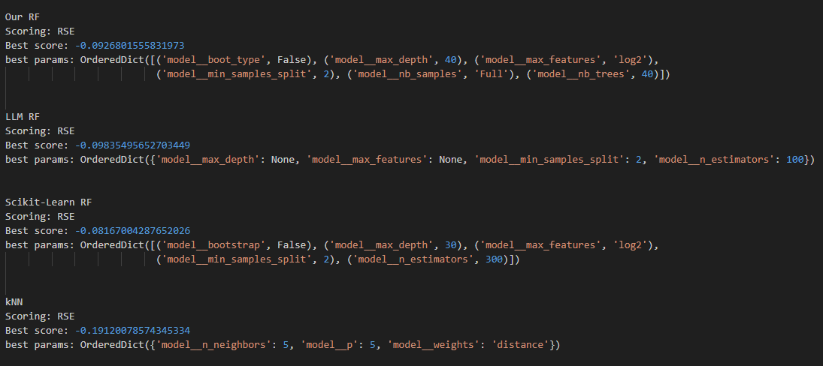
Tuning Results - Concrete Dataset

Slide 10
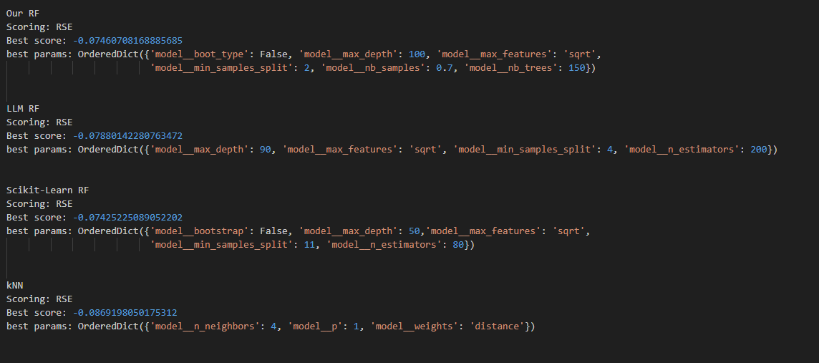
Tuning Results - Superconductivity Dataset

Slide 11
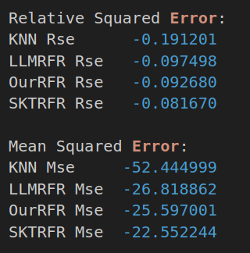
Cross Validation Results - Concrete Dataset

Slide 12
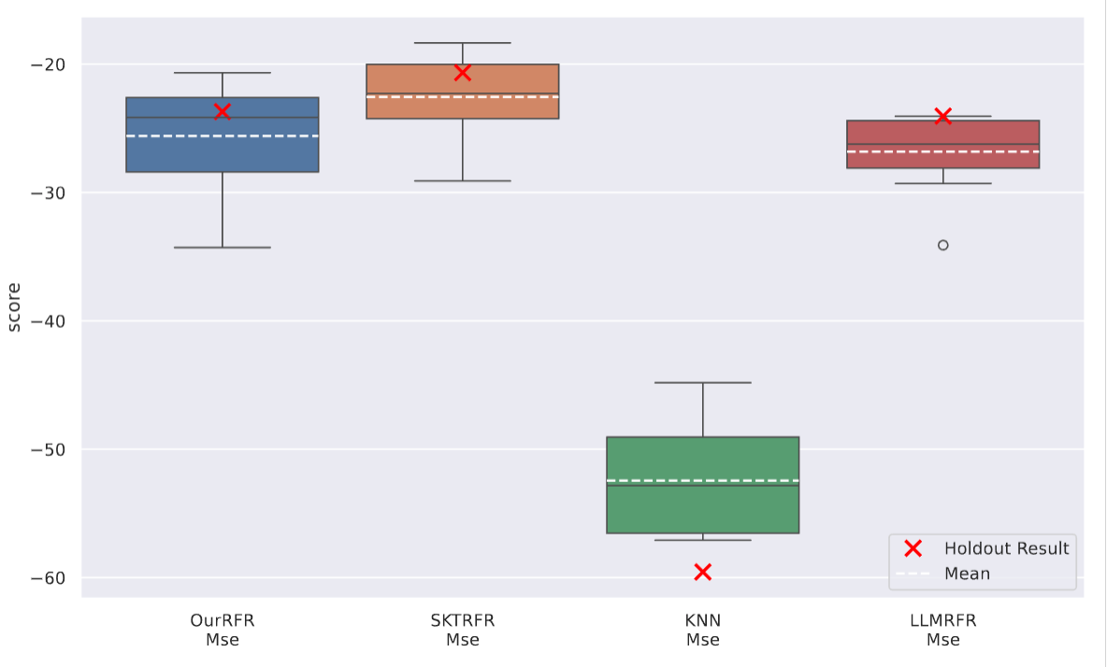
MSE Comparison - Concrete Dataset

Slide 13
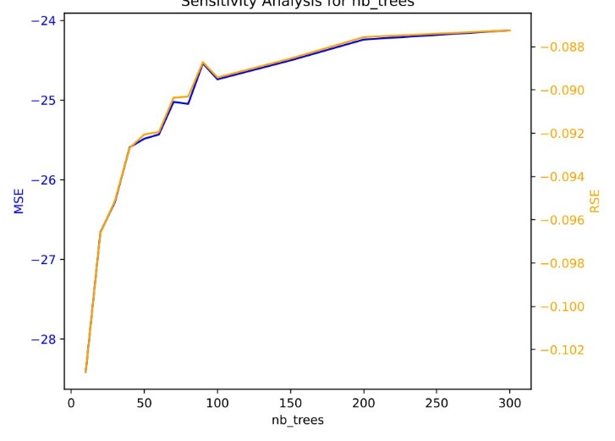
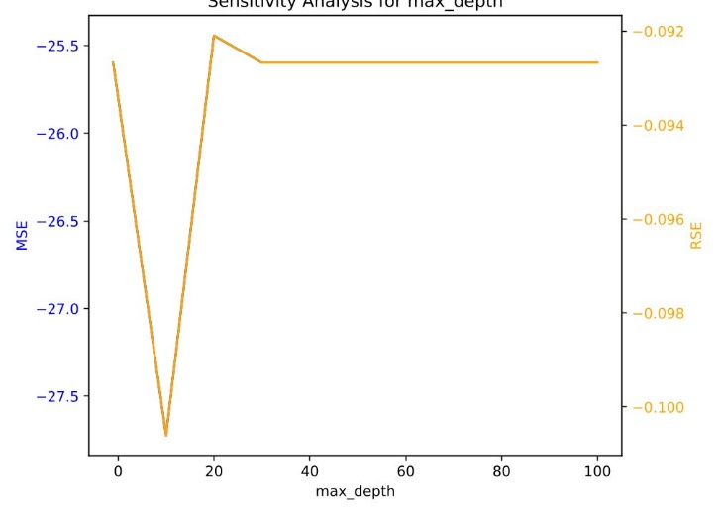
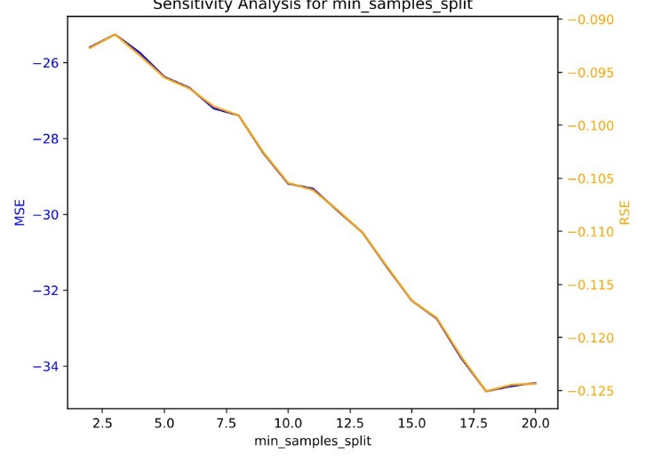
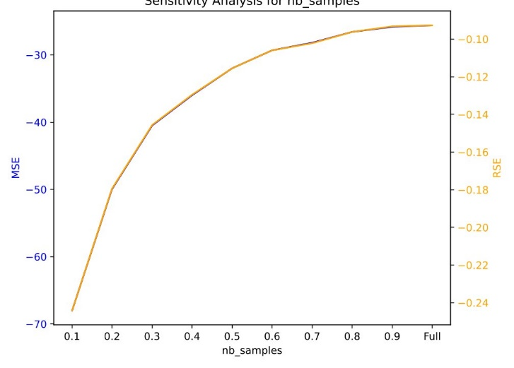
Sensitivity Plots Concrete Dataset Our Implementation

Slide 14
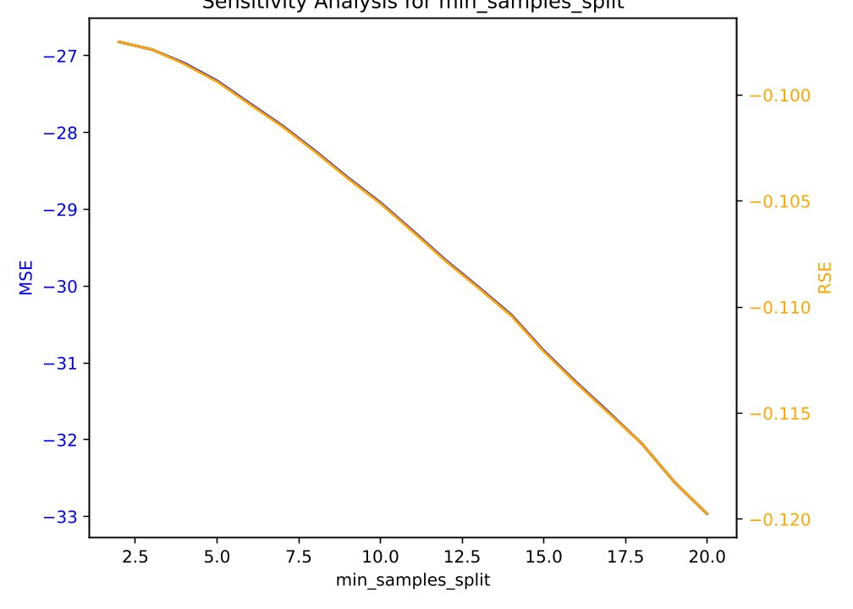
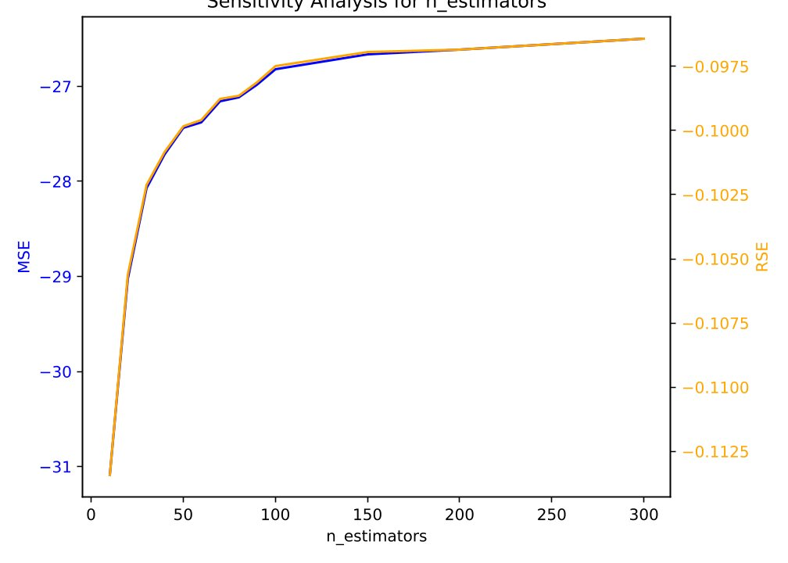
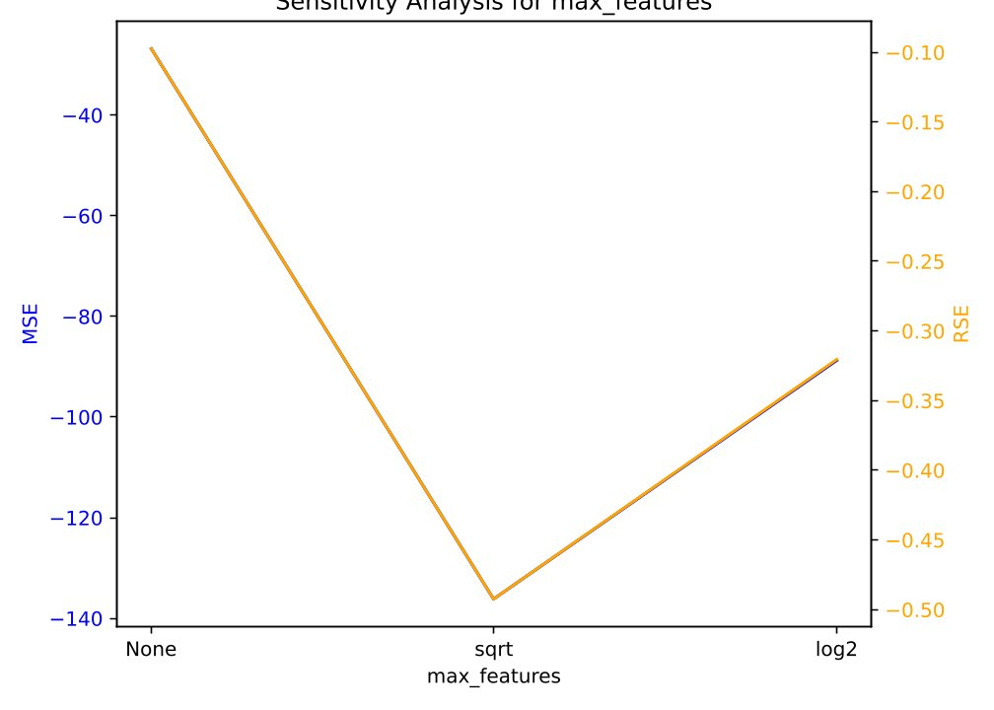
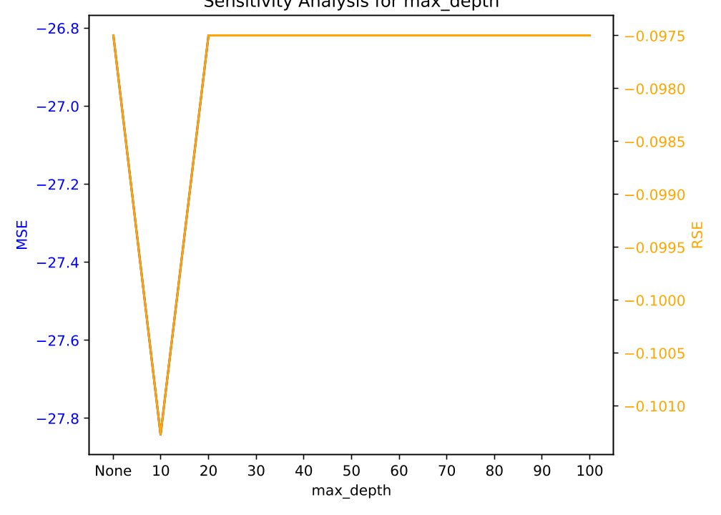
Sensitivity Plots Concrete Dataset LLM

Slide 15
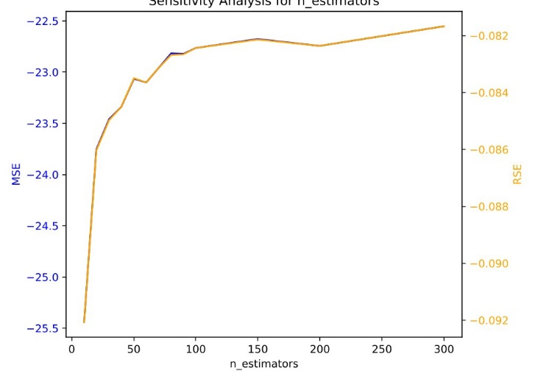
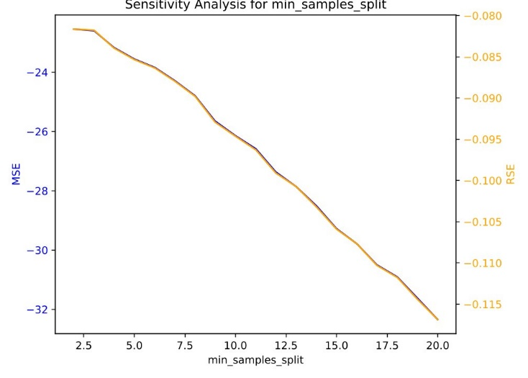
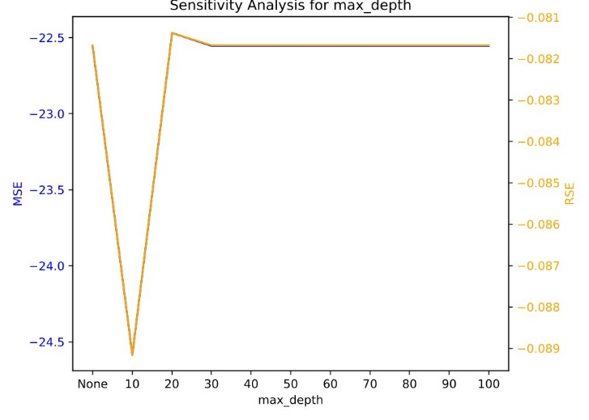
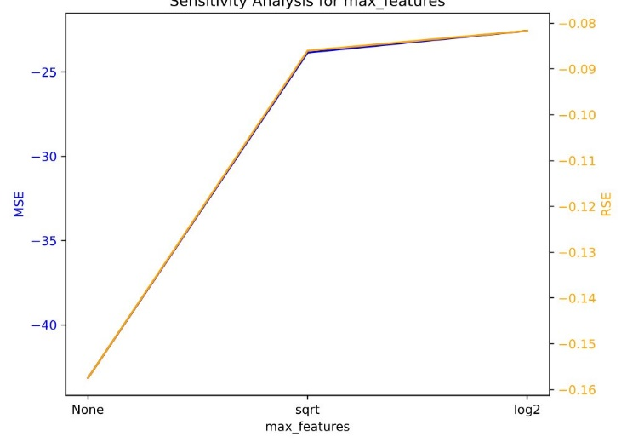
Sensitivity Plots Concrete Dataset scikit-rf

Slide 16
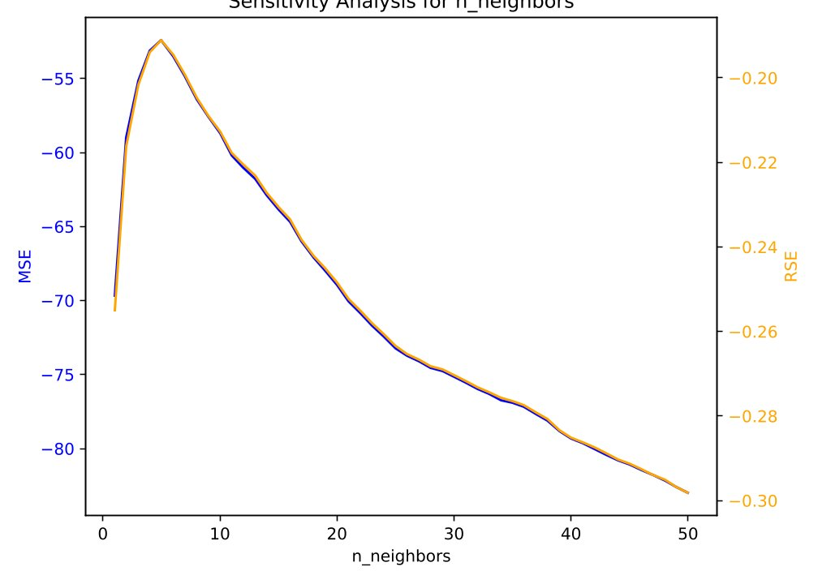
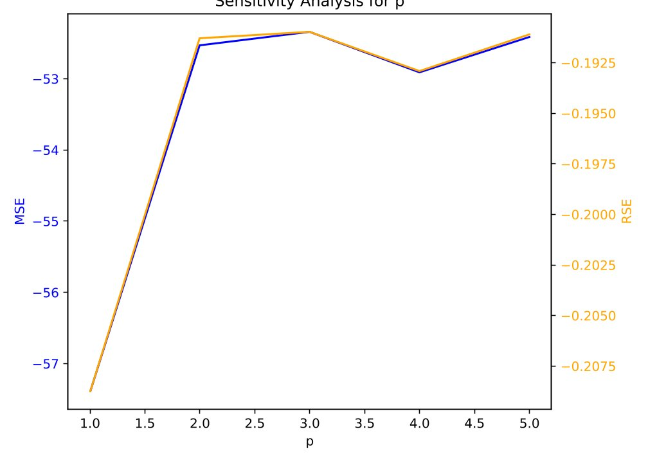
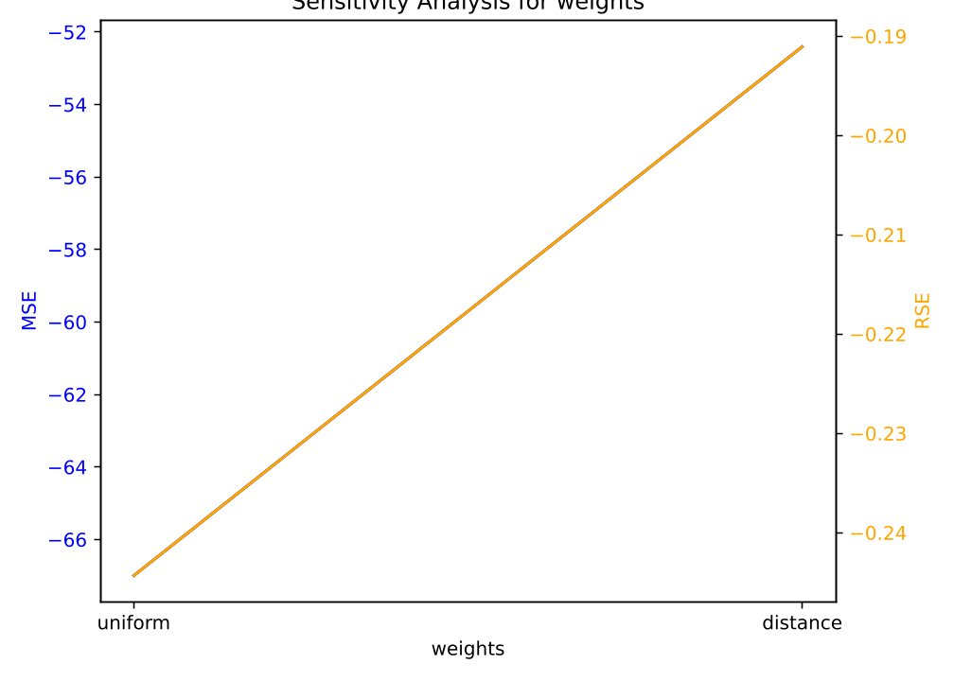
Sensitivity Plots Concrete Dataset kNN

Slide 17
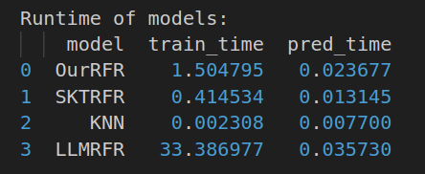
Runtime - Concrete Dataset

Slide 18
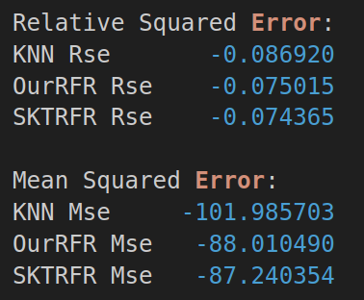
Cross Validation Results - Superconductivity Dataset

Slide 19
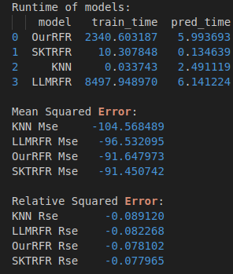
Cross Validation Results - Superconductivity
(no repetitions and few folds)

Slide 20
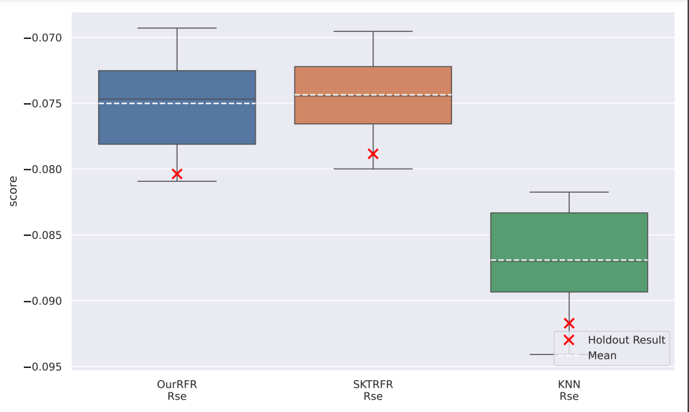
Relative Squared Error - Superconductivity Dataset

Slide 21
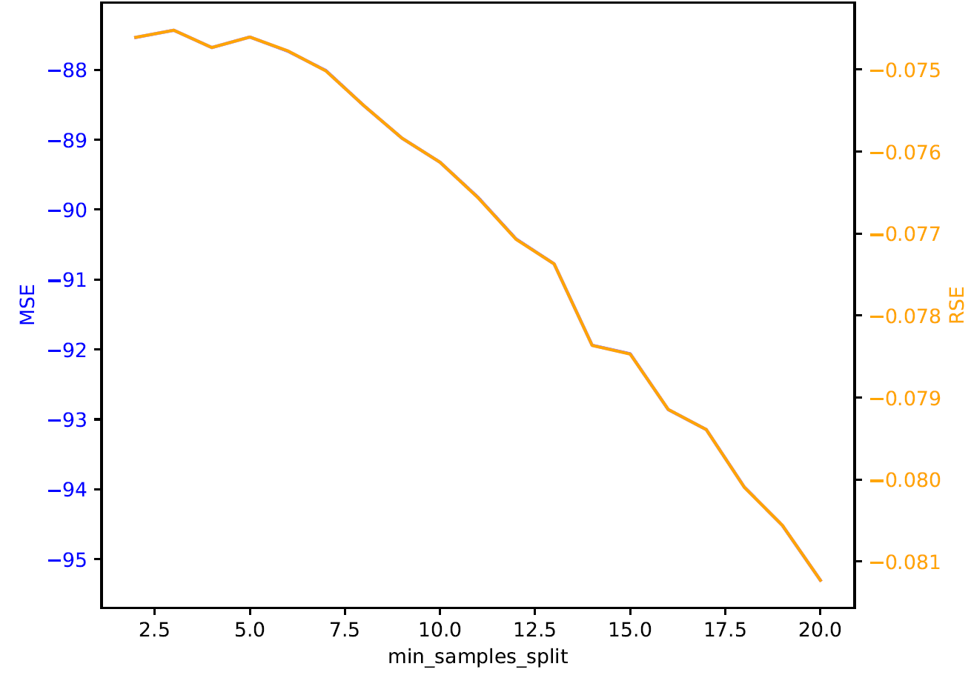
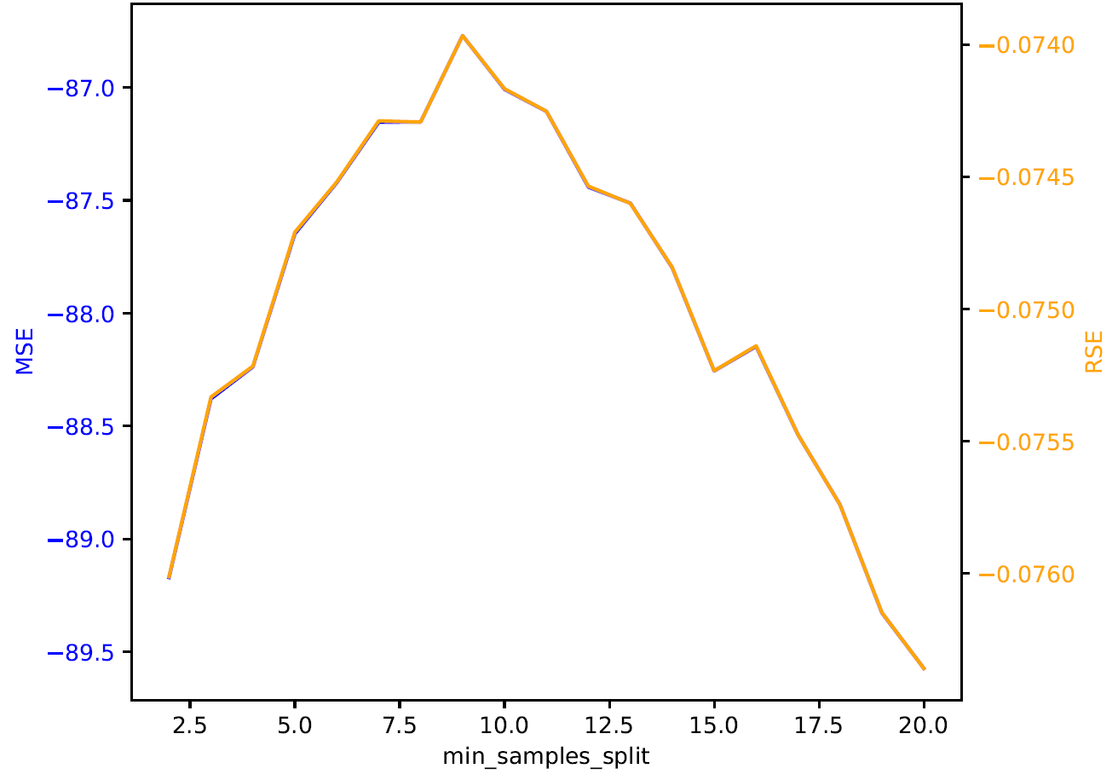
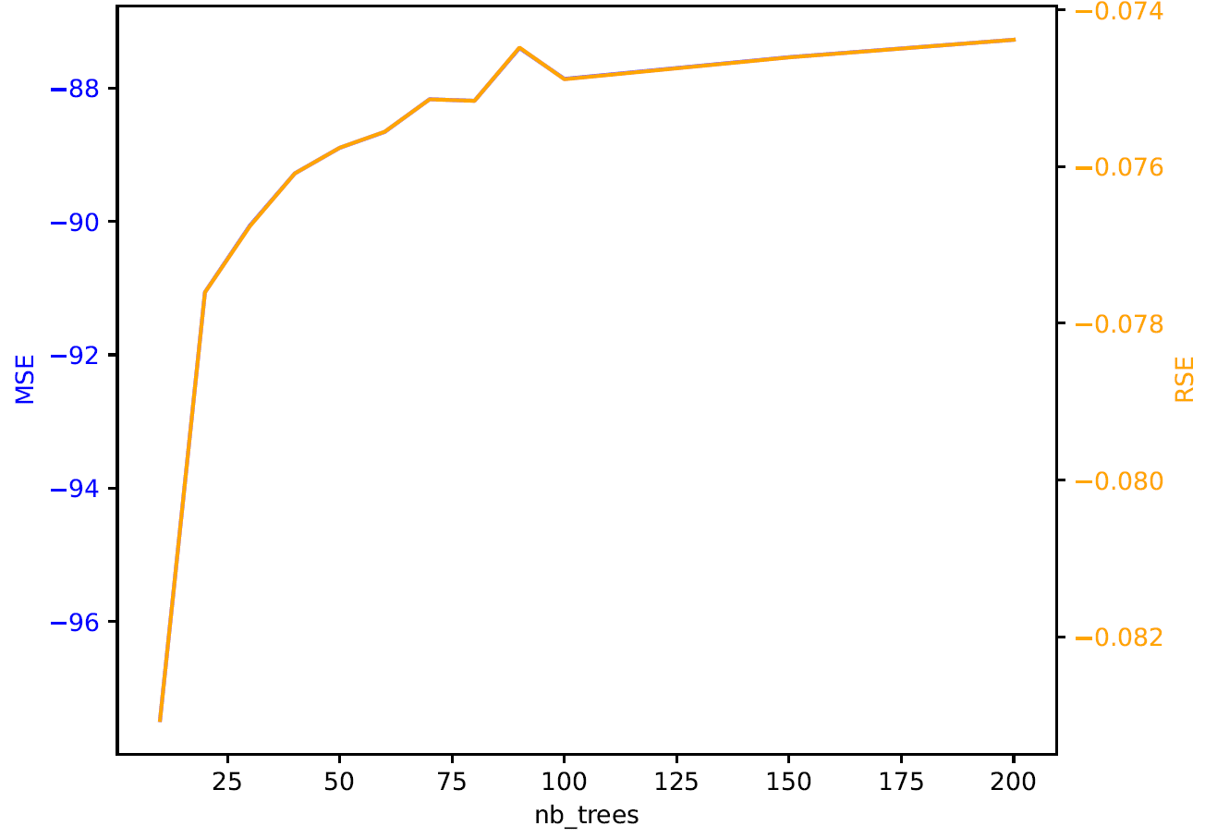
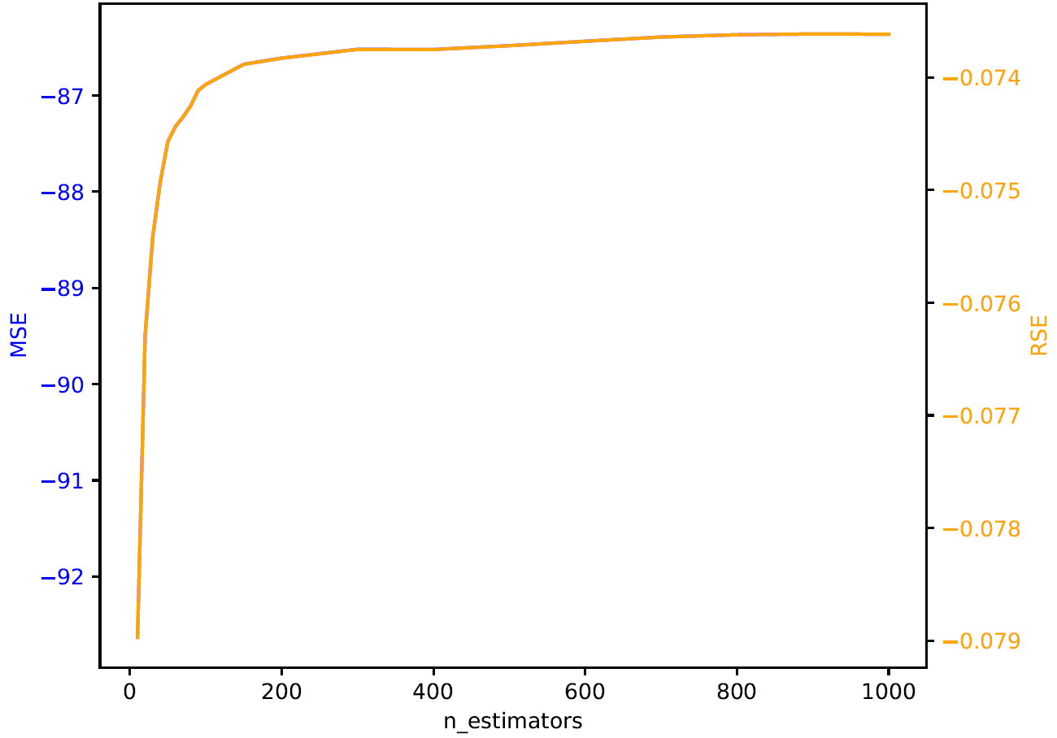
Sensitivity Plots – Superconductivity Dataset min_samples_split, nb_estimators/trees
Our Implementation
Scikit RF

Slide 22
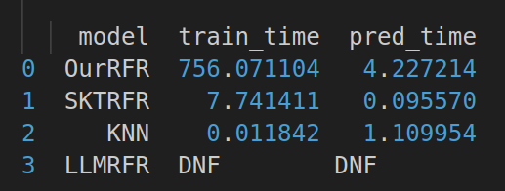
Runtime – Superconductivity Dataset

Slide 23
Conclusion – Key Takeaways
Performance:
implementing the max_features functionality boosts both efficiency and effectiveness
especially choosing a random subset at every node
biggest difference between LLM and our/Scikit’s RF
randomising the subsets of instances for each tree improves performance
min_samples_split can have a big influence depending on the implementation
Efficiency:
parallelisation is necessary for application on bigger datasets
Scikit-Learn is very efficient; bigger difference in efficiency, not effectiveness
kNN is very fast, but lacks in effectiveness
even a single regression tree outperforms it
Interestingly the metric had a very big influence

