Slide 1
Exercise 2 Random Forest
Lukas Sichert -12114770
Kristof Dadic - 12105475
Florian Engl - 12102619

Slide 2
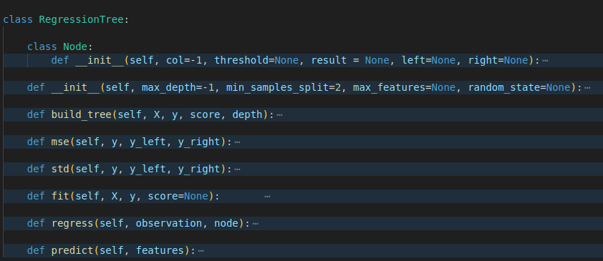
Regression Tree Code Overview

Slide 3
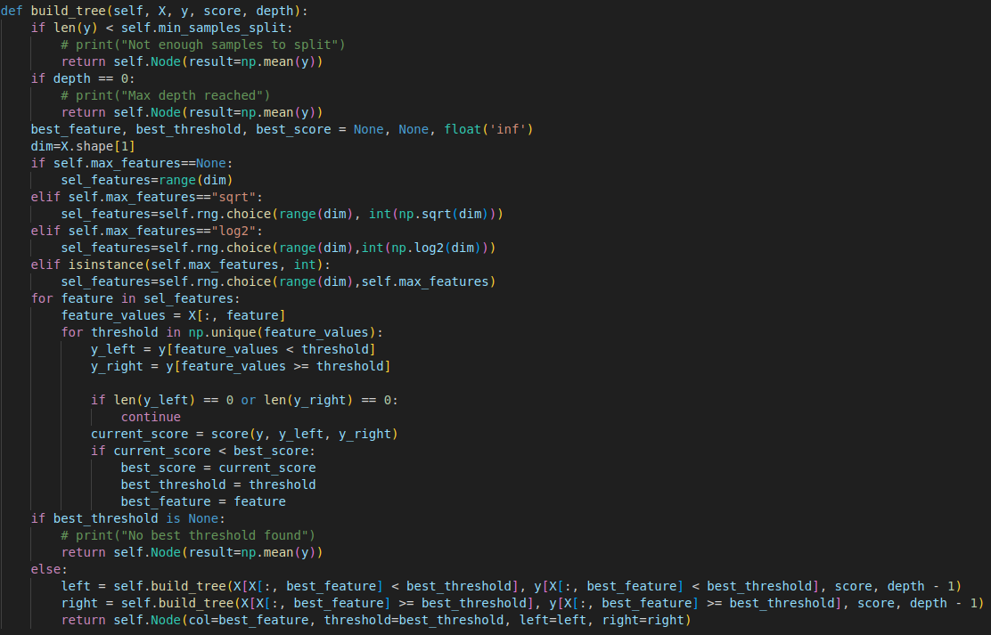
Regression Tree - build_tree function

Slide 4
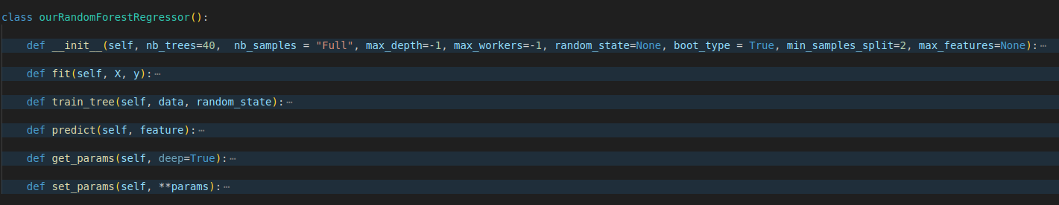
Random Forest Code Overview

Slide 5
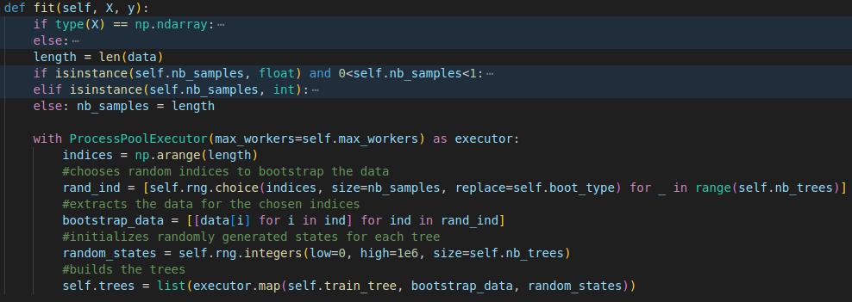
Random Forest - fit function

Slide 6
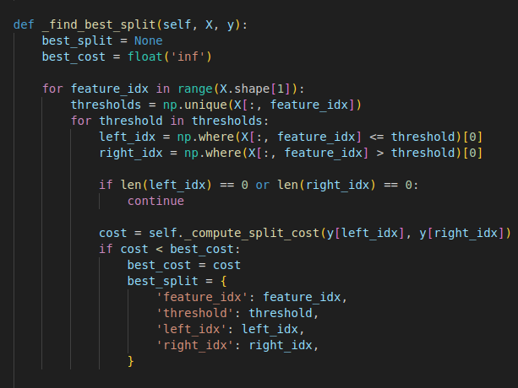
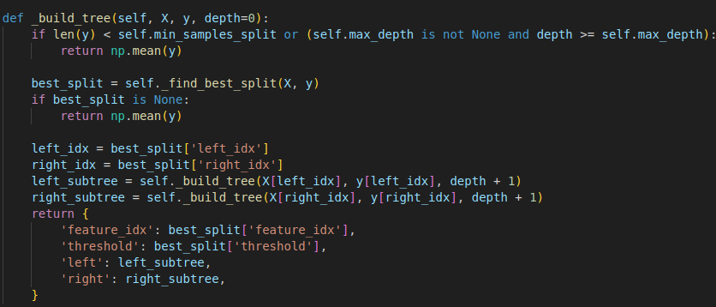
LLM Tree - _build_tree function

Slide 7
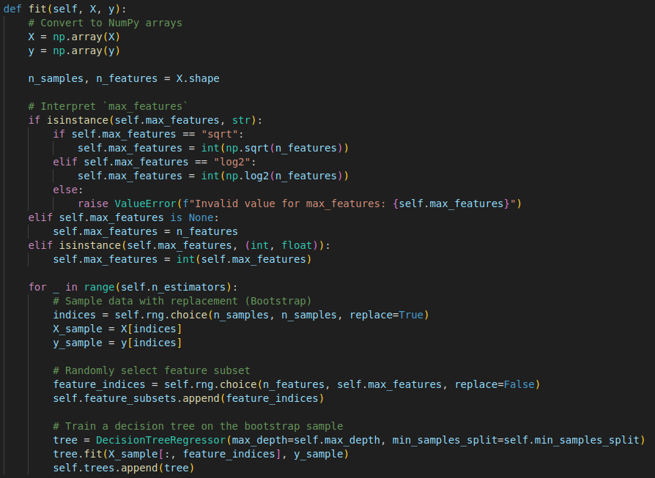
LLM - Random_Forest fit function

Slide 8
Key Differences
random feature selection:
we select a random feature subset at each tree node
LLM selects the random subset once for the whole tree
LLM did not parallelize, leading to worse performance
bootstrapping samples:
we always bootstrap and control replacement via boot_type = TRUE/FALSE
LLM does not bootstrap at all
scikit-learn bootstraps either with replacement or not at all, controlled via boot_type

Slide 9
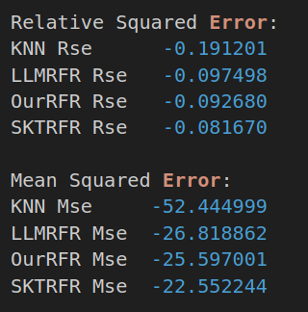
Cross Validation Results - Concrete Dataset

Slide 10
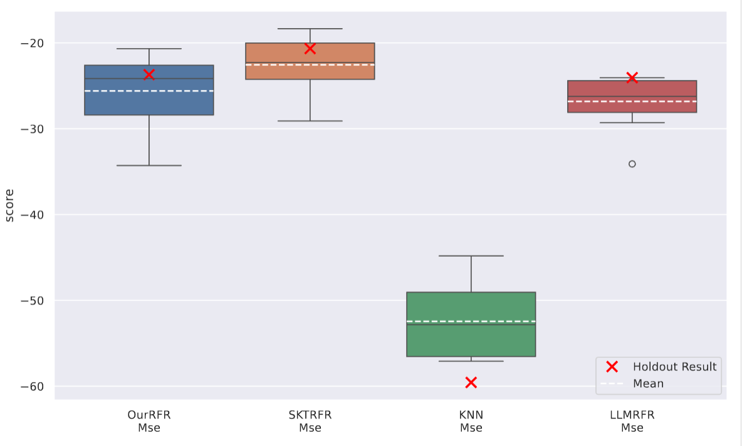
MSE Comparison - Concrete Dataset

Slide 11
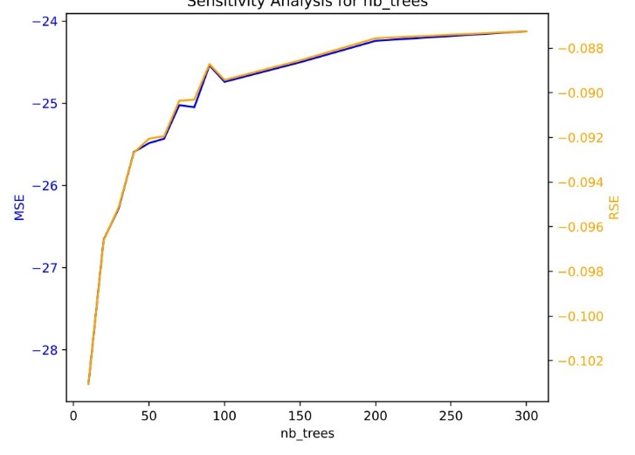
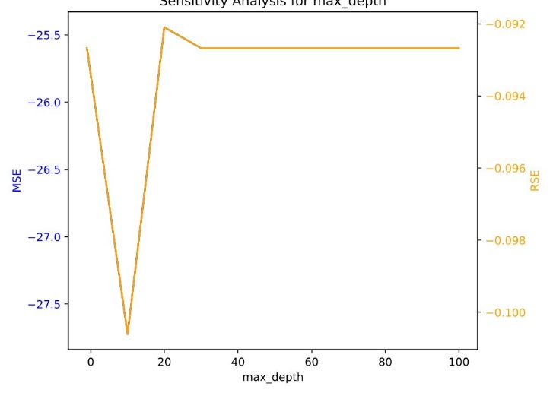
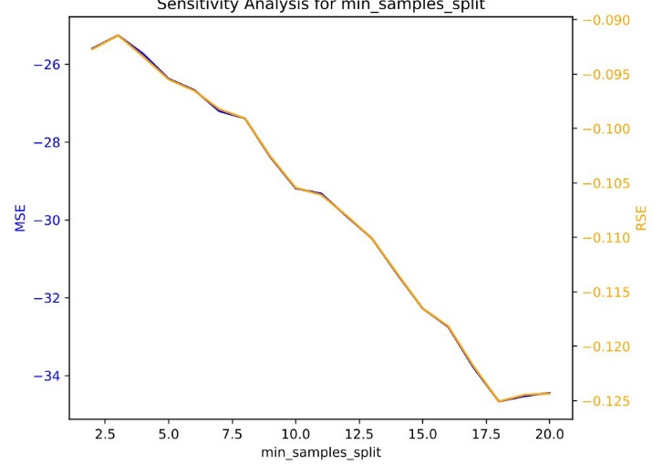
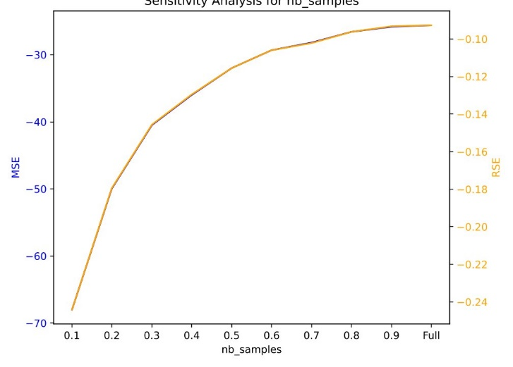
Sensitivity Plots Concrete Dataset Our Implementation

Slide 12
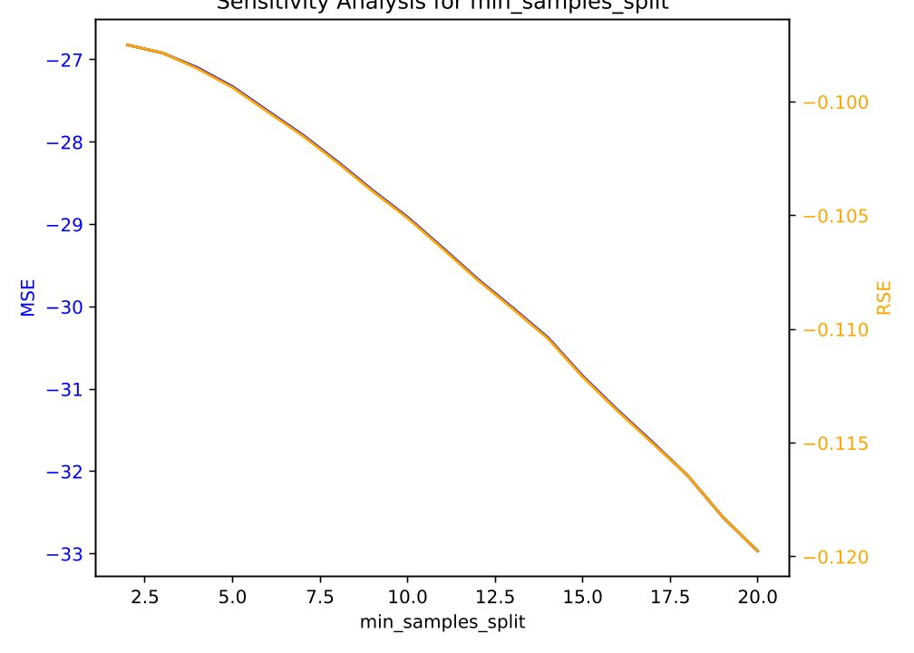
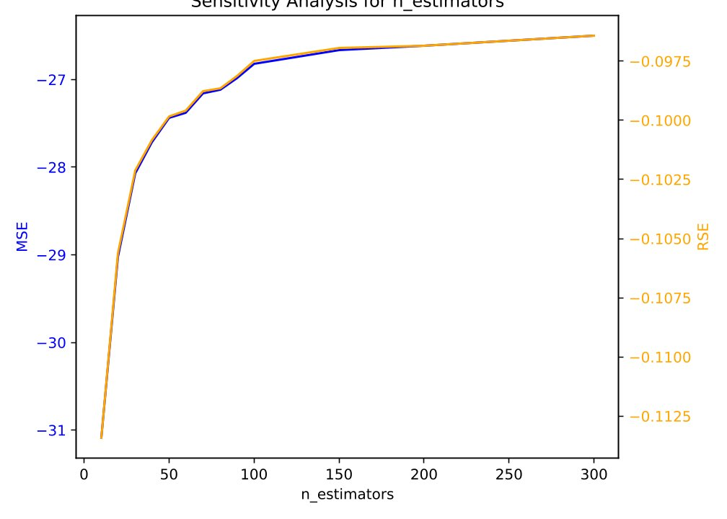
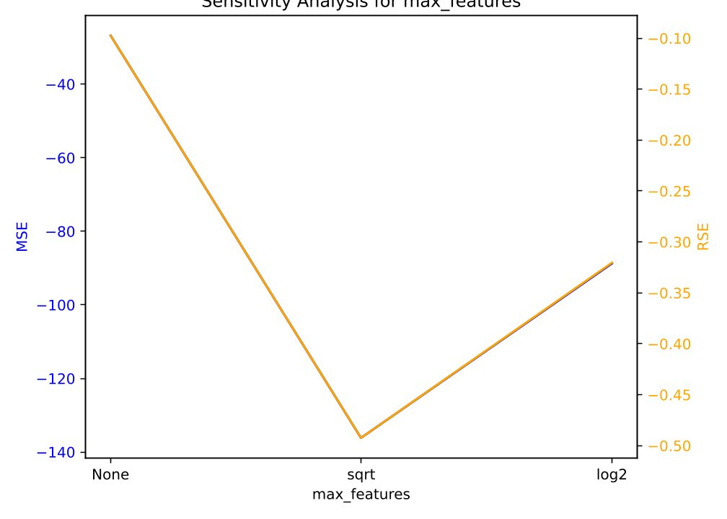
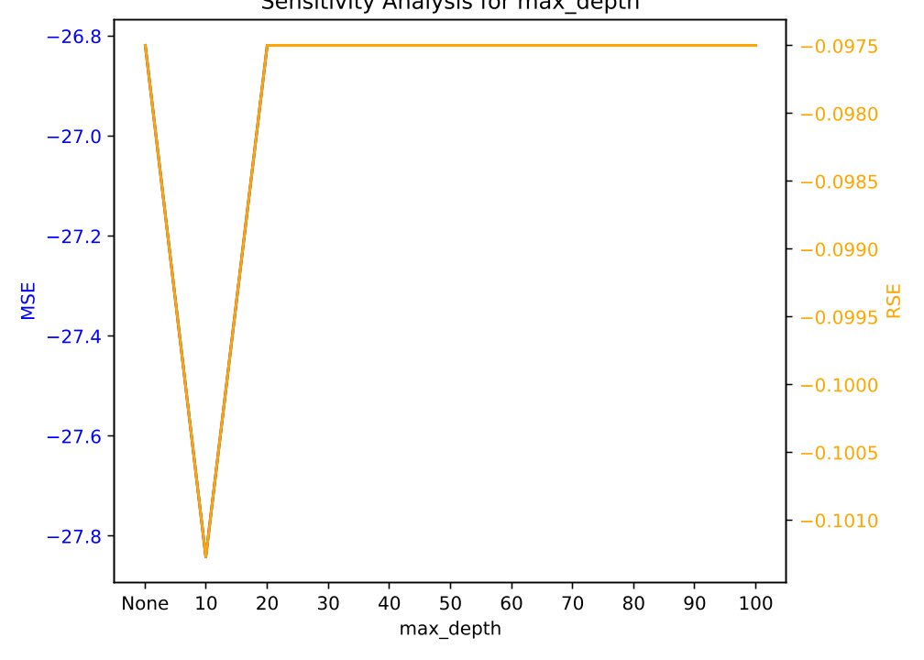
Sensitivity Plots Concrete Dataset LLM

Slide 13
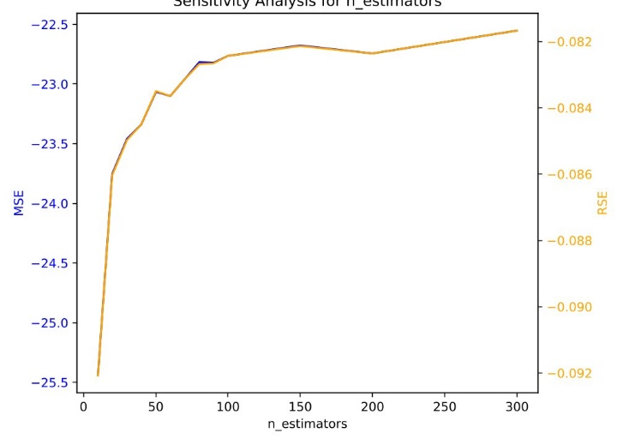
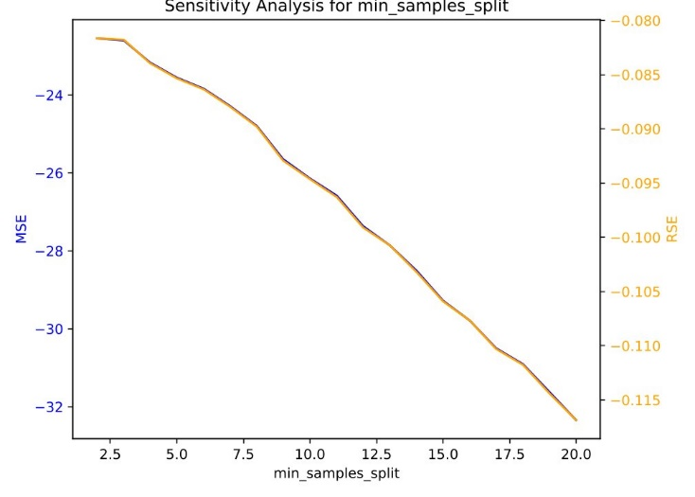
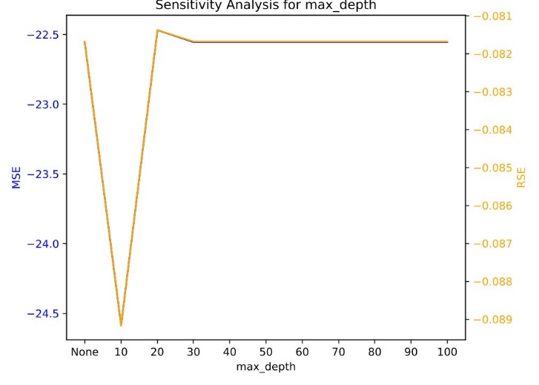
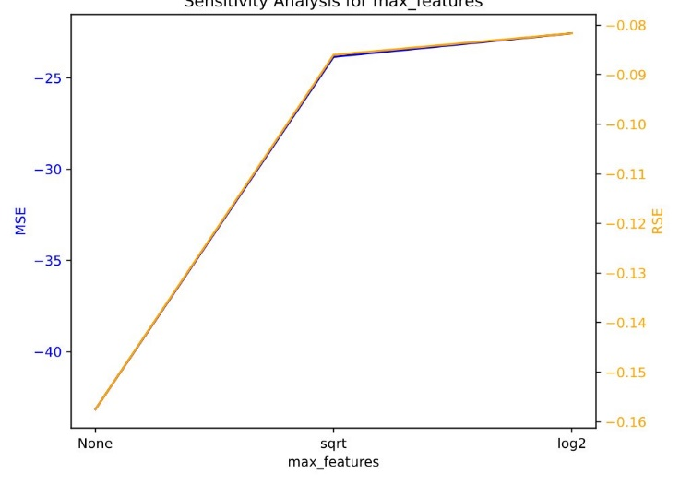
Sensitivity Plots Concrete Dataset scikit-rf

Slide 14
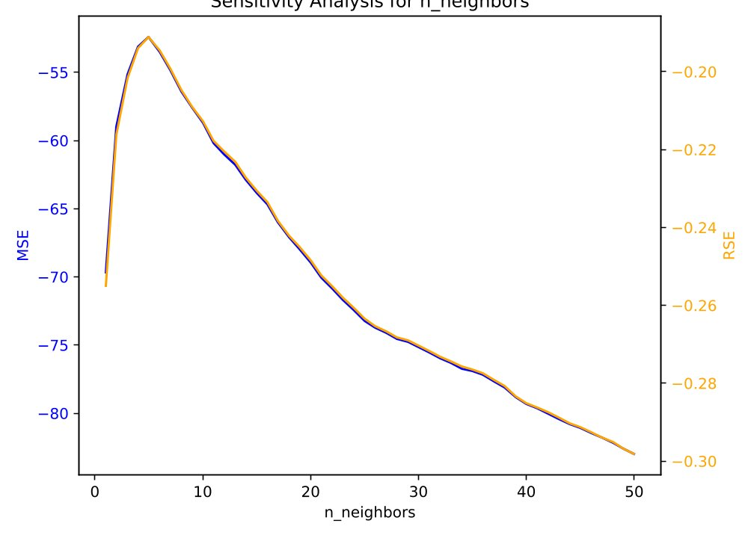
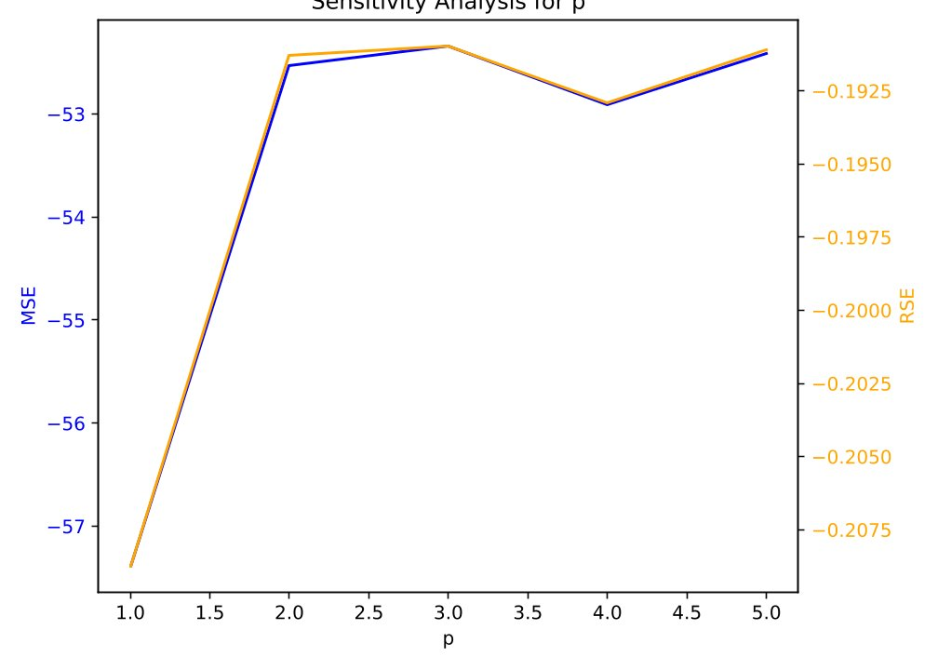
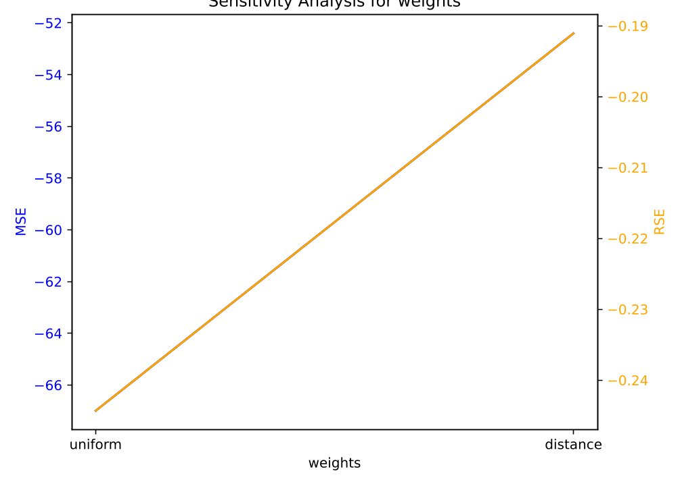
Sensitivity Plots Concrete Dataset kNN

Slide 15
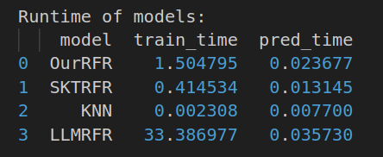
Runtime - Concrete Dataset

Slide 16
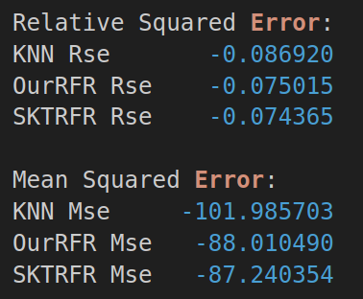
Cross Validation Results - Superconductivity Dataset

Slide 17
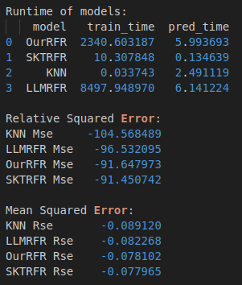
Cross Validation Results - Superconductivity
(few repetitions and folds)

Slide 18
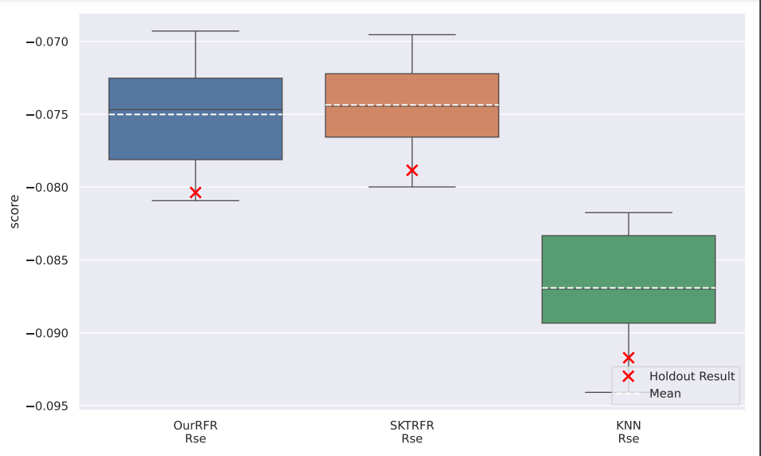
Relative Squared Error - Superconductivity Dataset

Slide 19
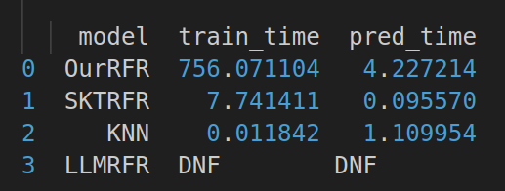
Runtime – Superconductivity Dataset

Slide 20
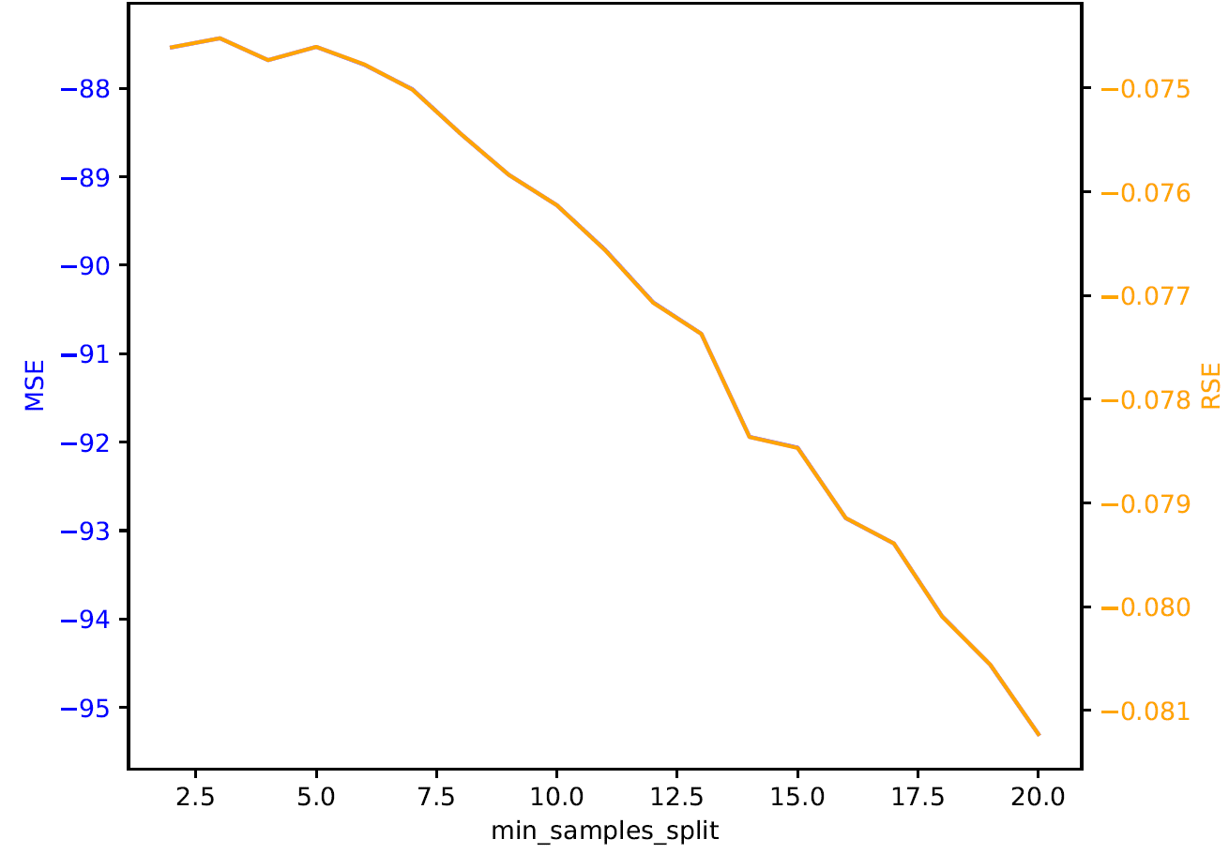
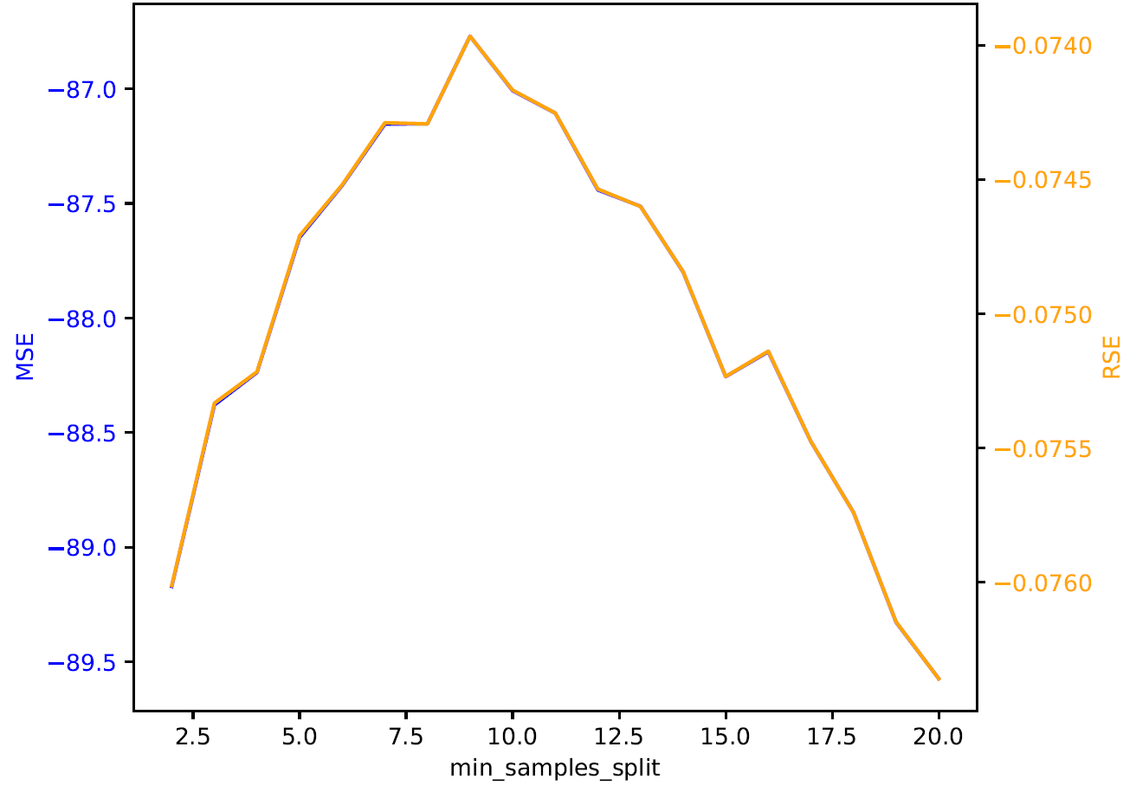
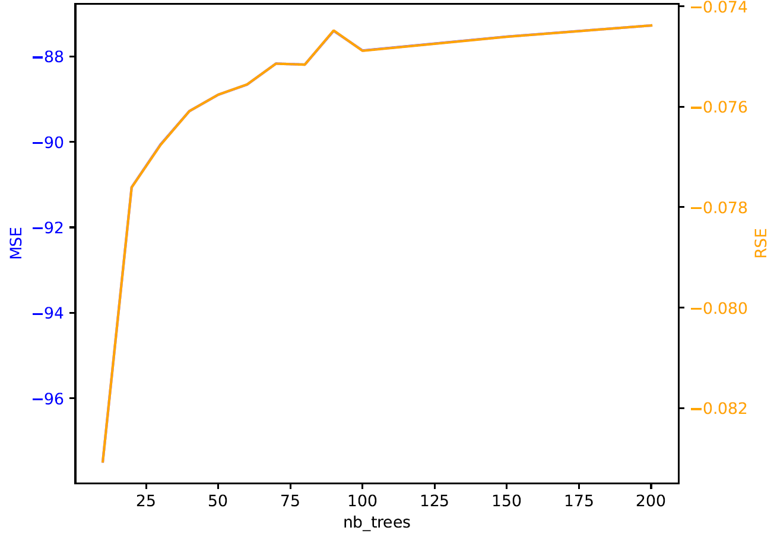
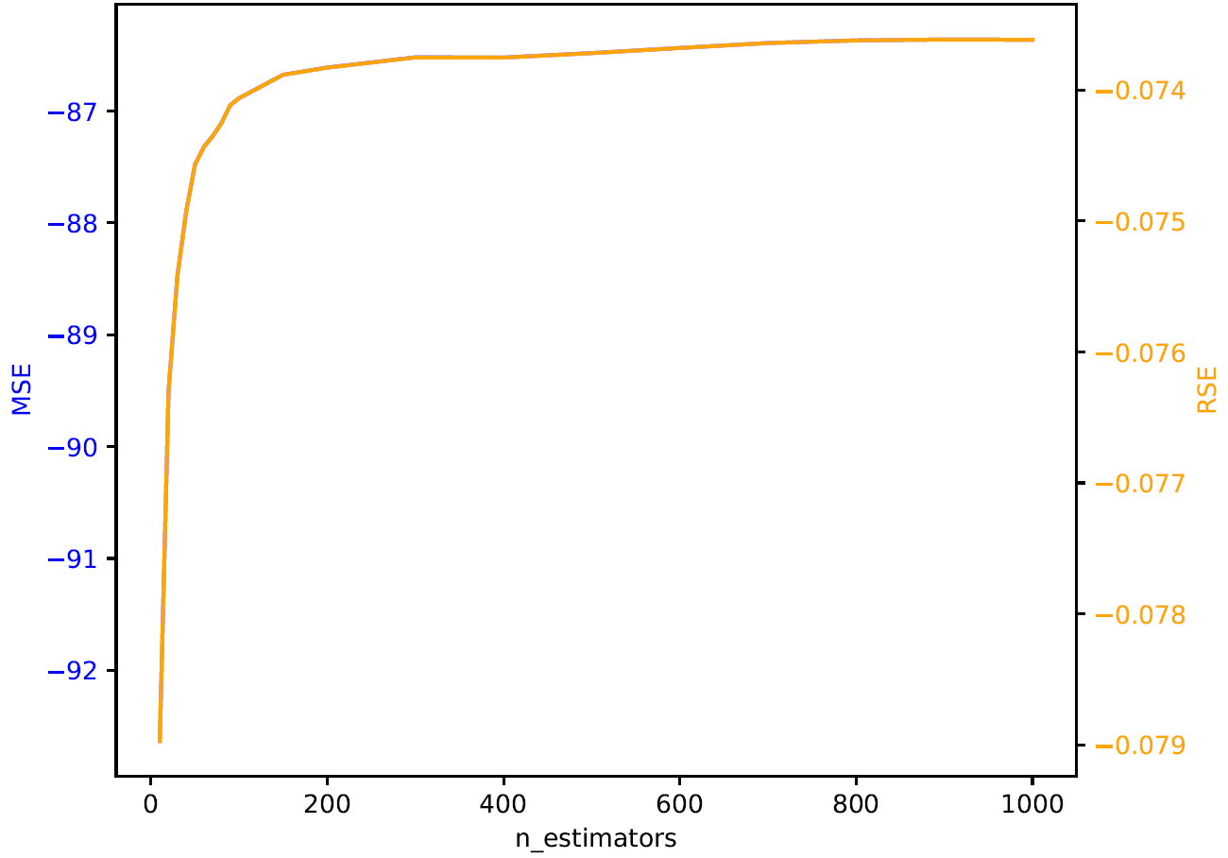
Sensitivity min_samples_split, nb_estimators/trees
Our Implementation:
scikit rf:

