Slide 1
Exercise 2 Random Forest
Lukas Sichert -12114770
Kristof Dadac - 12105475
Florian Engl -

Slide 2
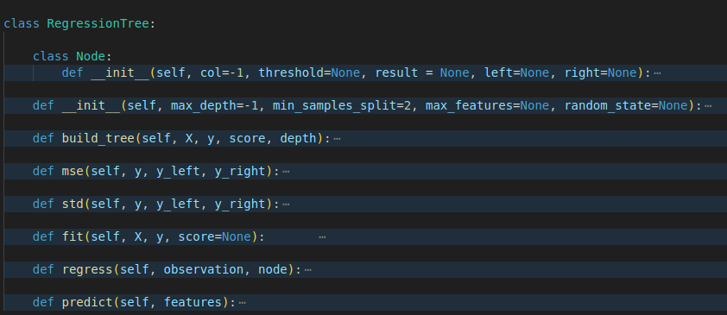
Regression Tree Code Overview

Slide 3
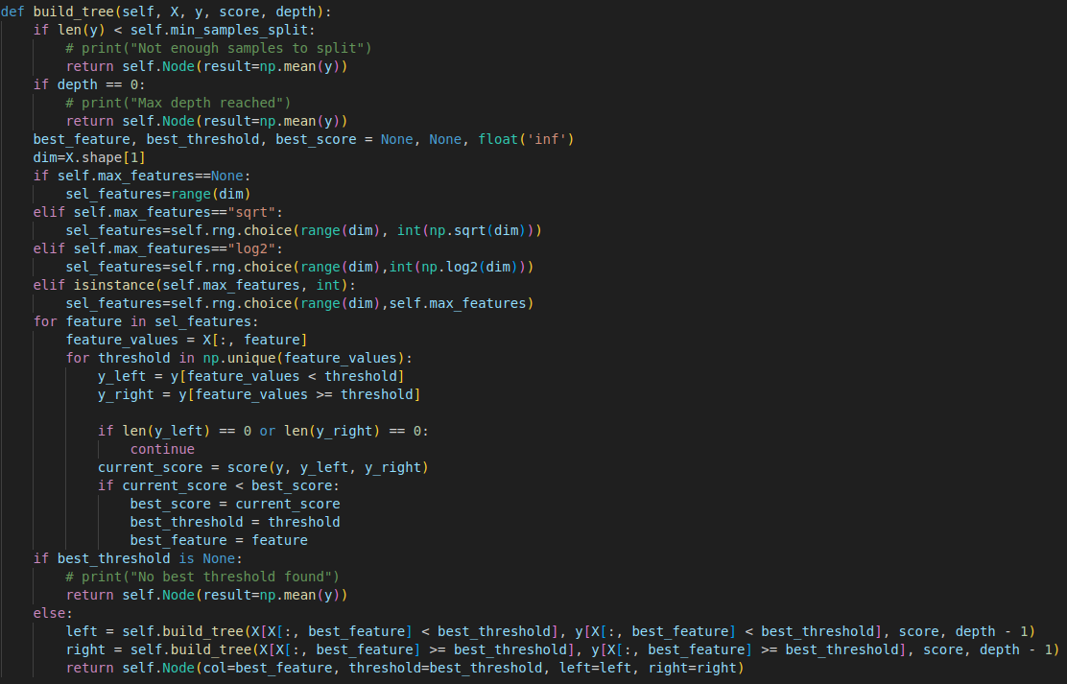
Regression Tree - build_tree function

Slide 4
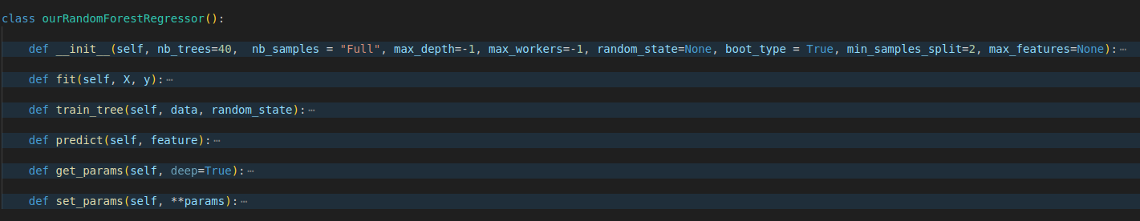
Random Forest Code Overview

Slide 5
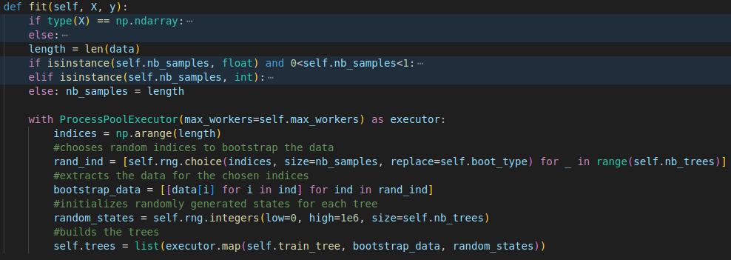
Random Forest - fit function

Slide 6
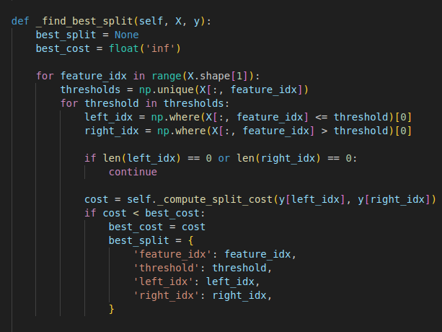
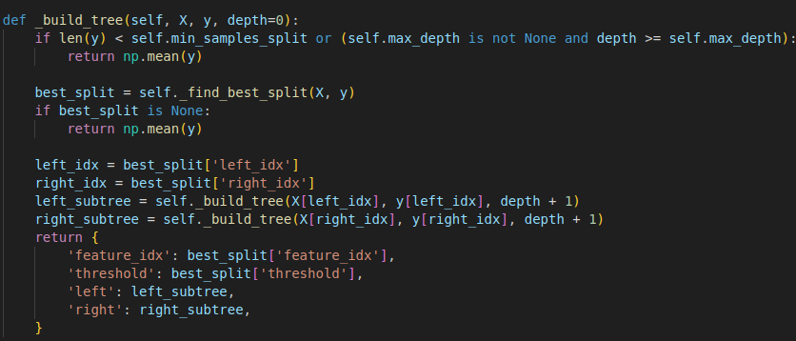
LLM Tree - _build_tree function

Slide 7
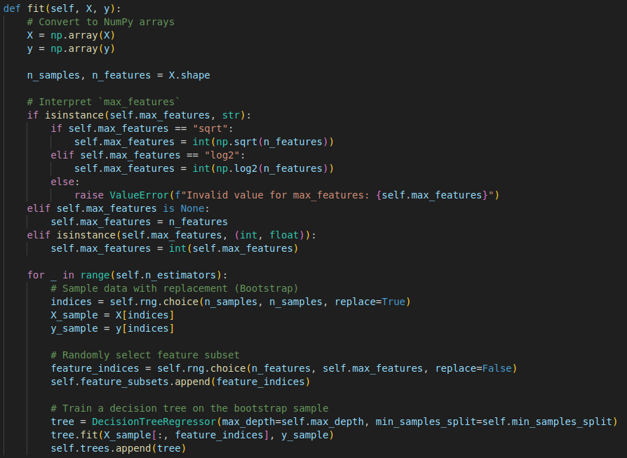
LLM - Random_Forest fit function

Slide 8
Key Differences - our Implementation vs. LLM
random feature selection:
at each node vs. once per tree
LLM not parallelized
integration of a boottype variable

Slide 9
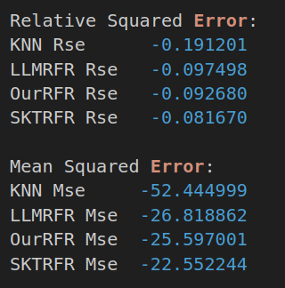
Cross Validation Results - Concrete Dataset

Slide 10
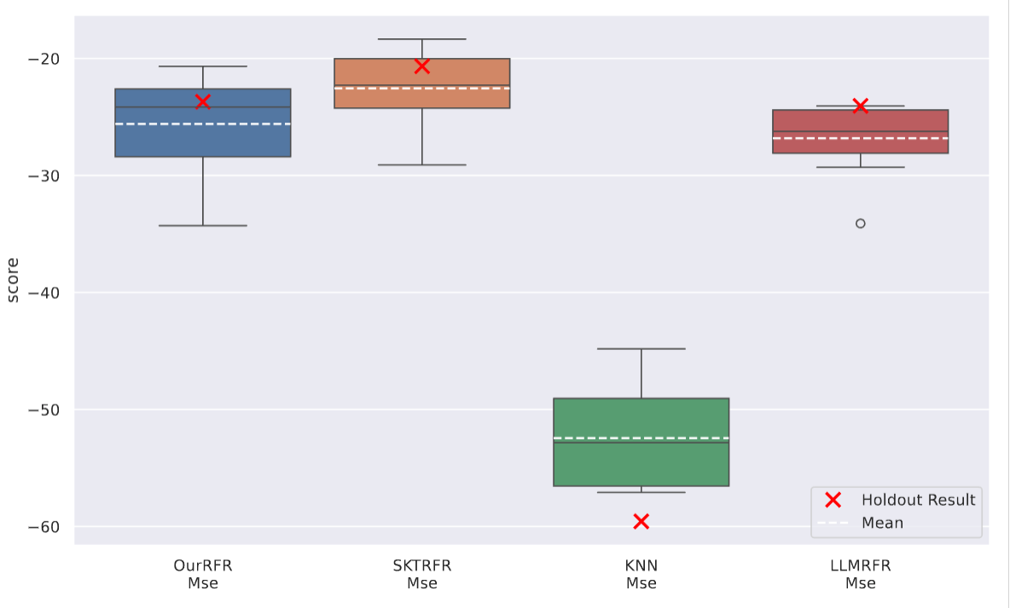
Mean Squared Error Comparison - Concrete Dataset

Slide 11
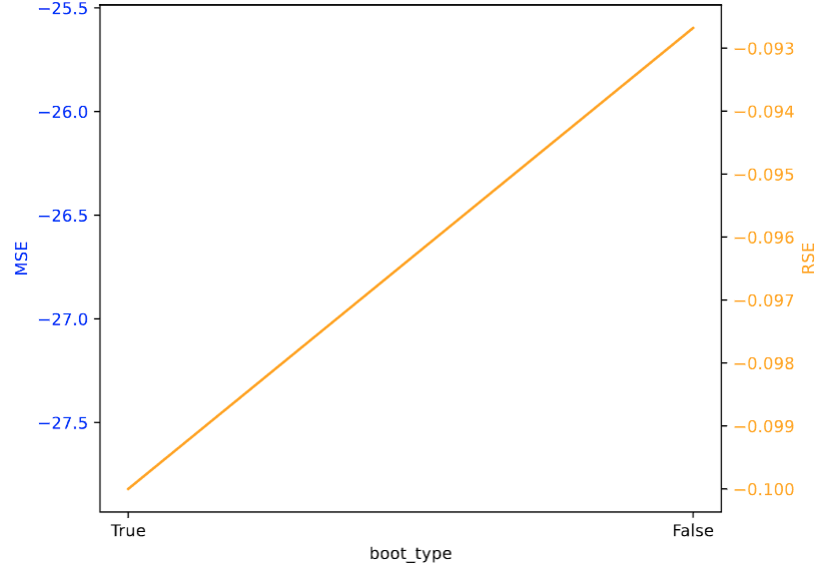
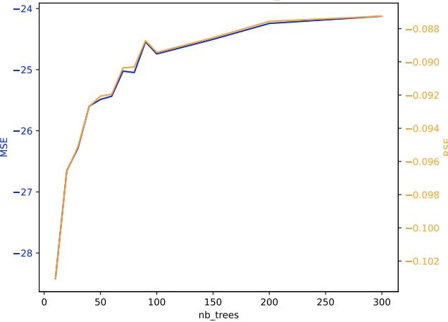
Sensitivity Plots - Concrete

Slide 12
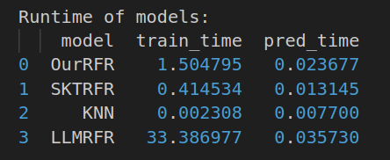
Runtime - Concrete Dataset

Slide 13
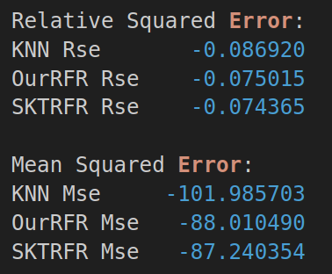
Cross Validation Restults - Supercoductivity Dataset

Slide 14
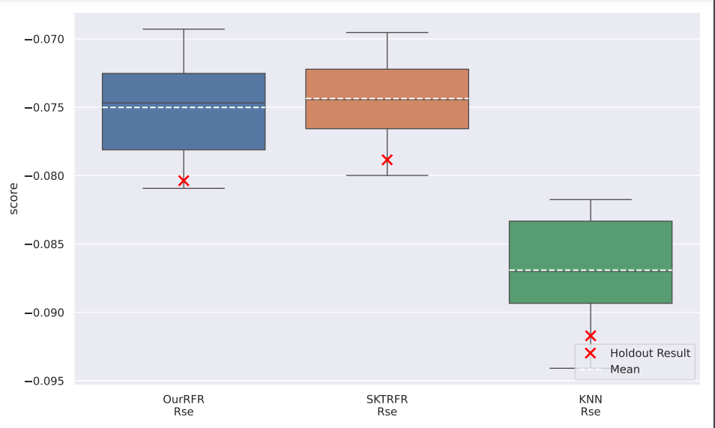
Relative Squared Error - Superconductivity Dataset

Slide 15
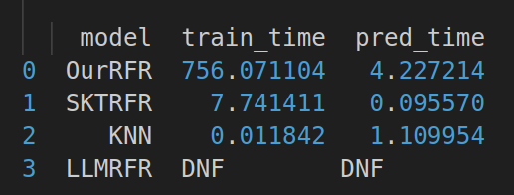
Runtime - Superconductivity

