Slide 1
Exercise 2 Random Forest
Lukas Sichert -12114770
Kristof Dadac -
Florian Engl -

Slide 2
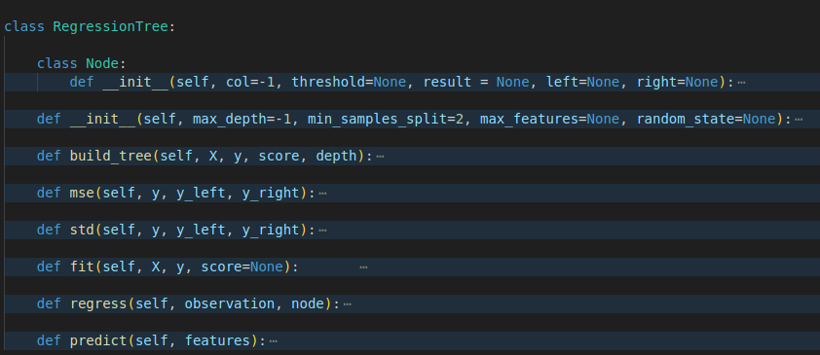
Regression Tree Code Overview

Slide 3
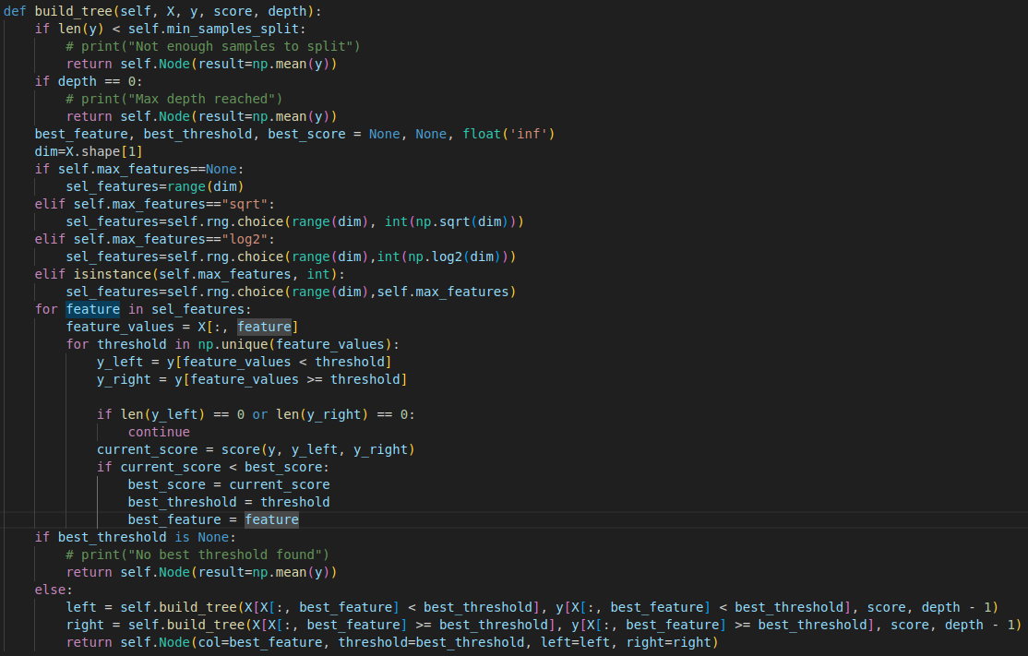
Regression Tree - build_tree function

Slide 4
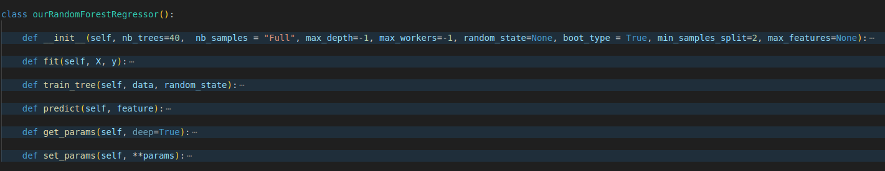
Random Forest Code Overview

Slide 5
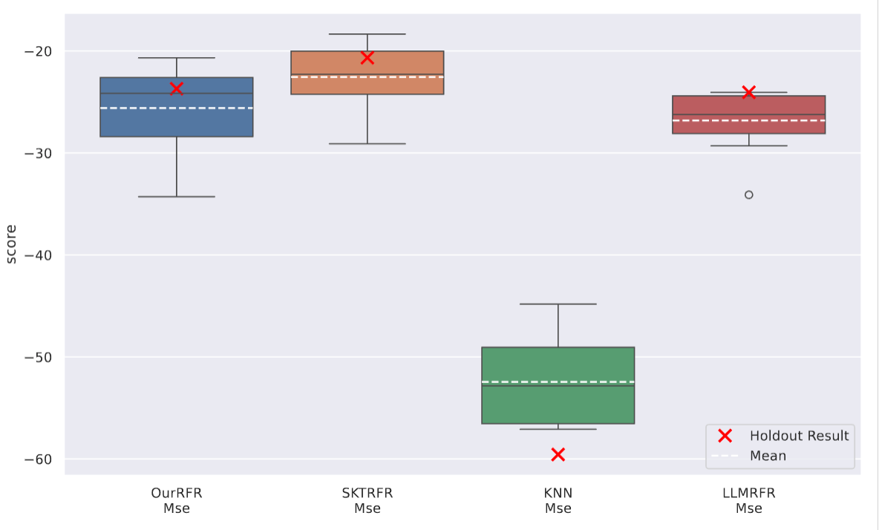
Mean Squared Error Comparison - Concrete Dataset

