Slide 1
Exercise 3 Simulated Annealing
Lukas Sichert -12114770
Kristof Dadic - 12105475
Florian Engl - 12102619

Slide 2
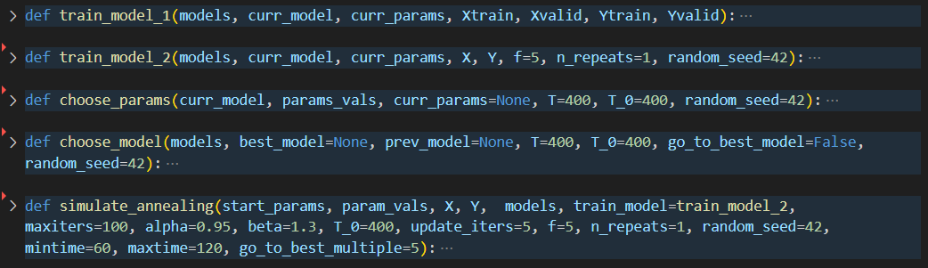
Functions Overview

Slide 3
Choosing next parameters
How to determine the neighbourhood of current parameters?
How do neighbourhoods change with temperature?
How to deal with nominal parameters?
What is the best searchspace?
How many parameters to change at once?

Slide 4
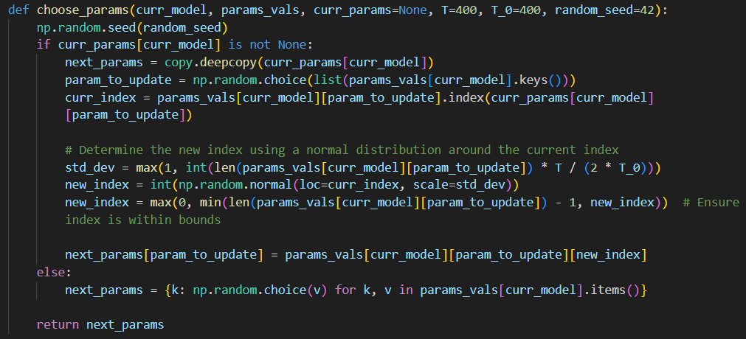
Choosing next parameters

Slide 5
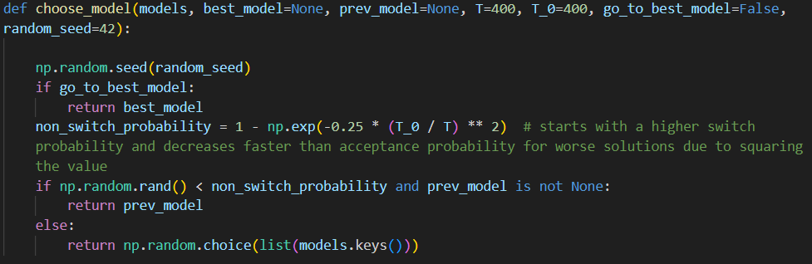
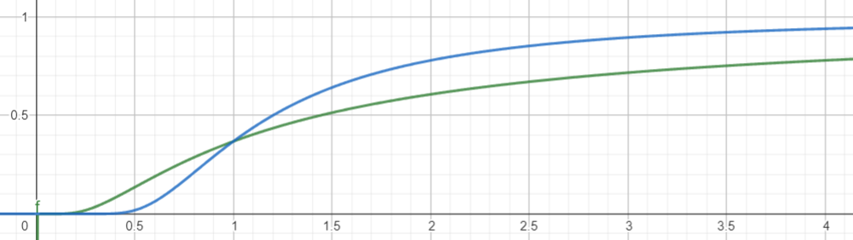
Choosing next model

Slide 6
Simulated Annealing function
How does the temperature decrease?
How do we handle reheating?
When do we stop?
Is the last model the solution? The best model?
Do we switch back to previously best models?

Slide 7
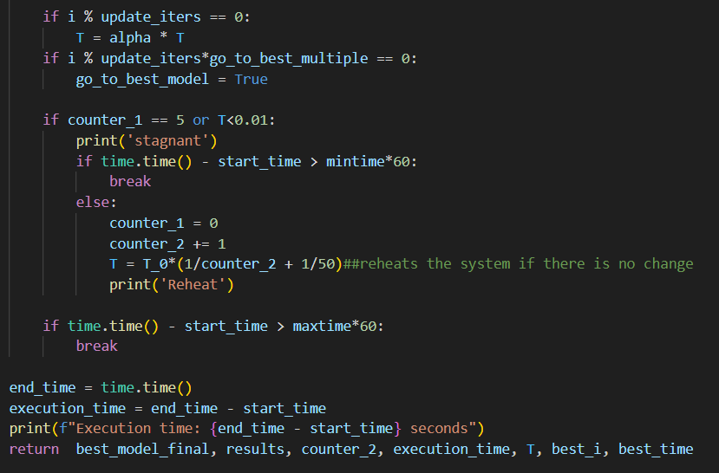
Simulated Annealing function

Slide 8
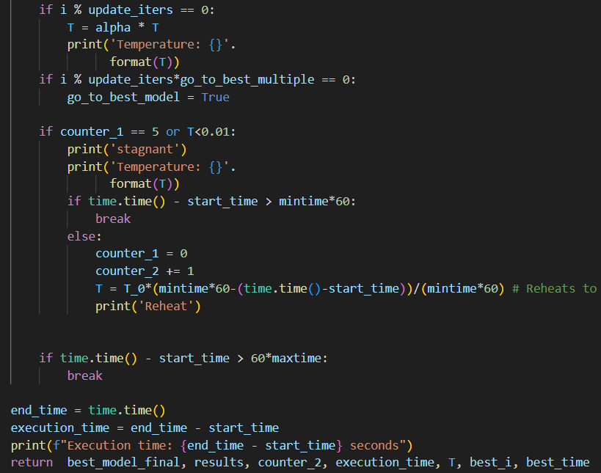
Simulated Annealing function

Slide 9
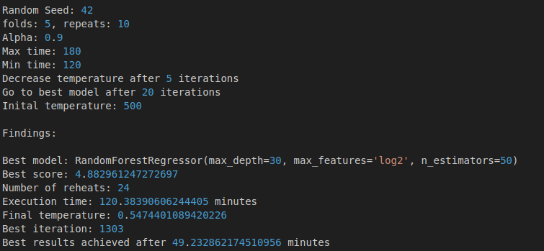
Concrete Dataset - search2

Slide 10
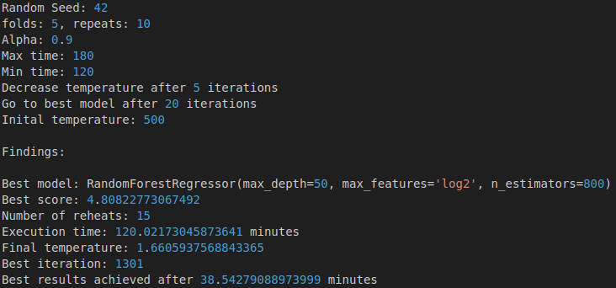
Concrete Dataset - search3

Slide 11
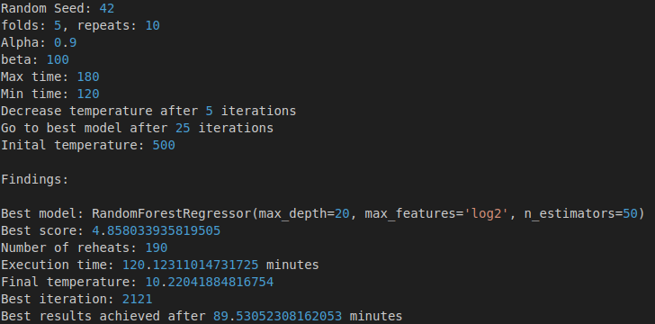
Concrete Dataset - search4

Slide 12
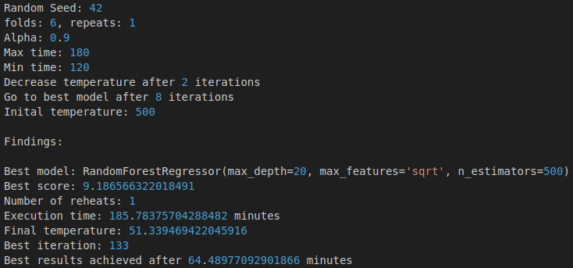
Superconductivity Dataset - search3

Slide 13
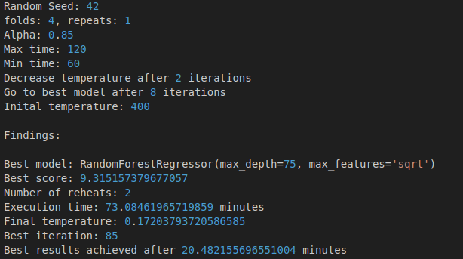
Superconductivity Dataset - search2 60 min, alpha = 0.85

Slide 14
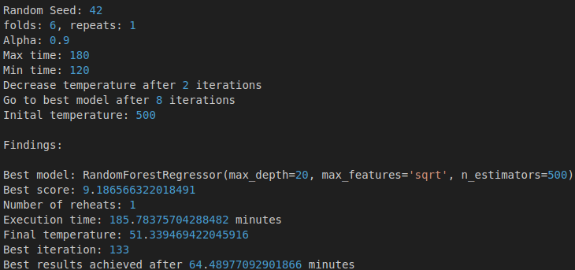
Superconductivity Dataset - search2 120 min, alpha = 0.9

Slide 15
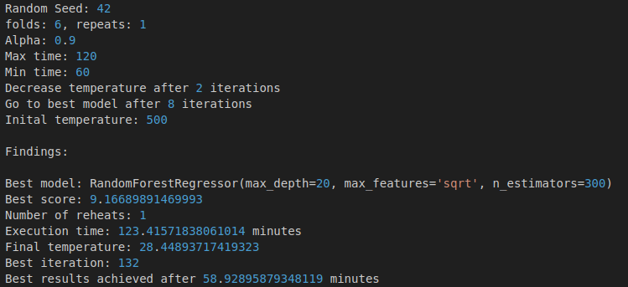
Superconductivity Dataset - search2 60 min, alpha = 0.9

Slide 16
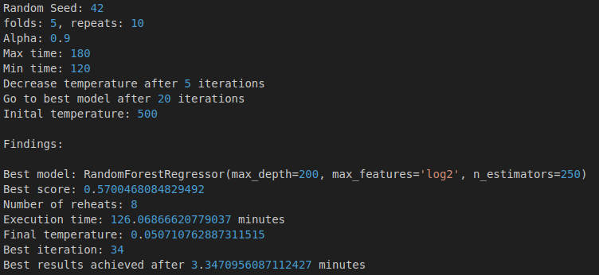
Wine Dataset - search 2

Slide 17
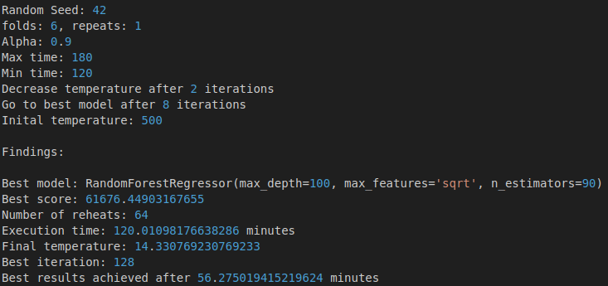
Waves - search2

Slide 18
Comparison with AutoML packages
FLAML:
estimates computation cost and only explores complex models if necessary
adjusts search patterns dynamically based on previous results
very customisable, although not all pre implemented options work with custom estimators
very efficient both computationally and in terms of runtime

Slide 19
Comparison with AutoML packages
TPOT:
optimizes machine learning pipelines using genetic programming
initial random population of pipelines
pipelines with better fitness (performance) are more likely chosen as parents for next generation
also easily customisable
slower than FLAML

Slide 20
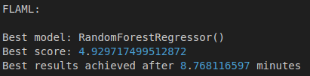

Concrete Dataset - other Models

Slide 21
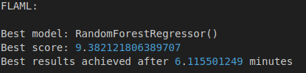
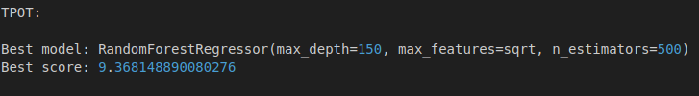
Superconductivity Dataset - other Models

Slide 22
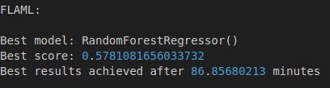

Wine - other Models

Slide 23
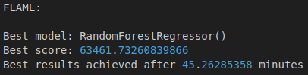

Waves - other Models

