Slide 1
Exercise 3 Simulated Annealing
Lukas Sichert -12114770
Kristof Dadic - 12105475
Florian Engl - 12102619

Slide 2
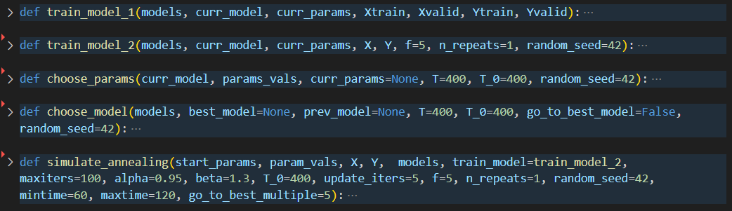
Functions Overview

Slide 3
Choosing next parameters
How to determine the neighbourhood of current parameters?
How do neighbourhoods change with temperature?
How to deal with nominal parameters?
What is the best searchspace?
How many parameters to change at once?

Slide 4
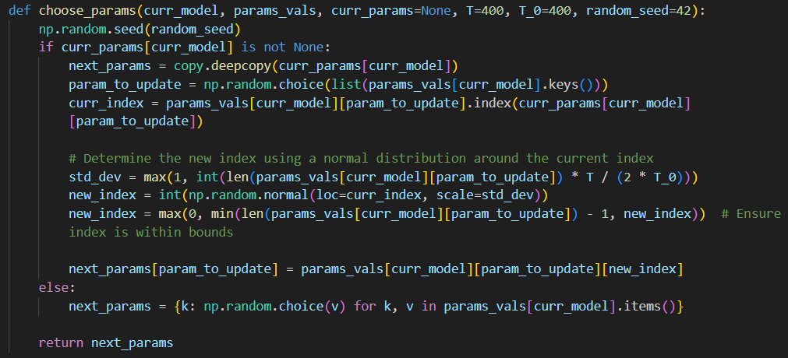
Choosing next parameters

Slide 5
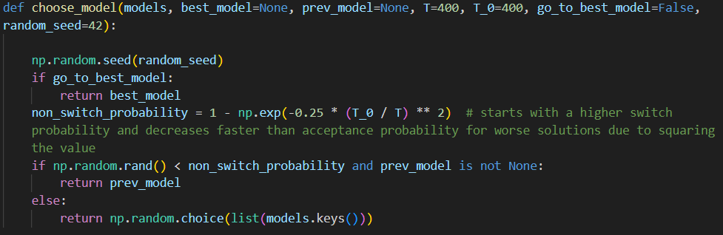
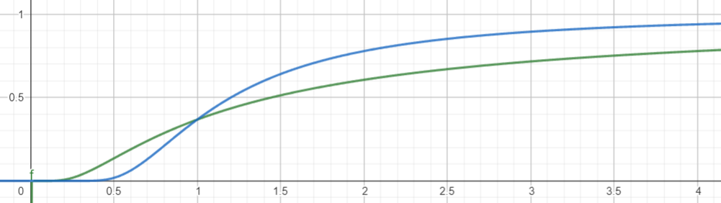
Choosing next model

Slide 6
Simulated Annealing function
How does the temperature decrease?
How do we handle reheating?
When do we stop?
Is the last model the solution? The best model?
Do we switch back to previously best models?

Slide 7
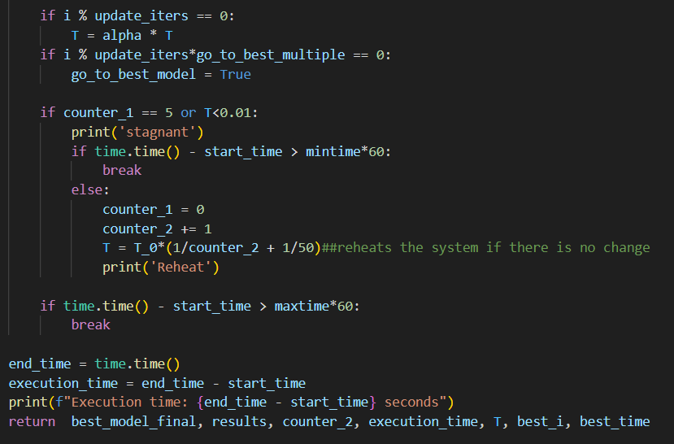
Simulated Annealing function

Slide 8
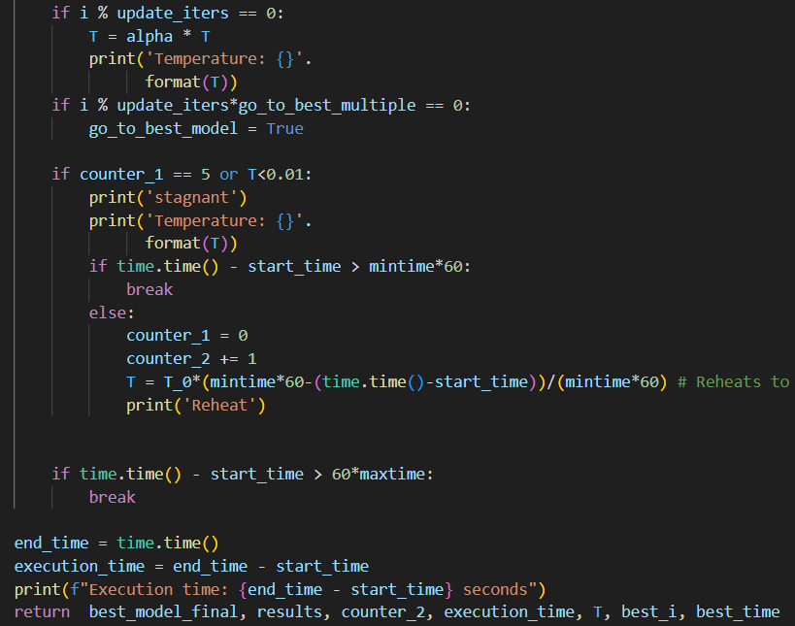
Simulated Annealing function

Slide 9
Key Differences
random feature selection:
we select a random feature subset at each tree node
LLM selects the random subset once for the whole tree
LLM did not parallelize, leading to worse performance
bootstrapping samples:
we always bootstrap and control replacement via boot_type = TRUE/FALSE
LLM does not bootstrap at all
scikit-learn bootstraps either with replacement or not at all, controlled via boot_type

Slide 10
Conclusion – Key Takeaways
Performance:
implementing the max_features functionality boosts both efficiency and effectiveness
especially choosing a random subset at every node
biggest difference between LLM and our/Scikit’s RF
randomising the subsets of instances for each tree improves performance
min_samples_split can have a big influence depending on the implementation
Efficiency:
parallelisation is necessary for application on bigger datasets
Scikit-Learn is very efficient; bigger difference in efficiency, not effectiveness
kNN is very fast, but lacks in effectiveness
even a single regression tree outperforms it
Interestingly the metric had a very big influence

