Slide 1
Data Center Landscape 2026: Where the Next $500B in Capex Lands
Industry report for the Q2 2026 strategy review
Iris Meng | New York AI Labs

Slide 2
Hyperscalers will spend $500B+ through 2027, concentrating capacity in five power-rich regions
• AI training drives ~60% of incremental capex; inference workloads scale 4x by 2027
• Power capacity is the binding constraint; new builds shift to TX, IA, ND, Quebec, and Riyadh
• Top 4 hyperscalers control 78% of cloud spend; colocation share drops below 25% by 2027
Page 2 / 15

Slide 3
Agenda
01 Market sizing and growth
How big, growing how fast, driven by what
02 Competitive landscape
Hyperscalers, colocation, and the new entrants
03 Where the capacity is going
Regional concentration and power constraints
Page 3 / 15

Slide 4
01
Market sizing and growth
Page 4 / 15

Slide 5
Global cloud infrastructure spend grows from $200B to $500B+ through 2027, a 17% CAGR
USD billions, annual capex
KEY TAKEAWAYS
• AI training drives the acceleration: spend rises from $70B (2024) to $260B (2027), surpassing non-AI cloud capex
• Inference workloads grow 4x by 2027 as enterprise adoption scales beyond pilots
• Hyperscale absorbs 85% of incremental spend; colocation share contracts to ~25% by 2027
• Liquid cooling moves from optional to mandatory; 70% of new hyperscale builds spec it by 2026
* Hyperscale defined as AWS, Azure, GCP, Meta, Oracle, and Alibaba combined.
Source: Synergy Research Group, 2024; JLL Data Center Outlook, 2024; IDC Worldwide AI Infrastructure Tracker, 2024
Page 5 / 15

Slide 6
02
Competitive landscape
Page 6 / 15

Slide 7



Top 4 hyperscalers control 78% of cloud spend; AWS leads but Azure and GCP gain share each year
Percentage share of global cloud infrastructure spend
KEY TAKEAWAYS
AWS: share compressed 33% → 32% over two years; absolute dollars still grow ~25% YoY
Azure: adds ~1pp annually; OpenAI exclusivity and enterprise integration are the wedges
Google Cloud: AI services drive incremental share against AWS general-purpose lead
Source: Synergy Research Group Cloud Infrastructure Quarterly, 2024
Page 7 / 15

Slide 8
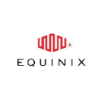

Colocation remains fragmented: top 5 hold just 35% combined, with Equinix and Digital Realty leading
Percentage share of global colocation revenue*
KEY TAKEAWAYS
Equinix: leads on retail interconnection and brand premium; trades at ~28x EBITDA
Digital Realty: leads on hyperscale wholesale; trades at ~22x EBITDA
◆
Tier-2 metros (Atlanta, Dallas, Phoenix) are the consolidation battleground for 2026
* Top 5 combined; remaining 65% split across 200+ regional and specialty providers.
Source: Structure Research Global Colocation Census, 2024
Page 8 / 15

Slide 9
Hyperscalers move toward self-build for AI; colocation pivots to enterprise hybrid and AI startups
Hyperscaler strategy
Colocation strategy
$
Self-build AI campuses to capture full margin and control power, cooling, and supply chain
●
Enterprise hybrid: 60% of revenue from financial services, healthcare, and government
→
Vertical integration: custom silicon (Trainium, TPU, Maia), networking, optical interconnect
★
AI startup foundry: powered shells with pre-installed liquid cooling for unicorn customers
⬡
Multi-region power deals: nuclear PPAs, gigawatt-scale wind and solar contracts
✓
Edge expansion: tier-2 metros where hyperscalers underbuild, locking in latency-sensitive customers
Source: JLL Data Center Outlook, 2024; company earnings filings
Page 9 / 15

Slide 10
03
Where the capacity is going
Page 10 / 15

Slide 11

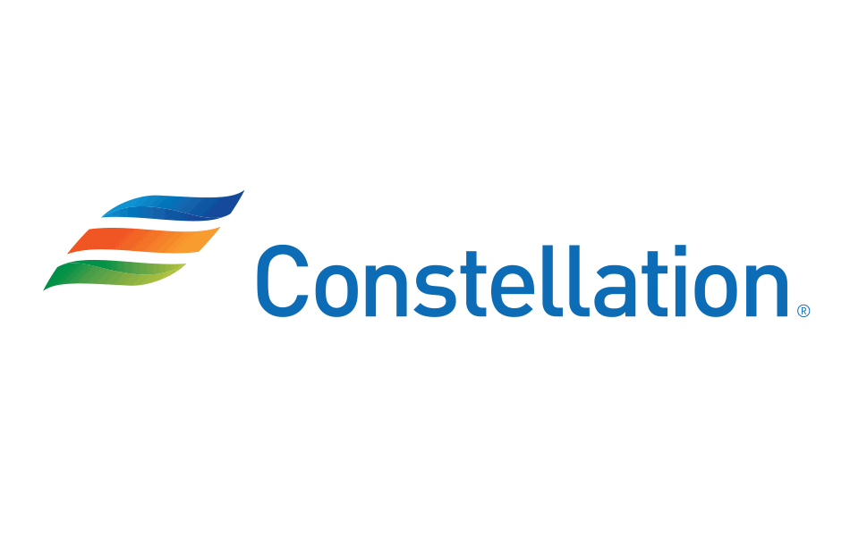




Five regions absorb 70% of new capacity; the US heartland sees the largest acceleration
Gigawatts of contracted IT load
KEY TAKEAWAYS
Dominion paused new high-density requests in 2024; North VA queue stretches 7+ years
Constellation-Microsoft deal sets the SMR/nuclear-restart template for 2027 unlock
Hydro-Quebec is the cleanest power option: 95% hydro grid attractive for AI training
ERCOT (Texas) leads on speed: 18-month interconnect for projects under 200MW
MidAmerican (Iowa) attracts hyperscalers via long-term clean-power PPAs
PIF (Saudi sovereign wealth fund) backs Riyadh: capital-rich, queue-light, gas-heavy
* Power, not land or fiber, is now the binding constraint; interconnect queues range from 4 to 7 years.
Source: JLL Data Center Outlook, 2024; ERCOT Capacity Outlook, 2024; Hydro-Quebec Industrial Customer Briefing, 2024
Page 11 / 15

Slide 12
Build NYAL data center exposure in Texas and Quebec; partner with colocation incumbents in tier-2 metros
Owner | Action | Outcome
Investment team | Issue term sheets for two TX powered-shell sites by 2026-09; target 50MW each | Texas footprint locked ahead of 2027 demand peak
Strategy team | Negotiate Hydro-Quebec PPA with anchor tenant (Anthropic or OpenAI) by 2026-12 | Clean-power positioning, 15-year cost certainty
Partnerships | Sign MSAs with Equinix and Digital Realty for tier-2 metro colocation by 2026-08 | Coverage in 12 metros without capex commitment
Capital markets | Raise $1.2B preferred equity for AI-campus development by 2026-11 | Capital committed, dilution minimized
Page 12 / 15

Slide 13
Appendix
Backup detail and supporting analysis
Page 13 / 15

Slide 14
Methodology: market sizing reconciles four data sources and a NYAL-built power-availability model
• Cloud infrastructure spend reconciled across Synergy Research, IDC, Dell'Oro, and Gartner; 2024 baseline within +/- 4%
• Colocation share derived from Structure Research census plus public 10-Ks for top 10 providers
• Regional capacity figures triangulated from JLL, Dgtl Infra, and ERCOT/Hydro-Quebec interconnect filings
• Power-availability model: 12-month rolling queue depth across 18 ISOs, mapped to hyperscaler RFP windows
Source: NYAL data center research methodology, 2026
Page 14 / 15

Slide 15

Detailed hyperscaler capex by year: AWS leads in absolute dollars, Microsoft accelerates fastest in 2025-2027
USD billions, annual data center and AI capex
KEY TAKEAWAYS
Microsoft surpasses AWS in 2025 incremental capex; OpenAI partnership drives the gap
Meta's 2024-2025 inflection reflects the pivot to in-house AI (Llama, AI Studio, Reels recommender)
Google's slower growth reflects GCP's smaller share, not strategic restraint
* Includes both data center construction and AI accelerator purchases; excludes traditional R&D.
Source: Company 10-Ks and quarterly capex disclosures, NYAL analysis, 2026
Page 15 / 15

