Slide 1
Analysis of Algorithms
Input
Algorithm
Output
An algorithm is a step-by-step procedure for
solving a problem in a finite amount of time.

Slide 2
Case Study
Sorting Algorithms
  Given N items, rearrange them in ascending order.
  Applications: statistics, databases, data compression, computational biology, computer graphics, scientific computing,…
Dog Breeds
Bulldog
Rottweiler
Akita
Terrier
Doberman
Chihuahua
Dog Breeds
Akita
Bulldog
Chihuahua
Doberman
Rottweiler
Terrier

Slide 3
There are many different algorithms to implement sorting:
  bubblesort, heapsort, mergesort, quicksort, radix sort, insertion sort and shellsort
  We will study some of them in detail in the course
How do we know which one is better?
What variables are we going to compare?

Slide 4
The algorithm has to be correct
We want our data structures and algorithms to run as fast as possible and to use as less resources as possible.
Variables to consider:
    Running-time
    Space (memory use)

Slide 5
Running-time
The running time of an algorithm typically grows with the input size.
What input should we consider?
The difficulty of the INPUT will depend on the algorithm
Best Case (Descending)
Average Case (Random)
Worst Case (Ascending)
Dog Breeds
Akita
Bulldog
Chihuahua
Doberman
Rottweiler
Terrier
Dog Breeds
Bulldog
Rottweiler
Akita
Terrier
Doberman
Chihuahua
Dog Breeds
Terrier
Rottweiler
Doberman
Chihuahua
Bulldog
Akita

Slide 6

Average case time is often difficult to determine.
We focus on the worst case running time.
  Easier to analyze
  Crucial to applications such as games, finance and robotics

Slide 7
Space
How much memory is the algorithm using?
If a program has a long running-time you can wait.
If a program is using too much memory the program could crash! (insufficient memory)
SPACE is also important

Slide 8
Only new memory counts
Space utilization occurs in two places:
  Every time you call a constructor (malloc, new).
  Hidden usage: function calls
    Depth of function calls is critical here.
Time and space tradeoff:
  Sometimes using more space can save time, and using more time can save space .

Slide 9
Analysis of Algorithms
Variables to consider:
    Running-time
    Space (memory use)
How do we calculate or estimate them?
  Experimental Studies
    Implement algorithm, run and compare!
  Theoretical Analysis
    Mathematical analysis of the algorithm

Slide 10
Experimental Studies
Write a program implementing the algorithm
Run the program with inputs of varying size and composition
Use a method to get an accurate measure of the actual running time
Plot the results
Case Study:
  Two algorithms: Insertion Sort and Quicksort

Slide 11
Insertion Sort
Dog Breeds
Bulldog
Rottweiler
Akita
Terrier
Doberman
Chihuahua
Dog Breeds
Bulldog
Akita
Rottweiler
Terrier
Doberman
Chihuahua
Dog Breeds
Akita
Bulldog
Rottweiler
Terrier
Doberman
Chihuahua
Dog Breeds
Akita
Bulldog
Rottweiler
Doberman
Terrier
Chihuahua
Dog Breeds
Akita
Bulldog
Doberman
Rottweiler
Terrier
Chihuahua
Dog Breeds
Akita
Bulldog
Doberman
Rottweiler
Chihuahua
Terrier
Dog Breeds
Akita
Bulldog
Doberman
Chihuahua
Rottweiler
Terrier
Dog Breeds
Akita
Bulldog
Chihuahua
Doberman
Rottweiler
Terrier

Slide 12
QuickSort
Dog Breeds
Bulldog
Rottweiler
Akita
Terrier
Doberman
Chihuahua
Dog Breeds
Bulldog
Akita
Chihuahua
Rottweiler
Terrier
Doberman
Smaller than Chihuahua
Apply quicksort
Final Position
Dog Breeds
Akita
Bulldog
Chihuahua
Doberman
Rottweiler
Terrier
Bigger than Chihuahua
Apply quicksort
Bulldog
Akita
Akita
Bulldog
Rottweiler
Terrier
Doberman
Doberman
Rottweiler
Terrier
Rottweiler
Terrier

Slide 13
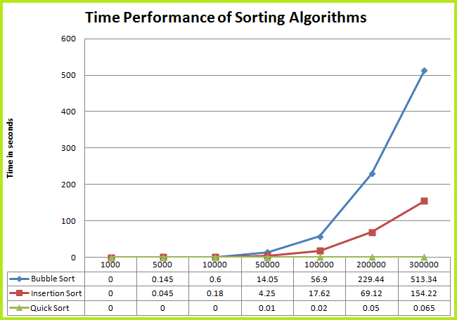
Figure: Comparison of Insertion Sort and Quicksort for Worst Input

Slide 14
Limitations of Experiments
Running time depends on:
  hardware.
  operating system, compiler, etc.
  It is often difficult to compare two algorithms
Experiments can only be done on a limited number of test cases.
    Results may not be indicative of the running time on other inputs not included in the experiment.
It is necessary to implement the algorithm, which may be difficult and time consuming

Slide 15
Can we do better?
We want a methodology for analyzing the running time of an algorithm that
  Considers all possible inputs.
  Allows us compare two algorithms in a way that is independent of the hardware and software environment.
  Can be performed by studying a high-level description of the algorithm without actually implementing it.

Slide 16
Mathematical Review
Before we continue to discuss how we can analyze an algorithm, we need to take a quick review of some:
  Functions
  Mathematical concepts
  Properties
We will use them in our analysis.

Slide 17
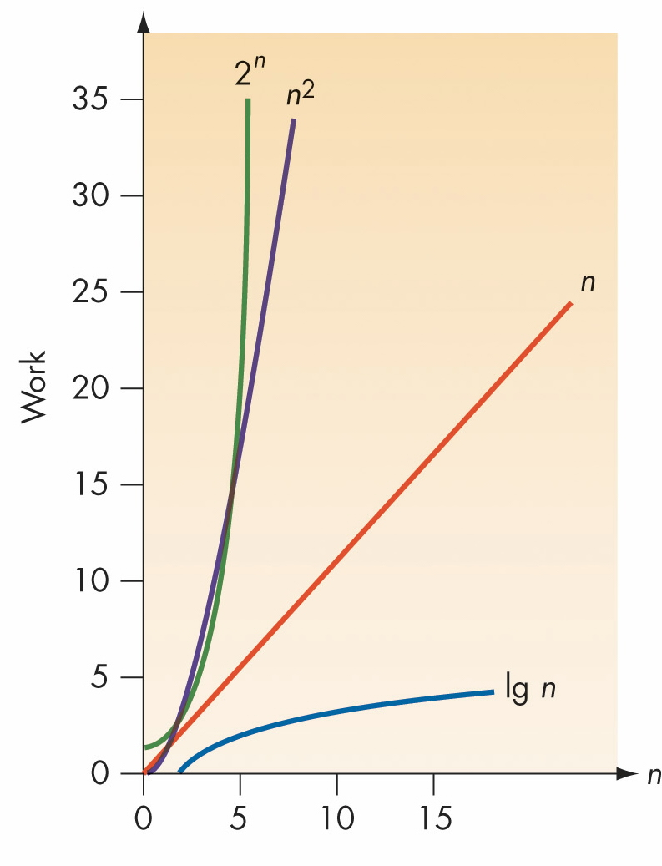
Seven Important Functions
Seven relevant functions:
  Constant ≈ 1
  Logarithmic ≈ log n
  Linear ≈ n
  N-Log-N ≈ n log n
  Quadratic ≈ n²
  Cubic ≈ n³
  Exponential ≈ 2^{n}
Bigger Growth rate

Slide 18
Growth Rates
n | lgn | n | n×lgn | n² | n³ | 2^{n} | n!
10 | 3.3 | 10 | 3.3×10 | 10² | 10³ | 10³ | 3.6×10⁶
10² | 6.6 | 10² | 6.6×10² | 10⁴ | 10⁶ | 1.3×10³⁰ | 9.3×10¹⁵⁷
10³ | 10 | 10³ | 10×10³ | 10⁶ | 10⁹
10⁴ | 13 | 10⁴ | 13×10⁴ | 10⁸ | 10¹²
10⁵ | 17 | 10⁵ | 17×10⁵ | 10¹⁰ | 10¹⁵
10⁶ | 20 | 10⁶ | 20×10⁶ | 10¹² | 10¹⁸

Slide 19
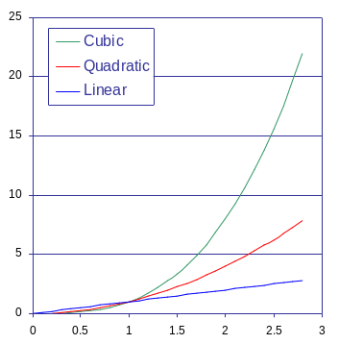
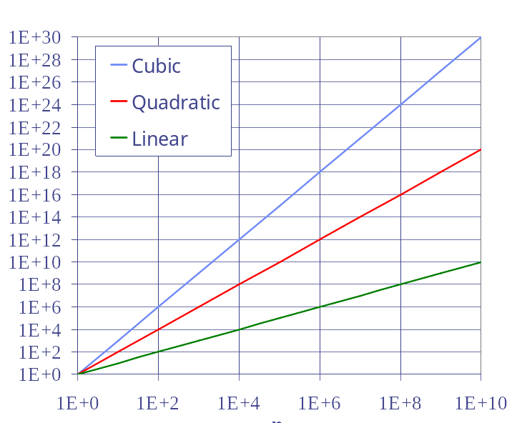
Log-Log Charts
T(n)
Normal Chart
T(n)
Log-Log Chart
n
n

Slide 20
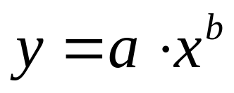
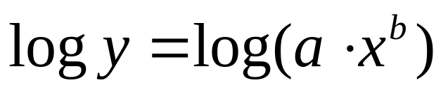
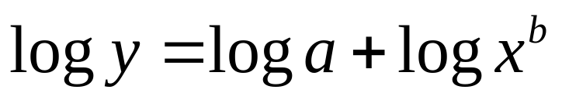
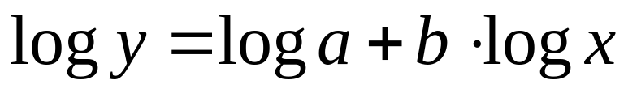
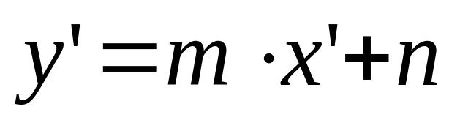

Which is the relationship between them?
In a log-log chart, the slope of the line corresponds to the growth rate of the function
Growth Rate = slope in log-log chart =b
This is a line equation!
Notes:
Show a graph with y=ax^{b} and the same graph in log-log. Explain that b is the slope in log-log and that for log(x)=1 we get log(a) (but in a log-log graph it will correspond exactly to “a”!!

Slide 21

Logarithms and Exponents
properties of logarithms:
  log_{b}a = c a = b^{c}
  log_{b}(xy) = log_{b}x + log_{b}y
  log_{b} (x/y) = log_{b}x - log_{b}y
  log_{b}xª = alog_{b}x
  log_{b}a = log_{x}a/log_{x}b
properties of exponentials:
  a^{(b+c)} = a^{b}a ^{c}
  a^{bc} = (a^{b})^{c}
  a^{b} /a^{c} = a^{(b-c)}
  b = a ^{log}_{a}^{b}
  b^{c} = a ^{c*log}_{a}^{b}

Slide 22
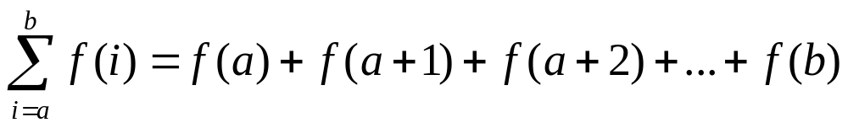
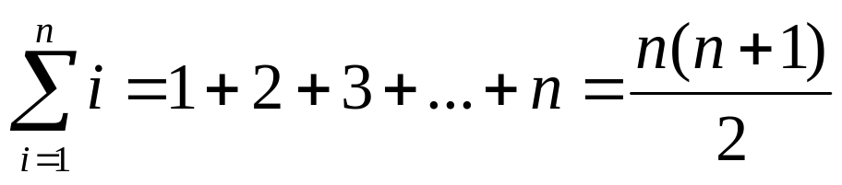
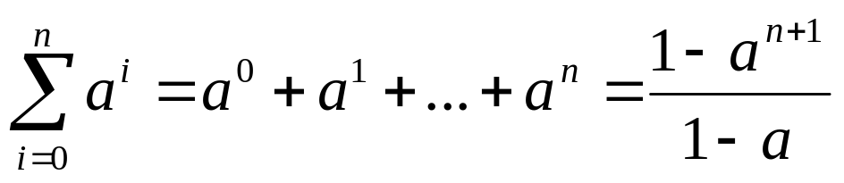
Summations
Definition
Arithmetic Series
Geometric Series, giving a>0

Slide 23
Algorithm Analysis
We want a methodology for analyzing the running time of an algorithm that
  Considers all possible inputs.
  Allows us compare two algorithms in a way that is independent of the hardware and software environment.
  Can be performed by studying a high-level description of the algorithm without actually implementing it.

Slide 24
Theoretical Analysis
Uses a high-level description of the algorithm instead of an implementation (Pseudo-code)
Characterizes running time as a function of the input size, n.
Takes into account all possible inputs
Allows us to evaluate the speed of an algorithm independent of the hardware/software environment

Slide 25
Pseudo-code
Example: find max element of an array
High-level description of an algorithm
More structured than English prose
Less detailed than a program
Preferred notation for describing algorithms
Hides program design issues
Algorithm arrayMax(A, n)
Input array A of n integers
Output maximum element of A
currentMax ← A[0]
for i ← 1 to n − 1 do
if A[i] > currentMax then
currentMax ← A[i]
return currentMax

Slide 26
Pseudocode Details
Indentation replaces braces
Method declaration
  Algorithm method (arg [, arg…])
  Input …
  Output …
Return value
  return expression
Expressions
  Assignment
  (like = in Java)
  Equality testing
  (like == in Java)
Method call
  var.method (arg [, arg…])
  var can be omitted if it is clear which object calls the method

Slide 27
Pseudocode Details
Control flow
  if condition then true-action [else false-action]
  while condition do actions
    while count <= 10 do
    M ← M*count
    Add 1 to count
  repeat actions until condition
    repeat
    Display count_value
    Add 1 to count_value;
    until count_value > 10
  for iteration-bounds do actions
    for count = 1 to 10 do
    Display count + count
    for each month of the year do
    Display month

Slide 28
Theoretical Models
We have a high-level language
How do we compute the running time?
There are many ways:
  Turing machines
  Random access machines (RAM)
  lambda calculus
  Recursive functions
  Parallel RAM (PRAM)
The most used is RAM

Slide 29
The Random Access Machine (RAM) Model
A CPU
A potentially unbounded bank of memory cells, each of which can hold an arbitrary number or character
2
1
0
Memory cells are numbered and accessing any cell in memory takes unit time.

Slide 30
Primitive Operations
Basic computations performed by an algorithm
They are identifiable in the pseudocode
Largely independent from the programming language
Exact definition not important (we will see why later)
Assumed to take a constant amount of time in the RAM model

Slide 31
Primitive Operations
Examples:
  Evaluating an expression
    N-1
  Assigning a value to a variable
    Max ← 1
  Indexing into an array
    A[2]
  Calling a method
    Max(L)
  Returning from a method
    return 3

Slide 32
Counting Primitive Operations
By inspecting the pseudocode, we can determine the maximum number of primitive operations executed by an algorithm, as a function of the input size
Algorithm arrayMax(A, n)
# operations
currentMax ← A[0] 2
for i ← 1 to n − 1 do 1+n
if A[i] > currentMax then 2(n − 1)
currentMax ← A[i] 2(n − 1)
{ increment counter i } 2(n − 1)
return currentMax 1
Total 7n − 2
Worse input assumption is used here

Slide 33
Estimating Running Time
Algorithm arrayMax executes 7n − 2 primitive operations in the worst case.
Define:
  a = Time taken by the fastest primitive operation
  b = Time taken by the slowest primitive operation
Let T(n) be worst-case time of arrayMax. Then
a (7n − 2) ≤ T(n) ≤ b(7n − 2)
Hence, the running time T(n) is bounded by two linear functions

Slide 34
Estimating Running Time
Even though we cannot determine the exact time function, we know that it has an upper bound given by:
T(n) ≤ b(7n − 2)
What is the growth rate of b(7n − 2)?
  It is linear
  Are constants b, 7 and 2 relevant?

Slide 35
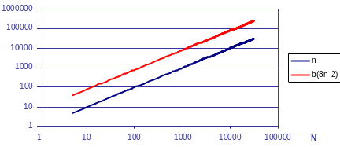
Growth Rate of Running Time
For arrayMax: T(n) ≤ b(7n − 2)
Do the 7 and 2 affect the growth rate?
  This is, does it have the same growth rate as n?
log-log chart
The log-log chart shows that growth rate is not affected! (it is 1 in both cases)

Slide 36
Estimating Running Time
Method arrayMax:
T(n) ≤ b(7n − 2)
Since b(7n − 2) has linear growth rate
⇒ T(n) has linear growth rate too!

Slide 37
Growth Rate and Constant Factors
What if we have
T(n) = n² + 10⁸n + 3001
  Is the constant factor 3001 relevant?
  Is the lower order term 10⁸n relevant?
They are not!
  n² + 10⁸n + 3001 is a quadratic function
The growth rate is not affected by
  constant factors or
  lower-order terms

Slide 38
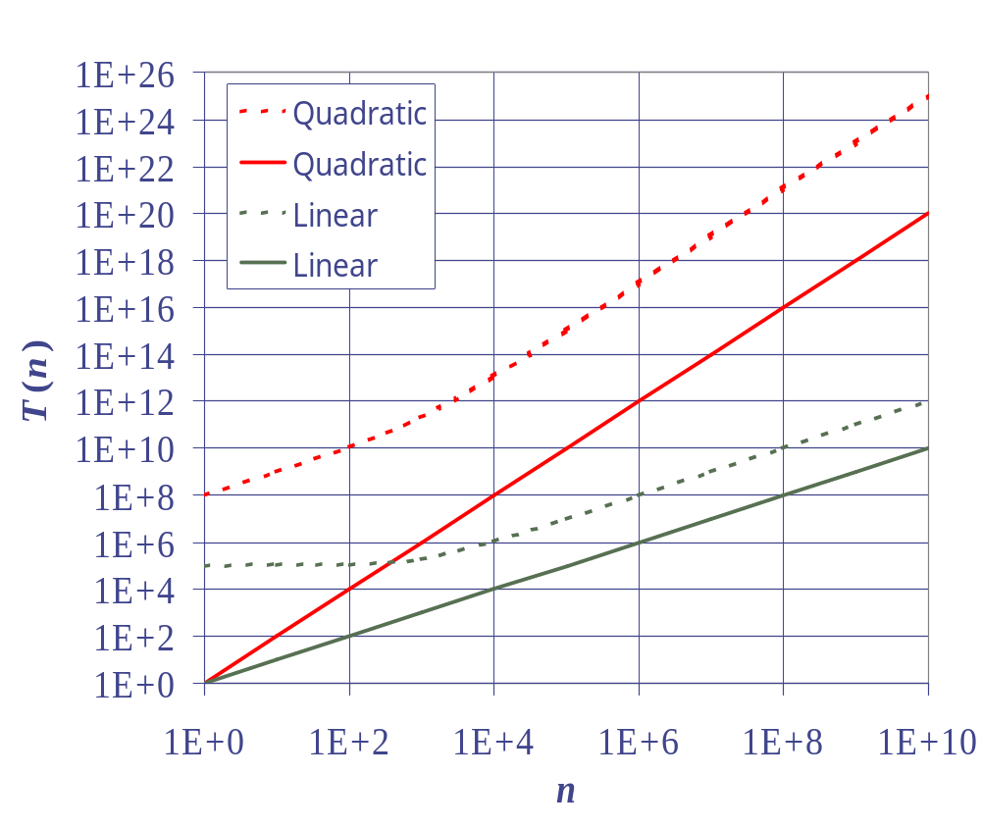
Growth Rate and Constant Factors
log-log chart
10⁵n² + 10⁸n
n²
10²n + 10⁵
n

Slide 39
Log-Log Charts
Normal Chart
Log-Log Chart

Slide 40
Growth Rate of Running Time
Changing the hardware/ software environment
  Affects T(n) by a constant factor, but
  Does not alter the growth rate of T(n)
The linear growth rate of the running time T(n) is an intrinsic property of algorithm arrayMax

Slide 41
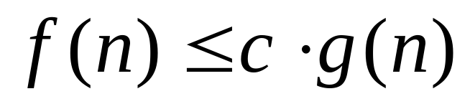
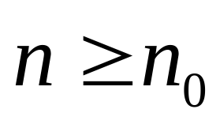
Big-Oh Notation
Given functions f(n) and g(n), we say that f(n) is O(g(n)) if there are positive constants
c and n₀ such that:
for
Notes:
Draw graph to show

Slide 42
Big-Oh Example
Example: 2n + 10 is O(n)
  2n + 10 ≤ cn
  (c − 2) n ≥ 10
  n ≥ 10/(c − 2)
  Pick:
    c = 3
    n₀ = 10
  Or:
    c = 12
    n₀ = 1
Notes:
Solve this in the blackboard!!!!

Slide 43
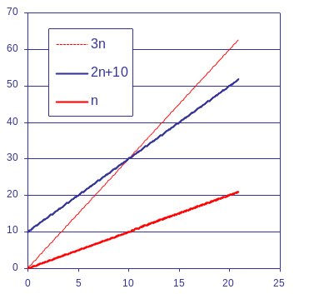
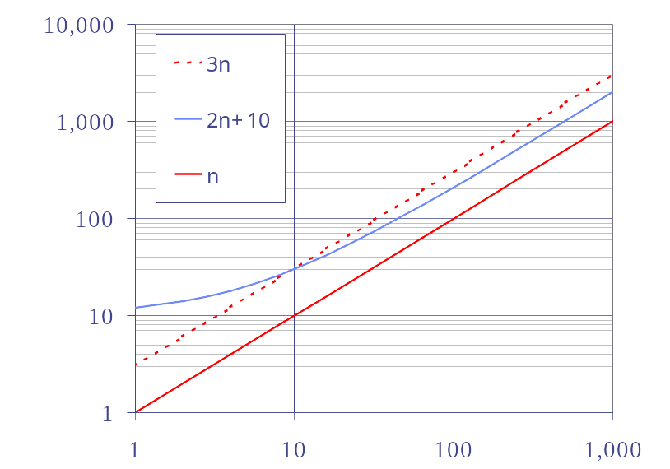
Big-Oh Example
Example: 2n + 10 is O(n)
log-log chart

Slide 44
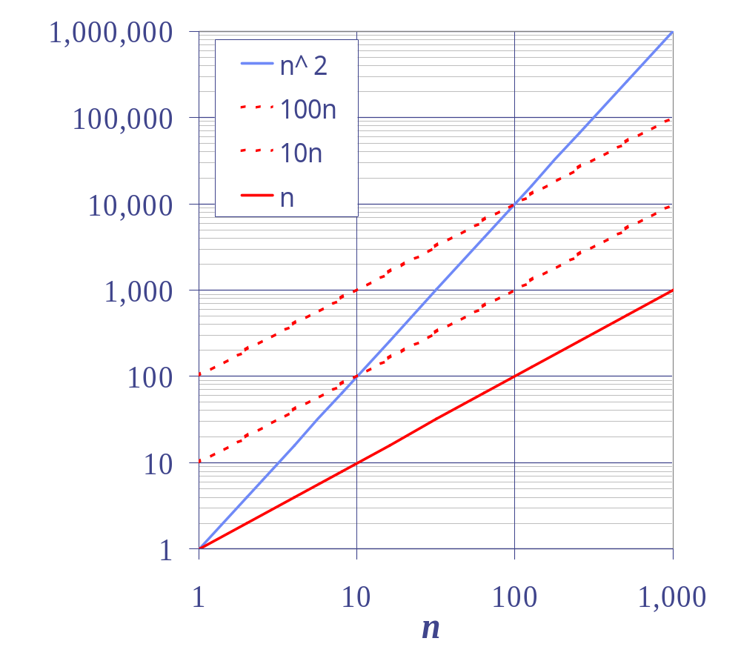
Big-Oh Example
Example: the function n² is not O(n)
  n² ≤ cn
  n ≤ c
  The above inequality cannot be satisfied since c must be a constant

Slide 45

More Big-Oh Examples
7n-2
  7n-2 is O(n)
  need c > 0 and n₀ ≥ 1 such that 7n-2 ≤ c·n for n ≥ n₀
  this is true for c = 7 and n₀ = 1
3n³ + 20n² + 5
  3n³ + 20n² + 5 is O(n³)
  need c > 0 and n₀ ≥ 1 such that 3n³ + 20n² + 5 ≤ c·n³ for n ≥ n₀
  this is true for c = 4 and n₀ = 21
3 log n + 5
  3 log n + 5 is O(log n)
  need c > 0 and n₀ ≥ 1 such that 3 log n + 5 ≤ c·log n for n ≥ n₀
  this is true for c = 8 and n₀ = 2
Notes:
Do them on the blackboard

Slide 46
Big-Oh and Growth Rate
The big-Oh notation gives an upper bound on the growth rate of a function
The statement “f(n) is O(g(n))” means that the growth rate of f(n) is no more than the growth rate of g(n)
We can use the big-Oh notation to rank functions according to their growth rate
 | f(n) is O(g(n)) | g(n) is O(f(n))
g(n) grows more | Yes | No
f(n) grows more | No | Yes
Same growth | Yes | Yes

Slide 47
Tight Big-Oh Rules
If f(n) is a polynomial of degree d, then f(n) is O(n^{d}), i.e.,
  Drop lower-order terms
  Drop constant factors
  Say “2n²+3n+3 is O(n²)” instead of “2n²+3n+3 is O(2n²+3n)”
Use the smallest possible class of functions
  Say “2n is O(n)” instead of “2n is O(n²)”
  Note that “2n is O(n²)” but the analysis is not tight.
Use the simplest expression of the class
  Say “3n + 5 is O(n)” instead of “3n + 5 is O(3n)”
  Note that “3n + 5 is O(3n)” but the analysis is not tight.

Slide 48
Asymptotic Algorithm Analysis
The asymptotic analysis of an algorithm determines the running time in big-Oh notation
To perform the asymptotic analysis
  We find the worst-case number of primitive operations executed as a function of the input size
  We express this function with big-Oh notation
Example:
  We determine that algorithm arrayMax executes at most 7n − 2 primitive operations
  We say that algorithm arrayMax “runs in O(n) time”
Since constant factors and lower-order terms are eventually dropped anyhow, we can disregard them when counting primitive operations

Slide 49
Asymptotic Algorithm Analysis
By inspecting the pseudocode, we can determine the maximum number of primitive operations executed by an algorithm, as a function of the input size
primitive asymptotic
Algorithm arrayMax(A, n) analysis
# operations
currentMax ← A[0] 2 1
for i ← 1 to n − 1 do n + 1 n
if A[i] > currentMax then 2(n − 1) n
currentMax ← A[i] 2(n − 1) n
{ increment counter i } 2(n − 1) n
return currentMax 1 1
Total 7n − 2 O(n)

Slide 50

Example
We further illustrate asymptotic analysis with two algorithms for prefix averages
The i-th prefix average of an array X is average of the first (i + 1) elements of X:
A[i] = (X[0] + X[1] + … + X[i])/(i+1)
Computing the array A of prefix averages of another array X has applications to financial analysis
i
Notes:
Show the array X and calculate some elements in array A.

Slide 51
Algorithm 1
The following algorithm computes prefix averages in quadratic time by applying the definition
Algorithm prefixAverages1(X, n)
Input array X of n integers
Output array A of prefix averages of X
A ← new array of n integers
for i ← 0 to n − 1 do
s ← 0
for j ← 0 to i do
s ← s + X[j]
A[i] ← s / (i + 1)
return A
#operations
n
n
n
1+2+…+(n-1)
1+2+…+(n-1)
n
1
Notes:
First do the algorithm using the example.
Then calculate operations:
We are already forgetting about the constant factors and lower order terms

Slide 52
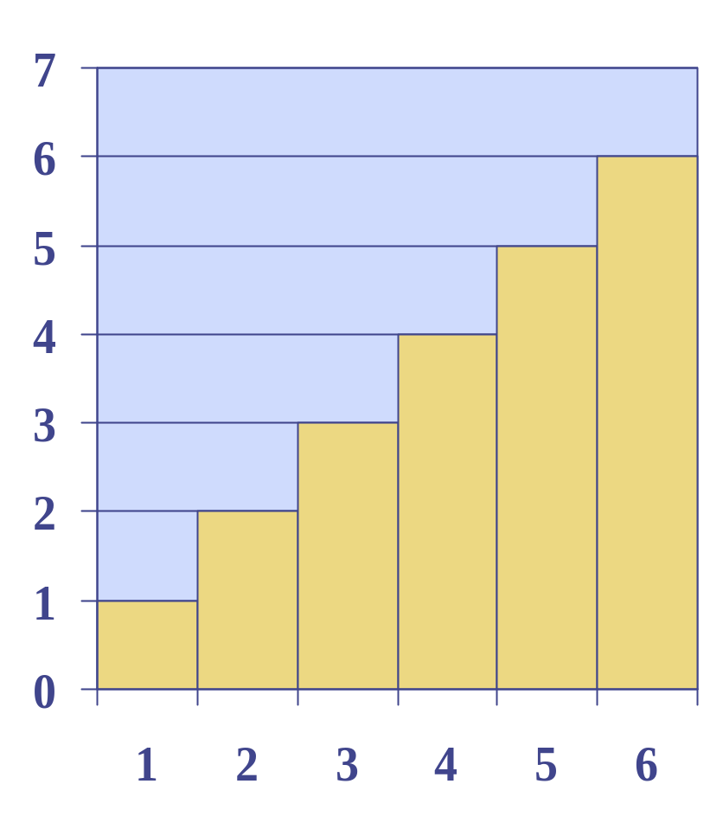
Which is the order of an arithmetic progression?
1 + 2 + …+ (n-1) = ?
= (n-1)(n) / 2
= (n² - n) / 2
The running time of prefixAverages1 is O(n²) time
Figure: visual proof of result of arithmetic progression

Slide 53
Algorithm 2
The following algorithm computes prefix averages in linear time by keeping a running sum
Algorithm prefixAverages2(X, n)
Input array X of n integers
Output array A of prefix averages of X
A ← new array of n integers
s ← 0
for i ← 0 to n − 1 do
s ← s + X[i]
A[i] ← s / (i + 1)
return A
#operations
n
1
n
n
n
1
Algorithm prefixAverages2 runs in O(n) time

Slide 54
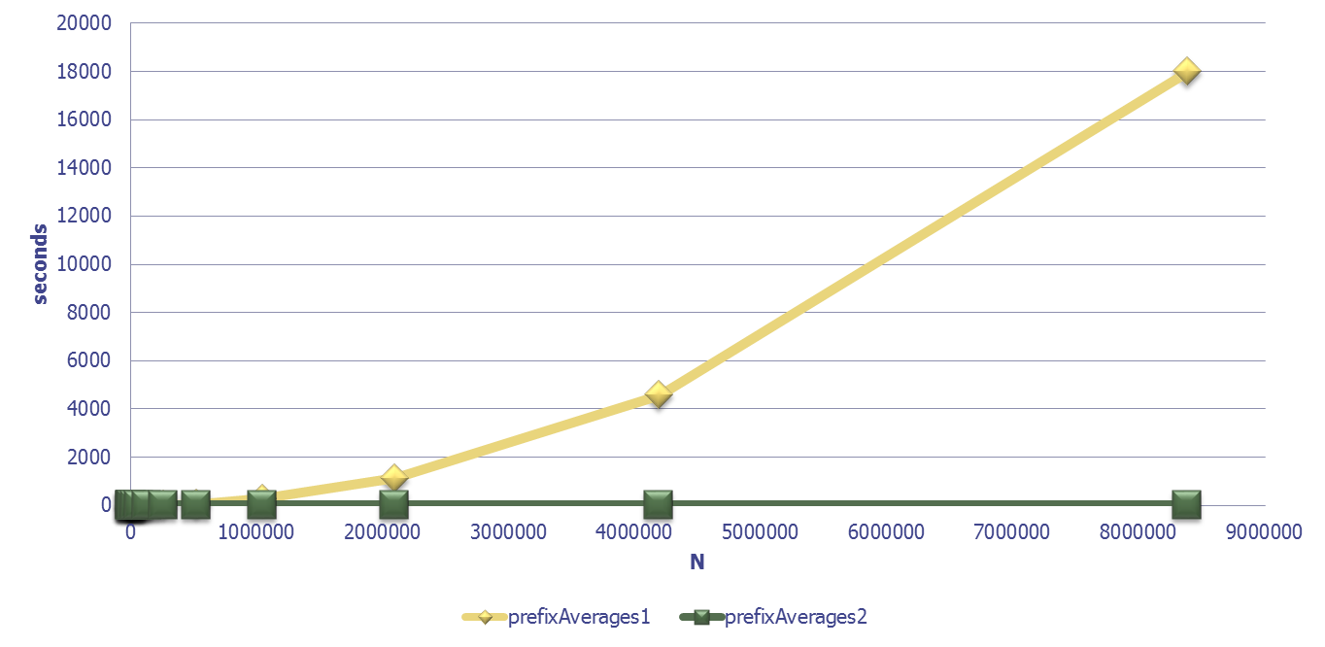
Experiment
As expected, if we run experiments we get the following:

Slide 55


Relatives of Big-Oh
big-Omega
  f(n) is Ω(g(n)) if there is a constant c > 0
  and an integer constant n₀ ≥ 1 such that:
  for
big-Theta
  f(n) is Θ(g(n)) if there are constants c’ > 0 and c’’ > 0 and an integer constant n₀ ≥ 1 such that:
  for

Slide 56
Intuition for Asymptotic Notation
Big-Oh
  f(n) is O(g(n)) if:
  f(n) is asymptotically less than or equal to g(n)
big-Omega
  f(n) is Ω(g(n)) if:
  f(n) is asymptotically greater than or equal to g(n)
big-Theta
  f(n) is Θ(g(n)) if:
  f(n) is asymptotically equal to g(n)

Slide 57
Examples of Relatives of Big-Oh
5n² is Ω(n²)
  f(n) is Ω(g(n)) if there is a constant c > 0 and an integer constant n₀ ≥ 1 such that f(n) ≥ c∙g(n) for n ≥ n₀
  let c = 5 and n₀ = 1
5n² is Ω(n)
  f(n) is Ω(g(n)) if there is a constant c > 0 and an integer constant n₀ ≥ 1 such that f(n) ≥ c∙g(n) for n ≥ n₀
  let c = 1 and n₀ = 1
5n² is Θ(n²)
  f(n) is Θ(g(n)) if it is Ω(n²) and O(n²). We have already seen the former, for the latter recall that f(n) is O(g(n)) if there is a constant c > 0 and an integer constant n₀ ≥ 1 such that f(n) < c∙g(n) for n ≥ n₀
  Let c = 5 and n₀ = 1

Slide 58
Algorithm Analysis
Summarizing:
  Variables to consider:
    Running-time
    Space (memory use)
  How do we calculate or estimate them?
    Experimental Studies
    Theoretical Analysis

Slide 59
Theoretical vs Experimental
Theoretical Analysis has a lot of great properties:
  Uses a high-level description of the algorithm instead of an implementation
  Characterizes running time as a function of the input size, n.
  Takes into account all possible inputs
  Independent of hardware/software
Then… when are the experiments useful?

Slide 60
Experiments are useful to:
  compare algorithms with the same asymptotic running times.
  compare algorithms with exponential running time.
    Check if they do better in practice
  compare algorithm performance on specific types of instances, even if the algorithms have known different asymptotic running times.
  demonstrate or confirm known differences in asymptotic running times.

Slide 61

Algorithm Correctness

Slide 62
Justification Techniques
We also need to justify that our claims on the correctness and the running time for our algorithms
Common Techniques:
  By Example
  The Contra Attack
    Contrapositive
    Contradiction
  Mathematical Induction
  Loop Invariants

Slide 63
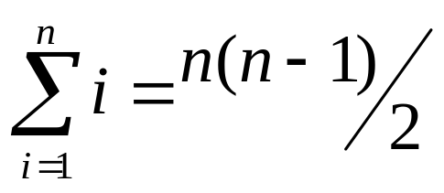
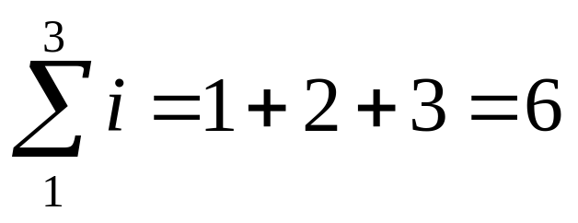

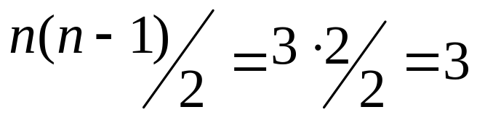
By Example
Counterexample
  n=3
?

Slide 64
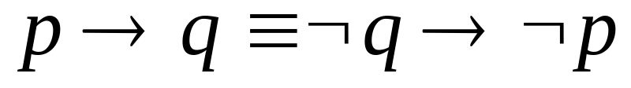
The Contra Attack
Contrapositive
  Instead of proving:
    “If p is true then q is true”
  We prove:
    “If q is false then p is false”
“If the square of a number is odd, then the number is odd”
“If a number is not odd, then its square is not odd”

Slide 65

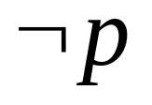

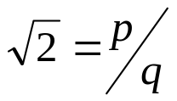
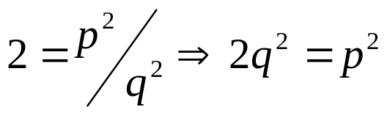

The Contra Attack
Contradiction
is irrational
  By contradiction we will assume it is rational
    Then there exist p and q such that
    Then, p² is even and therefore p is even and can be written as 2k:
    Thus q² is even and therefore q is even.
    This means that both p and q are divisible by 2 and this contradicts the fact that they have no common factors
leads to contradiction
Notes:
1.Suppose not. Then p 2 is rational.
2. Since p 2 is rational there exists integers p and q 6= 0 such that p 2 = p/q and
p and q have no common factors.
2 = p²/q²
2q² = p²
p² is even and thus p is even
p = 2k for some integer k
2q² = p² = 4k²
q² = 2k², and thus q² is even and thus q is even.
This means that p and q are both even (divisible by 2), but this contradicts the fact that they have no
common factors
3. Hence p 2 is irrational.

Slide 66
The Contra Attack
Contradiction
  Let a*b be odd, then a is odd and b is odd
  Try to prove that for a*b odd, a or b are even and reach a contradiction
    a*b odd, a even (can be written as 2s), b odd
      a*b=2s*b
      it is even! contradiction
    a*b odd, a odd, b even (can be written as 2t)
      a*b=a*2t
      it is even! contradiction
    a*b odd, a even (2s), b even (2t)
      a*b=2s*2t
      it is even! contradiction
Notes:
1.Suppose not. Then p 2 is rational.
2. Since p 2 is rational there exists integers p and q 6= 0 such that p 2 = p/q and
p and q have no common factors.
2 = p²/q²
2q² = p²
p² is even and thus p is even
p = 2k for some integer k
2q² = p² = 4k²
q² = 2k², and thus q² is even and thus q is even.
This means that p and q are both even (divisible by 2), but this contradicts the fact that they have no
common factors
3. Hence p 2 is irrational.

Slide 67
Induction
A technique to prove that a statement P(n) is true for all positive integers n > n₀
  n₀ is the base case
Steps:
  Base Case: show that P(n) is true for n =n₀.
  Induction Step: show that if P(n) is true for n= n₀, …, k, then P(n) is also true for n=k+1.
Notes:
Hacer dibujo.
Caso base un punto
Caso inductivo dibujo aparte. Y luego juntarlos y mostrar que asi queda demostrado todo!

Slide 68
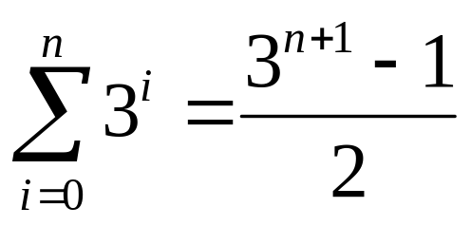
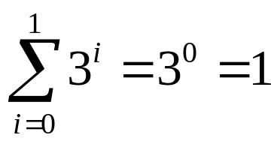
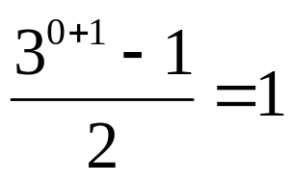

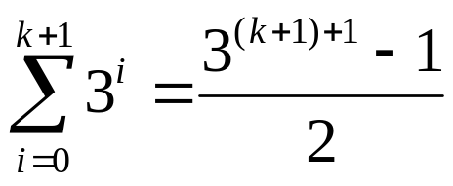
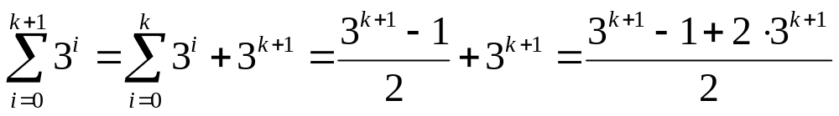
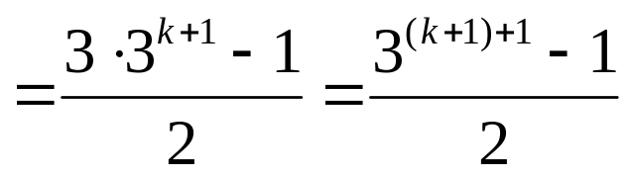
Base case i=0:
Inductive case:
  Assume:
✓
To prove:
✓
Notes:
Do without the slide

Slide 69
Loop Invariant
This technique is usually used to prove the correctness of an algorithm, especially for those that use loops (for-loop, while-loops).
We have to establish a statement related to the loop (the loop invariant) and prove that the statement is true at the beginning and/or the end of each loop.
Notes:
Hacer dibujo.
Caso base un punto
Caso inductivo dibujo aparte. Y luego juntarlos y mostrar que asi queda demostrado todo!

Slide 70
The technique we use in loop invariants is very similar to mathematical induction.
After we establish the loop invariant, we show that it is true before we enter the loop.
Then we:
  Assume the statement is true at the beginning and/or end of the k^{th} loop
  Show:
    that either it is also true for the beginning and/or end of the (k+1)^{th} loop, or
    the statement for the next loop does not exist (because the loop ends).
As a result, we conclude that the loop invariant is true and the algorithm is correct.

Slide 71
Loop Invariant
Algorithm arrayFind (x, A):
Input: An element x and an n-element array A of numbers.
Output: The index i such that x=A [i] or -1 if no element of A is equal to x.
let i ← 0
while i < n do
if x = A[i] then
return i
else
i ← i + 1
return -1.
Notes:
• Our Statement:
– Si: x is not equal to any of the first i elements of A.
• Base case: statement is true at the beginning of the loops:
– S0: x is not equal to any of the first 0 element of A.
• Assume the statement is true up to Sk at the beginning of
the (k+1)th loop:
– Sk: x is not equal to any of the first k elements of A.
• During the (k+1)th loop, two things can happen:
– if x = A[k], then we return k, thus there will be no Sk+1.
– if x ≠ A[k], then we continue to the next loop. In this case, we know from Sk that x is not equal to any of the first k elements of A, but we also have that x is not equal to the (k+1)th element of A. Therefore we know Sk+1 is also true:
• Sk+1: x is not equal to any of the first k+1 elements of A.

Slide 72
Loop invariant:
  S_{i}: x is not equal to any of the first i elements of A.
Base case: statement is true at the beginning of the loops:
  S₀: x is not equal to any of the first 0 element of A.
Assume the statement is true up to S_{k} at the beginning of the (k+1)^{th} loop:
  S_{k}: x is not equal to any of the first k elements of A.
  During the (k+1)^{th} loop, two things can happen:
    if x = A[k], then we return k, thus there will be no Sk+1.
    if x ≠ A[k], then we continue to the next loop.
      Sk that x is not equal to any of the first k elements of A
      x is not equal to the (k+1)^{th} element of A.
      Therefore we know S_{k+1} is also true:
  S_{k+1}: x is not equal to any of the first k+1 elements of A
Notes:
• Our Statement:
– Si: x is not equal to any of the first i elements of A.
• Base case: statement is true at the beginning of the loops:
– S0: x is not equal to any of the first 0 element of A.
• Assume the statement is true up to Sk at the beginning of
the (k+1)th loop:
– Sk: x is not equal to any of the first k elements of A.
• During the (k+1)th loop, two things can happen:
– if x = A[k], then we return k, thus there will be no Sk+1.
– if x ≠ A[k], then we continue to the next loop. In this case, we know from Sk that x is not equal to any of the first k elements of A, but we also have that x is not equal to the (k+1)th element of A. Therefore we know Sk+1 is also true:
• Sk+1: x is not equal to any of the first k+1 elements of A.

Slide 73
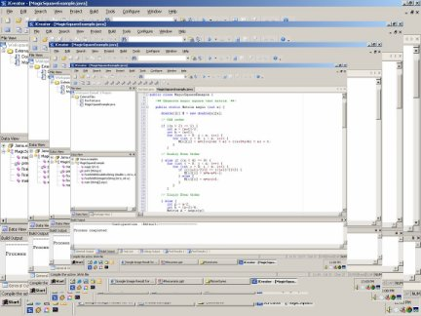
2. Recursion Pattern

Slide 74
Algorithm Design and Implementation
Design Goals
  Correctness
  Efficiency
Design Principles
  Abstraction
  Encapsulation
  Modularity
Implementation Goals
  Robustness
  Adaptability
  Reusability
Design Techniques
  Interfaces and Typing
  Inheritance and Polymorphism
  Classes and Objects
  Design Patterns

Slide 75
Design Pattern s
A design pattern describes a solution to a “typical” software design problem.
It describes the main elements of a solution in an abstract way that can be specialized for the specific problem at hand.
Examples
  Recursion
  Amortization
  Divide-and-conquer
  Prune-and-search
  Brute Force
  Greedy Method
Notes:
We will see many patterns

Slide 76
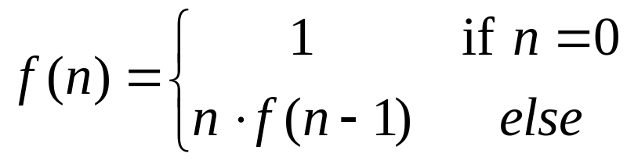
Recursion Pattern
Recursion: when a method calls itself
Classic example--the factorial function:
  n! = 1· 2· 3· ··· · (n-1)· n
Recursive definition:
Code:
  // recursive factorial function
  int recursiveFactorial(int n) {
  if (n == 0) return 1; // base case
  else return n * recursiveFactorial(n- 1); // recursive case
  }

Slide 77
Recursion Pattern
There must be at least one case (the base case), for a small value of n, that can be solved directly
A problem of a given size n can be split into one or more smaller versions of the same problem (recursive case)
Recognize the base case and provide a solution to it
Devise a strategy to split the problem into smaller versions of itself while making progress toward the base case
Combine the solutions of the smaller problems in such a way as to solve the larger problem

Slide 78
Infinite Loops
Recursion is an alternative to looping.
As with looping, recursion can cause your program to loop forever.
  This is prevented with the base case, which acts as the stopping condition.

Slide 79
Linear Recursion
Test for base cases.
  Begin by testing for a set of base cases
    there should be at least one
  Every possible chain of recursive calls must eventually reach a base case.
Recur once (Linear)
  Perform a single recursive call.
    This step may involve a test that decides which of several possible recursive calls to make
  The recursive call should make progress towards a base case.

Slide 80
Adding elements in an array
Write an iterative algorithm to add the elements in an array A of size n:
  The algorithm should return 20 for the following array:
  What is its performance?
How can this be transformed to a recursive algorithm?
  What is its performance?
A=
4 | 3 | 6 | 2 | 5
Notes:
Introduce the Recursion Trace
Complexities of each running time and space

Slide 81
IterativeLinearSum Algorithm (pseudo-code)
Algorithm IterativeSum(A):
Input: An integer array A
Output: The sum of the integers in A
n ← A.length
sum ← 0
for i ← 0 to n − 1 do
sum ← sum +A[i]
return sum
What is the performance of IterativeSum?
  Space?
  Running time?
  O(1) (the pointer to the array and variables n and sum)
  O(n)
Notes:
Introduce the Recursion Trace
Complexities of each running time and space

Slide 82
LinearSum Algorithm (pseudo-code)
Algorithm LinearSum(A, n):
Input:
A integer array A and an integer n = 1, such that A has at least n elements
Output:
The sum of the first n integers in A
if n = 1 then
return A[0]
else
return LinearSum(A, n - 1) + A[n - 1]
Note the extra argument!
How should this algorithm be called the first time to solve the given problem?
A=
4 | 3 | 6 | 2 | 5
Recursion trace for array A:
call
return
15
+
A
[
4
] =
15
+
5
=
20
LinearSum
(
A
,
5
)
call
return
13
+
A
[
3
] =
13
+
2
=
15
LinearSum
(
A
,
4
)
call
return
7
+
A
[
2
] =
7
+
6
=
13
LinearSum
(
A
,
3
)
call
return
4
+
A
[
1
] =
4
+
3
=
7
LinearSum
(
A
,
2
)
call
return
A
[
0
] =
4
LinearSum
(
A
,
1
)
Notes:
Introduce the Recursion Trace
Complexities of each running time and space

Slide 83
LinearSum Algorithm (pseudo-code)
call
return
15
+
A
[
4
] =
15
+
5
=
20
LinearSum
(
A
,
5
)
call
return
13
+
A
[
3
] =
13
+
2
=
15
LinearSum
(
A
,
4
)
call
return
7
+
A
[
2
] =
7
+
6
=
13
LinearSum
(
A
,
3
)
call
return
4
+
A
[
1
] =
4
+
3
=
7
LinearSum
(
A
,
2
)
call
return
A
[
0
] =
4
LinearSum
(
A
,
1
)
What is the performance of LinearSum?
  Space?
  Running time?
  O(n) (the pointer to the array and the recursive call in the stack)
  O(n)
Notes:
Introduce the Recursion Trace
Complexities of each running time and space

Slide 84
Binary Search
Is value v in the sorted array A?
  Algorithm binarySearch(a, value, left, right)
  Input: A sorted array, a value to search in it and nonnegative integer indices left and right
  Output: The index of array a where the value is or -1 if the value is not in the array
  if right < left
  return -1
  mid := floor((left+right)/2)
  if a[mid] = value
  return mid
  if value < a[mid]
  binarySearch(a, value, left, mid-1)
  else
  binarySearch(a, value, mid+1, right)
How would the recursive trace look?
Notes:
int binary_search(int a[], int x, unsigned int n)
{
int low = 0, mid, high = n-1;
while(low <= high) {
mid = (low + high)/2;
if (a[mid] < x )
low = mid +1;
else
if (a[mid] > x )
high = mid -1;
else return mid;
}
return NOT_FOUND;
}
! Binary Search Search: if elements are stored in an array in sorted
: order, the Find operation takes logarithmic worst case time
-1 3 7 10 15 -5 17
0 6 3
Ex.: Find(4)
-1 3 7 10 15 -5 17

Slide 85
Reversing an Array (pseudo-code)
Algorithm ReverseArray(A, i, j):
Input: An array A and nonnegative integer indices i and j
Output: The reversal of the elements in A starting at index i and ending at j
if i < j then
Swap A[i ] and A[j ]
ReverseArray(A, i + 1, j - 1)
How would the recursive trace look?
Notes:
Do it with the class!
i: first element of the list
j: last element of the list
SO we swap them and then swap the ones in between.
There are two base cases: i=j, i>j Is it guranteed to terminate?

Slide 86
Defining Arguments for Recursion
In creating recursive methods, it is important to define the methods in ways that facilitate recursion.
This sometimes requires we define additional parameters that are passed to the method.
For example, we defined the array reversal method as ReverseArray(A, i, j), not ReverseArray(A).

Slide 87
Binary and multiple Recursion
Test for base cases.
  Begin by testing for a set of base cases
For a non-base case:
  Binary case: two recursive calls.
  Multiple case: n recursive calls.
f(n₁₁)
f(n₁)
f(n₁₂)
…
f(n)
f(n₂₁)
f(n₂)
f(n₂₂)

Slide 88
Example
Problem: add all the numbers in an integer array A:
  Algorithm BinarySum(A, i, n):
  Input: An array A and integers i and n
  Output: The sum of the n integers in A starting at index i
  if n = 1 then
  return A[i ]
  return BinarySum(A, i, n/ 2) + BinarySum(A, i + n/ 2, n-n/ 2)
Example trace:
0
,
8
0
,
4
4
,
4
0
,
2
2
,
2
4
,
2
6
,
2
0
,
1
1
,
1
2
,
1
3
,
1
4
,
1
5
,
1
6
,
1
7
,
1
Notes:
- Do the algorithm with the class
- do an example
- analyze complexity
- space O(logn)
- runnning time O(n)
Compare it with linear sum!!!!
better space, same time
n * \Sum (1/2^i)

Slide 89
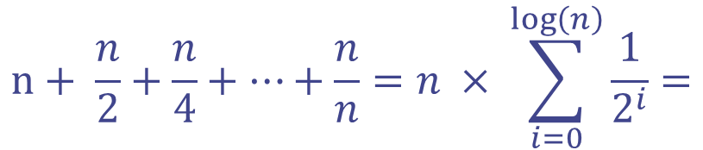

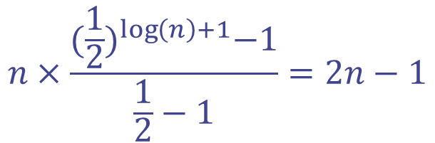
Number of Nodes?
0
,
8
0
,
4
4
4
0
,
2
2
,
2
4
,
2
6
,
2
0
,
1
1
,
1
2
,
1
3
,
1
4
,
1
5
,
1
6
,
1
7
,
1
Number of nodes is O(n)
Notes:
- Do the algorithm with the class
- do an example
- analyze complexity
- space O(logn)
- runnning time O(n)
Compare it with linear sum!!!!
better space, same time
n * \Sum (1/2^i)

Slide 90
How is the performance of BinarySum?
  Space?
  Running time?
How is it compared to Linear Sum?
  Space O(n)
  Running Time O(n)
  O(depth of the trace) = O(log n) (the recursive calls stored in the stack)
  O(number of nodes) = O(n)
call
return
15
+
A
[
4
] =
15
+
5
=
20
LinearSum
(
A
,
5
)
call
return
13
+
A
[
3
] =
13
+
2
=
15
LinearSum
(
A
,
4
)
call
return
7
+
A
[
2
] =
7
+
6
=
13
LinearSum
(
A
,
3
)
call
return
4
+
A
[
1
] =
4
+
3
=
7
LinearSum
(
A
,
2
)
call
return
A
[
0
] =
4
LinearSum
(
A
,
1
)
Notes:
Introduce the Recursion Trace
Complexities of each running time and space

Slide 91
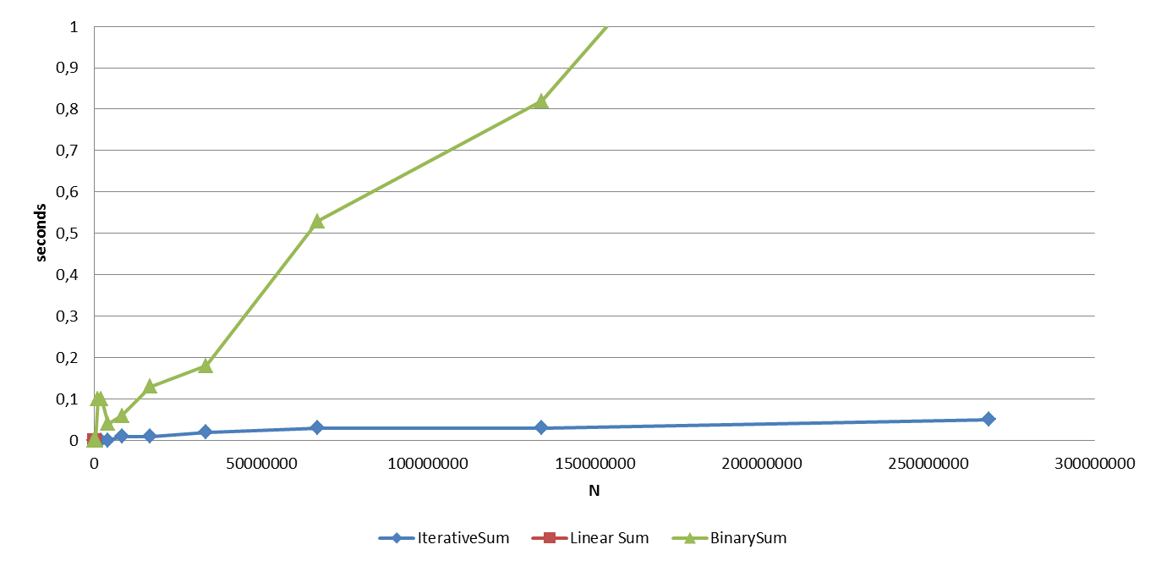
Experiments
LinearSum runs out of space for N= 16384

Slide 92
Tail recursion (advanced topic)
When a linearly recursive method makes its recursive call as its last step.
Ex.: the array reversal method.
Such methods can be easily converted to non-recursive methods (which saves on some resources).
Algorithm ItReverseArray(A, i, j):
Input: An array A and nonnegative integer indices i and j
Output: The reversal of the elements in A starting at index i and ending at j
while i < j do
Swap A[i ] and A[j ]
i = i + 1;
j= j – 1;
return;

Slide 93
Recursion: Exercise
Consider the function f(n)=2^{n}.
Can we give a recursive definition?
  f(n) = 2 * f(n-1) for n >=0
  and f(0) = 1
Lets calculate f(3).

Slide 94
f(3)
f (n) = 2 * f (n-1)
f (0) = 1
n >= 0
2 *
f(2)
2 *
f(1)
2 *
f(0)
1

Slide 95
f (3) = 8
f (n) = 2 * f (n-1)
f (0) = 1
n >= 0
f(3)
8
2 *
f(2)
4
2 *
f(1)
2
2 *
1
recursive trace

Slide 96
f (n)=2^{n} in code
double f( int n )
{
if ( n == 0 ) // Base case
{
return 1;
}
else
{
return (2 * f (n-1)); // Recursion
}
}
f (n) = 2 * f (n-1)
f (0) = 1
n >= 0
What’s wrong?
  n<0 !!

Slide 97
double f( int n )
{
if ( n == 0 ) // Base case
{
return 1;
}
else if (n < 0)
{
return (1 / f(-1*n));
}
else
{
return 2 * f (n-1); // Recursion
}
}
f(0) = 1
f(n) = 1/f(-n) [n<0]
f(n) = 2*f(n-1) [n > 0]
Notes:
Analyzing the algorithms
The base case has a running-time complexity o(1) but we call the function (n-1) times, therefore the complexity is o(n)
What about space complexity?
- Do a drawing showing that f(n) calls f(n-1), that one calls f(n-2)…. So there are n active calls, therefore the algorithm’s space is O(n)
The drawing is called “Recursion TRACE”

Slide 98
double f( int n )
{
if ( n == 0 ) // Base case
{ return 1; }
else if (n < 0)
{ return (1 / f(-1*n)); }
else
{ return 2 * f (n-1);} // Recursion
}
Running time? O(n)
  Without considering the recursive call the algorithm takes O(1)
  But the algorithm is called n times
Space use? O(n)
  n active calls!
Notes:
Analyzing the algorithms
The base case has a running-time complexity o(1) but we call the function (n-1) times, therefore the complexity is o(n)
What about space complexity?
- Do a drawing showing that f(n) calls f(n-1), that one calls f(n-2)…. So there are n active calls, therefore the algorithm’s space is O(n)
The drawing is called “Recursion TRACE”

Slide 99
Iterative code for f(n)=2^{n}
int f( int n ){
int total = 1;
int y=n;
if (n<0){
y=-n;}
for (int i=0; i<y; i++){ // Iterative
total = total * 2;}
if (n<0){
total = 1 / total;}
return total;
}
Complexity??
Notes:
Complexity?
Recursion is elegant but not always efficient

Slide 100
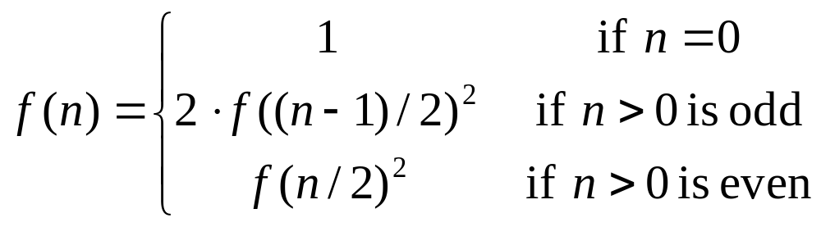
Recursive Squaring
We can derive a more efficient linearly recursive algorithm by using repeated squaring:
For example,
  2⁴ = f(4)= (f(4/2))² = (f(2))² = ((f(1))²)² = ((2(f(0))²)²)²= ((2)²)²=16
  2⁵ = f(5)= 2(f(4/2))² = 2(f(2))² = 2((f(1))²)² = 2((2(f(0))²)²)² =32
  2⁶ = 2^{(6/ 2)2} = (2^{6/2})² = (2³)² = 8² = 64
  2⁷ = 2^{1+(6/2)2} = 2(2^{6/2})² = 2(2³)² = 2(8²) = 128.

Slide 101
A Recursive Squaring Method
Algorithm f(n):
Input: an integer n
Output: The value 2^{n}
if n = 0 then
return 1
if n is odd then
y = f((n - 1)/ 2)
return 2 · y ·y
else
y = f(n/ 2)
return y · y
Notes:
Complexity?
Explain log(n)

Slide 102
Analyzing the Recursive Squaring Method
Algorithm f (n):
Input: an integer n
Output: The value 2^{n}
if n = 0 then
return 1
if n is odd then
y = f ((n - 1)/ 2)
return 2 · y · y
else
y = f (n/ 2)
return y · y
Each time we make a recursive call we halve the value of n; hence, we make log n recursive calls. That is, this method runs in O(log n) time.
It is important that we used a variable twice here rather than calling the method twice.

