Slide 1
Stacks

Slide 2
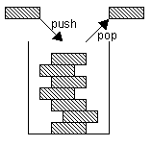
The Stack ADT
The Stack ADT stores arbitrary objects
Insertions and deletions follow the last-in first-out scheme (LIFO)
Main stack operations:
  push(object): inserts an element
  object pop(): removes and returns the last inserted element

Slide 3
The Stack ADT
Auxiliary stack operations:
  object top(): returns the last inserted element without removing it
  integer size(): returns the number of elements stored
  boolean isEmpty(): indicates whether no elements are stored

Slide 4
Algebraic Specification
Structure Stack (Element)
  declare
    new() → Stack
    push(Stack; Element) → Stack
    pop(Stack) → Element
    top(Stack) → Element
    isEmpty (Stack) → boolean
    size(Stack) → integer
  for all STACK s and Element e let
    isEmpty (new()) ::= true
    isEmpty (push(s; e)) ::= false
    size(new()) ::= 0
    size(push(s;e)) ::= size(s)+1
    size(pop(s)) ::= size(s)-1
    top(new()) ::= error
    top(push(s;e)) ::= e
    pop(new()) ::= new()
    pop(push(s; e)) ::= s

Slide 5
C++ STL stack
stack<int> myStack;
myStack.push(5);
cout << myStack.top() << endl;
cout << myStack.size() << endl;
myStack.pop();
cout << myStack.size() << endl;
Notes:
Hacer en código

Slide 6
Stack Interface in Java
public interface Stack {
public int size();
public boolean isEmpty();
public Object top()
throws EmptyStackException;
public void push(Object o);
public Object pop()
throws EmptyStackException;
}
Java interface corresponding to our Stack ADT
Requires the definition of class EmptyStackException
Different from the built-in Java class java.util.Stack
Notes:
Ver uso de Object

Slide 7
Exceptions
Attempting the execution of an operation of ADT may sometimes cause an error condition, called an exception
Exceptions are said to be “thrown” by an operation that cannot be executed
In the Stack ADT, operations pop and top cannot be performed if the stack is empty
Attempting the execution of pop or top on an empty stack throws an EmptyStackException
Notes:
No utilizaremos excepciones en este curso

Slide 8
Stack interface in C++
class stack {
public:
virtual void push(int val) = 0;
virtual int pop() = 0;
virtual bool isEmpty() = 0;
};
Templates may be used to create a generic stack
Notes:
Centrarnos en las diferencias:
No utilizamos Object (esto tampoco se hace hoy en día en Java moderno).
En este curso no nos preocuparemos de las excepciones

Slide 9
Stack implemented with Array
A simple way of implementing the Stack ADT uses an array
We add elements from left to right
A variable keeps track of the index of the top element
public class ArrayStack implements Stack {
Object S[ ];
int t = -1;
…
}
…
S
0
1
2
t

Slide 10
Stack implemented with Array
Algorithm size()
return t + 1
Algorithm pop()
if isEmpty() then
throw EmptyStackException
else
t ← t − 1
return S[t + 1]
Algorithm isEmpty()
return ( t = -1 )
…
S
0
1
2
t

Slide 11

Stack implemented with Array
The array storing the stack elements may become full
A push operation will then throw a FullStackException
  Limitation of the array-based implementation
  Not intrinsic to the Stack ADT!!
Algorithm push(o)
if t = S.length − 1 then
throw FullStackException
else
t ← t + 1
S[t] ← o
…
S
0
1
2
t
Notes:
Alternativamente a FullStackException podemos duplicar el tamaño del arreglo y copiar los elementos

Slide 12
Stack implemented with Array
Performance
  Let n be the number of elements in the stack and N the size of the array
  The space used is O(N)
  Each operation runs in:
    time O(1)
Limitations
  The maximum size of the stack must be defined a priori and cannot be changed
  Trying to push a new element into a full stack causes an implementation-specific exception

Slide 13
ArrayStack in Java
public class ArrayStack
implements Stack {
// holds the stack elements
private Object S[ ];
// index to top element
private int top = -1;
// constructor
public ArrayStack(int capacity) {
S = new Object[capacity]);
}
public Object pop()
throws EmptyStackException {
if isEmpty()
throw new EmptyStackException
(“Empty stack: cannot pop”);
Object temp = S[top];
// facilitates garbage collection
S[top] = null;
top = top – 1;
return temp;
}

Slide 14
Note: Casting when using Objects
One advantage of stacks is that it stores generic objects
When we pop() we get an object that is an instance of the object class
Is this statement correct?
  Integer b= A.pop();
No! We need to use casting
  Integer b= (Integer) (A.pop());
  You have to be sure that in runtime this will be true

Slide 15
ArrayStack in C++
class array_stack : public stack {
public:
array_stack(int inital);
~ array_stack();
void push(int val);
int pop();
bool isEmpty();
private:
int* container;
int last;
};
array_stack:: array_stack(int i) {
container = new int[i];
last = -1;
}
pila_array::~pila_array() {
delete [] container;
}
…
bool array_stack::isEmpty() {
return last == -1;
}

Slide 16




Stack with a Singly Linked List
We can implement a stack with a singly linked list
The top element is stored at the first node of the list
The space used is O(n) and each operation of the Stack ADT takes O(1) time
nodes
t
∅
elements

Slide 17
Stack with a Singly Linked List
With a linked-list representation, a FullStackException will not happen
  You can get an exception if you exhaust memory, which is another kind of problem
When a node is removed from a list, and the node references an object, the reference (the pointer in the node) does not need to be set to null
  Unlike an array implementation, it really is removed--you can no longer get to it from the linked list
  In Java, garbage collection can occur as appropriate. However, in C++ we need to destroy the object

Slide 18
Applications of Stacks
Direct applications
  Page-visited history in a Web browser
  Undo sequence in a text editor
  Chain of method calls in the Stack
Indirect applications
  Auxiliary data structure for algorithms
  Component of other data structures

Slide 19
Example 1: Method Stack in the JVM
The Java Virtual Machine (JVM) keeps track of the chain of active methods with a stack
When a method is called, the JVM pushes on the stack a frame containing
  Local variables and return value
  Program counter, keeping track of the statement being executed
When a method ends, its frame is popped from the stack and control is passed to the method on top of the stack
Allows for recursion
Notes:
Explain why and how it allows recursion

Slide 20
Example 1: Method Stack in the JVM
main() {
int i = 5;
foo(i);
}
foo(int j) {
int k;
k = j+1;
bar(k);
}
bar(int m) {
…
}
bar
PC = 1
m = 6
foo
PC = 3
j = 5
k = 6
main
PC = 2
i = 5
Notes:
What are the program counters (PC)????
The method area is where the bytecodes reside. The program counter always points to (contains the address of) some byte in the method area. The program counter is used to keep track of the thread of execution. After a bytecode instruction has been executed, the program counter will contain the address of the next instruction to execute. After execution of an instruction, the JVM sets the program counter to the address of the instruction that immediately follows the previous one, unless the previous one specifically demanded a jump.

Slide 21
Example 2: Parentheses Matching
Each “(”, “{”, or “[” must be paired with a matching “)”, “}”, or “]”
  correct: ( )(( )){([( )])}
  incorrect: ((( )(( )){([( )])}
  incorrect: )(( )){([( )])}
  incorrect: ({[ ])}
  incorrect: (

Slide 22
Example 2: Parentheses Matching
Algorithm ParenMatch(X,n):
Input: An array X of n tokens, each of which is either a grouping symbol, a
variable, an arithmetic operator, or a number
Output: true if and only if all the grouping symbols in X match
Let S be an empty stack
for i=0 to n-1 do
if X[i] is an opening grouping symbol then
S.push(X[i])
else if X[i] is a closing grouping symbol then
if S.isEmpty() then
return false {nothing to match with}
if S.pop() does not match the type of X[i] then
return false {wrong type}
if S.isEmpty() then
return true {every symbol matched}
else
return false {some symbols were never matched}

Slide 23
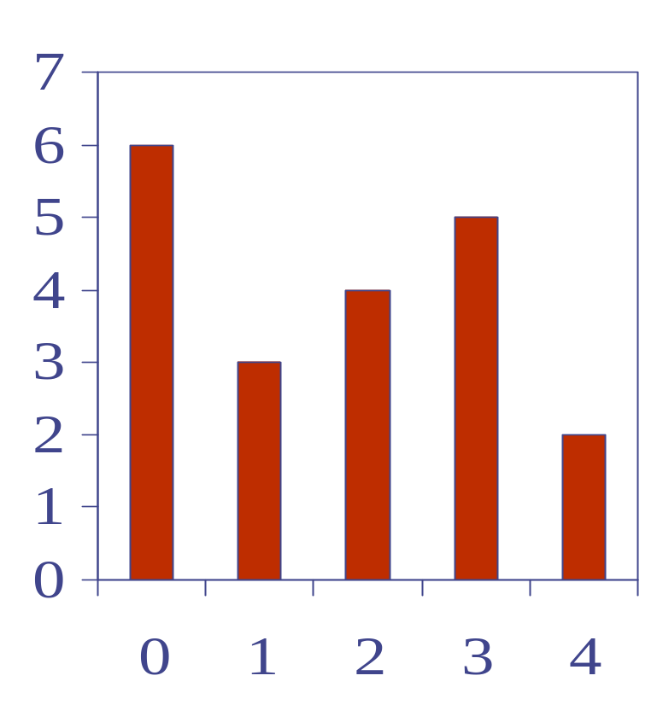
Example 3: Computing Spans
We show how to use a stack as an auxiliary data structure in an algorithm
Given an an array X, the span S[i] of X[i] is the maximum number of consecutive elements X[j] immediately preceding X[i] and such that X[j] ≤ X[i]
Spans have applications to financial analysis
  E.g., stock at 52-week high
X
6 | 3 | 4 | 5 | 2
1 | 1 | 2 | 3 | 1
S
Notes:
escribir juntos el algoritmo

Slide 24
Example 3: Computing Spans
Algorithm spans1(X, n)
Input array X of n integers
Output array S of spans of X
S ← new array of n integers
for i ← 0 to n − 1 do
s ← 1
while s ≤ i ∧ X[i − s] ≤ X[i]
s ← s + 1
S[i] ← s
return S
#
n
n
n
1+2+…+(n-1)
1+2+…+(n-1)
n
1
Algorithm spans1 runs in O(n²) time

Slide 25
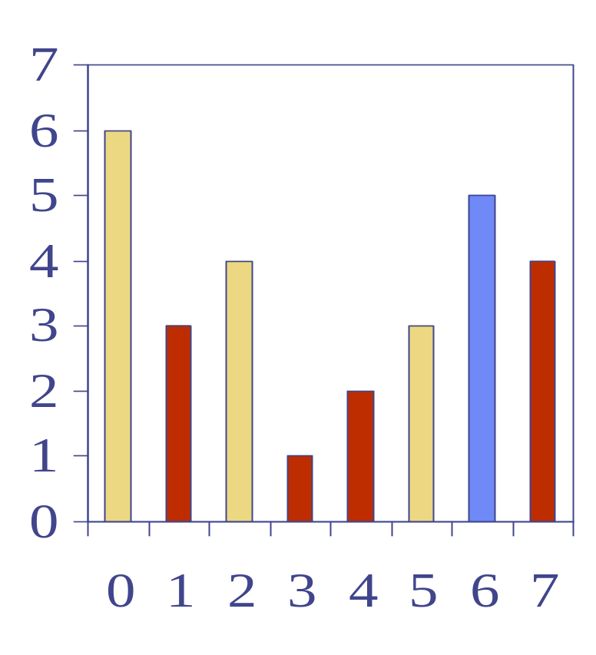
Example 3: Computing Spans with a Stack
We keep in a stack the indices of the elements visible when “looking back”
We scan the array from left to right
  Let i be the current index
  We pop indices from the stack until we find index j such that X[i] < X[j]
  We set S[i] ← i − j
  We push i into the stack
Notes:
tratar de hacerlo jutno con ellos

Slide 26
Example 3: Computing Spans with a Stack
Each index of the array
  Is pushed into the stack exactly one
  Is popped from the stack at most once
The statements in the while-loop are executed at most n times
Algorithm spans2 runs in O(n) time
Algorithm spans2(X, n) #
S ← new array of n integers n
A ← new empty stack 1
for i ← 0 to n − 1 do n
while (¬A.isEmpty() ∧
X[A.top()] ≤ X[i] ) do n
A.pop() n
if A.isEmpty() then n
S[i] ← i + 1 n
else
S[i] ← i − A.top() n
A.push(i) n
return S 1
Notes:
trat

