Slide 1

Queues

Slide 2
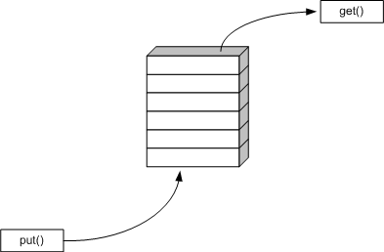
The Queue ADT
The Queue ADT stores arbitrary objects
Insertions and deletions follow the first-in first-out scheme (FIFO)
Insertions are at the rear of the queue and removals are at the front of the queue
Main queue operations:
dequeue()
  enqueue(object): inserts an element at the end of the queue
  object
  dequeue(): removes and returns the element at the front of the queue
enqueue()

Slide 3
The Queue ADT
Auxiliary queue operations:
  object front(): returns the element at the front without removing it
  integer size(): returns the number of elements stored
  boolean isEmpty(): indicates whether no elements are stored
Exceptions
  Attempting the execution of dequeue or front on an empty queue throws an EmptyQueueException

Slide 4
Algebraic Specification
Structure Queue (Element)
  declare
    new() → Queue
    enqueue(Queue; Element) → Queue
    dequeue(Queue) → Queue
    front(Queue) → Element
    isEmpty (Queue) → boolean
    size(Queue) → integer
  for all Queue q and Element e let
    isEmpty (new()) ::= true
    isEmpty (enqueue(q; e)) ::= false
    size(new()) ::= 0
    size(enqueue(q;e)) ::= size(q)+1
    size(dequeue(q;e)) ::= size(q)-1
    front(new()) ::= error
    front(enqueue(q;e)) ::= if isEmpty(q) then e else front(q)
    dequeue(new()) ::= new()
    dequeue(enqueue(q; e)) ::= if isEmpty(q) then new() else enqueue(dequeue(q);e)

Slide 5
Queue in C++
queue<int> myQueue;
myQueue.push(5);
myQueue.push(6);
myQueue.push(7);
while(!myQueue.empty()) {
cout << myQueue.front();
myQueue.pop();
}
public class Queue {
public:
virtual int size() = 0;
virtual boolean isEmpty() = 0;
virtual int front() = 0;
//throws EmptyQueueException;
virtual void enqueue(int o) = 0;
virtual int dequeue() = 0;
//throws EmptyQueueException;
};

Slide 6
Queue Interface in Java
public interface Queue {
public int size();
public boolean isEmpty();
public Object front()
throws EmptyQueueException;
public void enqueue(Object o);
public Object dequeue()
throws EmptyQueueException;
}
Java interface corresponding to our Queue ADT
Requires the definition of class EmptyQueueException
No corresponding built-in Java class

Slide 7
Applications of Queues
Direct applications
  Waiting lists, bureaucracy
  Access to shared resources (e.g., printer)
  Multiprogramming
Indirect applications
  Auxiliary data structure for algorithms
  Component of other data structures

Slide 8
Example 1:
Consider the following ADT with no size() method:
Write a method that computes the size of a queue of distinct elements using this interface. The method should return the queue as it was received
public interface Queue {
public boolean isEmpty();
public Object front() throws EmptyQueueException;
public void enqueue(Object o);
public Object dequeue() throws EmptyQueueException;}
        Algorithm size(Q)
        Input a queue Q with no repeated objects
        Output the number of objects in Q
        if (Q.IsEmtpy()){ return 0;}
        first  Q.front();
        Q.enqueue(Q.dequeue());
        size  1;
        while (Q.front()!=first){Q.enqueue(Q.dequeue()); size++;}
        return size;

Slide 9
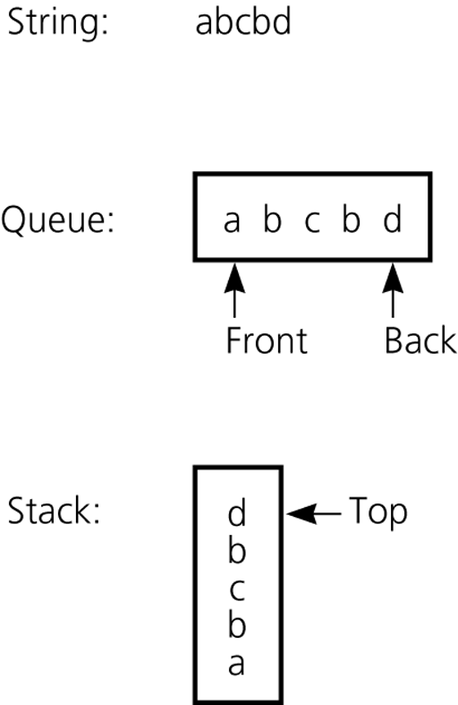
Example 2: Recognizing Palindromes
A palindrome
  A string of characters that reads the same from left to right as its does from right to left
To recognize a palindrome, a queue can be used in conjunction with a stack
  A stack can be used to reverse the order of occurrences
  A queue can be used to preserve the order of occurrences
Is string abcbd a palindrome?

Slide 10
Example 2: Recognizing Palindromes
A nonrecursive recognition algorithm for palindromes
  As you traverse the character string from left to right, insert each character into both a queue and a stack
  Compare the characters at the front of the queue and the top of the stack
        Algorithm isPalindrome(t)
        Input a string t
        Output true if t is a palindrome
        Q  an empty queue;
        S  an empty stack;
        for (int i=0; i < t.length(); i++)
        Q.enqueue(t[i]);
        S.push(t [i]);
        while(!S.isEmpty)
        if (Q.dequeue()!=S.pop())
        return False;
        return True

Slide 11
Implementation
Based in:
  Linked List
  Array
  Other data structures (not efficient but fun to try!)
    E.g. 2 stacks

Slide 12




Queue with a Singly Linked List
We can implement a queue with a singly linked list
  The front element is stored at the first node
  The rear element is stored at the last node
The space used is O(n) and each operation of the Queue ADT takes O(1) time
r
nodes
f
∅
elements

Slide 13
Array-based Queue Implementation
In order to have all operations in O(1) we use the array in a circular way
The idea of a circular array is that the end of the array “wraps around” to the start of the array
7
0
6
1
5
2
4
3

Slide 14
Array-based Queue Implementation
Two variables keep track of the front and rear
  f index of the front element
  r index immediately past the rear element
Array location r is kept empty
normal configuration
Q
0
1
2
f
r
wrapped-around configuration
Q
0
1
2
r
f

Slide 15
Queue Operations
We use the modulo operator (remainder of division)
Algorithm size()
return (N − f + r) mod N
Algorithm isEmpty()
return (f = r)
Q
0
1
2
f
r
Q
0
1
2
r
f

Slide 16
Queue Operations (cont.)
Operation enqueue throws an exception if the array is full
This exception is implementation-dependent!
Algorithm enqueue(o)
if size() = N then
throw FullQueueException
else
Q[r] ← o
r ← (r + 1) mod N
Q
0
1
2
f
r
Q
0
1
2
r
f

Slide 17
Queue Operations (cont.)
Operation dequeue throws an exception if the queue is empty
This exception is specified in the queue ADT
Algorithm dequeue()
if isEmpty() then
throw EmptyQueueException
else
o ← Q[f]
f ← (f + 1) mod N
return o
Q
0
1
2
f
r
Q
0
1
2
r
f

Slide 18
Array based Queue
Algorithm enqueue(o)
if size() = N then
throw FullQueueException
else
Q[r] ← o
r ← (r + 1) mod N
Algorithm size()
return (N − f + r) mod N
Algorithm isEmpty()
return (f = r)
Algorithm dequeue()
if isEmpty() then
throw EmptyQueueException
else
o ← Q[f]
f ← (f + 1) mod N
return o
Q
0
1
2
f
r
Q
0
1
2
r
f

Slide 19
Example: Array Queue
front =
0
//Code
queue q;
q.enqueue(6);//push
rear =
1
0
6
0
1
2
3
4
5
insert item at rear

Slide 20
Example: Array Queue
front =
0
//Code
queue q;
q.enqueue(6);
q.enqueue(4);
q.enqueue(7);
q.enqueue(3);
q.enqueue(8);
rear =
1
2
3
4
5
6
4
7
3
8
0
1
2
3
4
5

Slide 21
Example: Array Queue
front =
1
//Code
queue q;
q.enqueue(6);
q.enqueue(4);
q.enqueue(7);
q.enqueue(3);
q.enqueue(8);
q.dequeue();//front = 1
q.dequeue();//front = 2
q.enqueue(9);//pop
2
0
rear =
5
0
6
4
7
3
8
9
0
1
2
3
4
5
front = (0 + 1) % 6 = 1
front = (1 + 1) % 6 = 2
rear = (5 + 1) % 6 = 0

Slide 22
Example: Array Queue
front =
2
//Code
queue q;
q.enqueue(6);
q.enqueue(4);
q.enqueue(7);
q.enqueue(3);
q.enqueue(8);
q.dequeue();//front = 1
q.dequeue();//front = 2
q.enqueue(9);
q.enqueue(5);
rear =
0
1
5
7
3
8
9
0
1
2
3
4
5
rear = (0 + 1) % 6 = 1

Slide 23
Implementing Queue with Stacks
This is not a useful implementation but it is fun to try
  And it has didactical objectives.
enqueue(o)
dequeue()
S1.push(o)
S2.push(o)
S1.pop()
S₁
S₂
S2.pop()

Slide 24
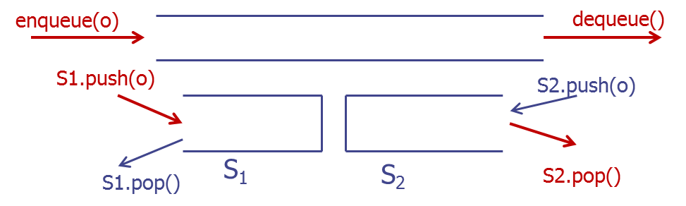
Implementing Queue with Stacks
Algorithm enqueue(o)
S1.push
Algorithm dequeue()
if isEmpty() then
throw EmptyQueueException
if S2.isEmpty() then
while !S1.isEmpty() do
S2.push(S1.pop())
return S2.pop()
Algorithm size()
return S1.size()+ S2.size()
Algorithm isEmpty()
return (size() == 0)

Slide 25
Summary
Method | LLS Node front; int size; | LLS Node front; Node tail; int size; | Array Object Q[N]; int size; | Circular Array Object Q[N]; int f; int r; | Two stacks Stack S1; Stack S2;
enqueue | O(n) | O(1) | O(1) error if array is full | O(1) error if array is full | O(1)
dequeue | O(1) | O(1) | O(n) | O(1) | O(n)
isEmpty | O(1) | O(1) | O(1) | O(1) | O(1)
size | O(1) | O(1) | O(1) | O(1) | O(1)
Space used | O(n) | O(n) | O(N) | O(N)

Slide 26
Example 2: Round Robin Schedulers
We can implement a round robin scheduler using a queue, Q, by repeatedly performing the following steps:
  e = Q.dequeue()
  Service element e
  Q.enqueue(e)
The Queue
1
.
Deque the
2
.
Service the
3
.
Enqueue the
next element
next element
serviced element
Shared
Service

Slide 27
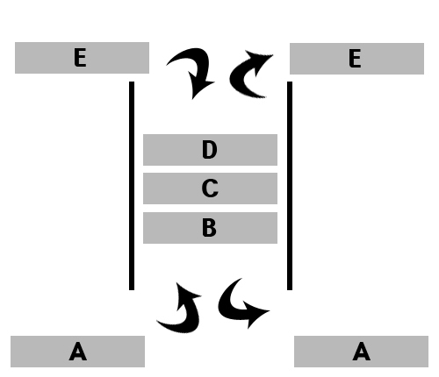
Deques

Slide 28
Deques
A deque is a double-ended queue (pronunced deck to distinguish from dequeue method)
Insertions and deletions can occur at either end
Implementation is similar to that for queues
Deques are not heavily used

Slide 29
Double-Ended Queues
A double-ended queue, or deque, supports insertion and deletion from the front and back.
The Deque Abstract Data Type
  insertFirst(e): Insert e at the beginning of deque.
  insertLast(e): Insert e at end of deque
  removeFirst(): Removes and returns first element
  removeLast(): Removes and returns last element
Additionally supported methods include:
  first()
  last()
  size()
  isEmpty()

Slide 30
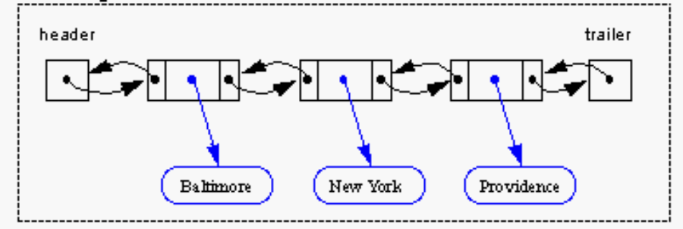
Implementing Deques with Doubly Linked Lists
Deletions at the tail of a singly linked list cannot be done in constant time.
To implement a deque, we use a doubly linked list with special header and trailer nodes
A node of a doubly linked list has a next and a prev link. It supports the following methods:
  setElement(Object e)
  setNext(Object newNext)
  setPrev(Object newPrev)
  getElement()
  getNext()
  getPrev()
All the methods of a deque run in O(1) time.

Slide 31
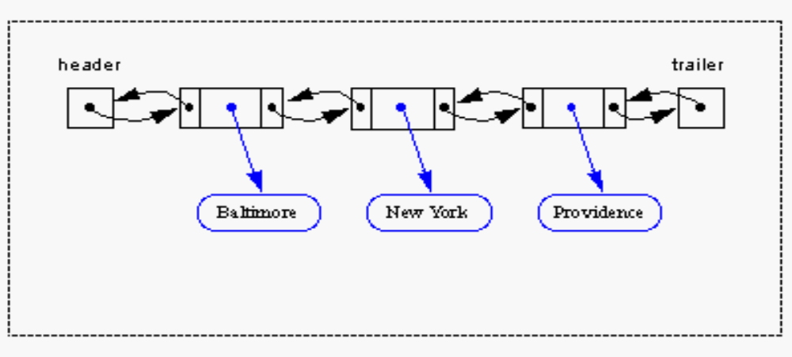
When implementing a doubly linked lists, we add two special nodes to the ends of the lists: the header and trailer nodes.
  The header node goes before the first list element. It has a valid next link but a null prev link.
  The trailer node goes after the last element. It has a valid prev reference but a null next reference.
NOTE: the header and trailer nodes are sentinel or “dummy” nodes because they do not store elements. Here’s a diagram of our doubly
linked list:

Slide 32
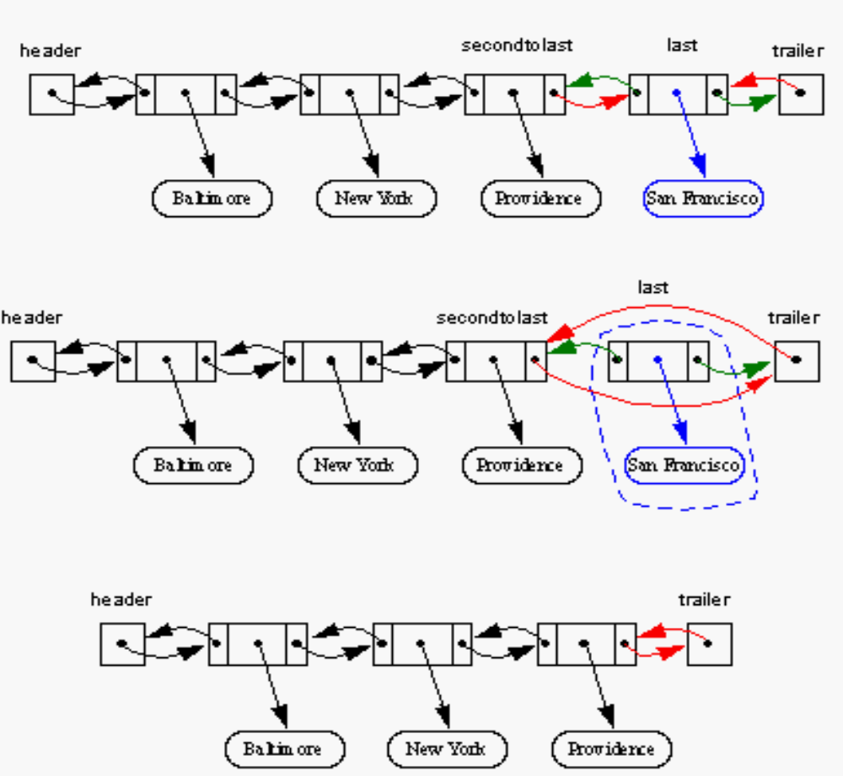
Here’s a visualization of the code for removeLast().

Slide 33
Summary
Method | LLS Node front; int size; | DLS Node front; Node tail; int size; | Array Object Q[N]; int size; | Circular Array Object Q[N]; int f; int r;
insertFirst | O(1) | O(1) | O(n) error if array is full | O(1) error if array is full
insertLast | O(n) | O(1) | O(1) error if array is full | O(1) error if array is full
removeFirst | O(1) | O(1) | O(n) | O(1)
removeLast | O(n) | O(1) | O(1) | O(1)
isEmpty | O(1) | O(1) | O(1) | O(1)
size | O(1) | O(1) | O(1) | O(1)
Space used | O(n) | O(n) | O(N) | O(N)

Slide 34
The Adapter Pattern
Adaptor patterns implement a class by using methods of another class
In general, adapter classes specialize general classes
Two such applications:
  Specialize a general class by changing some methods.
    Ex: implementing a stack with a deque.
  Specialize the types of objects used by a general class.
    Ex: Defining an IntegerArrayStack class that adapts ArrayStack to only store integers.

Slide 35
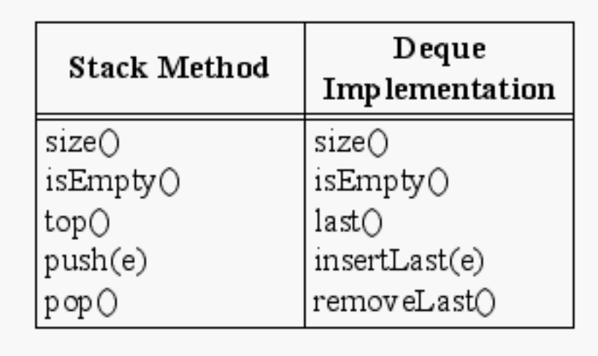
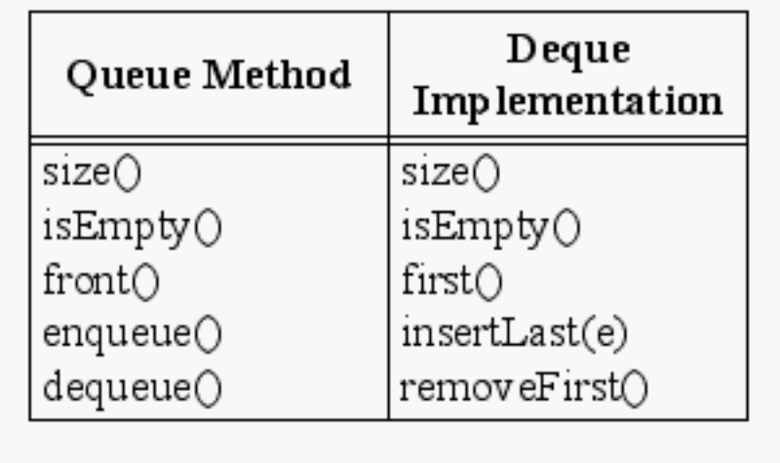
Implementing Stacks and Queues
Stacks with Deques:
Queues with Deques:

Slide 36
Other examples to apply the Adapter Pattern
We already used it when implementing a queue with 2 stacks.
We can also implement a stack with 1 queue. How? Is it efficient?
Notes:
Una de las operaciones push/pop tendrá que ser costosa

Slide 37
The Growable Array
N
2N

Slide 38
Array Implementations
Array has a limited size
  FullQueueException
  FullStackException
Why don’t we replace the array with a larger one when we run out of space in the array!
Notes:
What do they mean in circular fashion here?

Slide 39
Growable Array
Let us consider the stack case:
  In a push operation, when the array is full, instead of throwing an exception, we can replace the array with a larger one
How large should the new array be?
  incremental strategy
    increase the size by a constant c
  doubling strategy
    double the size
The space use of a growable array is O(n)

Slide 40
Growable Array
Algorithm push(o)
if t = S.length − 1 then
A ← new array of
size …
for i ← 0 to t do
A[i] ← S[i]
S ← A
t ← t + 1
S[t] ← o

Slide 41
Incremental vs Doubling Strategies
To compare we analyze the total time T(n) needed to perform a series of n push operations
We assume that we start with an empty stack represented by an array of size 1
We call amortized time of a push operation the average time taken by a push over the series of operations, i.e., T(n)/n

Slide 42
Incremental Strategy Analysis
We replace the array k = (n-1)/c times
The total time T(n) of a series of n push operations is proportional to
n +1+(1+ c)+(1+ 2c)+(1+ 3c)+ … +(1+ (k-1)c) =
n + k + c + 2c + 3c + 4c + … + (k-1)c =
n + k + c(1 + 2 + 3 + … + (k-1)) =
n + k + c(k-1)k/2
Since c is a constant, T(n) is O(n + k + k²), i.e., O(n²)
The amortized time of a push operation is O(n)
Notes:
Ej. C = 2
x oo xx oo xx ->(9-1)/2=4 “cambios de color”

Slide 43
Doubling Strategy Analysis
We replace the array k = log₂ n times
The total time T(n) of a series of n push operations is proportional to
n + 1 + 2 + 4 + 8 + …+ 2^{k-1} =
n + 2^{k} −1 = 2n −1
T(n) is O(n)
The amortized time of a push operation is O(1)
geometric series
2
4
1
1
8
Notes:
log 5=2.32
To insert 5 elements I need to update the size 3 times!
1-2-4-8
sum_i=0^n a^i= (1-a^{n+1})/(1-a)

Slide 44
Amortized Time of Push Operator
Incremental Strategy
  n’=n+c
  Amortized time of push: O(n)
Doubling Strategy
  n’=2n
  Amortized time of push: O(1)
Multiply by c the size
  n’=cn
  Amortized time of push: O(1)
  Used in practice! Java's ArrayList uses c = 3/2 and Python's list data structure uses c = 9/8
Any other choice?
  Squaring: n’=n*n
  Amortized time of push???

Slide 45
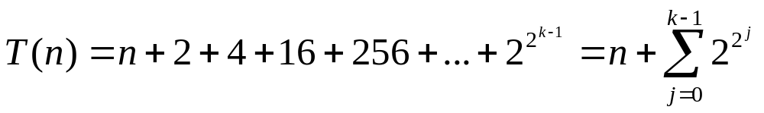
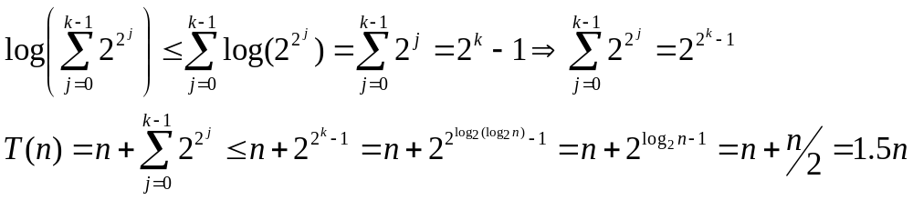
Squaring Strategy
N
N²
We replace the array k = log₂(log₂(n)) times
The total time T(n) of a series of n push operations is proportional to
Log has the following property:
Therefore:
T(n) is O(n) and the amortized time of a push operation is O(1)

