Slide 1
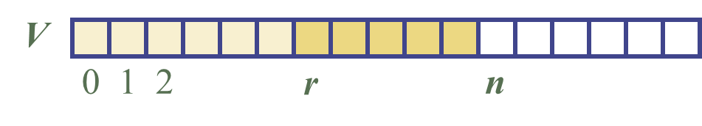
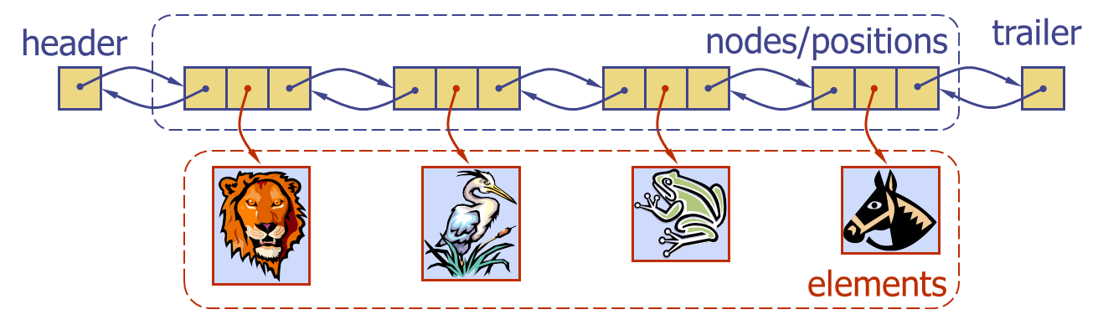
Vectors and Lists

Slide 2
How have we implement our ADTs so far?
  Array
  (Singly-Doubly) Linked List
But, shouldn’t they also have an associated ADT?
  Array Vector
  Linked-List List
Vector and List are abstractions and extensions of Array and Linked List resp.

Slide 3
Vectors (a.k.a. Array Lists)

Slide 4
The Vector ADT
The Vector ADT is an abstraction and extension of the Array data structure
A vector is a data structure that stores a collection of objects that can be accessed and modified using a rank (the position within the data structure)
  A rank in a Vector corresponds to the index in an Array
  An exception is thrown if an incorrect rank is specified (e.g., a negative rank)
Differences with an Array:
  Vector is an ADT!
  An array is of a fixed size, but a Vector expands as you add things to it

Slide 5
The Vector ADT
Main vector operations:
  object elemAtRank(integer r)
    returns the element at rank r without removing it
  object replaceAtRank(integer r, object o)
    replace the element at rank with o and return the old element
  insertAtRank(integer r, object o)
    insert a new element o to have rank r
  object removeAtRank(integer r)
    removes and returns the element at rank r
Additional operations size() and isEmpty()

Slide 6
Applications of Vectors
Direct applications
  Sorted collection of objects
Indirect applications
  Auxiliary data structure for algorithms
  Component of other data structures

Slide 7
Array-based Vector
Use an array V of size N
A variable n keeps track of the size of the vector (number of elements stored)
Operation elemAtRank(r) is implemented in O(1) time by returning V[r]
V
0
1
2
r
n

Slide 8
Insertion
In operation insertAtRank(r, o)
  we need to make room for the new element by shifting forward the n − r elements V[r], …, V[n − 1]
  In the worst case (r = 0), this takes O(n) time
V
0
1
2
r
n
V
0
1
2
r
n
V
o
0
1
2
r
n

Slide 9
Deletion
In operation removeAtRank(r), we need to fill the hole left by the removed element by shifting backward the n − r − 1 elements V[r + 1], …, V[n − 1]
In the worst case (r = 0), this takes O(n) time
V
o
0
1
2
r
n
V
0
1
2
r
n
V
0
1
2
r
n

Slide 10
Performance
In the array based implementation of a Vector
  The space used by the data structure is:
    O(n) (amortized analysis)
  size, isEmpty, elemAtRank and replaceAtRank run in:
    O(1) time
  insertAtRank and removeAtRank run in
    O(n) time
Notes:
What do they mean in circular fashion here?

Slide 11
The Adapter Pattern
Let us implement Deque using a Vector!
Deque Method | Vector Method
size() | size()
isEmpty() | isEmpty()
first() | elemAtRank(0)
last() | elemAtRank(size()-1)
insertFirst(e) | insertAtRank(0,e)
insertLast(e) | insertAtRank(size(),e)
removeFirst() | removeAtRank(0)
removeLast() | removeAtRank(size()-1)
O(n)
O(1)
O(n)
O(1)
Running time?

Slide 12
Can we improve the performance?
If we use the array in a circular fashion, insertAtRank(0) and removeAtRank(0) run in O(1) time
V
rank
0
1
2
r
n
i=r-1
index
0
1
2
i
n
Notes:
What do they mean in circular fashion here?

Slide 13
Lists

Slide 14
Lists
Lists can be seen as an abstraction and generalization of Linked-List
A list is a data structure that stores a collection of objects that support the efficient execution of node-based operations:
  We can remove/add at a node only affecting the adjacent nodes (constant time operations)
We cannot add this operations directly to list because nodes are implementation specific!
  This goes against the spirit of ADT
  If we choose to implement with an array there are no nodes in that context

Slide 15
Position ADT
The Position ADT models the notion of place within a data structure where a single object is stored
It gives a unified view of diverse ways of storing data, such as
  a cell of an array
  a node of a linked list
Just one method:
  object element(): returns the element stored at the position
How do we implement the Position ADT?
  Index if an array is used
  Node if a linked-list is used

Slide 16
List ADT
The List ADT models a sequence of positions storing arbitrary objects
It establishes a before/after relation between positions
Generic methods:
  size()
  isEmpty()

Slide 17
List ADT
Accessor methods:
  first(), last()
  prev(position p), next(position p)
Update methods:
  replace(position p, object e)
  insertBefore(position p, object e)
  insertAfter(position p, object e),
  insertFirst(object e), insertLast(object e)
  remove(position p)
  swap(position p, position q)

Slide 18
Implementation
First we need to implement the ADT position
If we will use a linked list to implement List, then an implementation of Position could be Node
Nodes implement Position and stores:
  element
  link to the previous node
  link to the next node
prev
next
elem
node

Slide 19




Implementation
A doubly linked list provides a natural implementation of the List ADT
Special trailer and header nodes
header
nodes/positions
trailer
elements

Slide 20
Insertion
We visualize operation insertAfter(p, X), which returns position q
p
A
B
C
p
A
B
q
C
X
p
q
A
B
X
C

Slide 21
Insertion Algorithm
Algorithm insertAfter(p,e)
Input element e to insert after position p
Output the position of element e
Create a new node v
set the element in v to e
v.setPrev(p) {link v to its predecessor}
v.setNext(p.getNext()) {link v to its successor}
(p.getNext()).setPrev(v) {link p’s old successor to v}
p.setNext(v) {link p to its new successor, v}
return node v

Slide 22
Deletion
We visualize remove(p), where p = last()
p
A
B
C
D
A
B
C
p
D
A
B
C

Slide 23
Deletion Algorithm
Algorithm remove(p)
Input position p to remove
Output the element e in position p
e ← element in p
(p.getPrev()).setNext(p.getNext()) {linking out p}
(p.getNext()).setPrev(p.getPrev())
p.setPrev(null) {invalidating the position p}
p.setNext(null)
return e

Slide 24
Performance
In the implementation of the List ADT by means of a doubly linked list
  The space used by a list with n elements is:
    O(n)
  The space used by each position of the list:
    is O(1)
  All the operations of the List ADT run in:
    O(1) time
  Operation element() of the Position ADT runs in:
    O(1) time

Slide 25
Code
How can we implement List with an array?
  Will this implementation be as efficient as the one based in Linked lists?

Slide 26

7. Sequences

Slide 27
Sequence ADT
The Sequence ADT is the union of the Vector and List ADTs
  Example of multiple inheritance
Elements accessed by
  Rank, or
  Position
Generic methods:
  size(),
  isEmpty()

Slide 28
Sequence ADT
Vector-based methods:
  elemAtRank(r), replaceAtRank(r, o),
  insertAtRank(r, o), removeAtRank(r)
List-based methods:
  first(), last(), prev(p), next(p), replace(p, o), insertBefore(p, o), insertAfter(p, o), insertFirst(o), insertLast(o), remove(p), swap(p,q)
Bridge methods:
  atRank(r): returns the position at rank r
  rankOf(p): returns the rank of position p

Slide 29
Applications of Sequences
The Sequence ADT is a basic, general-purpose, data structure for storing an ordered collection of elements
Direct applications:
  Generic replacement for stack, queue, vector, or list
    It can be used to implement them using the Adapter Pattern
  Small database (e.g., address book)
Indirect applications:
  Building block of more complex data structures

Slide 30
Linked List Implementation
A doubly linked list provides a reasonable implementation of the Sequence ADT
header
nodes/positions
trailer
elements

Slide 31
Linked List Implementation
Nodes implement Position and store:
  element
  link to the previous node
  link to the next node
Special trailer and header nodes
Position-based methods run in constant time
Rank-based methods:
  require searching from header or trailer while keeping track of ranks
  Running Time:
    O(n)

Slide 32
Array-based Implementation
Would storing the objects directly in the circular array be a possible implementation?
What would be the implementation of position?
  How do we implement the element() method of position?
elements
S
f
l
We cannot implement Sequence in this way…
Notes:
We can define a position object p to hold an index i and a reference to array S.
Element(p) returns S[i]
However, we cannot map from cells to positions. Thus, after an insertFirst, we have no way of informing the existing positions in S that their ranks each went up by 1

Slide 33
Array-based Implementation
We use a circular array storing positions
A position object stores:
  Element
  Index
Indices f and l keep track of first and last positions
elements
0
1
2
3
positions
S
f
l

Slide 34
Sequence Implementations
Operation | Array O() | List O()
size(), isEmpty() | 1 | 1
atRank(r), rankOf(p), elemAtRank(r) | 1 | n
first(), last(), prev(p), next(p) | 1 | 1
replace(p,o),swap(p,q) | 1 | 1
replaceAtRank(r,o) | 1 | n
insertAtRank(r,o), removeAtRank(r) | n | n
insertFirst(o), insertLast(o) | 1 | 1
insertAfter(p,o), insertBefore(p,o) | n | 1
remove(p) | n | 1
Notes:
insertFirst en array es O(1) con arreglos circulares… y algo de trabajo (ver pag. 210 de libro)

Slide 35
Which implementation is better?
Each implementation has its own advantages and disadvantages.
Linked list implementation will use space more efficiently than array implementation.
The linked list implementation has a constant factor overhead to maintain the pointers
Which implementation is better depends on which method the application needs to use more frequently.

Slide 36
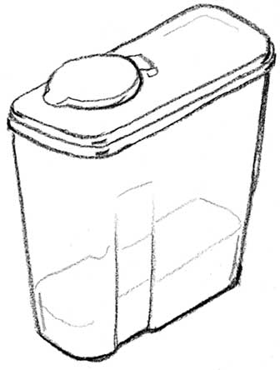
8. Containers and Iterators

Slide 37
Container
A container is a data structure that stores a collection of objects.
  Stacks
  Queues
  Vectors
  Lists
  Sequences
Each container has different ways to access, add, remove, update or manipulate elements stored in it.
But, implementation is hidden from the user.

Slide 38
Enumerating Elements
Container need to provide means to enumerate all the members one by one.
  Using the rank, we may process all members in a vector one by one.
  Using positions, we may walk through a List container.
In some cases the user code has to enumerate the members in a container
  The user code has to know the actual implementation of the container!!

Slide 39
Example
Suppose we define a container called Set with methods to:
  add a new member to a container
  delete a specified member from a container
  check to see if a given member is in the container.
Set can be implemented by either an array or a linked list.
If the container is implemented as an array:
for (int index = 0; index < size-of-the-container; ++index)
{ do something for the current member; }
If a container is implemented as a linked list:
for (ref = first; ref != null; ref = ref.getnext()) { do something for the current member; }

Slide 40
Do we want this?
This goes against the ADT principles!
  We don’t want to reveal the implementation of the container
Solution:
  We may define another class called an iterator class
    This class should be associated with a container class

Slide 41
Iterators
An iterator abstracts the process of scanning through a container (collection of elements)
Methods of the ObjectIterator ADT:
  boolean hasNext()
  object nextObject(): returns the objects and moves to the next element in the container
  void reset() (optional)
Extends the concept of Position by adding a traversal capability
Notes:
Verificar que hace cada funcion

Slide 42
Use of Iterator
The elements of, for example, a list l can be traversed using the iterator as follows:
  list<int> myList;
  myList.push_back(5);
  myList.push_back(7);
  myList.push_back(0);
  for(list<int>::iterator it= myList.begin(); it!=myList.end(); ++it) {
  cout << *it << " ";
  }
Notes:
Notar que es un poco diferente de lo presentado en la anterior (sintaxis Java)

Slide 43
Iterators Implementation
An iterator class
  A field, which is a reference to an object of a container class
  A field to represent a member in this container
    Array Implementation: the index of a member of an array
    Linked List Implementation: a reference to a node in a linked list.

Slide 44
Stack Iterators
public class ArrayStack implements Stack {
protected int capacity;
protected Object S[];
protected int top = -1;
…
public elements(){ return new ElemIterator();}
…
private class ElemIterator implements Iterator {
private int cursor= 0;
public boolean hasNext() {
return (cursor <= top);
}
public Object next() {
if (cursor==-1) throw ERROR;
Object toReturn = S[cursor];
cursor ++;
return toReturn;
}
}
public class NodeStack implements Stack {
protected Node head;
protected int size;
…
public elements(){ return new ElemIterator();}
…
private class ElemIterator implements Iterator {
private Node cursor= head;
public boolean hasNext() {
return (cursor != null);
}
public Object next() {
if (cursor==null) throw ERROR;
Object toReturn = cursor.getElement();
cursor =cursor.getNext();
return toReturn ;
}
}

