Slide 1
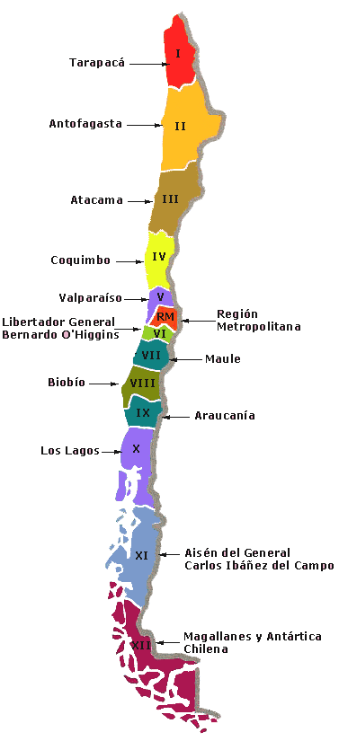
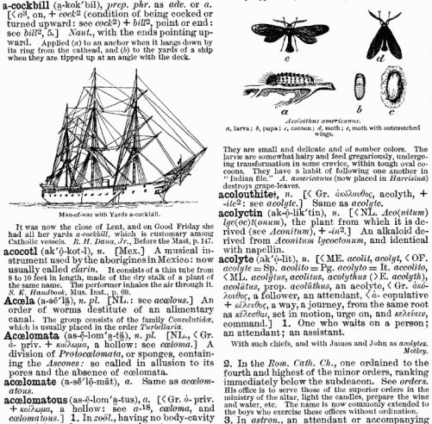
Dictionaries and Maps

Slide 2
Dictionaries
The dictionary ADT models a searchable collection of key-value entries
The main operations of a dictionary are searching, inserting, and deleting items
Multiple items with the same key are allowed
Applications:
  word-definition pairs
  credit card authorizations
  DNS mapping of host names (e.g., datastructures.net) to internet IP addresses (e.g., 128.148.34.101)

Slide 3
Dictionary ADT
Dictionary ADT methods:
  find(k): if the dictionary has an entry with key k, returns it, else, returns null
  findAll(k): returns an iterator of all entries with key k
  insert(k, o): inserts and returns the entry (k, o)
  remove(e): remove the entry e from the dictionary
    To remove all entries with a key k run remove for all entries returned by findAll(k)
  entries(): returns an iterator of the entries in the dictionary
  size(), isEmpty()

Slide 4
Maps
A map models a searchable collection of key-value entries
The main operations of a map are for searching, inserting, and deleting items
Multiple entries with the same key are not allowed
Applications:
  address book
  student-record database

Slide 5
The Map ADT
Map ADT methods:
  get(k): if the map M has an entry with key k, return its associated value; else, return null
  put(k, v): insert entry (k, v) into the map M; if key k is not already in M, then return null; else, return old value associated with k
  remove(k): if the map M has an entry with key k, remove it from M and return its associated value; else, return null
  size(), isEmpty()
  keys(): return an iterator of the keys in M
  values(): return an iterator of the values in M

Slide 6
In standard libraries
Map ADT | java.util.Map | STL Map (ordered map)
size() isEmpty() get(k) put(k,v) remove(k) keys() values() | size() isEmpty() get(k) put(k,v) remove(k) keySet().iterator() values().iterator() | size() empty() at(k), [k],find(k) [k]=v, insert(pair<k,v>) erase(k) begin() //first begin() //second

Slide 7
Implementations
Maps and Dictionaries can be implemented in several ways (with some modifications to deal with repeated keys):
  Array
    Ordered
    Unordered
  Linked List
    Ordered
    Unordered
Hash Tables
Trees
  Binary Search Tree
  AVL Tree
  B-Tree
  Red-Black Trees
  …

Slide 8
Hash Tables
0
∅
1
025-612-0001
2
981-101-0002
3
∅
4
451-229-0004

Slide 9
Hash Tables
Hash Tables are a data structure to implement Maps
Maps:
  Models a searchable collection of key-value entries
  The main operations of a map are for searching, inserting, and deleting items
  Multiple entries with the same key are not allowed
  Unordered maps
Notes:
Hashing (unordered maps) vs BST (ordered maps)

Slide 10
Hashing
Suppose we were to come up with a “magic function” that, given a value to search for, would tell us exactly where in the array to look
  If it’s in that location, it’s in the array
  If it’s not in that location, it’s not in the array
This function would have no other purpose
If we look at the function’s inputs and outputs, they probably won’t “make sense”
  The output has to look as a random number even though it is not

Slide 11
Example perfect hash function
0
1
2
3
4
5
6
7
8
9
kiwi
Suppose our hash function gave us the following values:
  hashCode("apple") = 5
  hashCode("watermelon") = 3
  hashCode("grapes") = 8
  hashCode("cantaloupe") = 7
  hashCode("kiwi") = 0
  hashCode("strawberry") = 9
  hashCode("mango") = 6
  hashCode(“orange") = 2
One element per bucket (position in the array)
orange
watermelon
apple
mango
cantaloupe
grapes
strawberry

Slide 12
Finding the hash function
How can we come up with this magic function?
In general, we cannot – there is no such magic function ☹
  In a few specific cases, where all the possible values are known in advance, it has been possible to compute a perfect hash function
Notes:
What is the next best thing?
A perfect hash function would tell us exactly where to look
In general, the best we can do is a function that tells us where to start looking!

Slide 13
Example imperfect hash function
Suppose our hash function gave us the following values:
  hash("apple") = 5
  hash("watermelon") = 3
  hash("grapes") = 8
  hash("cantaloupe") = 7
  hash("kiwi") = 0
  hash("strawberry") = 9
  hash("mango") = 6
  hash(“orange") = 2
  hash("honeydew") = 6
0
1
2
3
4
5
6
7
8
9
kiwi
orange
watermelon
apple
mango
cantaloupe
grapes
Now what?
  We will need to deal with collisions…
strawberry

Slide 14
Hash Functions and Hash Tables
A hash function h maps keys of a given type to integers in a fixed interval [0, N - 1]
Example:
h(x) = x mod N
is a hash function for integer keys
The integer h(x) is called the hash value of key x
A hash table for a given key type consists of
  Hash function h
  Array (called table) of size N
  Positions in the table are called buckets
When implementing a map with a hash table, the goal is to store item (k, o) at index h(k)

Slide 15
Implementing Map with a Hash Table
Using a Hash Table with a perfect hash function h(k)
  get(k): look at position h(k) in the table. If k is found in that position, then return its associated value; else, return null
  put(k, v): insert entry (k, v) into position h(k) in the table if key k is not already in return null; else, return old value associated with k
  remove(k): look at position h(k) in the table. If k is found in that position remove it from M and return its associated value; else, return null
What if the Hash function is not perfect?
  We need to deal with colissions!!

Slide 16
Collisions

Slide 17
Collisions
When two values hash to the same array location, this is called a collision
Collisions are normally treated as “first come, first served”—the first value that hashes to the location gets it
We have to find something to do with the second and subsequent values that hash to this same location
451-229-0004
4
981-101-0004
4

Slide 18
Handling collisions
What can we do when two different values attempt to occupy the same place in an array?
  Open Addressing: we use the empty places in the array
    Linear Probing: handles collisions by placing the colliding item in the next (circularly) available table cell
    Double hashing: Uses a second hash function to find a position
      ...and a third, and a fourth, and a fifth, ...
  Separate Chaining : Use the array location as the header of a linked list of values that hash to this location

Slide 19
Handling collisions
Both Open Addressing and Separate Chaining can be used to deal with collisions
  The same technique has to be used to add things to the array as we use to search for things in the array
10
41
18
44
59
32
22
31
73
12
0
1
2
3
4
5
6
7
8
9
10
11
12
0
1
2
3
4
5
6
7
8
9
10
11
12
41
18
59
22
32
73
44
31

Slide 20
Linear Probing
Linear Probing handles collisions by placing the colliding item in the next (circularly) available table cell
Each table cell inspected is referred to as a “probe”
Colliding items produce clusters, causing future collisions to cause a longer sequence of probes

Slide 21
Linear Probing
Example:
  h(x) = x mod 13
  Insert keys 18, 41, 22, 44, 59, 32, 31, 73, 12, 18, 10 in this order
    h(18)=5
    h(41)=2
    h(22)=9
    h(44)=5
    h(59)=7
    h(32)=6
    h(31)=5
    h(73)=8
    h(12)=12
    h(18)=5
    h(10)=10
0
1
2
3
4
5
6
7
8
9
10
11
12
10
41
18
44
59
32
22
31
73
12
0
1
2
3
4
5
6
7
8
9
10
11
12
18 is already there so it is not inserted!
The table is circular!

Slide 22
Search with Linear Probing
Consider a hash table A that uses linear probing
get(k)
  We start at cell h(k)
  We probe consecutive locations until one of the following occurs
    An item with key k is found, or
    An empty cell is found, or
    N cells have been unsuccessfully probed
Algorithm get(k)
i ← h(k)
p ← 0
repeat
c ← A[i]
if c = ∅
return null
else if c.key () = k
return c.element()
else
i ← (i + 1) mod N
  p ← p + 1
  until p = N
return null

Slide 23
Updates with Linear Probing
To handle insertions and deletions, we introduce a special object, called AVAILABLE, which replaces deleted elements
remove(k)
  We search for an entry with key k
  If such an entry (k, o) is found, we replace it with the special item AVAILABLE and we return element o
  Else, we return null
put(k, o)
  We throw an exception if the table is full
  We start at cell h(k)
  We probe consecutive cells until one of the following occurs
    A cell i is found that is either empty or stores AVAILABLE, or
    N cells have been unsuccessfully probed
  We store entry (k, o) in cell i
Notes:
AVAILABLE is needed so that when we search we DON’T stop if there is a cell labled available (the key might be afterwards)

Slide 24
Clustering
One problem with the above technique is the tendency to form “clusters”
A cluster is a group of items not containing any open slots
The bigger a cluster gets, the more likely it is that new values will hash into the cluster, and make it even bigger
Clusters cause efficiency to degrade
Here is a non-solution: instead of stepping one ahead, step n locations ahead
  The clusters are still there, they’re just harder to see
  Unless n and the table size are mutually prime, some table locations are never checked

Slide 25
Applet
Hash Tables
  http://groups.engin.umd.umich.edu/CIS/course.des/cis350/hashing/WEB/HashApplet.htm

Slide 26
Double Hashing
Given a hash function h(k), double hashing uses a secondary hash function d(k) and handles collisions by placing an item in the first available cell of the series
    (h(k) + jd(k)) mod N for j = 0, 1, … , N
The secondary hash function d(k) cannot have zero values
The table size N must be a prime

Slide 27
Double Hashing
Common choice of compression function for the secondary hash function:
  d (k) = q – (k mod q)
where q < N and q is a prime
The possible values for d (k) are
1, 2, … , q
  It is never zero! If it was double hashing would not work!

Slide 28
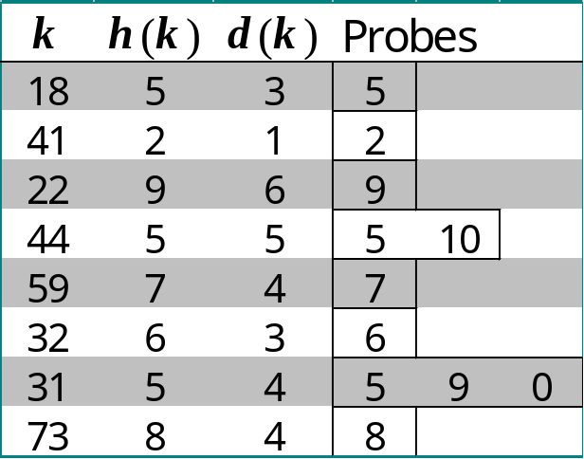
Example of Double Hashing
Consider a hash table storing integer keys that handles collision with double hashing
  N = 13
  h(k) = k mod 13
  d(k) = 7 − (k mod 7)
Insert keys 18, 41, 22, 44, 59, 32, 31, 73, in this order
0
1
2
3
4
5
6
7
8
9
10
11
12
31
41
18
32
59
73
22
44
0
1
2
3
4
5
6
7
8
9
10
11
12

Slide 29
Separate Chaining
The previous solutions used open addressing: all entries went into a “flat” (unstructured) array
Another solution is to make each array location the header of a linked list of values that hash to that location
Simple and efficient!

Slide 30
Separate Chaining
Example:
  h(x) = x mod 13
  Insert keys 18, 41, 22, 44, 59, 32, 31, 73 in this order
    h(18)=5
    h(41)=2
    h(22)=9
    h(44)=5
    h(59)=7
    h(32)=6
    h(31)=5
    h(73)=8
0
1
2
3
4
5
6
7
8
9
10
11
12
0
1
2
3
4
5
6
7
8
9
10
11
12
41
18
59
22
32
73
44
31

Slide 31
Load Factor and Rehashing
The load factor α = n/N affects the performance of a hash table
Assuming that the hash values are like random numbers, it can be shown that the expected number of probes for an insertion with open addressing is 1 / (1 − α)
The hash table might fill up; we need to be prepared for that
  Analysis shows that we should maintain:
    α < 0.5 for open addressing
    α < 0.9 for separate chaining
  If higher we need to rehash:
    Move elements to an array of at least double size
    Use a new hash function to copy elements one by one
      Usually just new parameters for the hash function
The default threshold for rehashing in java.util.HashMap is α = 0.75 while in C++ unordered_map is set to 1.0

Slide 32
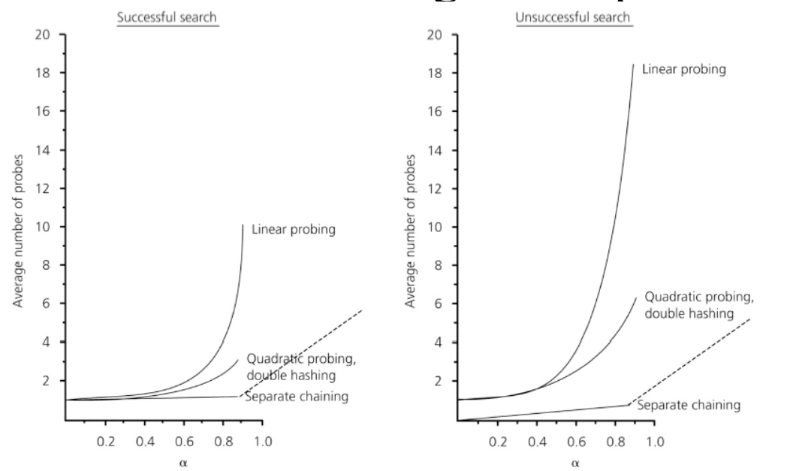
Comparison of techniques to handle collisions

Slide 33
Hash Functions

Slide 34
What is a good Hash Function?
The goal of the hash function is to “disperse” the keys in an apparently random way
Always return the same value for the same input
  It can’t use random numbers, or the time of day
Return the same value for equal inputs
  Must be consistent with your equals method: to objects that are considered equal should return the same value.
Should be efficient to compute
Should give a uniform distribution of array indices
Should not assign similar values to similar inputs
Does not need to return different values for different inputs

Slide 35
Example 1
We design a hash table for a map storing entries as (SIN, Name), where SIN (social insurance number) is a nine-digit positive integer
Our hash table uses an array of size N = 10,000 and the hash function
h₁(x) = first four digits of x
      Bad choice
h₂(x) = last four digits of x
h₂(x)
0
∅
1
025-612-0001
2
981-101-0002
3
∅
4
451-229-0004
…
9997
∅
9998
200-751-9998
9999
∅

Slide 36
Hash Functions
A hash function is usually specified as the composition of two functions:
Hash code:
h₁: keys → integers
Compression function:
h₂: integers → [0, N − 1]
The hash code is applied first, and the compression function is applied next on the result, i.e.,
h(x) = h₂(h₁(x))

Slide 37
Example 2
A List object is equal to another object iff:
  the other object is also a List and
  they contain the same elements (defined by Object.equals() on the elements) in the same order
A possible hashCode function could be for a list hashCode(List l):
  hashCode(List l){
  hashCode = 1;
  Iterator i = l.iterator();
  while (i.hasNext()) {
    Object obj = i.next();
    hashCode = 31*hashCode + (obj==null ? 0 : obj.hashCode());
    }
    return hashCode}
  A possible compression function to an array of size N is:
    compress(integer n){
    return (n % N) ;} //n mod N

Slide 38
Hash Codes: Memory address
We reinterpret the memory address of the key object as an integer (default hash code of all Java objects)
Good in general, except for numeric and string keys
0xABCDABCD
025-612-0001
2
0xABCDABCD
They will have different hash values
2
0xFAABFAAB

Slide 39
Hash Codes: Integer Cast
We reinterpret the bits of the key as an integer
Suitable for keys of length less than or equal to the number of bits of the integer type (e.g., byte, short, int and float)
  Example: characters is mapped to its ASCII code.
  A=65=01000001, B=66=01000010, …
  a=97=01100001, b=98 , …
  ,=44 , .=46
  Basically it corresponds to casting:
  int intKey = (int) ‘A’ = 65
Data type | # of bits
byte | 8
char | 8
int | 32
float | 32
double | 64
long | 64

Slide 40

Hash Codes: Component sum
We partition the bits of the key into components of fixed length (e.g., 16 or 32 bits) a₀ a₁ … a_{n−1} and we sum the components (ignoring overflows) a₀ + a₁ + a₂ + … +a_{n−1}
For partitions of 32 bits it would be:
  X = (X_{0,} X₁, …, X_{k-1})
32-bits 32-bits 32-bits
Suitable for keys with # of bits ≥ # of bits in int type

Slide 41
Hash Codes: Component sum
Example: AB=0100000101000010
  h₁(AB)= 01000001
  + 01000010
  10000011
Example: h₁(1000000110000010)=
  10000001
  + 10000010
  00000011 (ignore overflows)

Slide 42
Hash Codes: Component sum
In the case of numeric keys they need to have a length greater than or equal to the number of bits of the integer type (e.g., long and double)
Example We want the Hash code of 4292967299 (which is a long of 64 bits) to components of 32 bits
  long i = 4292967299 = 3x00000000 00000001 00000000 00000000 00000000 00000011
  X₀= 00000000 00000000 00000000 00000011
  X₁= 00000000 00000000 00000000 00000001
  h₁(4292967299)= X₀+ X₁ ₌ 00000000 00000000 00000000 00000100 = 4
Implementation:
int hashCode(long i){return ((int) i + (int) (i>>32))}
  i >> j denotes the result of shifting the bits of i right by distance j

Slide 43
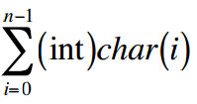
Hash Codes: Component sum
Strings
string ={char(0),char(1),…,char(n −1)}
  ⇒ h1(string) =
Examples:
  string1=“NOTE”={‘N’,’O’,’T’,’E’} h1(word1)=78+79+84+69=310
  string1=“STOP”={‘S’,’T’,’O’,’P’} h1(word1)=83+84+79+80=326
What happens with TONE or SPOT?
  Same hash value which is not very good
  The order is relevant

Slide 44
Hash Codes: Polynomial accumulation
Polynomial accumulation:
  We partition the bits of the key into a sequence of components of fixed length (e.g., 8, 16 or 32 bits)
  a₀ a₁ … a_{n−1}
  We evaluate the polynomial
  p(z) = a₀ + a₁ z + a₂ z² + … + a_{n−1}z^{n−1}
  at a fixed value z, ignoring overflows
  Especially suitable for strings
    z = 33 gives at most 6 collisions on a set of 50,000 English words
  Polynomial p(z) can be evaluated in O(n) time (Horner’s rule)
Notes:
Horner’s rule:
The following polynomials are successively computed, each from the previous one in O(1) time
p₀(z) = a_{n−1}
p_{i} (z) = a_{n−i−1} + zp_{i−1}(z)
(i = 1, 2, …, n −1)
We have p(z) = p_{n−1}(z)

Slide 45
Compression Functions
Division:
  h₂ (y) = y mod N
  The size N of the hash table is usually chosen to be a prime
    The reason has to do with number theory and is beyond the scope of this course
  Example: keys: {200, 205, 210, 215, 220,…, 600}.
    If N=100, 200 and 600 have the same code, i.e., 0.
    It is better to choose N=101.
Hash Tables

Slide 46

Compression Functions
Multiply, Add and Divide (MAD):
  h₂ (y) = (ay + b) mod N
  a >0 and b>0 are nonnegative integers such that
  a mod N ≠ 0 and N is a prime number.
  Example: Keys={200, 205, 210, 215, 220, 600}.
  N=101. a=3 and b=7.
    h(200)=(600+7) mod 101 = 607 mod 101=1.
    H(205)=(615+7) mod 101 = 622 mod 101=16.
    h(210)=(630+7) mod 101 = 637 mod 101=31.
    h(215)=(645+7) mod 101 = 652 mod 101=46.
    h(220)=(660+7) mod 101 = 667 mod 101=61.
    H(600)=(3600 +7) mod 101=3607 mod 101=72.
Hash Tables

Slide 47
Another Hash function for string keys
Each letter is ASCII character with 7-bit encoding, base 128 number.
Algorithm hash(String s, int N)
{ int h = 0;
int a = 127;
for {every char v in s}
h = (a*h + v) % N;
return h;
}
size of the Hash Table
Prime 127 is used instead of 128.
The algorithm can be used to compute hash value for a long string.

Slide 48
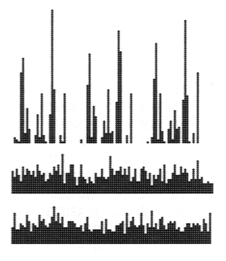
Experiment
1000 distinct words of Moby Dick
Top: histogram with
N=96, a=128.
Middle:
N=97, a=128.
Bottom:
N=96, a=127.

Slide 49
Exercise
Suppose you are given the following class Person:
    public class Person {
    private String name;
    private String gender; // either "M" or "F"
    private Person fiancee; // null if single
    private Queue<String> preferences;
    ...
    }
Write an equals method for the Person class. Two persons should be considered equal if they: have the same name, gender, preferences, and fiancée.
  If a null is given to check equality the method should return false.
Write a hashCode method for the Person class. Your hash code function should distribute codes effectively among persons.
  Be mindful that your methods should not produce infinite recursion by calling them on other Person objects. To get around this, you can compare fiancées using == in the equals method, and simply incorporate whether the person has a fiancée as a true/false value in your hashCode.
Write a Comparator that arranges persons by gender (men first, then women), and within the same gender by alphabetical order of the persons names
  You may assume that the name, gender, and preferences are not null, but the fiancée could be.
  You may assume that null is not passed to your Comparator.

Slide 50
Hash in Java
public int hashCode() is a Hash Code function defined in Object
Like equals, the default implementation of hashCode just uses the address of the object—probably not what you want for your own objects
You can override hashCode for your own objects
As you might expect, String overrides hashCode with a version appropriate for strings

Slide 51
Hash tables in Java
Java provides two classes, Hashtable and HashMap classes (java.util)
Both are maps: they associate keys with values
Hashtable is synchronized; it can be accessed safely from multiple threads
  Hashtable uses an open hash, and has a rehash method, to increase the size of the table
HashMap is newer, faster, and usually better, but it is not synchronized
  HashMap uses a bucket hash, and has a remove method

Slide 52
Performance of Hashing
In the worst case (without rehashing) searches, insertions and removals on a hash table take O(n) time
  The worst case occurs when all the keys inserted into the map collide
The expected running time of all the map ADT operations in a hash table is O(1)
Applications of hash tables:
  small databases
  compilers
  browser caches

Slide 53
Performance Comparison for implementations of Map ADT
 | worst case |  |  | average case
 | put | get | remove | put | get | remove
ordered array | n | log n | n | n | log n | log n
ordered linked list | n | n | n | n | n | n
unordered array | 1 | n | n | 1 | n | n
unordered linked list | 1 | n | n | 1 | n | n
binary search tree | n | n | n | log n | log n | log n
AVL tree | log n | log n | log n | log n | log n | log n
hashing | n (for open addresing 1 (for separate chainging) | n | n | 1 | 1 | 1

Slide 54
Implementing a Dictionary
Unordered Linked List
  insert: O(1)
  remove, removeAll: O(n)
  find, findAll: O(n)
Hash Table
  For load factor <1
  insert: O(1)
  remove, find:
    O(1) in average
    O(n) in worst case
  FindAll:
    O(1+m) in average (where m is the number of entries returned)
    O(n) in worst case
Ordered Vector
  insert: O(n)
  remove, removeAll: O(n)
  Find: O(log n)
  findAll: O(log n+m) (where m is the number of entries returned)
Notes:
Logfile:
Lots of insertions, rearly a search (only in case of a crush)

