Slide 1
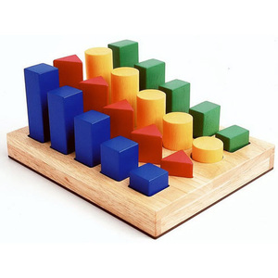
Sorting Algorithms based in Comparison

Slide 2
Sorting Algorithms
Given N items, rearrange them in ascending order.
We have seen most of the algorithms already!
There are many different algorithms to implement sorting:
  Based in Priority Queues:
    Selection Sort (PQ implemented with an unsorted array)
    Insertion sort (PQ implemented with a sorted array)
    Heap-sort (PQ implemented with a heap)
  Based in Divide and Conquer:
    Mergesort
    Quicksort
Applications: statistics, databases, data compression, computational biology, computer graphics, scientific computing,…

Slide 3
Priority Queue Sorting
Selection sort, and insertion sort are:
  O(n²)
  Selection sort and insertion sort are “good enough” for small arrays
  Insertion sort is usually the fastest of the two
    for small arrays (say, 10 or 15 elements), insertion sort is faster than more complicated sorting algorithms
Heap-sort is:
  O(n logn)

Slide 4
In-place Sorting
An algorithm can be implemented in-place if the same sequence that we want to sort can be used to sort the entries.
  No extra space is used!
Insertion, Selection and Heap sort can be implemented in-place
In the next slides we will see two examples.

Slide 5
In-place Selection sort
public void selectionSort(int[] a) {
int i, j, min;
for (i = 0; i < a.length - 1; i++) {
min = i;
for (j = i + 1; j < a.length; j++) {
if (a[j] < a[min]) {
min = j; }}
int temp = a[i];
a[i] = a[min];
a[min] = temp;
}
}
Running time is O(n²)
7
2
8
5
4
2
7
8
5
4
2
4
8
5
7
2
4
5
8
7
2
4
5
7
8

Slide 6
In-place Insertion sort
sorted
next to be inserted
3
4
7
12
14
14
20
21
33
38
10
55
9
23
28
16
temp
less than 10
10
3
4
7
10
12
14
14
20
21
33
38
55
9
23
28
16
sorted

Slide 7
In-place Heap-sort
Instead of using an external heap, we can implement heap-sort in-place
A portion of the input array itself serves as the heap
For in-place heap-sort
  The heap is kept at the beginning of the array
  We use swapElements to modify the array

Slide 8
Divide-and-Conquer Sorting
Divide-and conquer is a general algorithm design paradigm:
  Divide: divide the input data S in two disjoint subsets S₁ and S₂
  Recur: solve the subproblems associated with S₁ and S₂
  Conquer: combine the solutions for S₁ and S₂ into a solution for S
The base case for the recursion are subproblems of size 0 or 1 (small/easy problems, in general)
Mergesort and Quicksort are sorting algorithm based on the divide-and-conquer paradigm

Slide 9
Merge-Sort
Merge-sort on an input sequence S with n elements consists of three steps:
  Divide: partition S into two sequences S₁ and S₂ of about n/2 elements each
  Recur: recursively sort S₁ and S₂
  Conquer: merge S₁ and S₂ into a unique sorted sequence
Algorithm mergeSort(S, C)
Input sequence S with n elements, comparator C
Output sequence S sorted
  according to C
  if S.size() > 1
  (S₁, S₂) ← partition(S, n/2)
  mergeSort(S₁, C)
  mergeSort(S₂, C)
  S ← merge(S₁, S₂)

Slide 10
Merging Two Sorted Sequences
The conquer step of merge-sort consists of merging two sorted sequences A and B into a sorted sequence S containing the union of the elements of A and B
Merging two sorted sequences, each with n/2 elements and implemented by means of a doubly linked list, takes O(n) time
Algorithm merge(A, B)
Input sequences A and B with
n/2 elements each
Output sorted sequence of A ∪ B
  S ← empty sequence
  while ¬A.isEmpty() ∧ ¬B.isEmpty()
  if A.first().element() < B.first().element()
  S.insertLast(A.remove(A.first()))
  else
  S.insertLast(B.remove(B.first()))
  while ¬A.isEmpty() S.insertLast(A.remove(A.first()))
  while ¬B.isEmpty() S.insertLast(B.remove(B.first()))
  return S

Slide 11
Merge-Sort Tree
An execution of merge-sort is depicted by a binary tree
  each node represents a recursive call of merge-sort and stores
    unsorted sequence before the execution and its partition
    sorted sequence at the end of the execution
  the root is the initial call
  the leaves are calls on subsequences of size 0 or 1
7 2 ⏐ 9 4 → 2 4 7 9
7 ⏐ 2 → 2 7
9 ⏐ 4 → 4 9
7 → 7
2 → 2
9 → 9
4 → 4

Slide 12
Execution Example
7 2 9 4 ⏐ 3 8 6 1 → 1 2 3 4 6 7 8 9
1
14
7 2 ⏐ 9 4 → 2 4 7 9
3 8 6 1 → 1 3 6 8
2
8
7
13
7 ⏐ 2 → 2 7
9 4 → 4 9
3 8 → 3 8
6 1 → 1 6
3
5
9
11
4
6
10
12
7 → 7
2 → 2
9 → 9
4 → 4
3 → 3
8 → 8
6 → 6
1 → 1
Notes:
Para poner en vez de las anteriores cuando se imprime un pdf

Slide 13
Analysis of Merge-Sort
The height h of the merge-sort tree is O(log n)
  at each recursive call we divide in half the sequence,
The overall amount or work done at the nodes of depth i is O(n)
  we partition and merge 2^{i} sequences of size n/2^{i}
  we make 2^{i+1} recursive calls
Thus, the total running time of merge-sort is O(n log n)
depth | #seqs | size
0 | 1 | n
1 | 2 | n/2
i | 2^{i} | n/2^{i}
… | … | …

Slide 14
Summary
Algorithm | Time | Notes
selection-sort insertion-sort | O(n²) | slow in-place for small data sets (< 1K)
heap-sort | O(n log n) | fast in-place for large data sets (1K — 1M)
merge-sort | O(n log n) | fast difficult to implement in-place sequential data access excellent choice when data set cannot fit into main memory for huge data sets (> 1M)
Notes:
We can make better use of blocks of data brought from disk into main memory (minimizes the total number of disk reads)

Slide 15
Quick-Sort
Quick-sort is a sorting algorithm based on the divide-and-conquer paradigm:
  Divide: pick an element x (called pivot) and partition S into
    L elements less than x
    E elements equal x
    G elements greater than x
  Recur: sort L and G
  Conquer: join L, E and G
Can be implemented in-place
x
x
L
G
E
x

Slide 16
Quick-Sort
The pivot can be chosen in two ways:
  Deterministically:
    E.g. always the last of the sequence
  Randomly
    Algorithm is then called randomized Quick-sort
x
x
L
G
E
x

Slide 17
QuickSort (pivot: last element)
Dog Breeds
Bulldog
Rottweiler
Akita
Terrier
Doberman
Chihuahua
Dog Breeds
Bulldog
Akita
Chihuahua
Rottweiler
Terrier
Doberman
Smaller than Chihuahua
Apply quicksort
Final Position
Dog Breeds
Akita
Bulldog
Chihuahua
Doberman
Rottweiler
Terrier
Bigger than Chihuahua
Apply quicksort
Bulldog
Akita
Akita
Bulldog
Rottweiler
Terrier
Doberman
Doberman
Rottweiler
Terrier
Rottweiler
Terrier

Slide 18
Partition
After choosing the pivot we have to partition the sequence
We partition an input sequence as follows:
  We remove, in turn, each element y from S and
  We insert y into L, E or G, depending on the result of the comparison with the pivot x
Each insertion and removal is at the beginning or at the end of a sequence, and hence takes O(1) time
Thus, the partition step of quick-sort takes O(n) time
Algorithm partition(S, p)
Input sequence S, position p of pivot
Output subsequences L, E, G of the
elements of S less than, equal to,
or greater than the pivot, resp.
L, E, G ← empty sequences
  x ← S.remove(p)
  while ¬S.isEmpty()
  y ← S.remove(S.first())
  if y < x
  L.insertLast(y)
  else if y = x
  E.insertLast(y)
  else { y > x }
  G.insertLast(y)
  return L, E, G

Slide 19
Quick-Sort Tree
An execution of quick-sort is depicted by a binary tree
  Each node represents a recursive call of quick-sort and stores
    Unsorted sequence before the execution and its pivot
    Sorted sequence at the end of the execution
  The root is the initial call
  The leaves are calls on subsequences of size 0 or 1
7 4 9 6 2 → 2 4 6 7 9
4 2 → 2 4
7 9 → 7 9
2 → 2
9 → 9

Slide 20
Execution Example
Pivot selection
7 2 9 4 3 7 6 1 → 1 2 3 4 6 7 8 9
7 2 9 4 → 2 4 7 9
3 8 6 1 → 1 3 8 6
2 → 2
9 4 → 4 9
3 → 3
8 → 8
9 → 9
4 → 4

Slide 21
Execution Example (cont.)
Partition, recursive call, pivot selection
7 2 9 4 3 7 6 1 → 1 2 3 4 6 7 8 9
2 4 3 1 → 2 4 7 9
3 8 6 1 → 1 3 8 6
2 → 2
9 4 → 4 9
3 → 3
8 → 8
9 → 9
4 → 4

Slide 22
Execution Example (cont.)
Partition, recursive call, base case
7 2 9 4 3 7 6 1 → → 1 2 3 4 6 7 8 9
2 4 3 1 →→ 2 4 7
3 8 6 1 → 1 3 8 6
1 → 1
9 4 → 4 9
3 → 3
8 → 8
9 → 9
4 → 4

Slide 23
Execution Example (cont.)
Recursive call, …, base case, join
7 2 9 4 3 7 6 1 → 1 2 3 4 6 7 8 9
2 4 3 1 → 1 2 3 4
3 8 6 1 → 1 3 8 6
1 → 1
4 3 → 3 4
3 → 3
8 → 8
9 → 9
4 → 4

Slide 24
Execution Example (cont.)
Recursive call, pivot selection
7 2 9 4 3 7 6 1 → 1 2 3 4 6 7 8 9
2 4 3 1 → 1 2 3 4
7 9 7 1 → 1 3 8 6
1 → 1
4 3 → 3 4
8 → 8
9 → 9
9 → 9
4 → 4

Slide 25
Execution Example (cont.)
Partition, …, recursive call, base case
7 2 9 4 3 7 6 1 → 1 2 3 4 6 7 8 9
2 4 3 1 → 1 2 3 4
7 9 7 1 → 1 3 8 6
1 → 1
4 3 → 3 4
8 → 8
9 → 9
9 → 9
4 → 4

Slide 26
Execution Example (cont.)
Join, join
7 2 9 4 3 7 6 1 → 1 2 3 4 6 7 7 9
2 4 3 1 → 1 2 3 4
7 9 7 → 17 7 9
1 → 1
4 3 → 3 4
8 → 8
9 → 9
9 → 9
4 → 4

Slide 27
Example
7 2 9 4 3 7 6 1 → 1 2 3 4 6 7 7 9
2 4 3 1 → 1 2 3 4
7 9 7 → 17 7 9
1 → 1
4 3 → 3 4
8 → 8
9 → 9
9 → 9
4 → 4
Notes:
SLIDE TO PRINT
Poner esta slide cuando se imprimr el pdf

Slide 28
Running Time
The worst case for quick-sort occurs when the pivot is the unique minimum or maximum element
One of L and G has size n − 1 and the other has size 0
The running time is proportional to the sum
n + (n − 1) + … + 2 + 1
Thus, the worst-case running time of quick-sort is O(n²)
depth | time
0 | n
1 | n − 1
… | …
n − 1 | 1
…

Slide 29
Expected Running Time for Randomized Quick-sort
Expected Running time is O(n log n)
Proof relies on the probability of a good choice of the pivot:
Probability of good pivot: ½
Detailed proof in next course: “Análisis de Algoritmos”
7 2 9 4 3 7 6 1 9
7 2 9 4 3 7 6 1
2 4 3 1
7 9 7 1 → 1
1
7 2 9 4 3 7 6
Good call
Bad call
1 2 3 4 5 6 7 8 9 10 11 12 13 14 15 16
Bad pivots
Good pivots
Bad pivots

Slide 30
Expected Running Time, Part 2
Probabilistic Fact: The expected number of coin tosses required in order to get k heads is 2k
For a node of depth i, we expect
  i/2 ancestors are good calls
  The size of the input sequence for the current call is at most (3/4)^{i/2}n
Therefore, we have
  For a node of depth 2log_{4/3}n, the expected input size is one
  The expected height of the quick-sort tree is O(log n)
The amount or work done at the nodes of the same depth is O(n)
Thus, the expected running time of quick-sort is O(n log n)
expected height
time per level
s
(
r
)
O
(
n
)
s
(
a
)
s
(
b
)
O
(
n
)
O
(log
n
)
s
(
c
)
s
(
d
)
s
(
e
)
s
(
f
)
O
(
n
)
total expected time:
O
(
n
log
n
)
Notes:
(3/4)^{i/2}n=1
=>
i= 2log_{4/3}n

Slide 31
Summary of Sorting Algorithms
Algorithm | Time | Notes
selection-sort insertion-sort | O(n²) | in-place slow (good for small inputs)
heap-sort | O(n log n) | in-place fast (good for large inputs) for real-time application better than quick-sort
merge-sort | O(n log n) | sequential data access Best for external memory sorting fast (good for huge inputs)
randomized quick-sort | expected : O(n log n) worst case: O(n²) | in-place, randomized fastest (good for large inputs) In experiments it is on average better than heap-sort for in memory sorting

Slide 32
Sorting Algorithms without Comparison

Slide 33
Comparison sort
Many sorting algorithms are comparison based.
  They sort by making comparisons between pairs of objects
Comparison sort:
  Insertion, Selection sort, O(n²), upper bound in worst case
  Heapsort, O(n log n), upper bound in worst case
  Merge sort, O(n log n), upper bound in worst case
  Quicksort, O(n log n), in average case
What is the lower bounds for any comparison sorting: i.e., at least how many comparisons needed in worst case?
  Lower bound in worst case: Ω(n log n)

Slide 34
Counting Comparisons
Let us therefore derive a lower bound on the running time of any algorithm that uses comparisons to sort n elements, x₁, x₂, …, x_{n}.
Let us just count comparisons then!
Is x_{i} < x_{j}?
no
yes

Slide 35
Decision Tree Model
Each possible run of the algorithm corresponds to a root-to-leaf path in a decision tree
x
i
<
x
j
?
x
a
<
x
b
?
x
c
<
x
d
?
x
<
x
?
x
<
x
?
x
m
<
x
o
?
x
<
x
?
e
f
k
l
p
q

Slide 36
Example
≤
1:2
>
2:3
1:3
>
≤
>
≤
<1,2,3>
≤
1:3
>
<2,1,3>
≤
2:3
>
<1,3,2>
<2,3,1>
<3,1,2>
<3,2,1>
Internal node i:j indicates comparison between a_{i} and a_{j}.
Leaf node <π(1), π(2), π(3)> indicates ordering a_{π(1)}≤ a_{π(2)}≤ a_{π(3)}.
Path of bold lines indicates sorting path for a₁=2,a₂=3,a₃=1.
There are total 3!=6 possible permutations (paths).

Slide 37
Decision Tree Height
The height of this decision tree is a lower bound on the running time
Every possible input permutation must lead to a separate leaf output.
  If not, some input …4…5… would have same output ordering as …5…4…, which would be wrong.
There are n!=1*2*…*n leaves
A property of binary trees is that N_{leaves}≤2^{h}
  Then the height is Ω(log (n!))
minimum height
(
time
)
x
i
<
x
j
?
x
a
<
x
b
?
x
c
<
x
d
?
log
(
n
!)
x
e
<
x
f
?
x
k
<
x
l
?
x
m
<
x
o
?
x
p
<
x
q
?
n
!

Slide 38
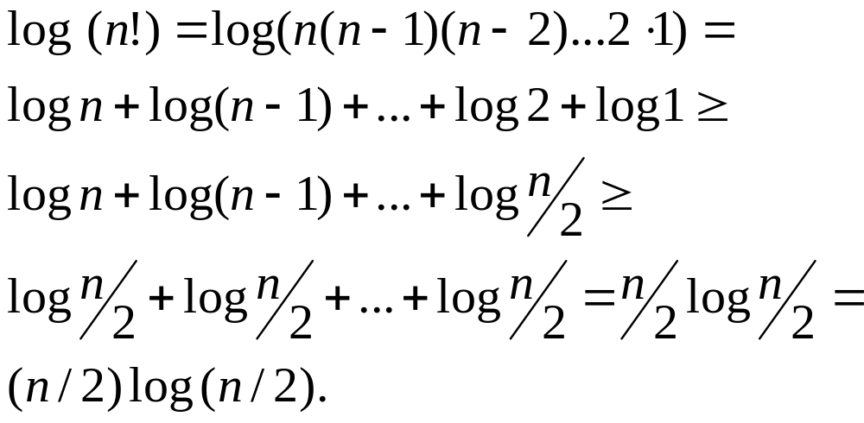
The Lower Bound of Comparison Sorts
Any comparison-based sorting algorithms takes at least log (n!) time
Therefore, any such algorithm takes time at least
That is, any comparison-based sorting algorithm must run in Ω(n log n) time.

Slide 39
Alternative to comparison?
Comparison-based sorting algorithm run in Ω(n log n) time
Can we write and algorithm to sort that is not based in comparison?
Not in the general case
  We need to make special assumptions
  Algorithms:
    Bucket-Sort
    Radix-Sort

Slide 40
Bucket-Sort
Let be S be a sequence of n (key, element) entries with keys in the range [0, N − 1]
Bucket-sort uses the keys as indices into an auxiliary array B of sequences (buckets)
  Phase 1: Empty sequence S by moving each entry (k, o) into its bucket B[k]
  Phase 2: For i = 0, …, N − 1, move the entries of bucket B[i] to the end of sequence S
Analysis:
  Phase 1 takes O(n) time
  Phase 2 takes O(n + N) time
Bucket-sort takes O(n + N) time
Algorithm bucketSort(S, N)
Input sequence S of (key, element)
items with keys in the range
[0, N − 1]
Output sequence S sorted by
increasing keys
B ← array of N empty sequences
  while ¬S.isEmpty()
  f ← S.first()
  (k, o) ← S.remove(f)
  B[k].insertLast((k, o))
  for i ← 0 to N − 1
  while ¬B[i].isEmpty()
  f ← B[i].first()
  (k, o) ← B[i].remove(f)
  S.insertLast((k, o))

Slide 41
Example
Key range [0, 9]
7, d
1, c
3, a
7, g
3, b
7, e
Phase 1
1, c
3, a
3, b
7, d
7, g
7, e
B
0
1
2
3
4
5
6
7
8
9
∅
∅
∅
∅
∅
∅
∅
Phase 2
1, c
3, a
3, b
7, d
7, g
7, e

Slide 42
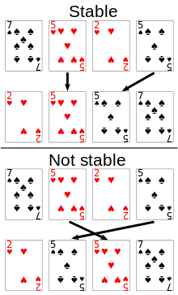
Properties
Key-type Property
  The keys are used as indices into an array and cannot be arbitrary objects
  No external comparator
Stable Sort Property
  The relative order of any two items with the same key is preserved after the execution of the algorithm

Slide 43
Extensions
Example: keys are the ages of the drivers with a license. All keys will be between 17 and 90
  Does it make sense to have an array of size 91?
    No! Buckets [0,17] will be empty
Extension: if the keys are integers in the range [a, b]:
  Use an array of size (b-a) Put entry (k, o) into bucket B[k − a]
Example: keys can only take values Male and Female
  The keys cannot be used as indices of an array!
  Extension: string keys from a set D of possible strings, where D has constant size (e.g., names of the 50 U.S. states, names of chilean regions, person’s sex)
  Sort D and compute the rank r(k) of each string k of D in the sorted sequence
  Put entry (k, o) into bucket B[r(k)]

Slide 44
Lexicographic Order
A d-tuple is a sequence of d keys (k₁, k₂, …, k_{d}), where key k_{i} is said to be the i-th dimension of the tuple
Example:
  The Cartesian coordinates of a point in space are a 3-tuple
The lexicographic order of two d-tuples is recursively defined as follows
(x₁, x₂, …, x_{d}) < (y₁, y₂, …, y_{d})
⇔
x₁ < y₁ ∨ x₁ = y₁ ∧ (x₂, …, x_{d}) < (y₂, …, y_{d})
I.e., the tuples are compared by the first dimension, then by the second dimension, etc.

Slide 45
Lexicographic-Sort
Algorithm lexicographicSort(S)
Input sequence S of d-tuples
Output sequence S sorted in
lexicographic order
for i ← d downto 1
  stableSort(S, C_{i})
Let C_{i} be the comparator that compares two tuples by their i-th dimension
Let stableSort(S, C) be a stable sorting algorithm that uses comparator C
Lexicographic-sort sorts a sequence of d-tuples in lexicographic order by executing d times algorithm stableSort, one per dimension
Lexicographic-sort runs in O(dT(n)) time, where T(n) is the running time of stableSort
Example:
(7,4,6) (5,1,5) (2,4,6) (2, 1, 4) (3, 2, 4)
(2, 1, 4) (3, 2, 4) (5,1,5) (7,4,6) (2,4,6)
(2, 1, 4) (5,1,5) (3, 2, 4) (7,4,6) (2,4,6)
(2, 1, 4) (2,4,6) (3, 2, 4) (5,1,5) (7,4,6)
Notes:
Show that we get the wrong sorting if we sort first wrt the first element and then wrt the second one, etc..

Slide 46
Radix-Sort
Radix-sort is a specialization of lexicographic-sort that uses bucket-sort as the stable sorting algorithm in each dimension
Radix-sort is applicable to tuples where the keys in each dimension i are integers in the range [0, N − 1]
Radix-sort runs in time
O(d( n + N))
Algorithm radixSort(S, N)
Input sequence S of d-tuples such
that (0, …, 0) ≤ (x₁, …, x_{d}) and
(x₁, …, x_{d}) ≤ (N − 1, …, N − 1)
for each tuple (x₁, …, x_{d}) in S
Output sequence S sorted in
lexicographic order
for i ← d downto 1
  bucketSort(S, N)

Slide 47
Radix-Sort for Binary Numbers
Consider a sequence of n b-bit integers
x = x_{b − 1} … x₁x₀
We represent each element as a b-tuple of integers in the range [0, 1] and apply radix-sort with N = 2
This application of the radix-sort algorithm runs in O(bn) time
For example, we can sort a sequence of 32-bit integers in linear time
Algorithm binaryRadixSort(S)
Input sequence S of b-bit
integers
Output sequence S sorted
replace each element x
of S with the item (0, x)
for i ← 0 to b − 1
replace the key k of
each item (k, x) of S with bit x_{i} of x
bucketSort(S, 2)

Slide 48
Example
Sorting a sequence of 4-bit integers
1001
0010
1001
1001
0001
0010
1110
1101
0001
0010
1101
1001
0001
0010
1001
0001
1101
0010
1101
1101
1110
0001
1110
1110
1110

Slide 49
Additional resources
The following resources may help to understand sorting algorithms:
https://www.youtube.com/watch?v=Jy6ntTe5Jzk&feature=youtu.be
https://www.youtube.com/watch?v=sjzP7T_ixwo
https://www.youtube.com/watch?v=rL3t9lzKHCI&feature=youtu.be
http://www.cs.usfca.edu/~galles/visualization/Algorithms.html

Slide 50
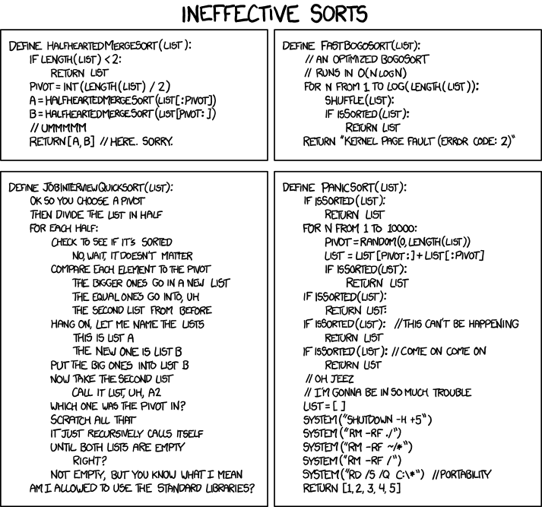
XKCD
Joke
Comic http://www.xkcd.com/1185/
Explanation: http://www.explainxkcd.com/wiki/index.php/1185:_Ineffective_Sorts

Slide 51
Extra Slides/material

Slide 52
Bubble Sort
(a sorting algorithm not seen in class)
Compare each element (except the last one) with its neighbor to the right
  If they are out of order, swap them
  This puts the largest element at the very end
  The last element is now in the correct and final place
Compare each element (except the last two) with its neighbor to the right
  If they are out of order, swap them
  This puts the second largest element next to last
  The last two elements are now in their correct and final places
Compare each element (except the last three) with its neighbor to the right
  Continue as above until you have no unsorted elements on the left
Notes:
Que rara la primera pasada… verificar que esta bien!

Slide 53
Bubble Sort
5
7
2
6
9
3
2
5
6
7
3
9
5
2
7
6
9
3
2
5
6
3
7
9
5
2
6
7
9
3
2
5
3
6
7
9
5
2
6
7
3
9
2
3
5
6
7
9

Slide 54
Code for bubble sort
public static void bubbleSort(int[] a) {
int i, j;
for (i = a.length - 1; i > 0; i--) {
for (j = 0; j < i; j++) {
if (a[j] > a[j + 1]) { // if out of order...
int temp = a[j]; // ...then swap
a[j] = a[j + 1];
a[j + 1] = temp;
} } } }
Bubble sort runs in O(n²) time

Slide 55
Merge-sort Example
7 2 9 4 ⏐ 3 8 6 1 → 1 2 3 4 6 7 8 9
7 2 9 4 → 2 4 7 9
3 8 6 1 → 1 3 8 6
7 2 → 2 7
9 4 → 4 9
3 8 → 3 8
6 1 → 1 6
7 → 7
2 → 2
9 → 9
4 → 4
3 → 3
8 → 8
6 → 6
1 → 1

Slide 56
Merge-sort Example
Partition
7 2 9 4 ⏐ 3 8 6 1 → 1 2 3 4 6 7 8 9
7 2 9 4 → 2 4 7 9
3 8 6 1 → 1 3 8 6
7 2 → 2 7
9 4 → 4 9
3 8 → 3 8
6 1 → 1 6
7 → 7
2 → 2
9 → 9
4 → 4
3 → 3
8 → 8
6 → 6
1 → 1

Slide 57
Merge-sort Example
Recursive call, partition
7 2 9 4 ⏐ 3 8 6 1 → 1 2 3 4 6 7 8 9
7 2 ⏐ 9 4 → 2 4 7 9
3 8 6 1 → 1 3 8 6
7 2 → 2 7
9 4 → 4 9
3 8 → 3 8
6 1 → 1 6
7 → 7
2 → 2
9 → 9
4 → 4
3 → 3
8 → 8
6 → 6
1 → 1

Slide 58
Merge-sort Example (cont.)
Recursive call, partition
7 2 9 4 ⏐ 3 8 6 1 → 1 2 3 4 6 7 8 9
7 2 ⏐ 9 4 → 2 4 7 9
3 8 6 1 → 1 3 8 6
7 ⏐ 2 → 2 7
9 4 → 4 9
3 8 → 3 8
6 1 → 1 6
7 → 7
2 → 2
9 → 9
4 → 4
3 → 3
8 → 8
6 → 6
1 → 1

Slide 59
Merge-sort Example (cont.)
Recursive call, base case
7 2 9 4 ⏐ 3 8 6 1 → 1 2 3 4 6 7 8 9
7 2 ⏐ 9 4 → 2 4 7 9
3 8 6 1 → 1 3 8 6
7 ⏐ 2 → 2 7
9 4 → 4 9
3 8 → 3 8
6 1 → 1 6
7 → 7
2 → 2
9 → 9
4 → 4
3 → 3
8 → 8
6 → 6
1 → 1

Slide 60
Merge-sort Example (cont.)
Recursive call, base case
7 2 9 4 ⏐ 3 8 6 1 → 1 2 3 4 6 7 8 9
7 2 ⏐ 9 4 → 2 4 7 9
3 8 6 1 → 1 3 8 6
7 ⏐ 2 → 2 7
9 4 → 4 9
3 8 → 3 8
6 1 → 1 6
7 → 7
2 → 2
9 → 9
4 → 4
3 → 3
8 → 8
6 → 6
1 → 1

Slide 61
Merge-sort Example (cont.)
Merge
7 2 9 4 ⏐ 3 8 6 1 → 1 2 3 4 6 7 8 9
7 2 ⏐ 9 4 → 2 4 7 9
3 8 6 1 → 1 3 8 6
7 ⏐ 2 → 2 7
9 4 → 4 9
3 8 → 3 8
6 1 → 1 6
7 → 7
2 → 2
9 → 9
4 → 4
3 → 3
8 → 8
6 → 6
1 → 1

Slide 62
Merge-sort Example (cont.)
Recursive call, …, base case, merge
7 2 9 4 ⏐ 3 8 6 1 → 1 2 3 4 6 7 8 9
7 2 ⏐ 9 4 → 2 4 7 9
3 8 6 1 → 1 3 8 6
7 ⏐ 2 → 2 7
9 4 → 4 9
3 8 → 3 8
6 1 → 1 6
7 → 7
2 → 2
9 → 9
4 → 4
3 → 3
8 → 8
6 → 6
1 → 1

Slide 63
Merge-sort Example (cont.)
Merge
7 2 9 4 ⏐ 3 8 6 1 → 1 2 3 4 6 7 8 9
7 2 ⏐ 9 4 → 2 4 7 9
3 8 6 1 → 1 3 8 6
7 ⏐ 2 → 2 7
9 4 → 4 9
3 8 → 3 8
6 1 → 1 6
7 → 7
2 → 2
9 → 9
4 → 4
3 → 3
8 → 8
6 → 6
1 → 1

Slide 64
Merge-sort Example (cont.)
Recursive call, …, merge, merge
7 2 9 4 ⏐ 3 8 6 1 → 1 2 3 4 6 7 8 9
7 2 ⏐ 9 4 → 2 4 7 9
3 8 6 1 → 1 3 6 8
7 ⏐ 2 → 2 7
9 4 → 4 9
3 8 → 3 8
6 1 → 1 6
7 → 7
2 → 2
9 → 9
4 → 4
3 → 3
8 → 8
6 → 6
1 → 1

Slide 65
Merge-sort Example (cont.)
Merge
7 2 9 4 ⏐ 3 8 6 1 → 1 2 3 4 6 7 8 9
7 2 ⏐ 9 4 → 2 4 7 9
3 8 6 1 → 1 3 6 8
7 ⏐ 2 → 2 7
9 4 → 4 9
3 8 → 3 8
6 1 → 1 6
7 → 7
2 → 2
9 → 9
4 → 4
3 → 3
8 → 8
6 → 6
1 → 1

Slide 66
Quick-Sort in-Place implementation
Quick-sort can be implemented to run in-place
In the partition step, we use replace operations to rearrange the elements of the input sequence such that
  the elements less than the pivot have rank less than h
  the elements equal to the pivot have rank between h and k
  the elements greater than the pivot have rank greater than k
The recursive calls consider
  elements with rank less than h
  elements with rank greater than k
Algorithm inPlaceQuickSort(S, l, r)
Input sequence S, ranks l and r
Output sequence S with the
elements of rank between l and r
rearranged in increasing order
if l ≥ r
  return
  i ← a random integer between l and r
  x ← S.elemAtRank(i)
  (h, k) ← inPlacePartition(x)
  inPlaceQuickSort(S, l, h − 1)
  inPlaceQuickSort(S, k + 1, r)

Slide 67
In-Place Partitioning
Perform the partition using two indices to split S into L and E U G (a similar method can split E U G into E and G).
Repeat until j and k cross:
  Scan j to the right until finding an element > x.
  Scan k to the left until finding an element < x.
  Swap elements at indices j and k
j
k
3 2 5 1 0 7 3 5 9 2 7 9 8 9 7 6 9
(pivot = 6)
j
k
3 2 5 1 0 7 3 5 9 2 7 9 8 9 7 6 9

Slide 68
Example
j
k
7 2 8 1 0 7 3 8 9 2 7 9 8 6 3 6 9
j
k
3 2 8 1 0 7 3 8 9 2 7 9 8 6 7 6 9
j
k
3 2 2 1 0 7 3 8 9 8 7 9 8 6 7 6 9
A similar method can split E U G into E and G
j
k
3 2 2 1 0 3 7 8 9 8 7 9 8 6 7 6 9
<6=L
≥6= E U G

