Slide 1
During the experiment I will also track your gaze, so lets calibrate the eyetracker first
The eye tracking only works properly if you keep your head in the same position afterwards, so please make sure youre comfortable and can hold the position for the next 20 minutes
'Remember: your goal is to find the uniquely oriented bar and press the corresponding key' ...
'During the experiment once you have found the uniquely oriented bar remember to press the corresponding button

Slide 2
Welcome :)

Slide 3
In this experiment you will be presented with a grid of bars.
Press the Left Shift Key if you can see a uniquely oriented bar on the left side of the screen
and the Right Shift Key if you can see a uniquely oriented bar on the right side of the screen
Try to be as fast and as accurate as possible!

Slide 4
Lets look at a possible images you will see later

Slide 5
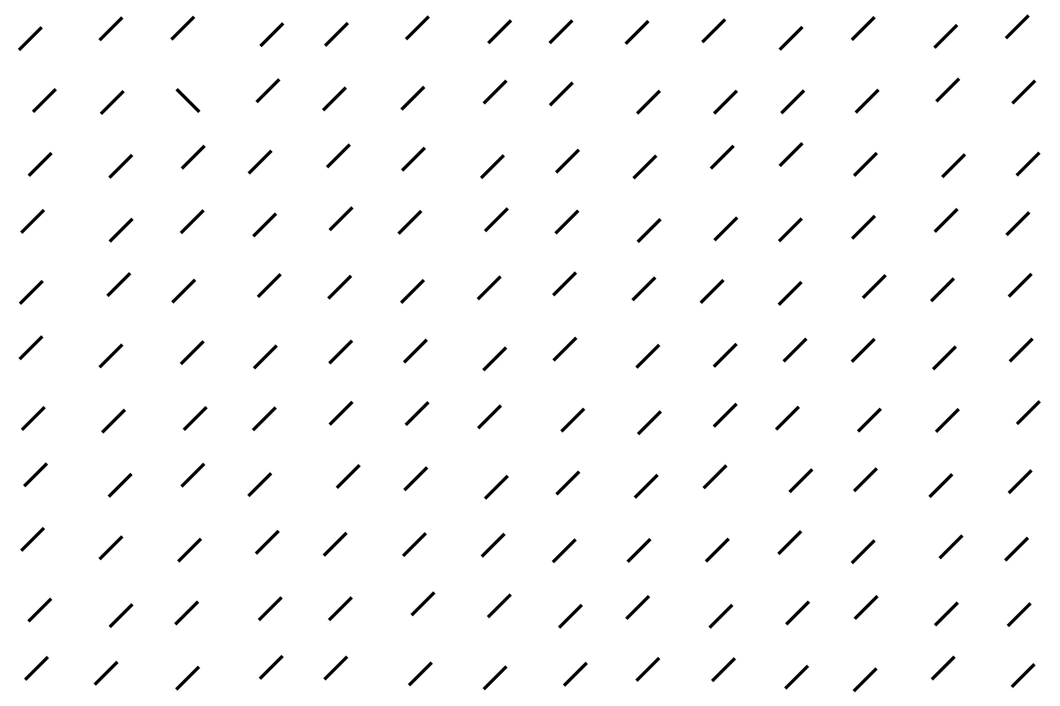
Trials can look like this for example.
Can you find the uniquely oriented bar?

Slide 6
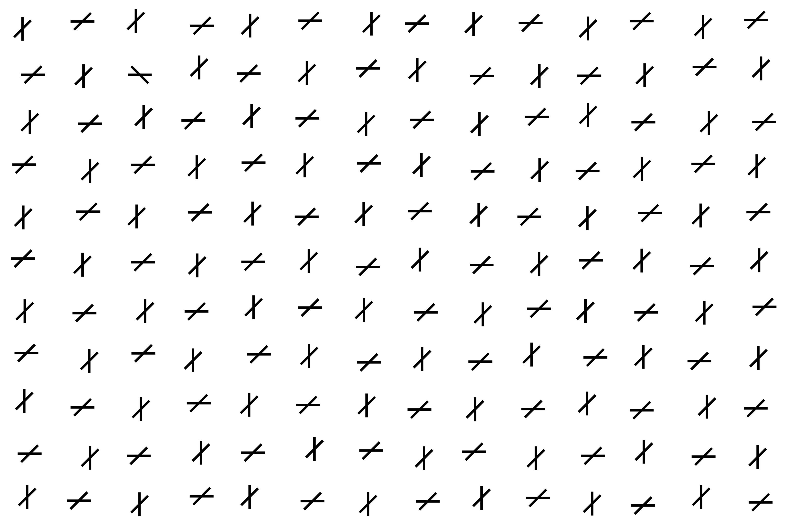
Some trials have horizontal & vertical bars added on top of the relevant bars.
Can you still see the uniquely oriented bar?

Slide 7
Each trial starts with a prompt:
Press any button to continue with the next trial

Slide 8
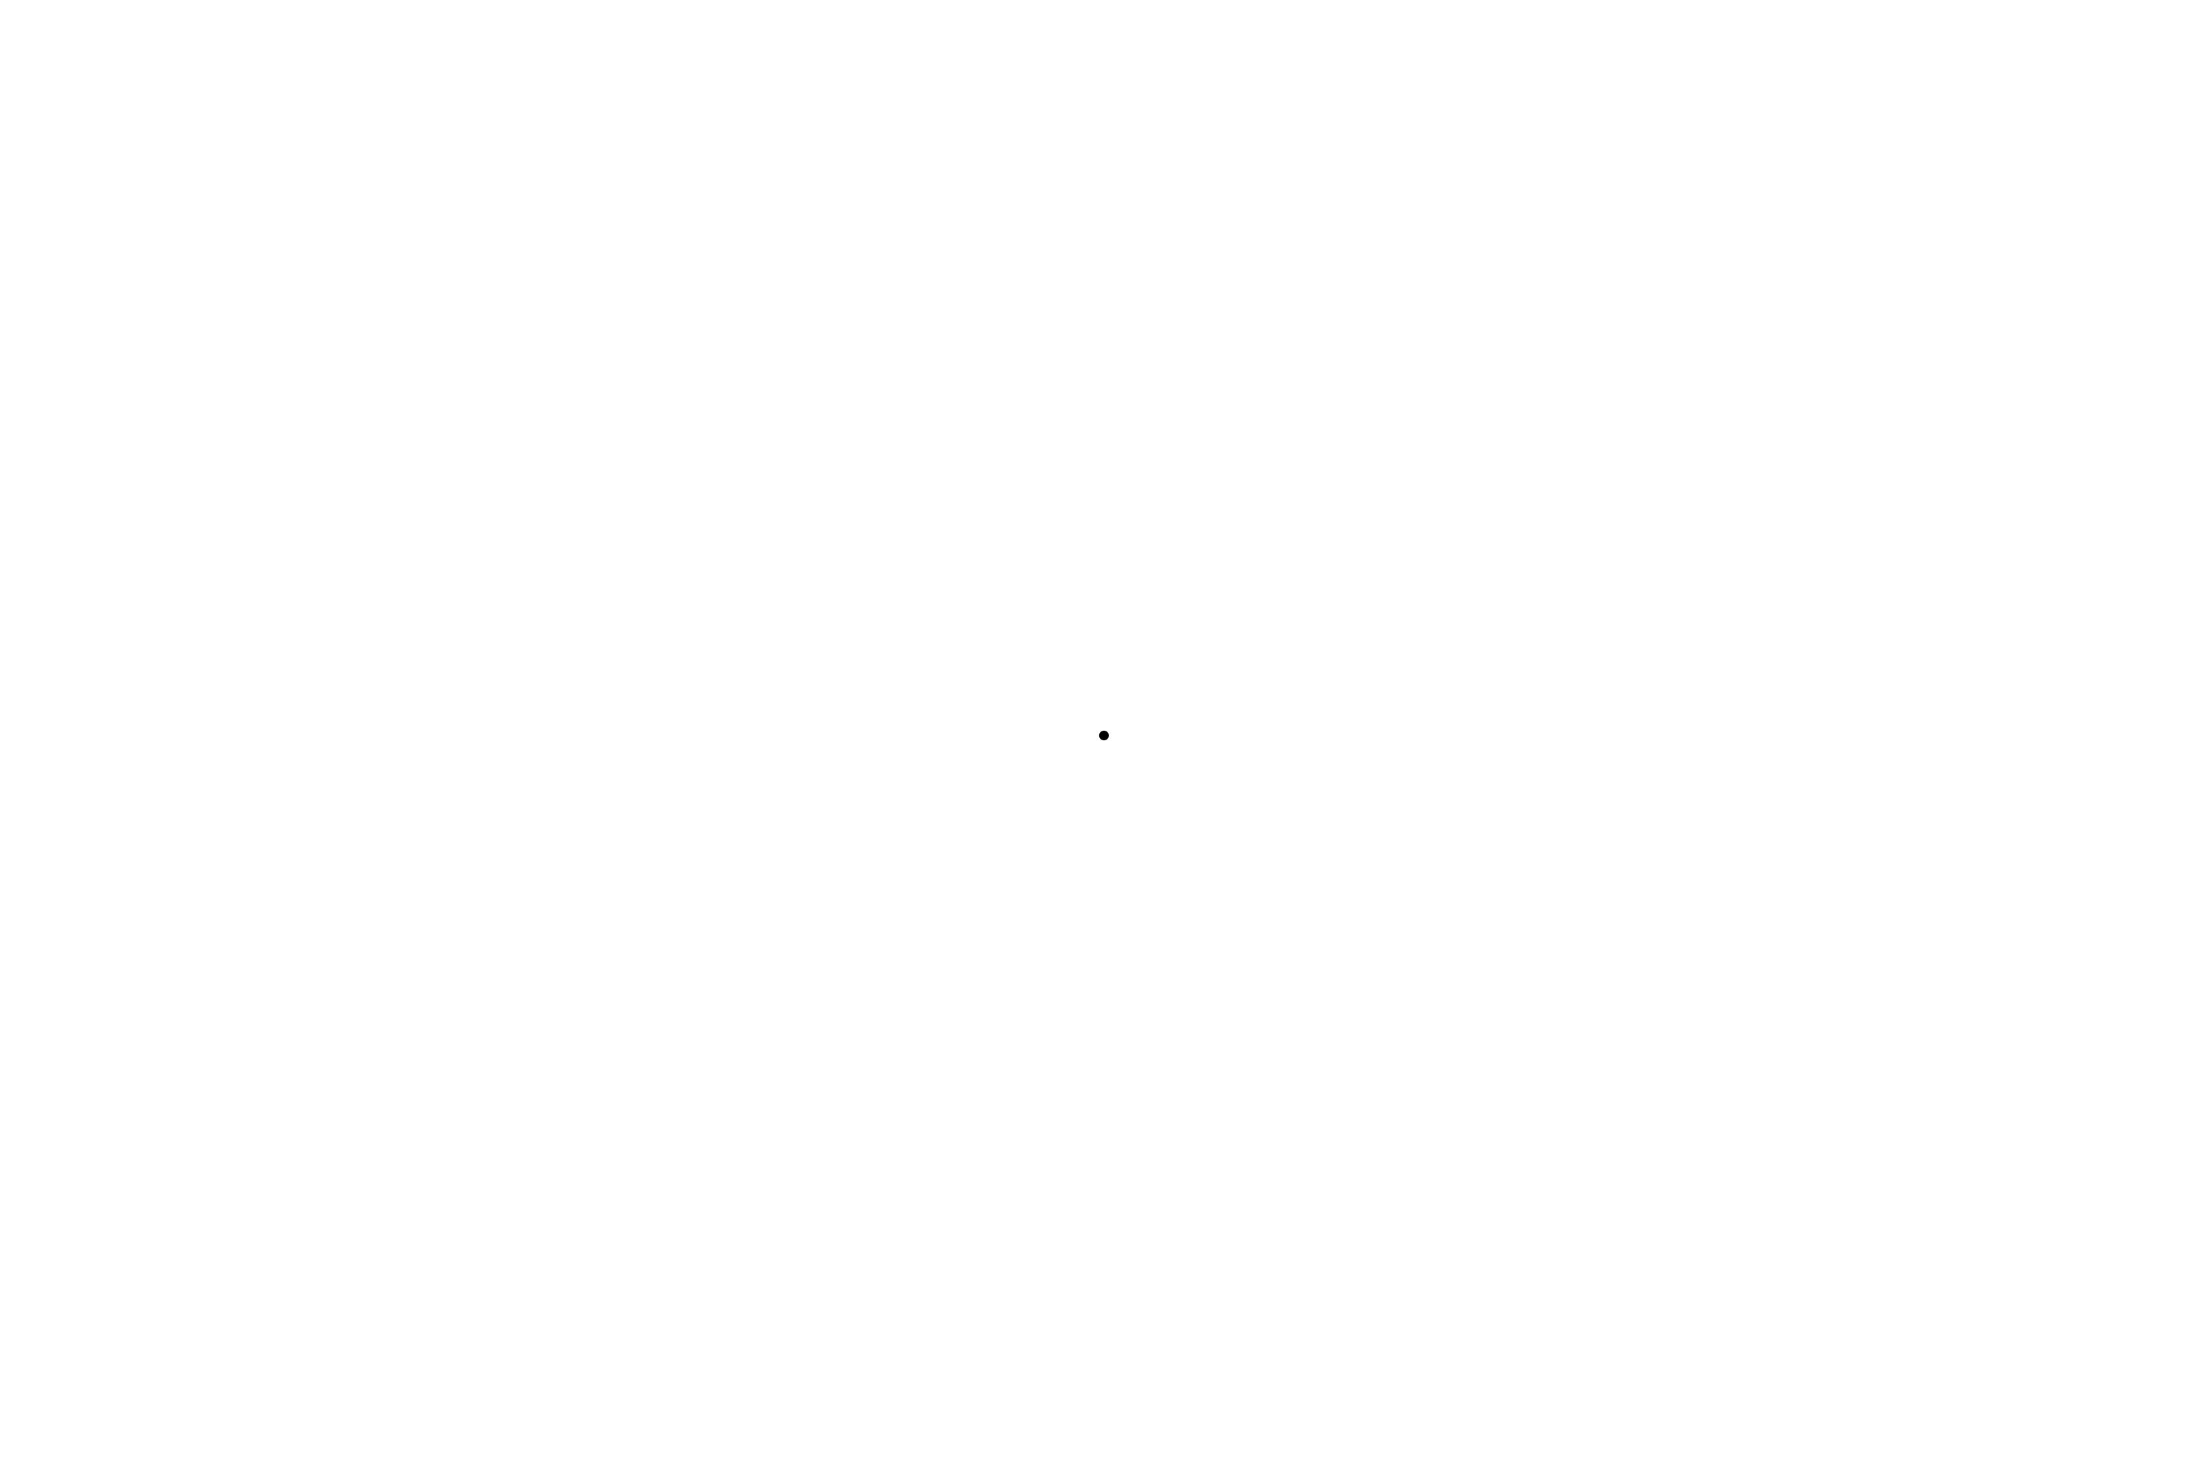
Once you press a button you will be presented with a fixation dot in the middle of the screen.
It will disappear after around half a second and the search task will start.

Slide 9
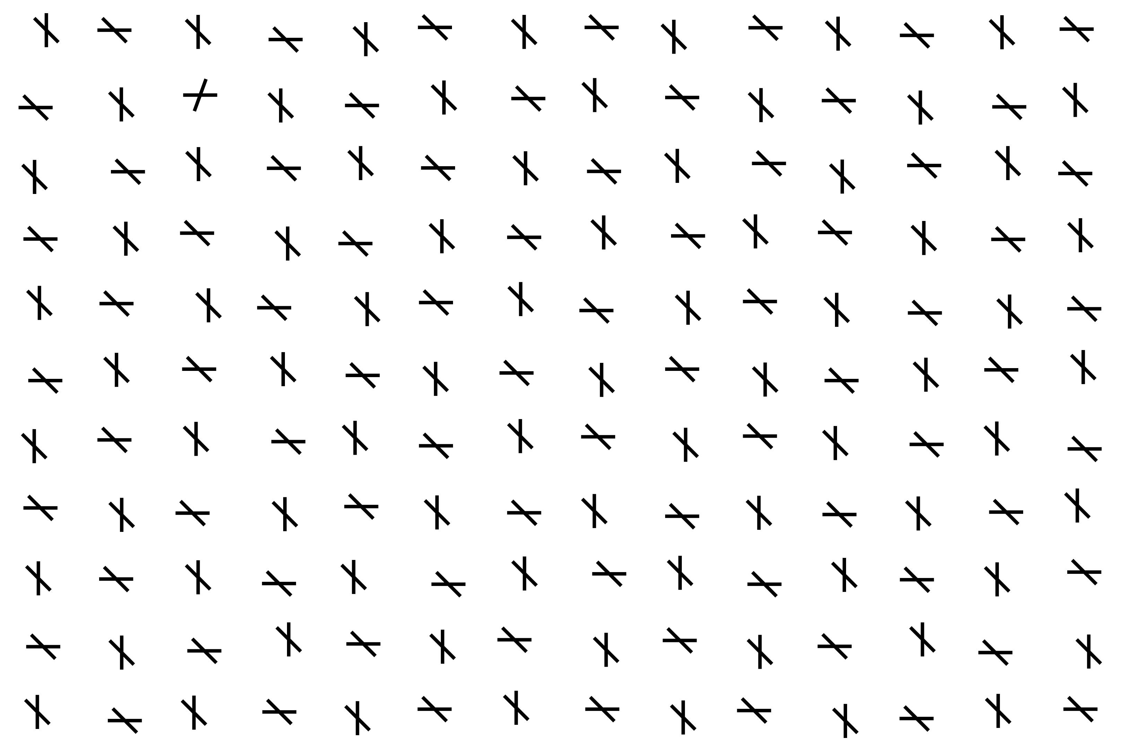
During the search task you have to look for the uniquely oriented
bar and press the corresponding button

Slide 10
There are several trials so this will repeat for roughly 20 minutes.

Slide 11
Do you have any questions?
If you feel ready let me know and I will start the experiment for you :)

Slide 12
Please remember to be as fast and accurate as possible

Slide 13
End of Experiment
Thank you for your participation:)

