Slide 1
Welcome :)

Slide 2
During the experiment I will track your gaze, so lets calibrate the eyetracker first
At the beginning you will be able to see how far you can move your head for the eyetracker to still track your gaze.
Move around a little to get a feeling for it while finding a position that feels comfortable for you
Once you have found a comfortable position I will start the calibration
Here you will have to look at circles appearing at different positions on the screen until they disappear.

Slide 3
In this experiment you will be presented with a grid of bars.
Press the Left Shift Key if you can see a uniquely oriented bar in the left half of the screen
and the Right Shift Key if you can see a uniquely oriented bar in the right half of the screen
Try to be as fast and as accurate as possible!

Slide 4
Let’s look at possible images you will see later

Slide 5
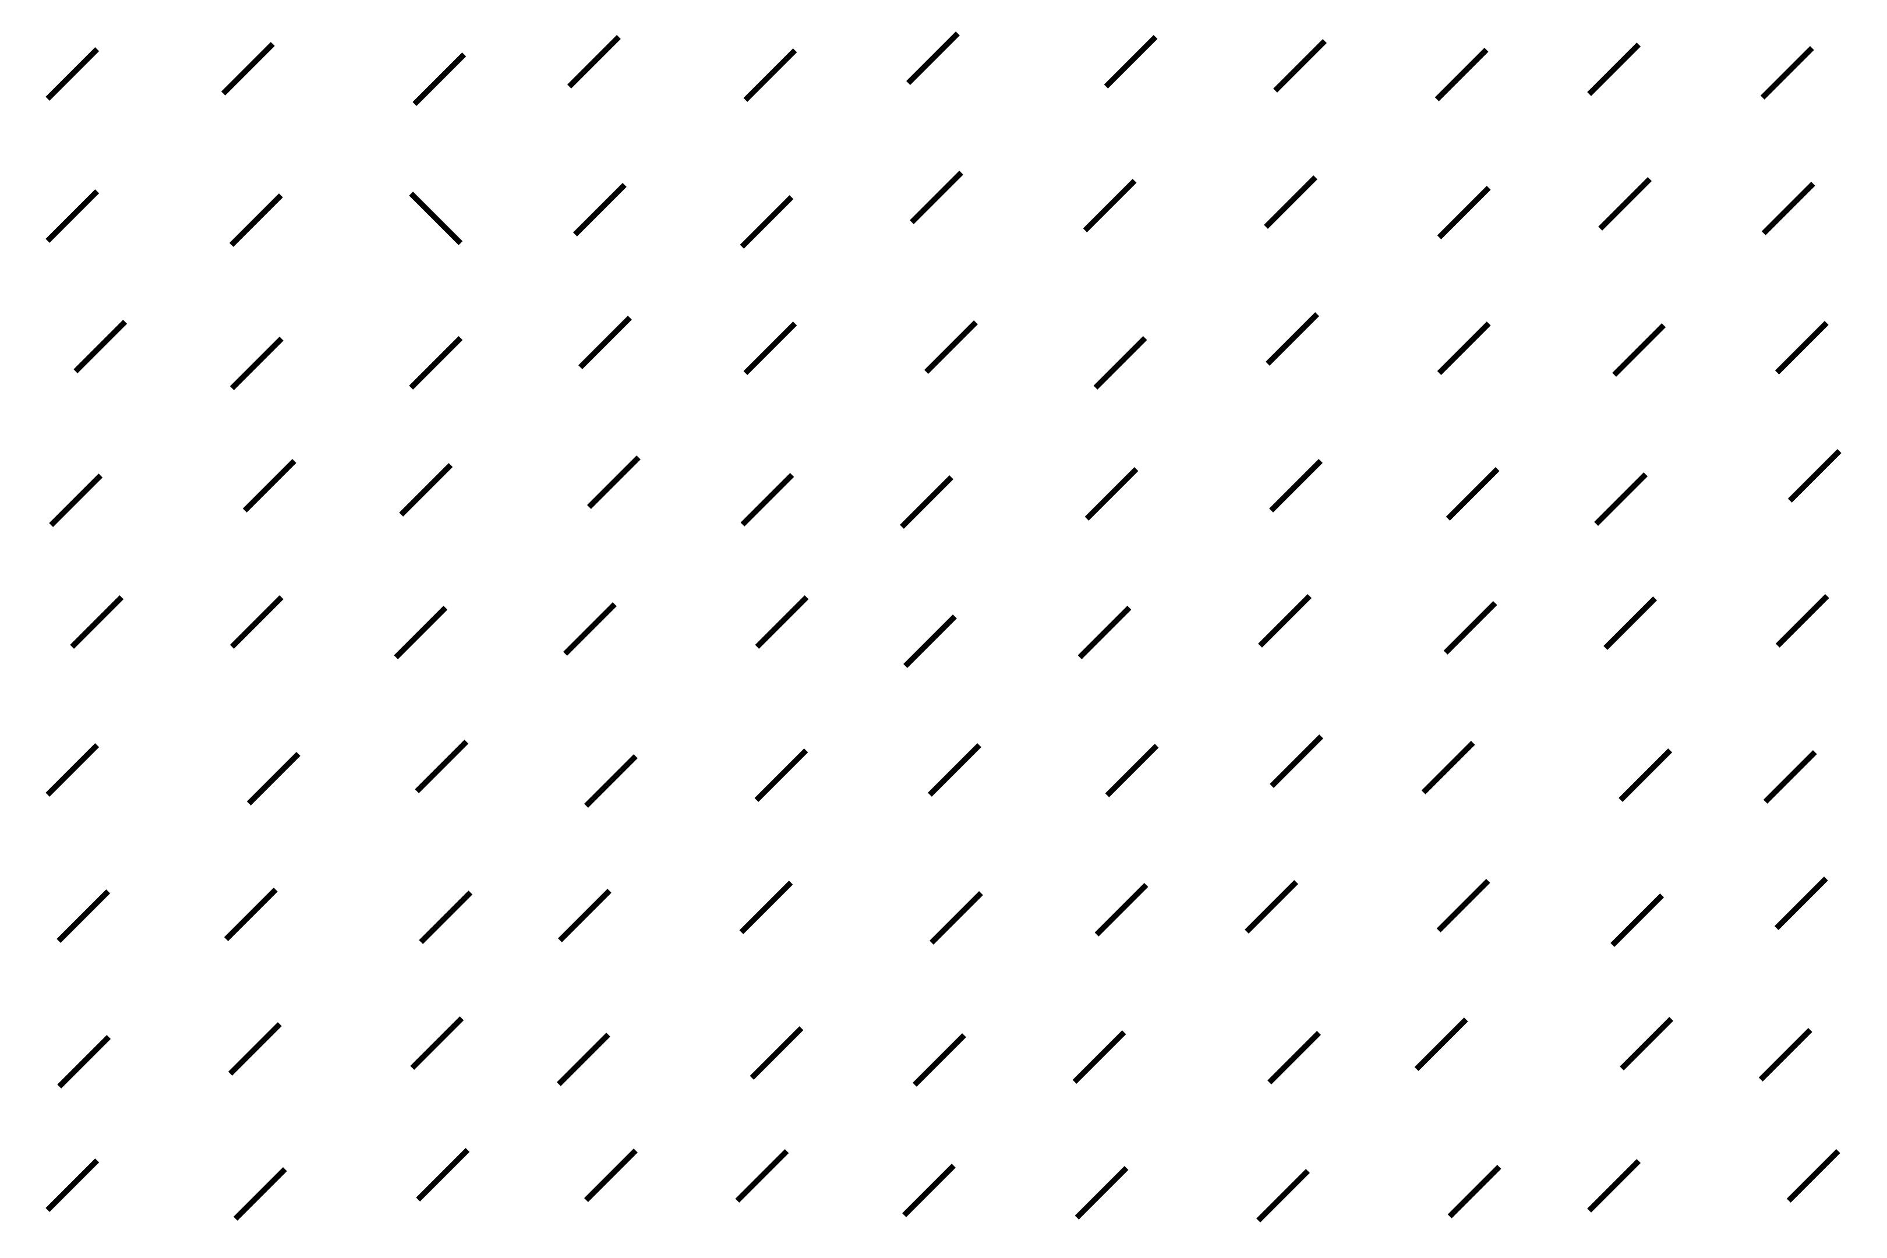

Slide 6
Trials can look like this for example.
Can you find the uniquely oriented bar?

Slide 7
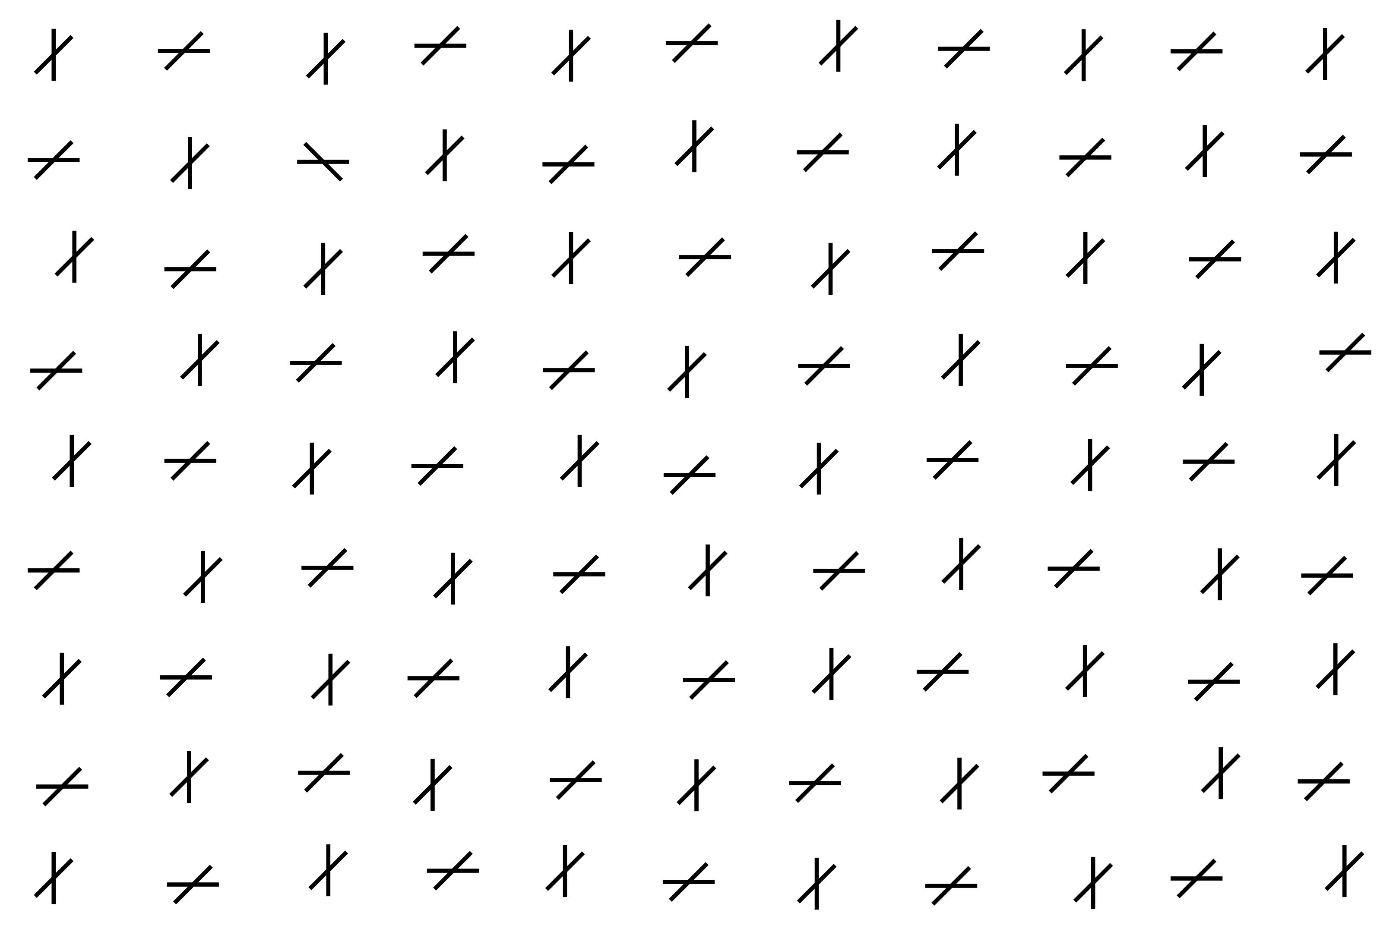

Slide 8
Some trials have horizontal & vertical bars added on top of the relevant bars.
Can you still see the uniquely oriented bar?

Slide 9
Put your two index fingers on the shift buttons to get ready
and press either of them to continue with the next trial

Slide 10
Each trial starts with a prompt
Put your two index fingers on the shift buttons to get ready
and press either of them to continue with the next trial

Slide 11
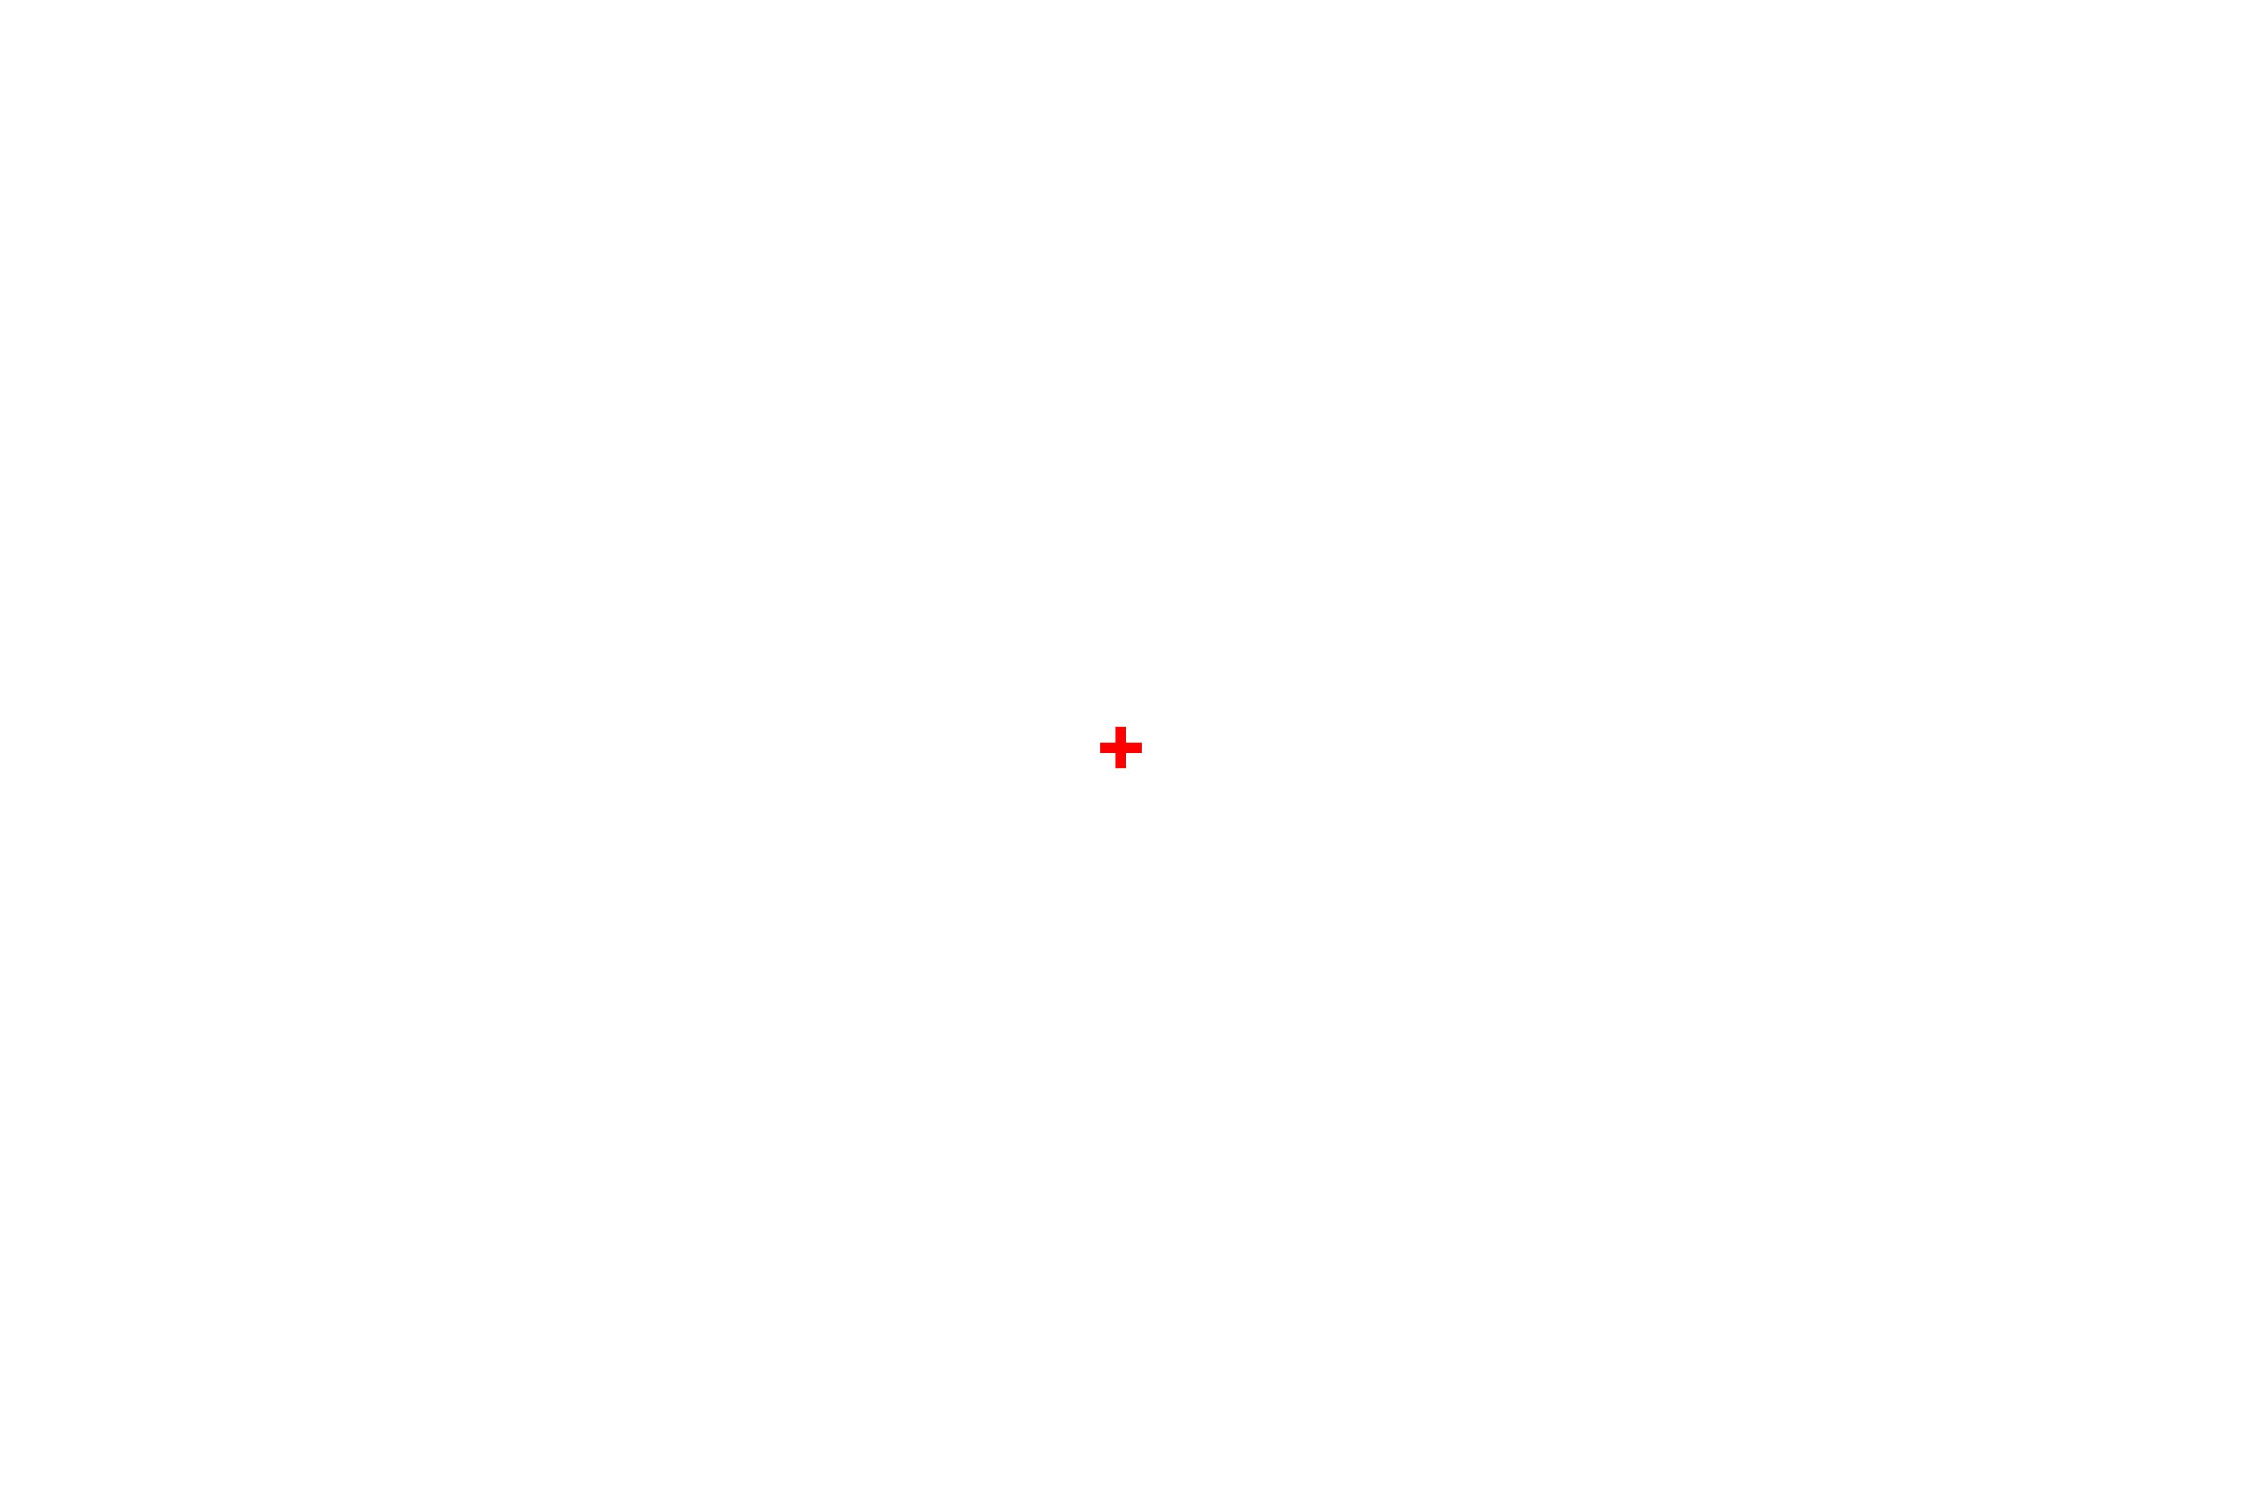

Slide 12
Once you press a button you will be presented with a fixation cross to look at
in the middle of the screen.
It will disappear after half a second and the search task will start.

Slide 13
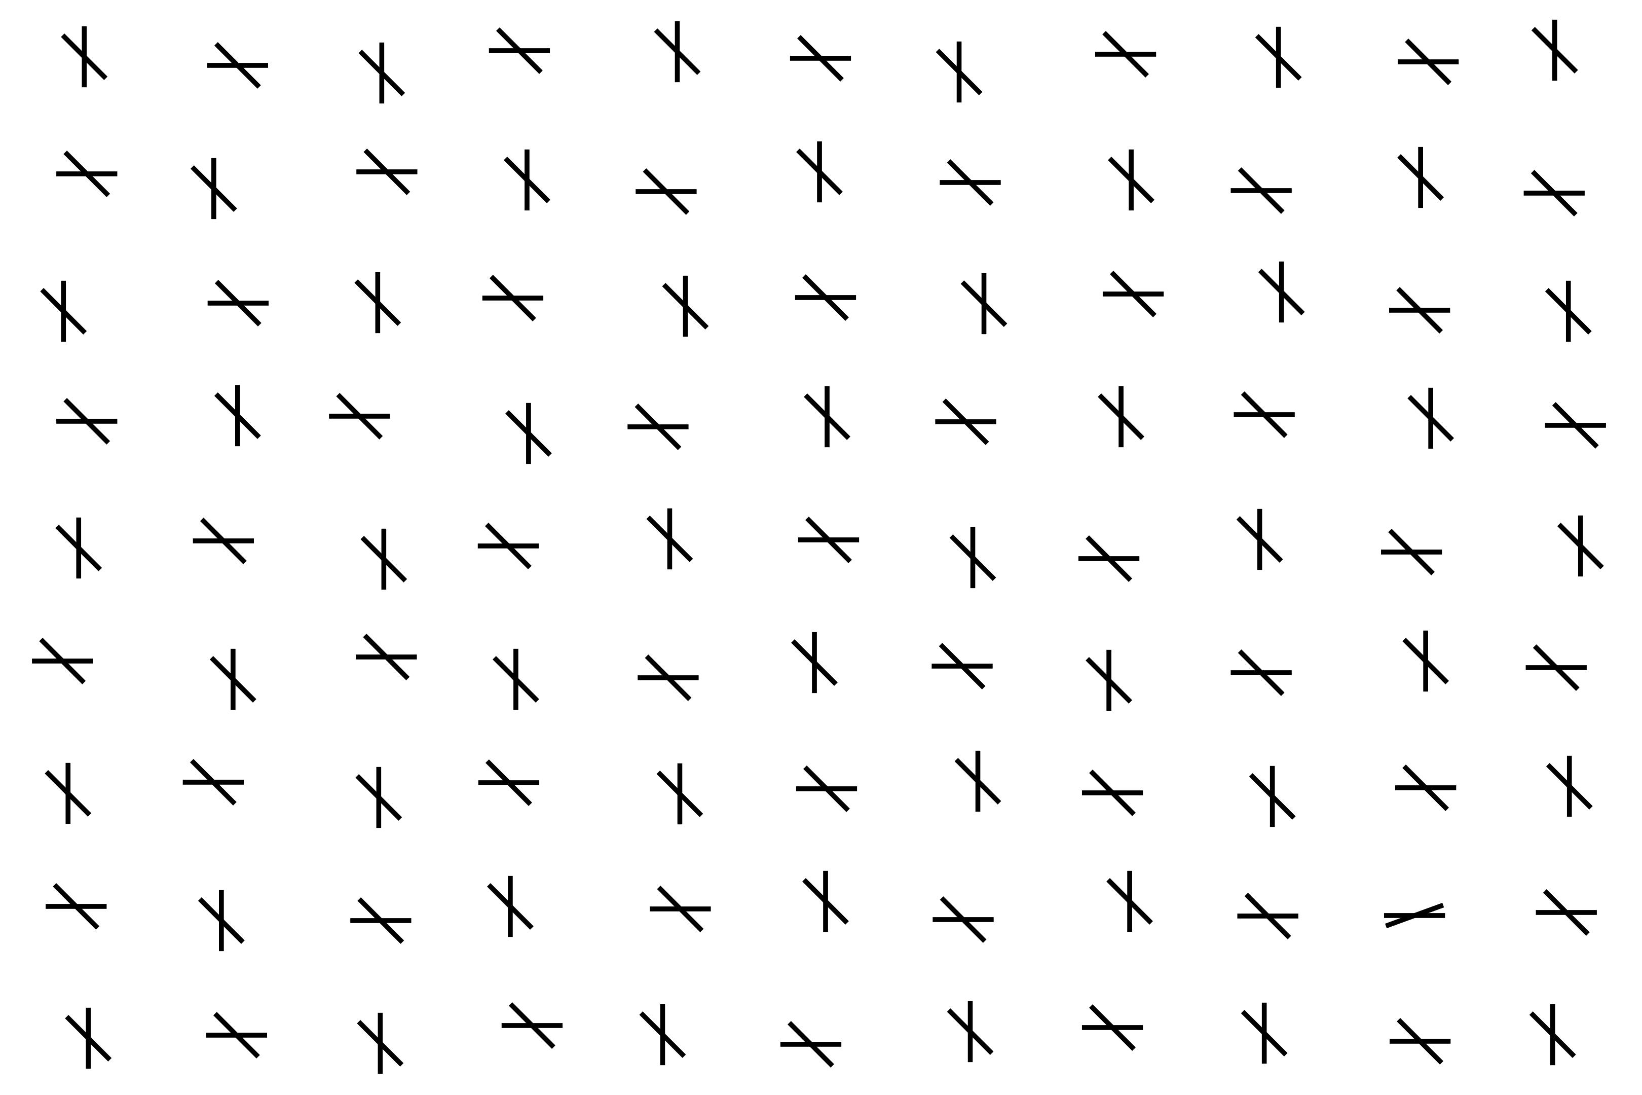

Slide 14
During the search task you have to look for the uniquely oriented
bar and press the corresponding button

Slide 15
This pattern will repeat for roughly 20 minutes.
We measure the speed at which you press the button, so please remember to be as fast and accurate as possible.

Slide 16
Do you have any questions?
If you feel ready let me know and I will start the experiment for you

Slide 17
Please remember to be as fast and accurate as possible

Slide 18
End of Experiment
Thank you for your participation :)

