Slide 1
戈德爾不完備定理
董世平
中原大學應用數學系

Slide 2
二十世紀數理邏輯之重大成果
上世紀末
1901
1903
1904
1930
1931
Georg Cantor
(1845-1919)
David Hilbert
(1862-1943)
Berfrand Russell
(1872-1970)
Ernst Zermelo
(1871-1956)
Kurt Gödel
(1907-1978)
Kurt Gödel
: (1)有理數可數 (N₀)
(2)實數不可數 (C )
(3)無窮數無窮
(4)超越數不可數
: 23個問題(第二屆世界數學家會議)
#1. 連續假設 C = N₁
#2. 算數公設之一致性(Hilbert Program)
#10. 不定方程式之演算法
: 羅素詭論
: 選擇公設
: 述詞邏輯完備
: 不完備定理

Slide 3
二十世紀數理邏輯之重大成果
1936
1939
1963
1966
1970
1971
Alan Turing
(1912-1954)
Alonzo Church
(1903-1995)
Kurt Gödel
Paul J. Cohen
Abraham Robinson
( ? -1974)
Juri Matijasevich
Stephen Cook
: 涂林機(全備計算機)
: 邱池論(定義計算)
: 連續假設與選擇公設之一致性
: 連續假設與選擇公設之獨立性
: 非標準分析
: 不定方程式不可決定
: NP-完備性 P=NP?

Slide 4
On January 14, 1978, Kurt Gödel died in Princeton in his seventy-first year.
There are those who believe that he was the most brilliant mind of the twentieth century.
When Harvard University gave him an honorary degree*, the citation described him as “discoverer of the most significant mathematical truth of this century, incomprehensible to laymen, revolutionary for philosophers and logicians.”
* 1952

Slide 5
It is with this analysis, and its impact on the minds of such men as John von Neumann and others, that the theoretical concepts and the analysis of the digital computer in the modern sense began.
It remains true to this very day that the theoretical description of what can be computed in general and its more penetrating analysis are rooted in the soil of mathematical logic which Gödel turned over for the first time in his memoir of 1931.

Slide 6
The great abstract logical work of Gödel had a striking outcome.
In analyzing the forma; machinery of Gödel’s description of what could be obtained by step-by-step procedures, the brilliant young English logician Alan Turing identified the results of such procedures-the general recursive functions-with the outcomes of what could be computed on a machine in general.

Slide 7
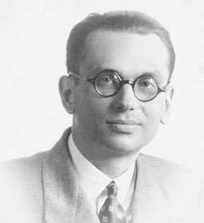

Slide 8
第一不完備定理
任何一個足夠強的一致公設系統，必定是不完備的。
即除非這個系統很簡單（所以能敘述的不多），或是包含矛盾的，否則必有一真的敘述。
第二不完備定理
任何一個足夠強的一致公設系統，必無法證明本身的一致性
所以除非這個系統很簡單，否則你若在此系統，證明了本身的一致性， 反而已顯出它是不一致的。

Slide 9
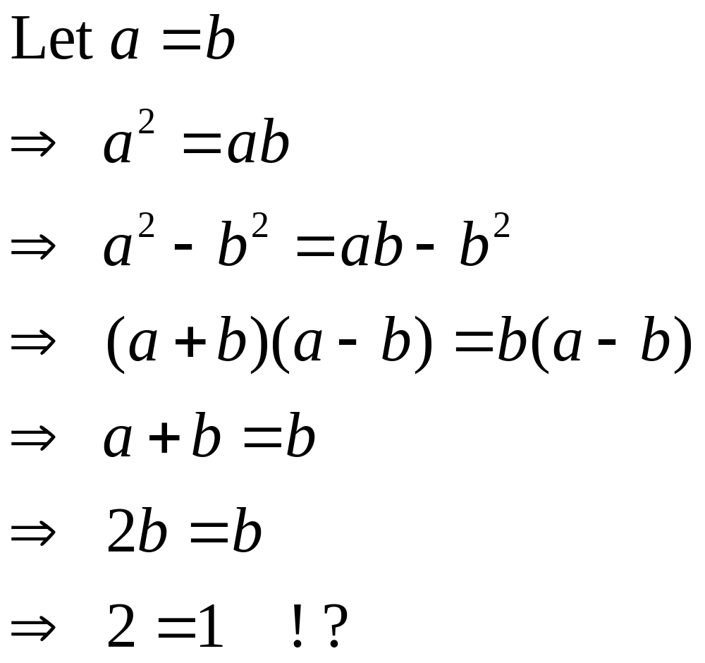

Slide 10
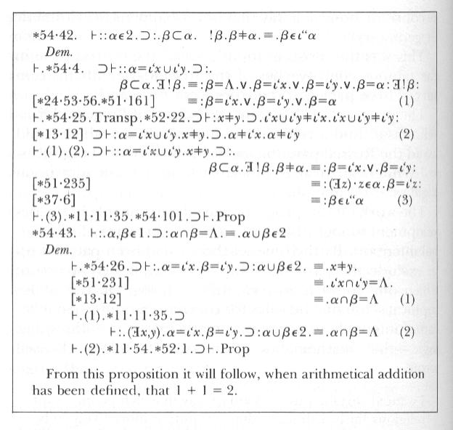

Slide 11
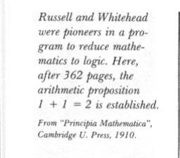

Slide 12
？
真 ＝ 可證明
真 ⊇ 可證明
一致性
真 ⊆ 可證明
完備性

Slide 13
Rucker, Infinity and the Mind
The proof of Gödel's Incompleteness Theorem is so simple, and so sneaky, that it is almost embarassing to relate. His basic procedure is as follows: Someone introduces Gödel to a UTM, a machine that is supposed to be a Universal Truth Machine, capable of correctly answering any question at all.

Slide 14
Gödel asks for the program and the circuit design of the UTM. The program may be complicated, but it can only be finitely long. Call the program P(UTM) for Program of the Universal Truth Machine. Smiling a little, Gödel writes out the following sentence: "The machine constructed on the basis of the program P(UTM) will never say that this sentence is true." Call this sentence G for Gödel. Note that G is equivalent to: "UTM will never say G is true."

Slide 15
Now Gödel laughs his high laugh and asks UTM whether G is true or not. If UTM says G is true, then "UTM will never say G is true" is false. If "UTM will never say G is true" is false, then G is false (since G = "UTM will never say G is true"). So if UTM says G is true, then G is in fact false, and UTM has made a false statement. So UTM will never say that G is true, since UTM makes only true statements.

Slide 16
We have established that UTM will never say G is true. So "UTM will never say G is true" is in fact a true statement. So G is true (since G = "UTM will never say G is true"). I know a truth that UTM can never utter," Gödel says. "I know that G is true. UTM is not truly universal."

Slide 17
Think about it - it grows on you ... With his great mathematical and logical genius, Gödel was able to find a way (for any given P(UTM)) actually to write down a complicated polynomial equation that has a solution if and only if G is true. So G is not at all some vague or non-mathematical sentence. G is a specific mathematical problem that we know the answer to, even though UTM does not! So UTM does not, and cannot, embody a best and final theory of mathematics ...

Slide 18
Although this theorem can be stated and proved in a rigorously mathematical way, what it seems to say is that rational thought can never penetrate to the final ultimate truth ... But, paradoxically, to understand Gödel's proof is to find a sort of liberation. For many logic students, the final breakthrough to full understanding of the Incompleteness Theorem is practically a conversion experience. This is partly a by-product of the potent mystique Gödel's name carries. But, more profoundly, to understand the essentially labyrinthine nature of the castle is, somehow, to be free of it.

Slide 19
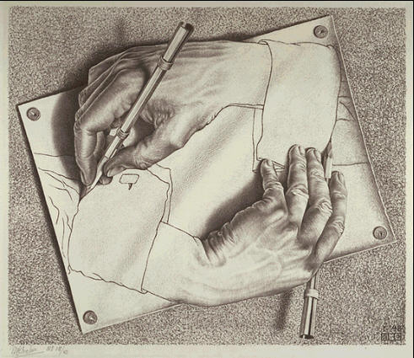

Slide 20
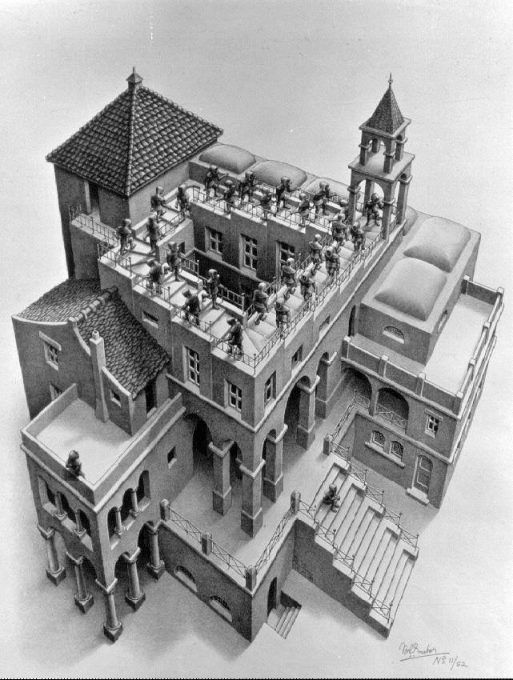

Slide 22
A：B這句話是真的
B：A這句話是假的
這句話是假的
這句話不能被證明

Slide 23
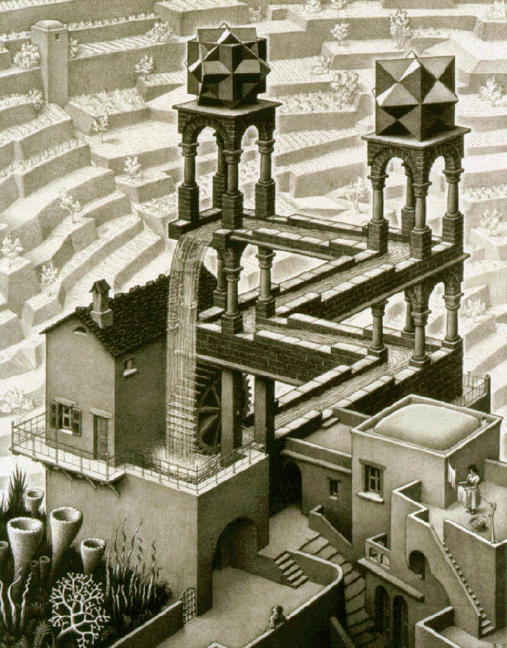

Slide 24
The Goodstein sequence on a number m, notated G(m), is defined as follows:
1. the first element of the sequence is m.
2. write m in hereditary base 2 notation, change all the 2's to 3's, and then subtract 1. This is the second element of G(m).
3. write the previous number in hereditary base 3 notation, change all 3's to 4's, and subtract 1 again.
4. continue until the result is zero, at which point the sequence terminates.

Slide 25
Hereditary notation
Value
2²
4
2·3² + 2·3 + 2
26
2·4² + 2·4 + 1
41
Elements of G(4) continue to increase for a while, but at base
3 · 2⁴⁰²⁶⁵³²⁰⁹, they reach the maximum of 3 · 2⁴⁰²⁶⁵³²¹⁰ − 1, stay there for the next
3 · 2⁴⁰²⁶⁵³²⁰⁹ steps, and then begin their first and final descent.
The value 0 is reached at base
3 · 2⁴⁰²⁶⁵³²¹¹ − 1
2·5² + 2·5
60
2·6² + 6 + 5
83
2·7² + 7 + 4
109
...
2·11² + 11
253
2·12² + 11
299
...

Slide 26
Base
Hereditary notation
Value
Notes
2
2¹ + 1
3
The 1 represents 2⁰.
3
3¹ + 1 − 1 = 3
3
Switch the 2 to a 3, then subtract 1
4
4¹ − 1
= 1 + 1 + 1
3
Switch the 3 to a 4, and subtract 1. Because the value to be expressed, 3, is less than 4, the representation switches from 4¹-1 to 4⁰ + 4⁰ + 4⁰, or 1 + 1 + 1
5
1 + 1 + 1 − 1 = 1 + 1
2
Since each of the 1s represents 5⁰, changing the base no longer has an effect. The sequence is now doomed to hit 0.
6
1 + 1 − 1 = 1
1
7
1 − 1 = 0
0

Slide 27
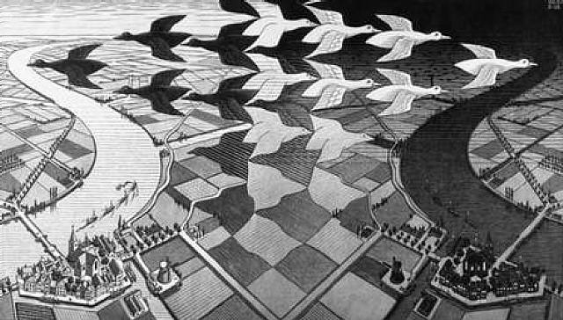

Slide 28
Halting Problem is uncomputable.
There is no program can tell semantic errors.

Slide 29
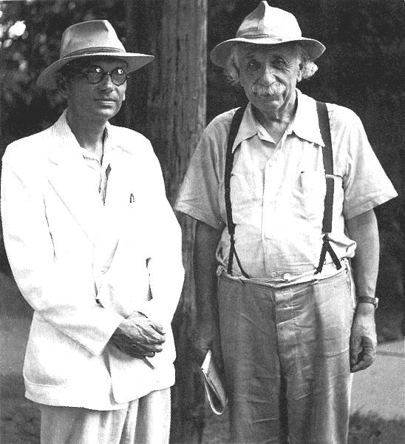

Slide 30
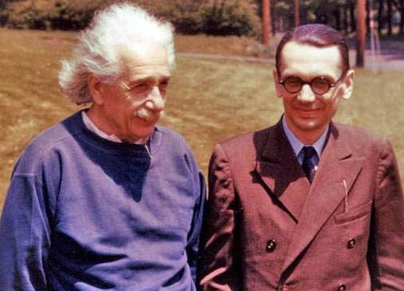

Slide 31
參考文獻
柏拉圖的天空 天下文化
數學巨人哥德爾-關於邏輯的故事 究竟出版社
戈德爾不完備定理 數學傳播 董世平
理性之夢 天下文化
Gödel, Escher, Bach: an eternal golden braid
Douglas R. Hofstadter Vintage

