Slide 1
My Experience with Haskell’s Type Classes
λ
政大資科系
陳 恭
July 10, 2014
FLOLAC 2014
Notes:
FLOLAC 08
2008/06/30
FP & Types

Slide 2
Agenda
An Introduction to type classes
  What and why
  How it works
Some proposals of extending type classes in mid-1990’s
  Multi-parameter type classes
  Constructor classes
  Parametric type classes
  Functional dependency
FLOLAC 2014

Slide 3
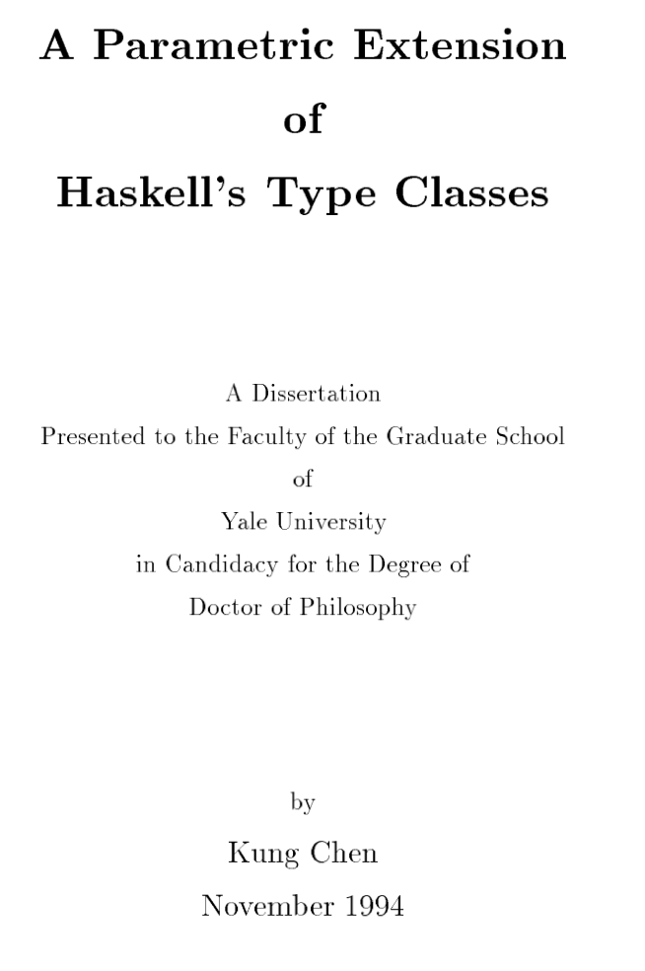


My PhD Thesis, Submitted in July 1994
唐鳳：
「Haskell has a solid niche
as a PhD generator」
My Study at Yale: 1989~1994
Paul Hudak
Martin Odersky

Slide 4
A Brief Overview of Haskell’s Type Classes
Acknowledgement: Many of the following slides are based on slides by
1) Keith Hanna: Slides on Type Classes, Kent University
2) Kathleen Fischer, Slides on Type Classes for Stanford University CS242
FLOLAC 2014

Slide 5


Why Type Classes:
The 1989 POPL Paper
FLOLAC 2014

Slide 6
Overloading:
Ad Hoc Polymorphism
Overloading: A single symbol may refer to more than one algorithm, such as +, -, *, /.
Typical programming languages handle overloading in an ad hoc way.
For example, Java provides:
  a pre-defined set of numeric operators
  +, -, *, . . . ==, >> (about 40 in all)
  Over a pre-defined set of numeric types (byte, short, int, long, float, double)
  A pre-defined set of rules for "numeric promotion". Eg, if either operand is double, then convert the other to double.
There is no way of extending these rules.
FLOLAC 2014

Slide 7
Parametric Polymorphism
Single algorithm may be given many types
Type variable may be replaced by any type
length:: [a] -> Int //for all a
[int] -> Int
[double] -> Int
[Float->Char] -> Int
FLOLAC 2014

Slide 8
When Overloading Meets Parametric Polymorphism
The first encounter I had (back in 1990 while I was studying SML):
How to type
square x = x * x
FLOLAC 2014

Slide 9
First Approach
Allow functions containing overloaded symbols to define multiple functions:
But consider:
This approach has not been widely used because of exponential growth in number of versions.
square x = x * x -- legal
-- Defines two versions:
-- Int -> Int and Float -> Float
squares (x,y,z) =
(square x, square y, square z)
-- There are 8 possible versions!
Source: K. Fischer

Slide 10
When Overloading Meets Parametric Polymorphism
The first encounter I had (back in 1990 while I was studying SML):
How to type
square x = x * x
The earlier versions of SML rejects this kind of functions.
FLOLAC 2014

Slide 11
When Overloading Meets Parametric Polymorphism
The first encounter I had (back in 1990 I was while studying SML):
How to type
square x = x * x
Int->Int
versus
a->a
Or somewhere in between?
FLOLAC 2014

Slide 12
Why Parametric Overloading?
Many useful functions are not parametric.
Can member work for any type?
  No! Only for types w for that support equality.
Can sort work for any type?
  No! Only for types w that support ordering.
member :: [w] -> w -> Bool
sort :: [w] -> [w]

Slide 13
Type classes in Haskell
Haskell introduced type classes, a highly expressive mechanism for systematically handling overloading.
Type classes are one of the most distinctive features of Haskell.
The key idea:
treat overloading as a
restricted form of polymorphism.
Source: K. Hanna

Slide 14
Restricted polymorphism
Ordinary (parametric) polymorphism
f :: a -> a
  "f is of type a -> a for any type a"
Parametric Overloading (qualified types)
f :: C a => a -> a
  "f is of type a -> a for any type a belonging to the type class C (supporting certain operations)"
Source: K. Hanna

Slide 15
Intuition
Class context on type variabes
square:: Num a=> a->a
square x = x * x
Pass an additional parameter to get the
overloaded operation
square:: Num a=> a->a
square dict x = (getOP dict) x x

Slide 16
Qualified Types
member work for types w for that support equality
sort work for types w that support ordering.
member :: Eq w => [w] -> w -> Bool
sort :: Ord w => [w] -> [w]

Slide 17
Type Classes (Qualified Types):
How They Work?
FLOLAC 2014

Slide 18
Intuition
Sorting functions often take a comparison operator as an argument:
which allows the function to be parametric.
We can use the same idea with other overloaded operations.
qsort:: (a -> a -> Bool) -> [a] -> [a]
qsort cmp [] = []
qsort cmp (x:xs) = qsort cmp (filter (cmp x) xs)
++ [x] ++
qsort cmp (filter (not.cmp x) xs)
Source: K. Fischer

Slide 19
Intuition, continued.
Consider the “overloaded” function parabola:
We can rewrite the function to take the overloaded operators as arguments:
The extra parameter is a “dictionary” that provides implementations for the overloaded ops.
parabola x = (x * x) + x
parabola' (plus, times) x = plus (times x x) x
Dictionary-Passing Style
Source: K. Fischer

Slide 20
Intuition, continued.
Consider the “overloaded” function parabola:
We can rewrite the function to take the overloaded operators as arguments:
The extra parameter is a “dictionary” that provides implementations for the overloaded ops.
We have to rewrite our call sites to pass appropriate implementations for plus and times:
parabola x = (x * x) + x
parabola' (plus, times) x = plus (times x x) x
y = parabola’(int_plus, int_times) 10
z = parabola’(float_plus, float_times) 3.14
Source: K. Fischer

Slide 21
Intuition: Better Typing
Type class declarations will generate Dictionary type and accessor functions.
-- Dictionary type
data MathDict a = MkMathDict (a->a->a) (a->a->a)
-- Accessor functions
get_plus :: MathDict a -> (a->a->a)
get_plus (MkMathDict p t) = p
get_times :: MathDict a -> (a->a->a)
get_times (MkMathDict p t) = t
-- “Dictionary-passing style”
parabola :: MathDict a -> a -> a
parabola dict x = let plus = get_plus dict
times = get_times dict
in plus (times x x) x
Source: K. Fischer

Slide 22
Intuition: Better Typing
Type class instance declarations generate instances of the Dictionary data type.
-- Dictionary type
data MathDict a = MkMathDict (a->a->a) (a->a->a)
-- Dictionary construction
intDict = MkMathDict intPlus intTimes
floatDict = MkMathDict floatPlus floatTimes
-- Passing dictionaries
y = parabola intDict 10
z = parabola floatDict 3.14
If a function has a qualified type, the compiler will add a dictionary parameter and rewrite the body as necessary.
Source: K. Fischer

Slide 23
Type Class Design Overview
Type class declarations
  Define a set of operations & give the set a name.
  The operations == and \=, each with type
  a -> a -> Bool, form the Eq a type class.
Type class instance declarations
  Specify the implementations for a particular type.
  For Int, == is defined to be integer equality.
Qualified types
  Concisely express the operations required on otherwise polymorphic type.
member:: Eq w => w -> [w] -> [w]
Source: K. Fischer

Slide 24
Qualified Types
“for all types w that support the Eq operations”
member:: ∀w. Eq w => w -> [w] -> [w]
If a function works for every type with particular properties, the type of the function says just that:
Otherwise, it must work for any type whatsoever
sort :: Ord a => [a] -> [a]
serialise :: Show a => a -> String
square :: Num n => n -> n
squares ::(Num t, Num t1, Num t2) =>
(t, t1, t2) -> (t, t1, t2)
reverse :: [a] -> [a]
filter :: (a -> Bool) -> [a] -> [a]
Source: K. Fischer

Slide 25
Type Classes
FORGET all you know about OO classes!
Works for any type ‘n’ that supports the Num operations
square :: Num n => n -> n
square x = x*x
The class declaration says what the Num operations are
class Num a where
(+) :: a -> a -> a
(*) :: a -> a -> a
negate :: a -> a
...etc...
An instance declaration for a type T says how the Num operations are implemented on T’s
instance Num Int where
a + b = plusInt a b
a * b = mulInt a b
negate a = negInt a
...etc...
plusInt :: Int -> Int -> Int
mulInt :: Int -> Int -> Int
etc, defined as primitives
Source: K. Fischer

Slide 26
Compiling Overloaded Functions
When you write this...
...the compiler generates this
square :: Num n => n -> n
square x = x*x
square :: Num n -> n -> n
square d x = (*) d x x
The “Num n =>” turns into an extra value argument to the function. It is a value of data type Num n.
This extra argument is a dictionary providing implementations of the required operations.
A value of type (Num n) is a dictionary of the Num operations for type n
Source: K. Fischer

Slide 27
Compiling Type Classes
When you write this...
...the compiler generates this
square :: Num n => n -> n
square x = x*x
square :: Num n -> n -> n
square d x = (*) d x x
class Num a where
(+) :: a -> a -> a
(*) :: a -> a -> a
negate :: a -> a
...etc..
data Num a
= MkNum (a->a->a)
(a->a->a)
(a->a)
...etc...
...
(*) :: Num a -> a -> a -> a
(*) (MkNum _ m _ ...) = m
The class decl translates to:
A data type decl for Num
A selector function for each class operation
A value of type (Num n) is a dictionary of the Num operations for type n

Slide 28
Compiling Instance Declarations
When you write this...
...the compiler generates this
square :: Num n => n -> n
square x = x*x
square :: Num n -> n -> n
square d x = (*) d x x
instance Num Int where
a + b = plusInt a b
a * b = mulInt a b
negate a = negInt a
...etc..
dNumInt :: Num Int
dNumInt = MkNum plusInt
mulInt
negInt
...
An instance decl for type T translates to a value declaration for the Num dictionary for T
A value of type (Num n) is a dictionary of the Num operations for type n
Source: K. Fischer

Slide 29
More on Instance Declarations
Define equality over Lists
context
Instance Eq a => Eq [a] where
[] == [] = True
(x:xs)==(y:ys) = (x==y) && xs==ys
The dictionary for ‘equality of [a]’ takes the dictionary
for ‘equality of a’ as a parameter.
FLOLAC 2014

Slide 30
More on Instance Declarations
Define equality over Pairs
context
instance (Eq a, Eq b) => Eq (a, b) where
(x, y)==(u, v) = x==u && y==v
Examples: (5, ‘a’) == (5, ‘c’)
((5, ‘a’), 3.5) == ((5, ‘a’), 6.5)
Generates a context constraint:
Eq ((Int, Char), Float)
FLOLAC 2014

Slide 31
More on Instance Declarations
context
instance (Eq a, Eq b) => Eq (a, b) where
(x, y)==(u, v) = x==u && y==v
Ex: ((5, ‘a’), 3.5) == ((5, ‘a’), 6.5)
Can the context ‘Eq ((Int, Char), Float)’ be satisfied?
Eq (Int, Char) , Eq Float
Eq Int, Eq Char
OK
FLOLAC 2014

Slide 32
Issues of Type Classes
The semantics of a program depends on the type checking process (translational semantics).
  Ambiguous contexts and Coherent Translation
Monomorphism restriction
  Rely on the default mechanism
Type classes have only a parameter
  Eq a, Num a, …
  No (Collection c a)
Instance declarations can instantiate single level of type structure (No instance Eq (a, Int) )
…
FLOLAC 2014

Slide 33
1. Ambiguous Contexts
Type-directed translation in Haskell
  square :: Num a => a -> a
  Takes a dictionary parameter
Ambiguous contexts: constrained type variables not occur in the type body
  nono :: Read a => String -> String
  nono s = show (read s)
No proper translation if ambiguous contexts encountered
‘a’ not occur in body here
FLOLAC 2014

Slide 34
Numeric Literals
class Num a where
(+) :: a -> a -> a
(-) :: a -> a -> a
fromInteger :: Integer -> a
....
inc :: Num a => a -> a
inc x = x + 1
Even literals are overloaded.
1 :: (Num a) => a
“1” means
“fromInteger 1”
Haskell defines numeric literals in this indirect way so that they can be interpreted as values of any appropriate numeric type. Hence 1 can be an Integer or a Float or a user-defined numeric type.
Source: K. Fischer

Slide 35
2. Monomorphic Restriction
Overloaded numerals:
  the types for numeric literals are overloaded
  1 :: Num a => a
  For supporting auto conversion
Top-level constants
  10 ? //becomes fromInteger 10:: Num a=>a
  How to resolve ‘a’?
  Default to (Integer, Double, Int)
FLOLAC 2014

Slide 36
3. Single Parameter Type Classes
The restriction of "class" declarations to a single
variable.
We cannot define classes with multi-parameters as follows.
class Corerce a b where
coerce :: a -> b
…
class Collection c a
where
empty :: c
add :: c ->a -> c
…
FLOLAC 2014

Slide 37
3. Restricted Form of Instance declarations
Restrict "instance" declarations to instantiate
a single level of type structure.
OK example:
Bad example:
intance C₁ a₁, … C_{n} a_{n} => C (T a₁ a_{n)} where …
normalized contexts
instance (Eq a, Eq b) => Eq (a, b) where
(x, y)==(u, v) = x==u && y==v
instance (Eq a) => Eq (a, Int) where
(x, y)==(u, v) = x==u && y==v
FLOLAC 2014

Slide 38
Illegal Instance Declarations
instance C (a,a) where ...
instance C (Int,a) where ...
instance C [[a]] where ...
No Overlapping Instances
1) instance C (a, [b]) where ...
2) instance C ([a],b) where …
Why?
How to resolve the context: C ([Int], [Int])?
Ambiguity: both instance decls match.
FLOLAC 2014

Slide 39
Extensions of Type Classes
In the Early Days
FLOLAC 2014

Slide 40
Early Proposals to Extend Type Classes
Soon after the introduction of type classes in Haskell, people started to propose extensions of type classes!
Let’s focus on two motivating points:
Mark Jones: “qualified types” and Gofer, Ph. D Thesis work, 1991
Paul Hudak, to equip type classes with “parameterization over type constructors”, email to Haskell mailing list, May 1991
FLOLAC 2014

Slide 41
Early Proposals to Extend Type Classes
Let’s examine four proposals
  Multi-parameter type classes
  Parametric type classes
  Constructor classes
  Functional dependency
Use an example of building a library for collection types
with overloaded operations
FLOLAC 2014

Slide 42
Views on the “Context” constraints
A predicate view of type class contexts
  Eq a => [a] -> [a] -> Bool
  Eq(a): a predicate on ‘a’
This easily leads to multi-parameter type classes
class Collects e ce where
empty ::ce
insert ::e->ce->ce
member ::e->ce->Bool
member :: (Collects ce e) => e->ce->Bool
FLOLAC 2014

Slide 43

Appendix: Gofer and Multi-Parameter Type Classes
Haskell Type Classes
  Single type variable: Eq a, Num a, Ord a, …
Qualified Types by Mark Jones, 1992
  Design and implemented a version of Haskell, called Gofer on MS Windows, with multi-parameter type classes
class Num a b c where
(+),(-),(*),(/) :: a -> b -> c
instance Num Int Integer Integer where
x + y = addInteger (int2integer x) y
...
FLOLAC 2014

Slide 44
1. Multi-Parameter Type Classes
Many types are collections that have a common set of operations:
class Collects e ce where
empty ::ce
insert ::e->ce->ce
member ::e->ce->Bool
Many instances:
instance Eq e=> Collects e [e] where ...
instance Eq e=> Collects e (e->Bool) where ...
instance Collects Char BitSet where ...
instance (Hashable e, Collects e ce) =>
Collects e (Array Int ce) where ...
FLOLAC 2014

Slide 45
2. Parameterization over Type Constructors
Motivating examples by Paul Hudak
class LinearStore (t a)
where add :: a -> t a -> t a
remove :: t a -> t a
first :: t a -> a
instance LinearStore (Stack a)
where add :: stackAdd
remove :: stackRemove
first :: stackFirst
instance LinearStore (Queue a)
where add :: queueAdd
remove :: queueRemove
first :: queueFirst

Slide 46
2. Parameterization over Type Constructors
Motivating examples by Paul Hudak
class Mapable (t a)
where map :: (a->b) -> t a -> t b
instance Mapable [a]
where map f [] = [] -- standard list map
map f (a:as) = f a : map f as
data Tree a = Leaf a | Branch (Tree a) (Tree a)
instance Mapable (Tree a)
where map f (Leaf a) = Leaf (f a)
map f (Branch left right) = Branch (map f left)
(map f right)

Slide 47
Problems with Multi-Parameter Type Classes
No simple form of normalized contexts
  (Collects a [Int])
  (Collects Int a)
  (Collects a [b])
  …
Easy to get ambiguous contexts
  class Collects e ce where
  empty :: ce //ambiguous due to “e”
  insert :: e -> ce -> ce
Tend to admits overlapping instances
FLOLAC 2014

Slide 48
Problems with Multi-Parameter Type Classes
Too general to capture intended relations between collections and their elements.
What’s the types for f and g below?
f x y coll = insert x (insert y coll)
g coll = f True 'a' coll // a type error
f:: (Collects a c, Collects b c) => a -> b -> c -> c
g:: (Collects Bool c, Collects Char c) => c -> c
FLOLAC 2014

Slide 49
2. Constructor Classes
FLOLAC 2014

Slide 50
Constructor Classes
There are many types in Haskell for which it makes sense to have a map function.
mapList:: (a -> b) -> [a] -> [b]
mapList f [] = []
mapList f (x:xs) = f x : mapList f xs
Data Tree a = Leaf a | Node(Tree a, Tree a)
mapTree :: (a -> b) -> Tree a -> Tree b
mapTree f (Leaf x) = Leaf (f x)
mapTree f (Node(l,r)) = …
FLOLAC 2014
Source: K. Fischer

Slide 51
Constructor Classes
All of these map functions share the same structure.
They can all be written as:
where f is [-] for lists, Tree for trees.
Note that f is a function from types to types.
It is a type constructor.
mapList :: (a -> b) -> [a] -> [b]
mapTree :: (a -> b) -> Tree a -> Tree b
map:: (a -> b) -> f a -> f b
FLOLAC 2014
Source: K. Fischer

Slide 52
Constructor Classes
We can capture this pattern in a constructor class, which is a type class where the predicate ranges over type constructors:
class HasMap f where
map :: (a->b) ->(f a -> f b)
Source: K. Fischer

Slide 53
Constructor Classes
We can make Lists, Trees, and Opts instances of this class:
class HasMap f where
map :: (a->b) ->(f a -> f b)
Instance HasMap [] where
map f [] = []
map f (x:xs) = f x : map f xs
instance HasMap Tree where
map f (Leaf x) = Leaf (f x)
map f (Node(t1,t2)) = Node(map f t1, map f t2)
instance HasMap Opt where
map f (Some s) = Some (f s)
map f None = None

Slide 54
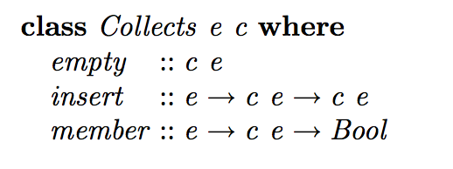
Constructor Classes
Define the collection class as follows:
c : type constructor
FLOLAC 2014

Slide 55
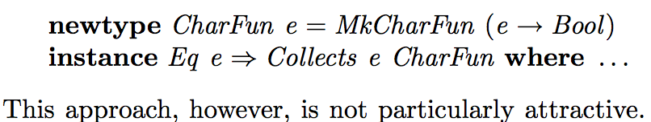
Shortcomings of Constructor
May not declare many
instances in a natural way
Type Classes with Functional Dependencies, Mark P. Jones, In Proceedings of the 9th European Symposium on Programming, ESOP 2000, Berlin, Germany, March 2000, Springer-Verlag LNCS 1782.
FLOLAC 2014

Slide 56
3. Parametric Type Classes
FLOLAC 2014

Slide 57
3. Parametric Type Classes (PTC)
Extend type classes to have parameters
class ce :: Collects e where
empty ::ce
insert ::e->ce->ce
member ::e->ce->Bool
The unknown element type e, treated as a paramter to Collects, is uniquely determined by ce
empty:: (ce::Collects e)=> ce
which is not ambiguous
FLOLAC 2014

Slide 58
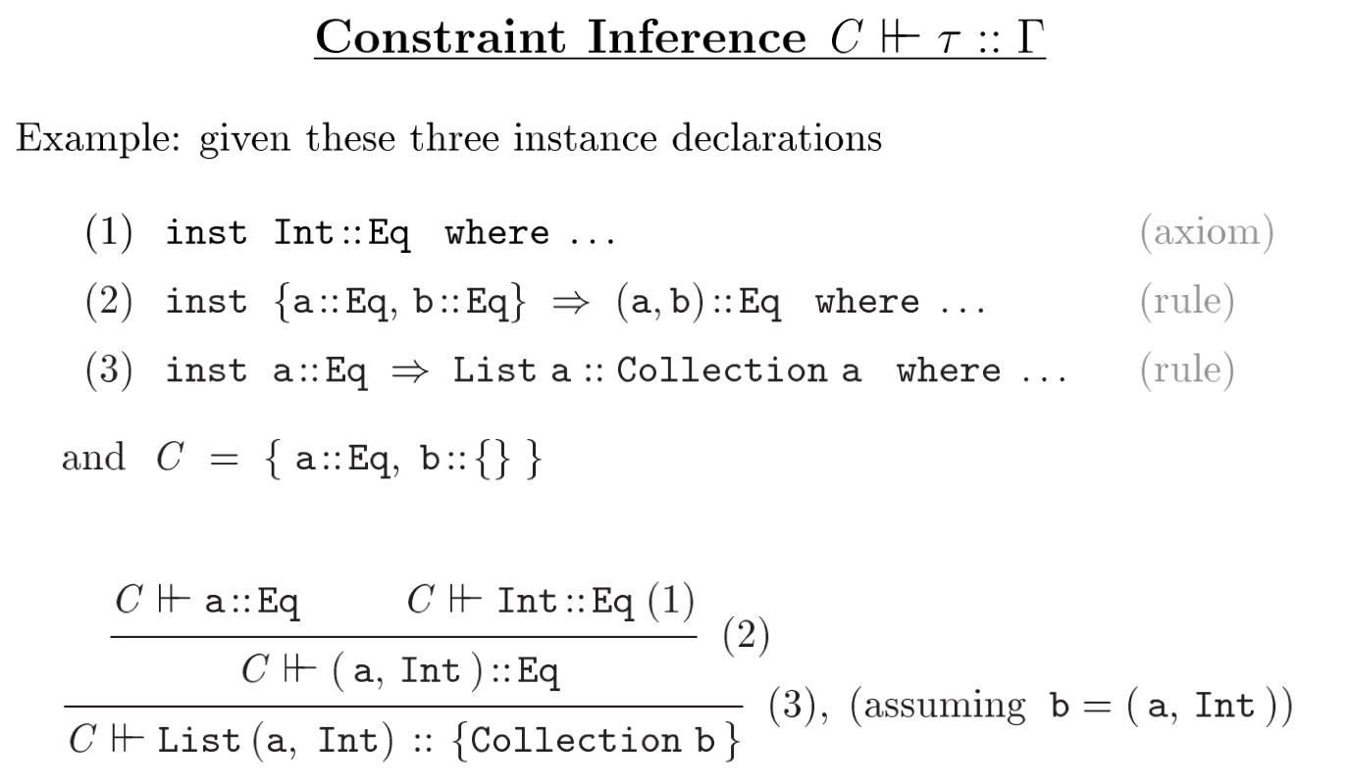
Context Normalization and Constraint Inference
Normalized class context as in Haskell:
a::Eq, b:: Eq, c::Collection ce
FLOLAC 2014

Slide 59
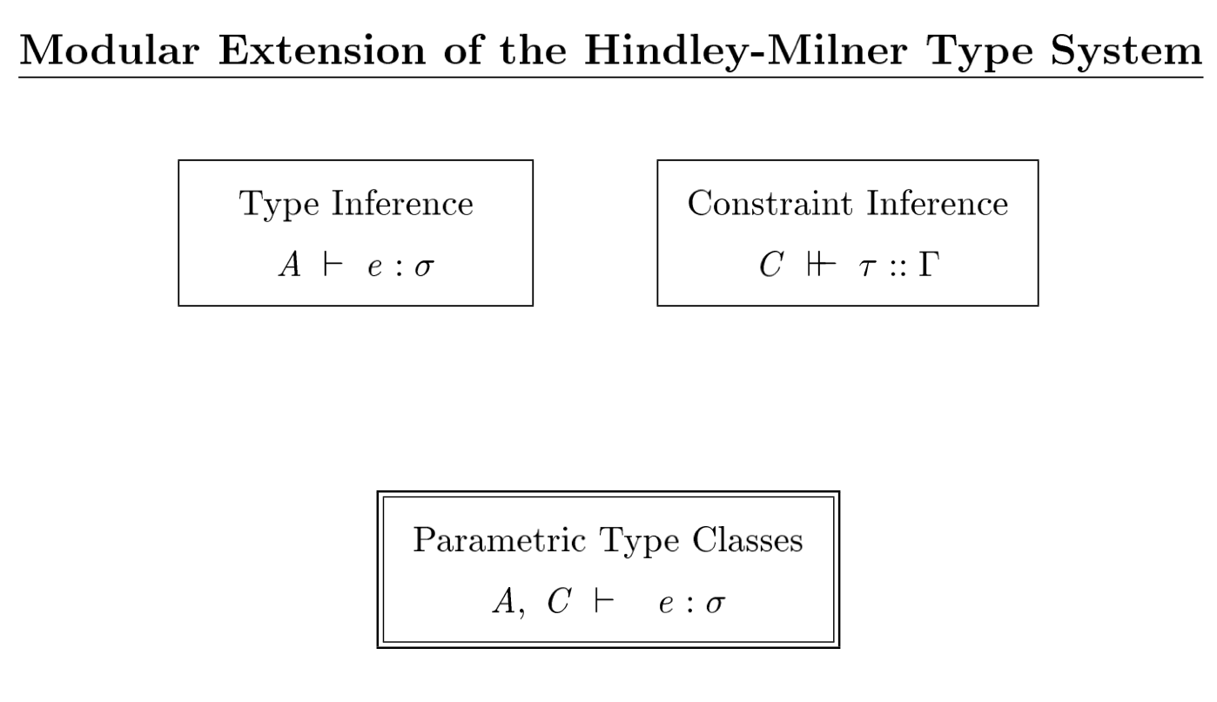
Class Constraints and Context Normalization
FP talk 2010

Slide 60
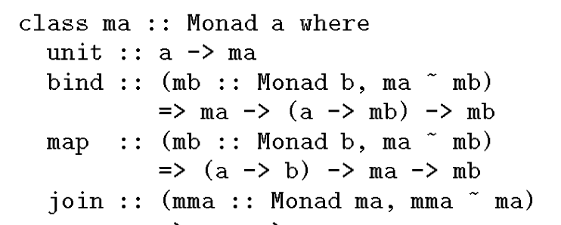
Shortcomings of PTC
Cannot handle cases like overloaded “map” well.
FLOLAC 2014

Slide 61
4. Type Classes with Functional Dependency
FLOLAC 2014

Slide 62
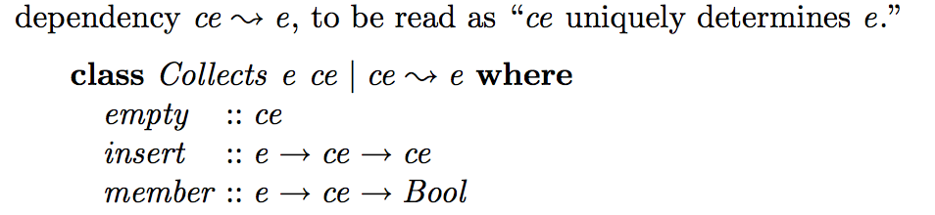
Functional Dependencies
Multi-parameter type classes + dependencies
like PTC
FLOLAC 2014

Slide 63
Summary
Type classes is a much more far-reaching idea than the Haskell designers first realised: the automatic, type-driven generation of executable “evidence”, ie, dictionaries.
Many interesting generalisations, still being explored
FLOLAC 2014

Slide 64
Peyton Jones’ take on type classes over time
Type classes are the most unusual feature of Haskell’s type system
Hey, what’s the big deal?
Wild enthusiasm
Despair
Hack, hack, hack
Incomprehension
1987
1989
1993
1997
Implementation begins

Slide 65
References
How to make ad-hoc polymorphism less ad hoc
Philip Wadler and Stephen Blott. 16'th Symposium on Principles of Programming Languages, ACM Press, Austin, Texas, January 1989.
Parametric Type Classes, Kung Chen, Paul Hudak and Martin Odersky. In Proceedings, ACM Conference on Lisp and Functional Programming, San Francisco, CA, June 1992.
A system of constructor classes: overloading and implicit higher-order polymorphism, Mark P. Jones, In FPCA '93: Conference on Functional Programming
Type classes: exploring the design space, Procedings of the Simon Peyton Jones, Mark Jones, Erik Meijer. Haskell Workshop 1997.
Type Classes with Functional Dependencies, Mark P. Jones, In Proceedings of the 9th European Symposium on Programming, ESOP 2000, Berlin, Germany, March 2000, Springer-Verlag LNCS 1782.
FLOLAC 2014

Slide 66
Why Overloading?
Many useful functions are not parametric.
Can serialize work for any type?
  No! Only for types w that support serialization.
Can sumOfSquares work for any type?
  No! Only for types that support numeric operations.
serialize:: w -> String
sumOfSquares:: [w] -> w

