Slide 1
Program verification
Lecturer: Yu-Fang Chen
Credits:
Thanks to Yu-Chia Chen for making the slides. The contents are based on the Slides of Ming-Hsien Tsai, Anthony Lin and David Mantre

Slide 2
Software Verification via SMT

Slide 3
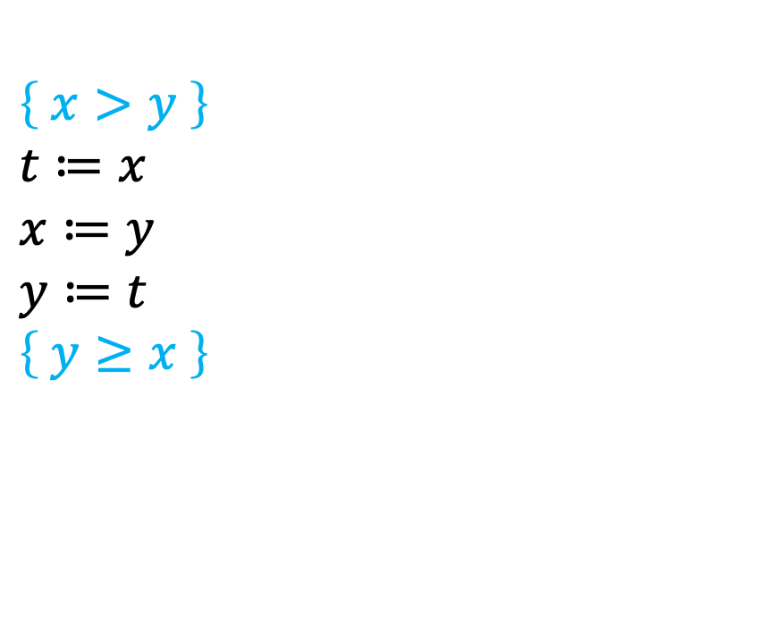
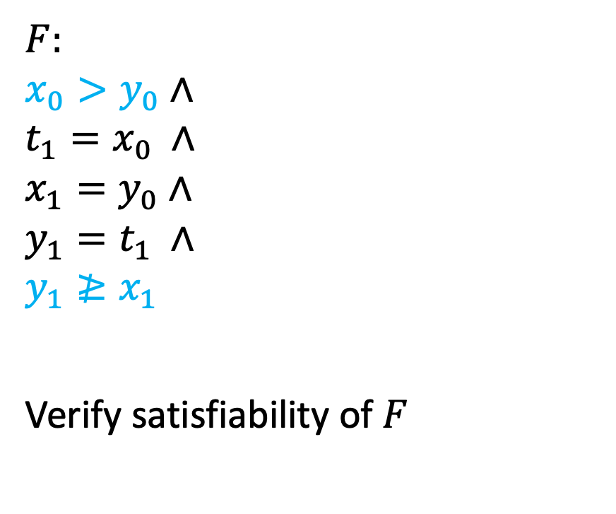
Static single assignment form
$$\left\{ x>y \right\} \\ t≔x \\ x≔y \\ y≔t \\ \left\{ y≥x \right\}$$
$F$: $$x_{0}>y_{0}∧ \\ t_{1}=x_{0} ∧ \\ x_{1}=y_{0}∧ \\ y_{1}=t_{1} ∧ \\ y_{1}≱x_{1}$$
Verify satisfiability of $F$

Slide 4
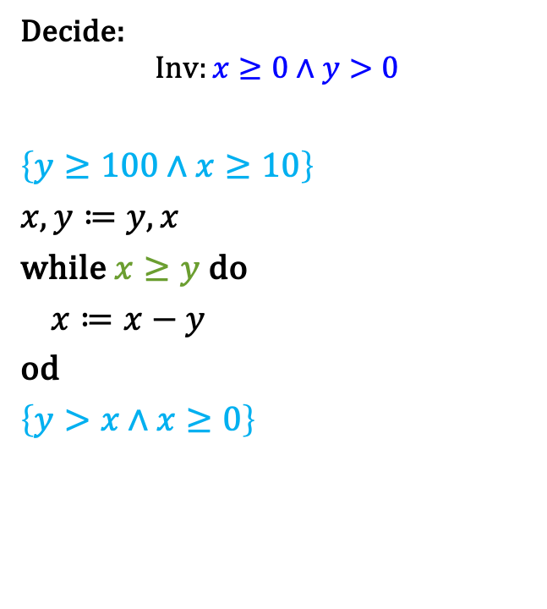
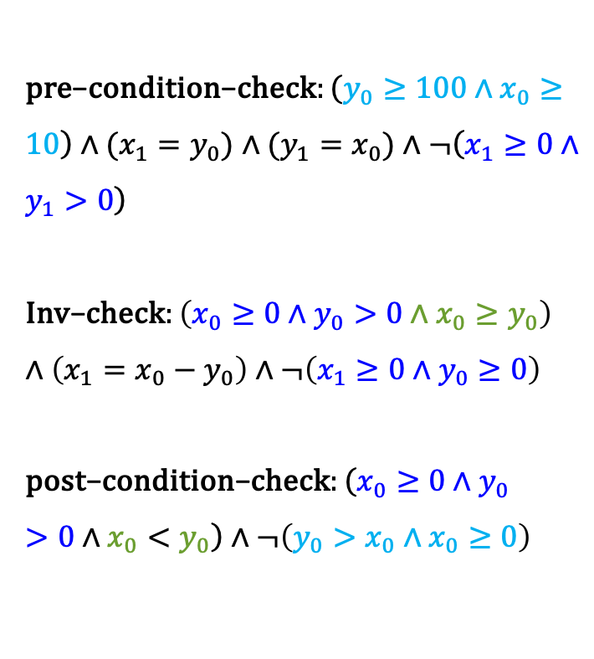
Example SSA
Decide:
$$Inv:x≥0∧y>0$$
$$\left\{y≥100∧x≥10\right\} \\ x,y≔y,x \\ \text{while} x≥y \text{do} \\ x≔x−y \\ \text{od} \\ \left\{y>x∧x≥0\right\}$$
$\text{pre}\text{−}\text{condition}\text{−}\text{check}:\left(y_{0}≥100∧x_{0}≥10\right)∧(x_{1}=y_{0})$ $∧(y_{1}=x_{0})∧¬\left(x_{1}≥0∧y_{1}>0\right)$ $$\text{Inv}\text{−}\text{check}:\left(x_{0}≥0∧y_{0}>0∧x_{0}≥y_{0}\right)∧\left(x_{1}=x_{0}−y_{0}\right)∧¬\left(x_{1}≥0∧y_{0}≥0\right)$$ $$\text{p}\text{ost}\text{−}\text{condition}\text{−}\text{check}:\left(x_{0}≥0∧y_{0}>0∧x_{0}<y_{0}\right)∧¬\left(y_{0}>x_{0}∧x_{0}≥0\right)$$

Slide 5

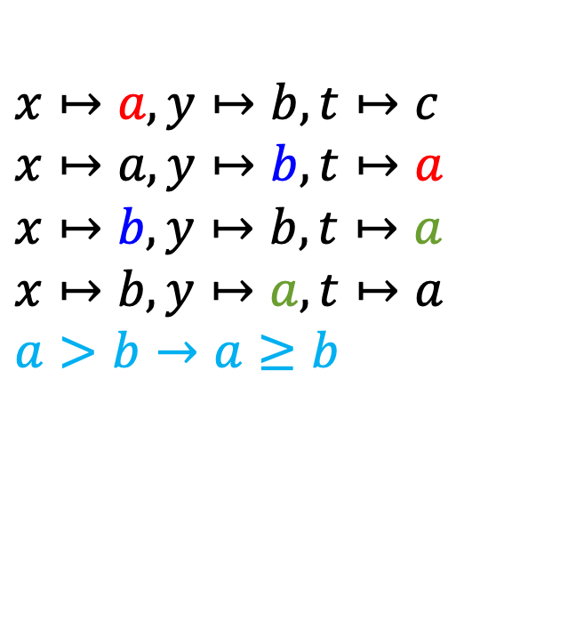
Symbolic execution
$$\left\{ x>y \right\} \\ t≔x \\ x≔y \\ y≔t \\ \left\{ y≥x \right\}$$
$$x↦a, y↦b,t↦c \\ x↦a, y↦b,t↦a \\ x↦b, y↦b,t↦a \\ x↦b, y↦a,t↦a \\ a>b→a≥b$$

Slide 6


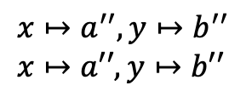
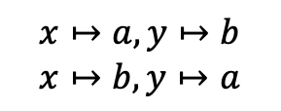
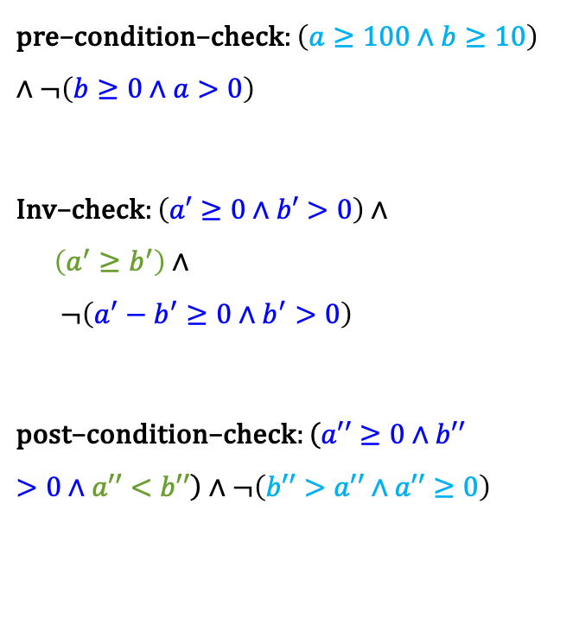

Symbolic execution – example
Decide:
$$Inv:x≥0∧y>0$$
$$\left\{y≥100∧x≥10\right\} \\ x,y≔y,x \\ \text{while} x≥y \text{do} \\ x≔x−y \\ \text{od} \\ \left\{y>x∧x≥0\right\}$$
$$\text{pre}\text{−}\text{condition}\text{−}\text{check}:\left(a≥100∧b≥10\right)∧¬\left(b≥0∧a>0\right)$$
$$\text{Inv}\text{−}\text{check}:\left(a′≥0∧b′>0\right)∧ \\ \left(a^{′}≥b^{′}\right)∧ \\ ¬\left(a^{′}−b^{′}≥0∧b^{′}>0\right)$$
$$\text{p}\text{ost}\text{−}\text{condition}\text{−}\text{check}:\left(a′′≥0∧b′′>0∧a′′<b′′\right)∧¬\left(b′′>a′′∧a′′≥0\right)$$
$$x↦a,y↦b \\ x↦b,y↦a$$
$$x↦a^{′},y↦b^{′} \\ x↦a^{′},y↦b^{′},a^{′}\text{≥}b^{′} \\ x↦a^{′}\text{−}b^{′},y↦b^{′},a^{′}\text{≥}b′$$
$$\text{path}\text{−}\text{condition}$$
$$x↦a^{′′},y↦b^{′′} \\ x↦a′′,y↦b′′$$

