Slide 1

Florian M., Philip H., Nino S.

Slide 2
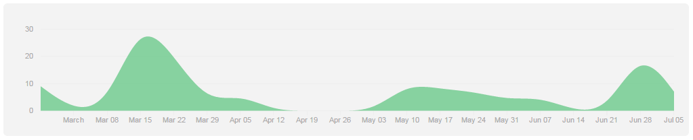
Project management
“kind of” SCRUM
Github issues - tasks
waffle.io - scrum task board

Slide 3
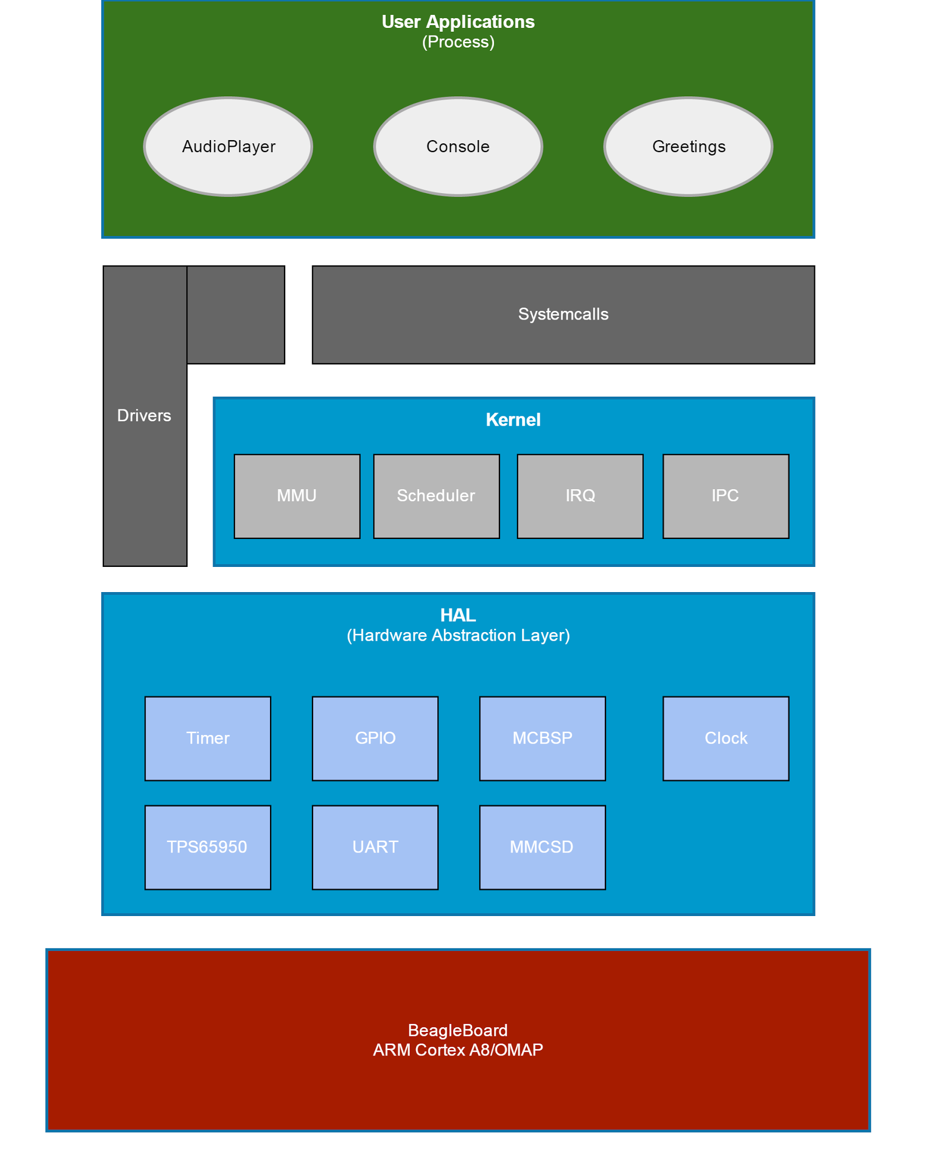
Architecture
User mode
User applications
Kernel
HAL
Kernel mode

Slide 4
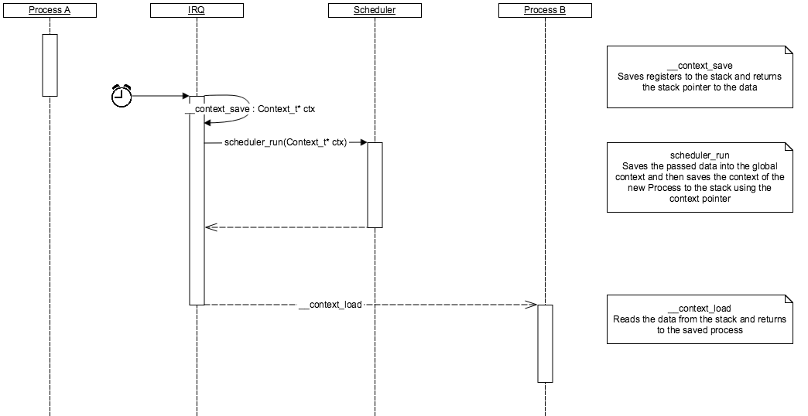
Scheduler

Slide 5
Scheduler
Scheduling time: ~100 ms
Max Number of Processes: 8
Could be increased if necessary
Currently running processes: 1 to 3
Round Robin

Slide 6
IPC
Semaphore
Process state is set to BLOCKED when semaphore is decreased (< 0)
Process state is set back to READY when semaphore is increased

Slide 7
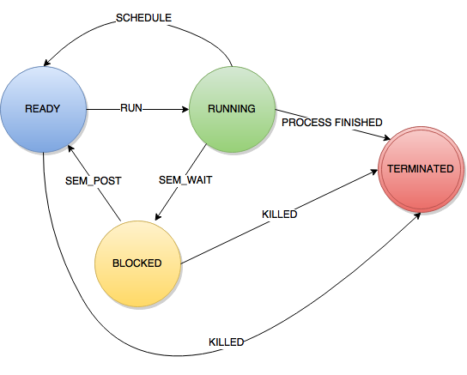
Process States

Slide 8
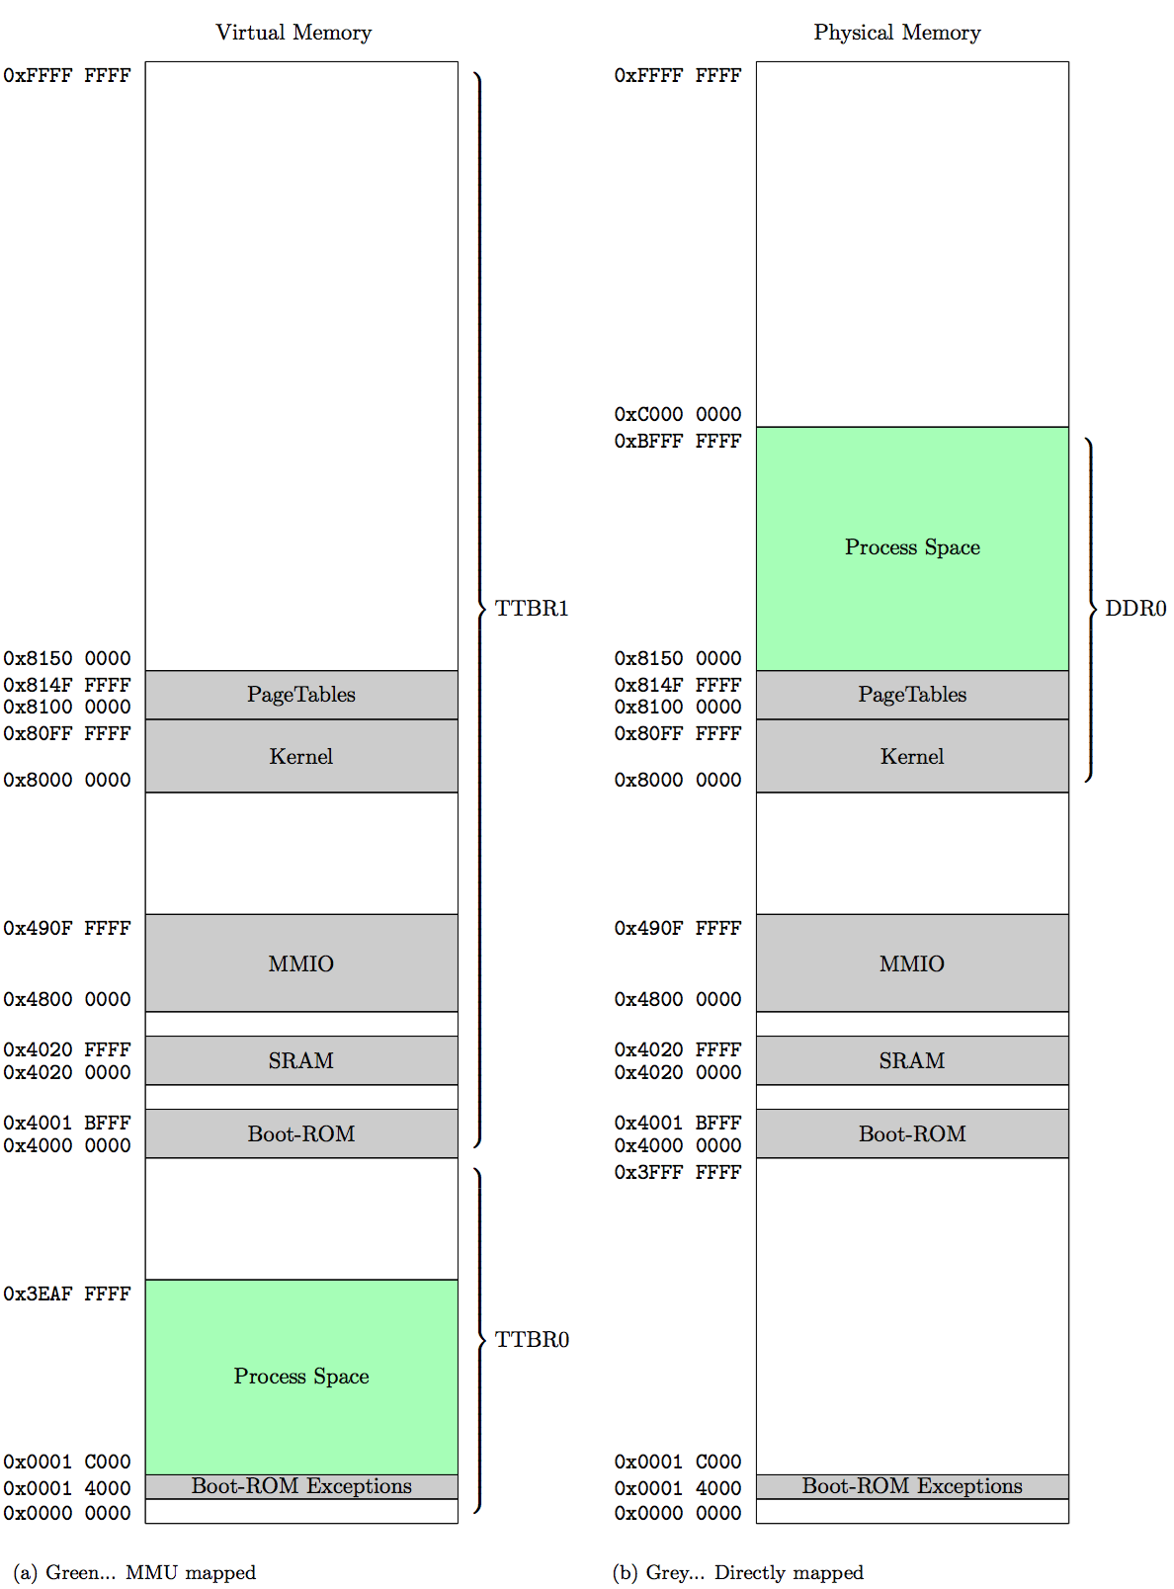
MMU
Memory Regions
Direct/Virtual mapping
Problems:
Memory access
Data aborts

Slide 9
Loader
Can load a binary file from external data source
Currently working: Loading binary data from DDR0 (Kernel)

Slide 10
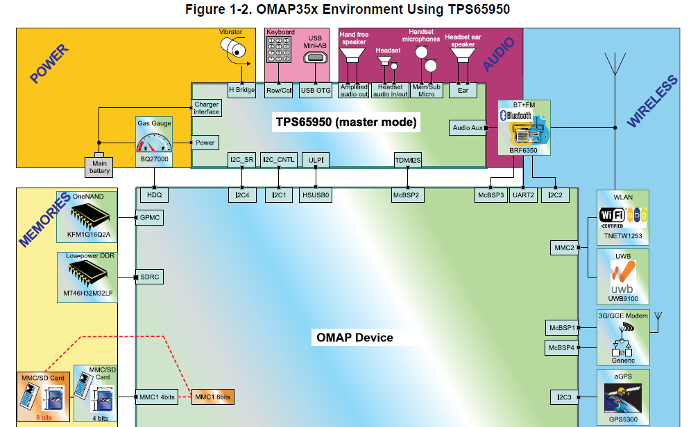
Audio

Slide 11
Problem section
Hardware Configuration (UART, MMCSD,…)
Understanding of concepts
MMU, context switch in detail
Weird behaviour of board (resets)

Slide 12
But there is work to do...
Strict separation of User/Kernel Layer
System stability
handling of unexpected failures
Audio performance
use of buffer
Filesystem (FAT)
Driver management
Yield

