Slide 1
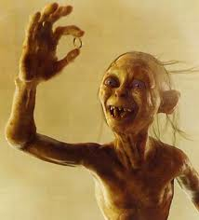
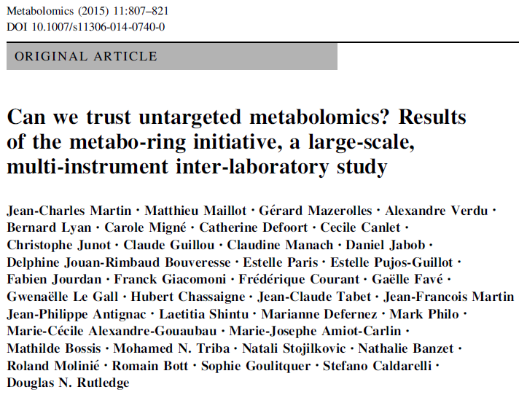


Slide 2


Rational
MassBank
NMR 500
MZMine
QTOF
GCMS
QTrap
Orbitrap
NMR 800
KEGG
TQ
In-house scripts
TOF
HMdB
LCMS
AMiX
NMR 800
reliability of my untargeted metabolomics study
MSI
XCMS
MetLin

Slide 3

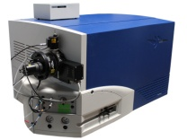
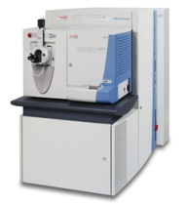
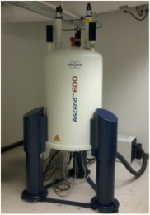
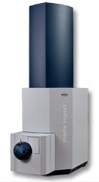
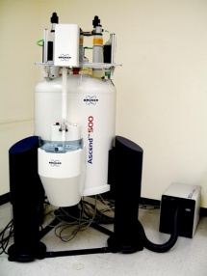

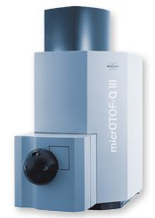
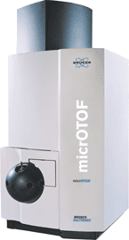
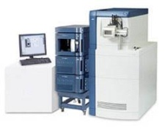
Rational
Where do we stand?
No prior standardization
Between MS
Between NMR
Between MS & NMR

Slide 4

Skills & Partners
,
LCMS
(9)
NMR
(5)
Gwenaelle Le Gall _IFR Norwich
Data processing
S.
Goulitquer
,
Metabomer
R. Molinié, U
-
Amiens
D Rutledge, IAQA,
agroparistech
A.
Verdu_Brüker
daltonics
Les Ulis
N Stojilkocic_LCH Verrière
C Junot_CEA Saclay
JP Antignac_Laberca
M Triba_UParisXIII
Nantes
D Jacob,
CBiB
E Pujos_JF Martin, INRA
Bordeaux
Clermont
C Canlet, F Jourdan_INRA
C Guillou_IHC, Ispra
Toulouse
G Mazerolles,
JC Martin AMU
supagro
, Montpellier
L Shintu U Med
Marseille

Slide 5
Method
High biological contrast
Low biological contrast
Analysis of urines provided by 14 healthy volunteers spiked with 32 standard metabolites vs non-spiked urines
Dietary supplementation of 20 rats with 20kUI vit D x 6 weeks vs control rats
Untargeted analysis of urines
Untargeted analysis of plasma
Data extraction and inter-platform convergence assessment

Slide 6
Method
LCMS
very high pressure LC from different vendors, different chromatographic columns used , ESI conditions, MS configurations (TOF, QTOF, orbital technology) and instrument series. All used XCMS but with different tuning; various post-processing filtering
Same metabolite gives various spectral features
NMR
Same metabolite gives various spectral features
Brüker avance 500 or 600, ¹[H]NMR spectra recording (1D NOESY), deconvolution with AMIX or in-house Matlab script, bucketing conditions from 0.001ppm to 0.01 and 0.04 ppm, normalization on total bucket intensity or on external TSP
Same metabolite gives various spectral features

Slide 7
Method
V₁ ….. V_{p}
V₁ ….. V_{k}
V₁ ….. V_{h}
..…..…
V₁ ….. V_{q}
1
Platform 1
Platform 2
Platform 3
……..
Platform i
2
individuals
:
i
Each statistical indivual are common to each block
No group assignment (unsupervised)
Each block has a specific set of variables, generally not shared with the other blocks.

Slide 8
Method
V₁ ….. V_{p}
V₁ ….. V_{k}
V₁ ….. V_{h}
..…..…
V₁ ….. V_{q}
1
Platform 1
Platform 2
Platform 3
……..
Platform j
2
individuals
:
i
Extraction of the common information shared by all blocks
Weight determination of each block in the common information
(common component and specific weight analysis or CCSW)
LocalLx{j}(i,:) = inv( T(:,i)' * T(:,i) ) * T(:,i)' *Table{j};
Qannari, E. M. et al, Food Quality and Preference 2000, 11, 151-154.

Slide 9
Method
RV coefficients = closeness between two variance-covariance matrices (≈ r²)
Lavit, C.; et a lComputational Statistics & Data Analysis 1994, 18, 97-119.
V₁ ….. V_{h}
Platform 3
V₁ ….. V_{q}
V₁ ….. V_{p}
Platform i
Platform 1
Rv1-3
Rv3-i
Rv2-3
Rv2-i
Rv3-4
Rv4-i
Rv1-4
V₁..….. V_{z}
V₁ ….. V_{k}
Platform 2
Platform 4

Slide 10
Results
Test#1
High biological contrast
urines

Slide 11
Results
Test#1: urine study
x80

Slide 12
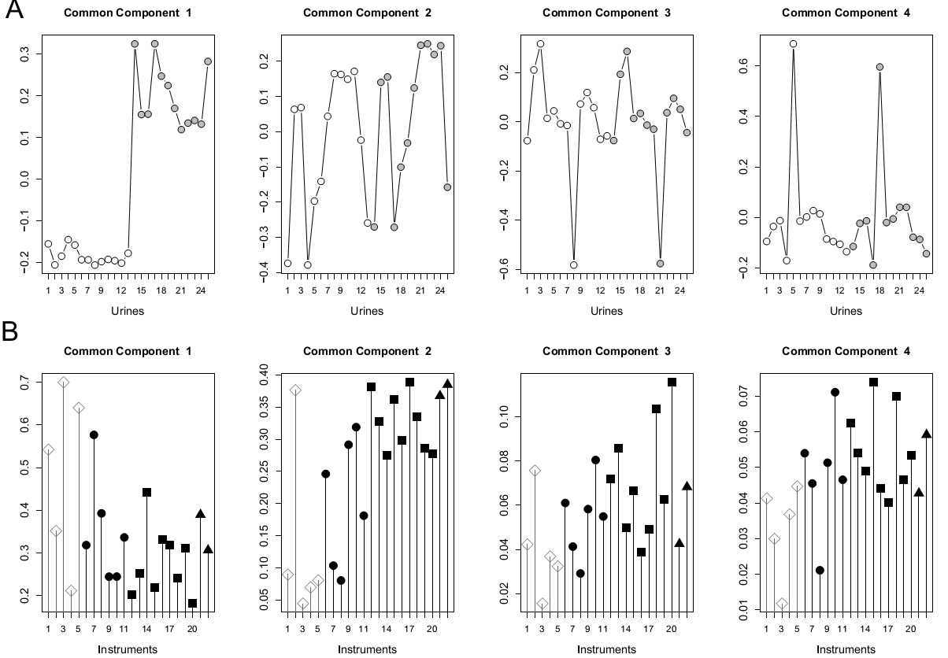
CCSW Results
Test#1: urine study
spiked
spiked
non spiked
non spiked
spiked
non spiked
spiked
non spiked
NMR
Orbi’s
QTOF’s
TOF’s

Slide 13
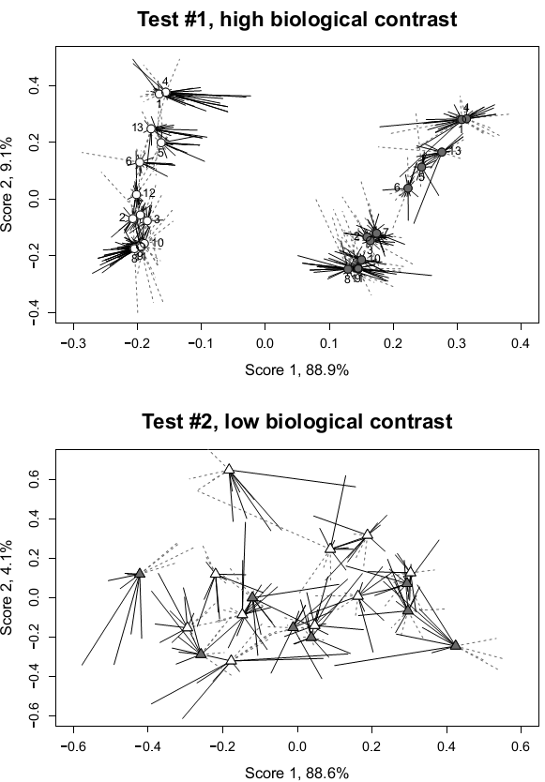

Slide 14
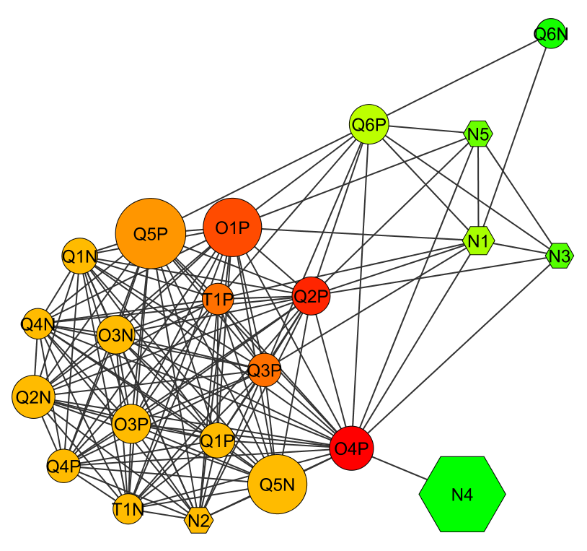
Rv coefficients Results
MS
Node size f(# features)
NMR
Correlation (Rv coeff ≈ r²) threshold over 0.79
# node connections
high
low
Mean RV between MS = 0.87
Mean RV between NMR = 0.78
Mean RV between NMR x MS = 0.74
Key:
N for NMR
Q for QTOF
O for orbitrap
T for TOF
Positive ionization indicated by P
Negative ionization indicated by N
MS

Slide 15
Results
Test#2
Low biological contrast
Rat plasma

Slide 16
Results
Test#2: rat plasma study
NMR1
NMR2
NMR3
QTOF1
NMR4
ORBI1
ORBI2
ORBI3
QTOF3
QTOF2

Slide 17
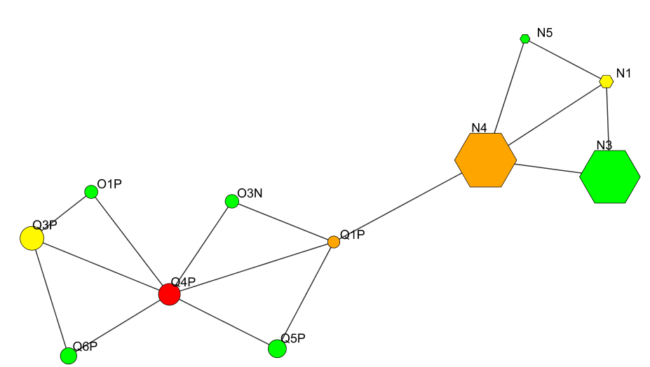
Results
Test#2: rat plasma study
MS
Node size f(# features)
NMR
Correlation (Rv coeff ≈ r²) over 0.71
# node connections
high
low
Mean RV between MS = 0.67
Mean RV between NMR = 0.78
Mean RV between NMR x MS = 0.57

Slide 19
Conclusion
Heterologous instruments are able to extract a convergent biological information without prior standardization
This information is not influenced by the number of extracted variables
For MS, the technological design has no effect when dealing with pattern comparisons
Metabotypes can be reported at different scales (MS and NMR sensitivity)
Our methodology could be used to assess the efficiency of standardization procedures to further improve inter-instrument convergence
Can we trust untargeted metabolomics?

Slide 20
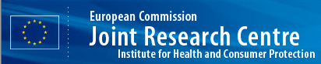


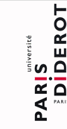









Acknowledgments
Matthieu Maillot, Gérard Mazerolles, Alexandre Verdu, Bernard Lyan, Carole Migne, Catherine Defoort, Cecile Canlet, Christophe Junot, Claude Guillou, Claudine Manach, Daniel Jabob, Delphine Jouan-Rimbaud Bouveresse, Estelle Paris, Estelle Pujos-Guillot, Fabien Jourdan, Fabrice Tranchida, Franck Giacomoni, Fréderique Courant, Gaëlle Favé, Gwenaëlle Le Gall, Hubert Chassaigne, Jean-Claude Tabet, Jean-Francois Martin, Jean-Philippe Antignac, Laetitia Shintu, Marianne Defernez, Mark Philo, Marie-Cécile Alexandre-Gouaubau, Marie-Josephe Amiot-Carlin, Mathilde Bossis, Mohamed N. Triba, Natali Stojilkovic, Nathalie Banzet, Roland Molinié, Romain Bott, Sophie Goulitquer, Stefano Caldarelli, Douglas N. Rutledge

