Slide 1
Brooklyn-Queens Ground
Transportation Service Routes
Project Benson
Derek, John, Mark, & Saniya

Slide 2
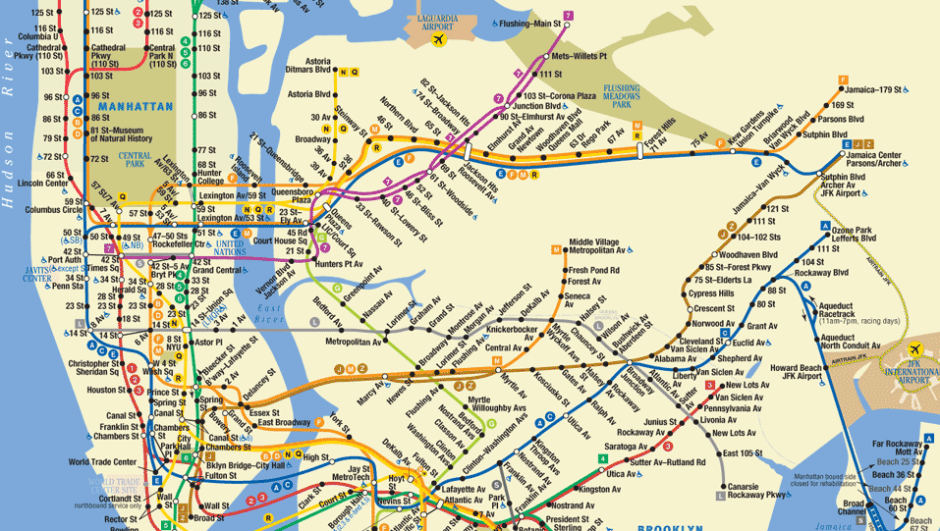
Client & Project
Qubra:
Startup which aims to connect communities by improving affordable ground transportation options in New York City
Acquires retired school and city buses to offer shuttle services
Need our help to analyze traffic flow in Queens and Brooklyn and plan the routes in these regions
Notes:
Saniya

Slide 3
Data Set
Turnstile Data provided by New York MTA
Under proper conditions, record 6 audits per day per turnstile in every station
Records include information on station name, date & time of audit, line number, number of entries and exits
Sample: September 19 - November 5, 2015
Idea: Analyze entry & exit numbers to determine popularity and demand for ground transportation at certain stations
Notes:
Saniya

Slide 4
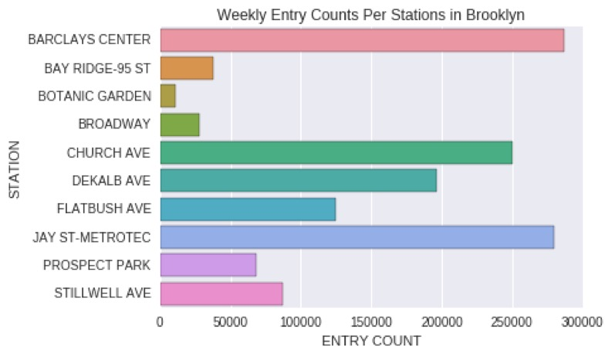
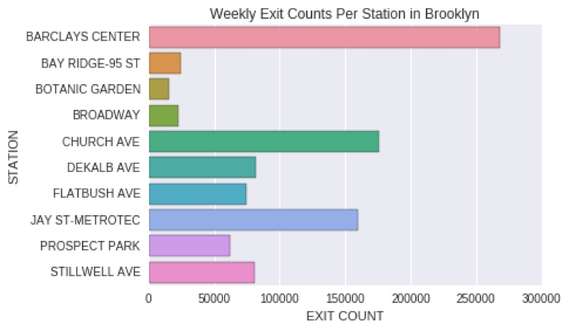
Brooklyn
Weekly Entry Counts
Weekly Exit Counts
Notes:
John
-LEFT SIDE ONLY -- Pre-lim analysis shows us that Barclays and Jay St may be possible transfer points (from train to shuttle)
-
Ones with high volumes of people can help us select which stations are possible for setting up transfers

Slide 5
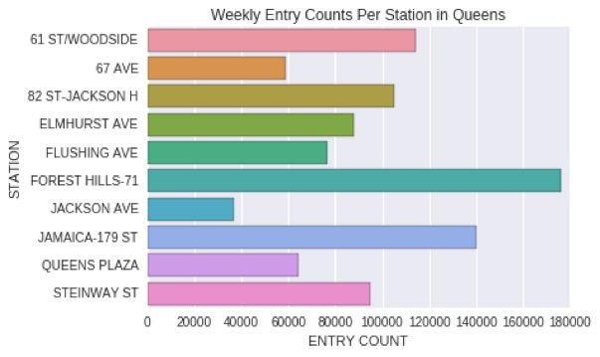
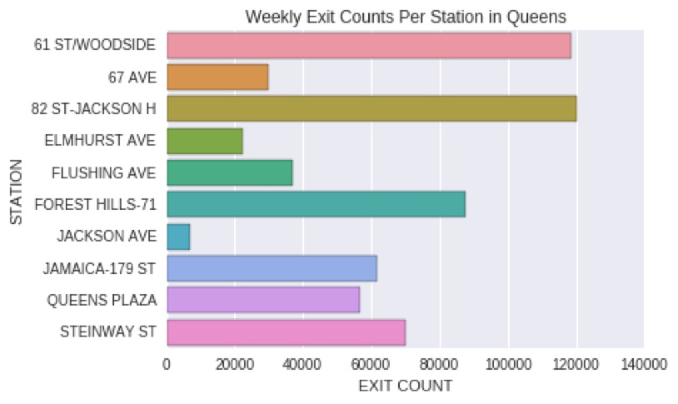
Queens
Weekly Entry Counts
Weekly Exit Counts
Notes:
Mark
FLushing, Forest HIlls, Jamaica: these are the end points of the subway lines.
It shows more entries than exits. It could mean people utilizing them in the morning to commute to manhattan and brooklyn, which is a great target point for the shuttles to transport people trying to commute in the morning. 61 St,
There are more exits, which may be the exit points for many people returning from work for the day. This may pose another opportunity to shuttle people home from these stations.
Possible reason for discrepancy: Changing the mode of transportation to and from home

Slide 6
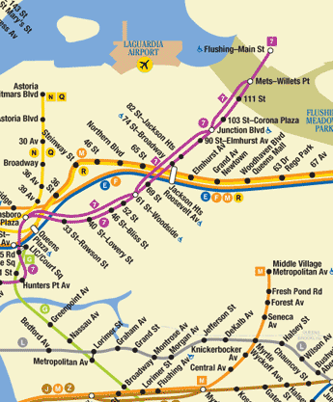
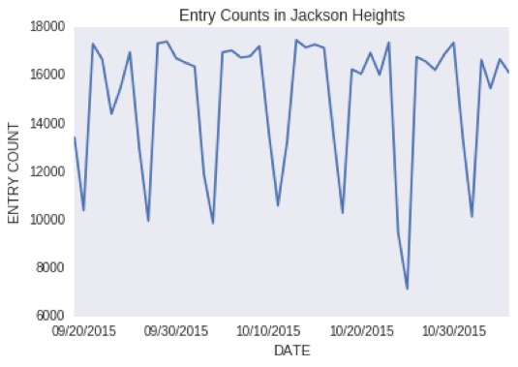
Single Station
Notes:
Deeper dive. Connecting point. Weekdays, result of connecting station. Traunches correlate to weekends. Seven peaks. One points? Couple of points. Maybe only sundays.

Slide 7
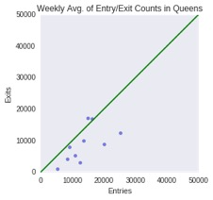
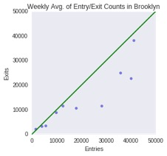
Weekly Averages of Entry vs Exit Counts
Notes:
More entries than exits. We would assume. Reality. Because flat rate system. Larger in brooklyn. Each points speaks to the design of each station.

Slide 8
Improvements & Next Steps
Estimating station-to-station ridership with entries/exits by time of day
Incorporating MTA bus ridership data
Google Maps characterization of transit times by time of day/day of week
Uber/Lyft surge fares and wait times
Investigation of other possible lines
Scheduling based on number of buses, driver shifts, opening hours, holidays, etc.

