Slide 1
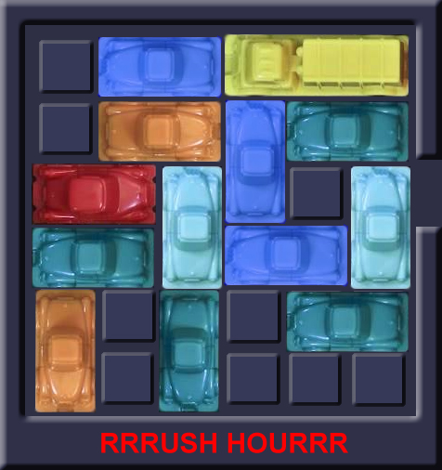
Rushhour

Slide 2
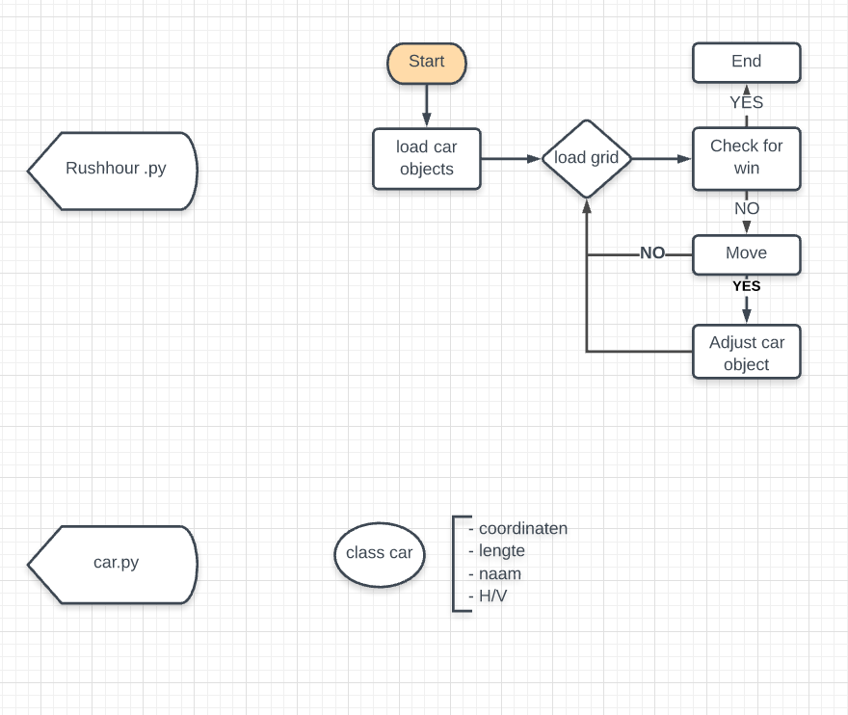
Game setup

Slide 3
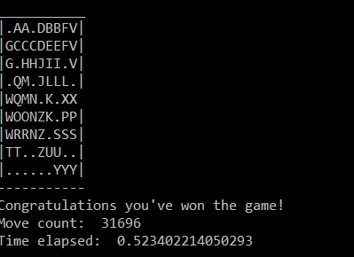
Visualization
Simple graphical

Slide 4




Random algorithm is able to give a valid solution for first 6 games
Description
Take-aways
First 6 boards solved with a max of 9x9
Efficiency very low algorithm does a lot of similar steps
Room for improvement
Check if won
Continue if not won
Pick a random car
From all the cars
4
1
Random algorithm
Input the move in the game
If possible perform the move
3
2
Pick a random move
From the list [-1, 1]

Slide 5
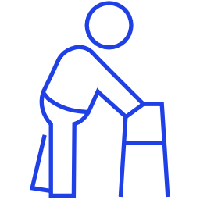
Project planning
2
Current state
Advanced (optional)
4
3
Create random boards
Solve the random created boards and determine what is the difficulty in solving them
2
Advanced algorithms
Algorithms with higher performance able to solve all boards
1
Random algorithm
Simple algorithm able to solve the simple boards
Simple gameplay possible
Game playable by hand
Notes:
5

Slide 6
Possible advanced algorithm
1.0
New board state
1.1.0
Similar board state (shut off node)
Not exhaustive
Visualization
Description
Nodes represent board states
Branches represent moves
Level represents number of moves
0.0.0
0: A-1
0.0
1: B-1
Algorithm
Take the node highest up the tree
Identify all possible moves
Create the corresponding nodes
Compare the new nodes with nodes earlier up the tree
Check if the game is won
Shut of nodes that represent a board state that was achieved before
Repeat
0: A-1
0.1.0
0
1: B-1
0.1
1: B+1
1.1.0
1.2.0
2: K+1
0: B-1
0.2
1: A-1
1.2.1
Notes:
6

