Slide 1
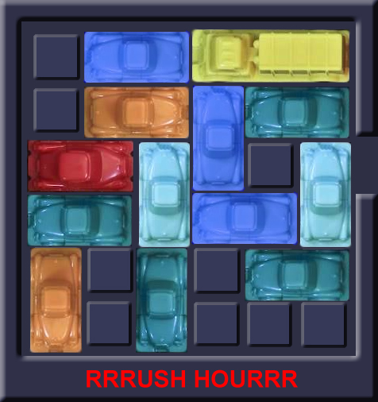
Rushhour
Bart Zeeuw van der Laan
Paloma van Moerkerken
Floor Berkhout
Commit4life

Slide 2
Rushhour
State space
State space of empty spots
36! = 1.6783439e+21
State space of two-space cars
36×34×32×30×28×26×24×22×20×18×
16×14×12×10×8×6×4×2 = 1.6783439e+21
State space of two-space cars
36×33×30×27×24×21×18×15×12×9×6×3 = 2.5456109e+14
State of board 6x6, game 1
2 x 2 x 3 x 3 x 5 x 3 x 3 x 5 x 5 x 4 x 3 x 3 x 5 = 7.290.000

Slide 3
Our algorithms
Random algorithm
Solved 12x12 board
Improved random algorithm
Solved 12x12 board
Breadth-first algorithm
Some 9x9 boards
Depth-first algorithm
Solved 12x12 board

Slide 4
Our algorithms
 | 6x6_1 | 6x6_2 | 6x6_3 | 9x9_4 | 9x9_5 | 9x9_6 | 12x12_7
Random
Improved random
Breadth-first
Depth-first
Solved board
Unsolved board
Unknown

Slide 5
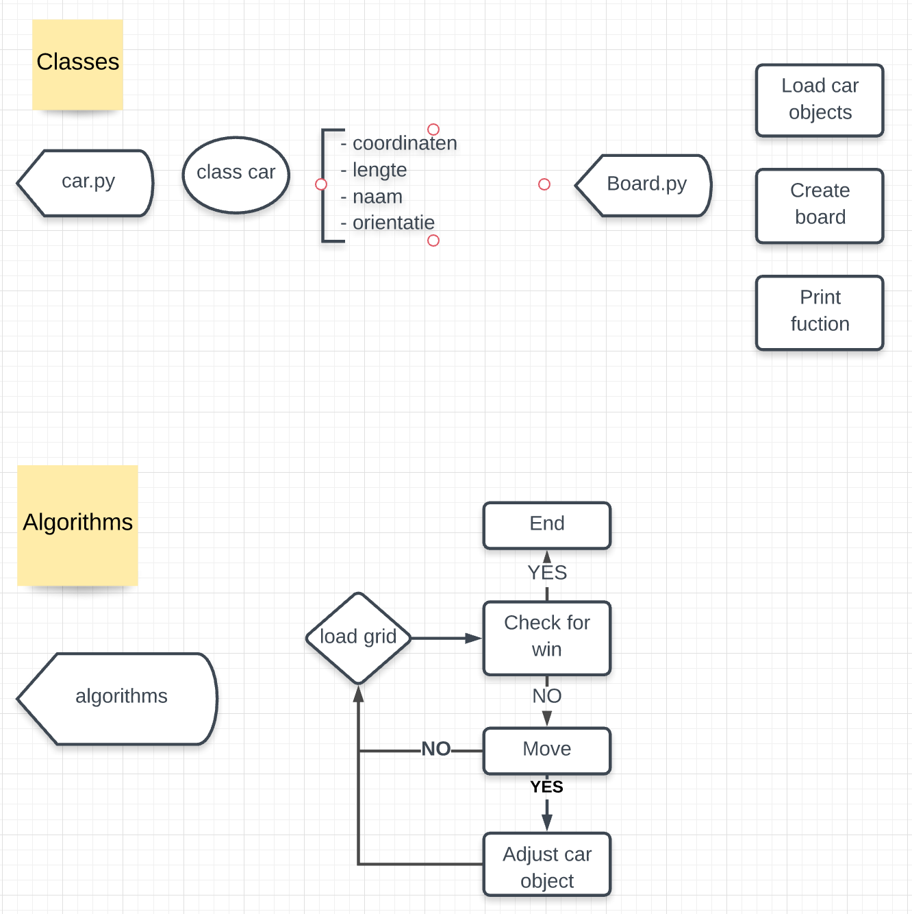
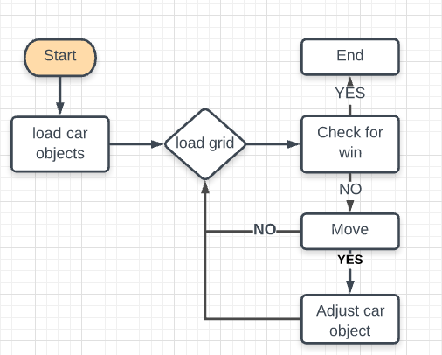
Game setup

Slide 6
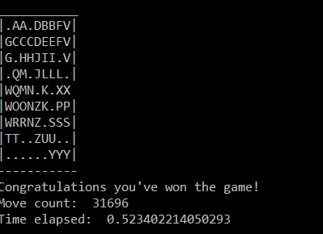
Visualization
Simple graphical

Slide 7




Random algorithm is able to give a valid solution for first 6 games
Description
Take-aways
First 6 boards solved with a max of 9x9
Efficiency very low algorithm does a lot of similar steps
Room for improvement
Check for win is not efficient
Check if won
Continue if not won
Pick a random car
From all the cars
4
1
Random algorithm
Input the move in the game
If possible perform the move
3
2
Pick a random move
From the list [-1, 1]

Slide 8
Random advanced algorithm met heuristiek
Description
Take-aways
Check if won
Continue if not won
By checking if no other car is blocking the X car
Is expected to need less moves to solve the game
Is expected to need more time for the extra steps
It surely doesn’t find the optimal solution
Pick a random car
From the moveable cars
4
1
Random
advanced algorithm
Pick a random move
From the list [-1, 1]
If the same car is moved multiple times in a row, this is seen as one move
Input the move in the game
If possible perform the move
3
2

Slide 9
Breadth-first & depth-first
1.0
New board state
1.1.0
Similar board state (shut off node)
Visualization
Description
Nodes represent board states
Branches represent moves
Level represents number of moves
0.0.0
0: A-1
0.0
Algorithm
Take the node highest up the tree
Identify all possible moves
Create the corresponding nodes
Compare the new nodes with nodes earlier up the tree
Check if the game is won
Shut of nodes that represent a board state that was achieved before
Repeat
1: B-1
0: A-1
0.1.0
0
1: B-1
0.1
1: B+1
1.1.0
1.2.0
2: K+1
0: B-1
0.2
1: A-1
1.2.1
Notes:
9
Bart +1 voor presentatie
Numpy
Geheugenprobleem als elke Node opgeslagen moet worden
State space verkleinen > in aantal zetten of nodes
Random_move algoritme

Slide 10
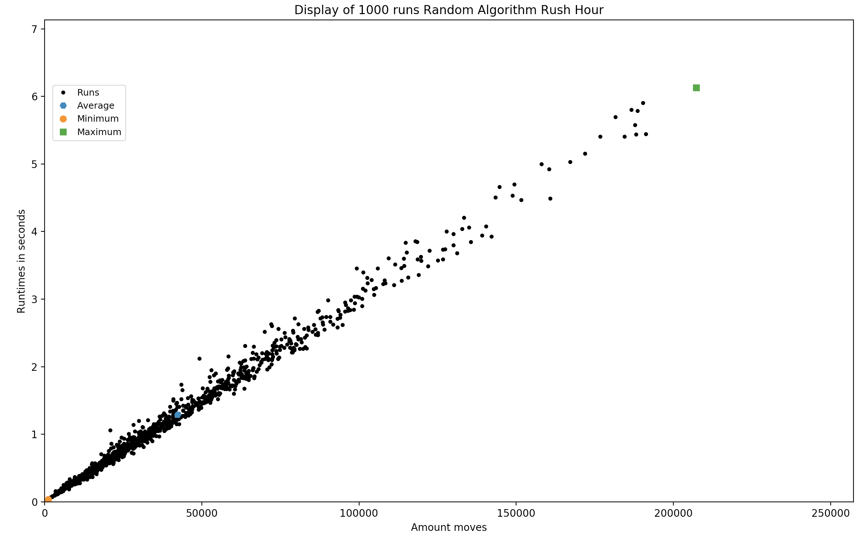
Random algorithm test
Board 6x6 game 1
Take-aways
To compare the lower and upper bound with the random advanced algorithm, breadth-first and depth-first.

Slide 11
Comparison of the algorithms
Board 6x6, game 1
Algorithms
Random algorithm 1000x
Advanced random
Depth-first
Breadth-first
Moves Lower bound, in case of. | Time Lower bound, in case of. seconds | Average moves | Average time seconden | Upper bound moves | Upper bound time minutes
314 | 0.6 | 14392 | 27.12 | 114266 | 3.486
- | - | - | - | - | -
185 | 1.439
20 | 1.413
Notes:
11
Bart +1 voor presentatie
Numpy
Geheugenprobleem als elke Node opgeslagen moet worden
State space verkleinen > in aantal zetten of nodes
Random_move algoritme

Slide 12
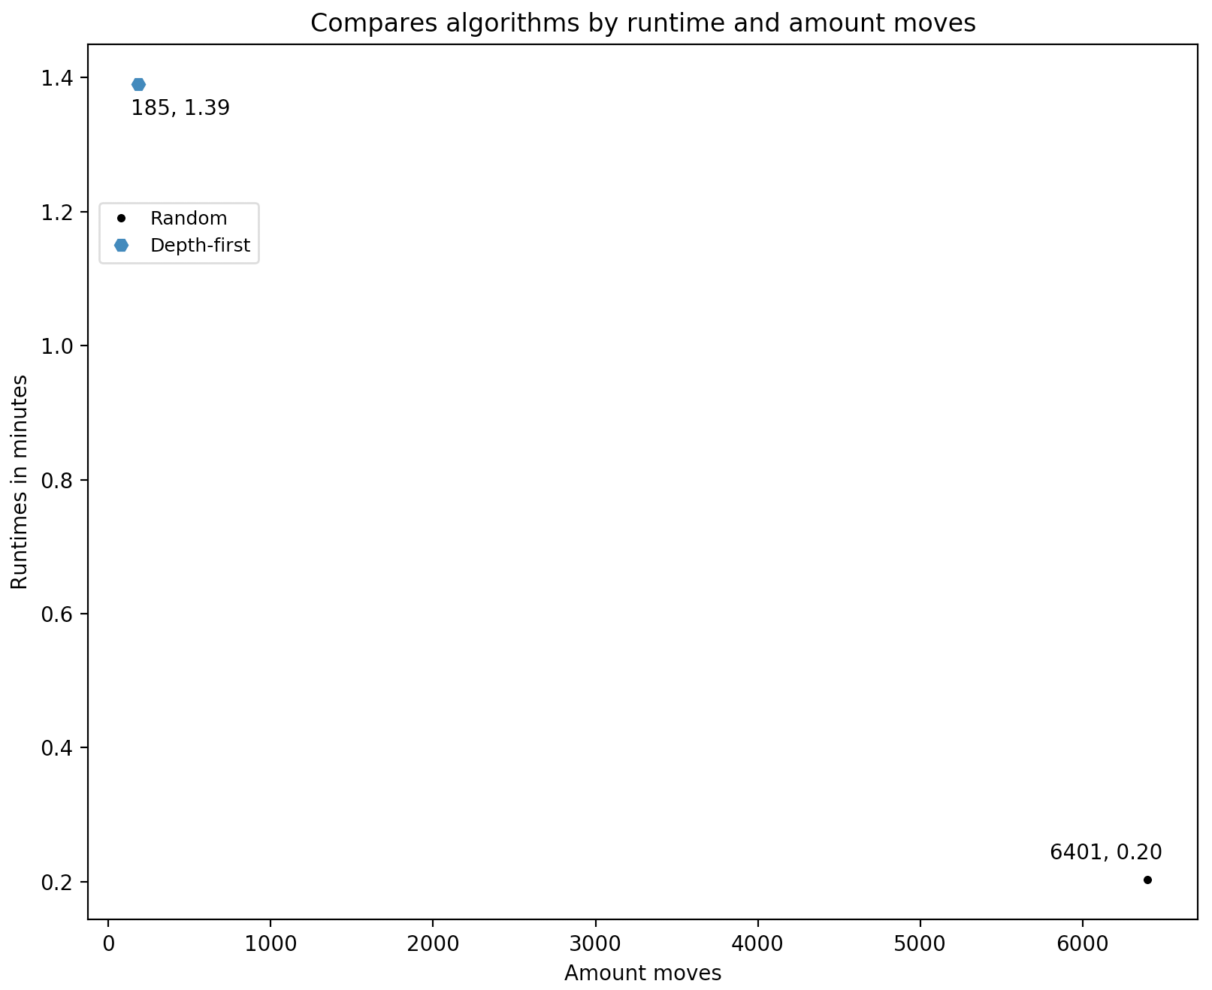
Comparison of the algorithms
Board 6x6, game 1
Notes:
12
Bart +1 voor presentatie
Numpy
Geheugenprobleem als elke Node opgeslagen moet worden
State space verkleinen > in aantal zetten of nodes
Random_move algoritme

Slide 13
Looking forward
Visual overview
Tree graph of state space per game
Geheugengebruik als vergelijkend gegeven
Notes:
13
Bart +1 voor presentatie
Numpy
Geheugenprobleem als elke Node opgeslagen moet worden
State space verkleinen > in aantal zetten of nodes
Random_move algoritme

Slide 14
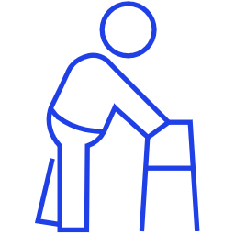
Project planning
3
Current state
Advanced (optional)
4
3
Create random boards
Solve the random created boards and determine what is the difficulty in solving them
2
Advanced algorithms
Algorithms with higher performance able to solve almost all boards
Data visalization
1
Random algorithm
Simple algorithm able to solve the simple boards
Simple gameplay possible
Game playable by hand
Notes:
14

