Slide 1
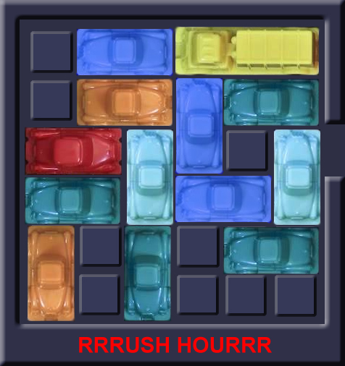


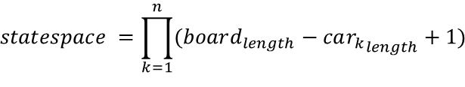

Statespace can be considered as all possible board states
Board specific an upper bound statespace is a function of all possible car positions and is
Generic formula
$$n=total cars on the board$$
Car can be in board_{length} – 1 positions
Horizontal cars can only move in their row
No limits assumed¹
Cars can be placed on top of each other for simplicity (this overestimates the space)
$$statespace =\prod_{k=1}^{n}{(board_{length}−{car_{k}}_{length}+1)}$$
Possible states is a function of positions of all cars
Calculated by the product of all separate cars possitions
Vertical cars same logic
Logic similar to horizontal cars that can be in every place of their row
1. This oversimplifies the amount of all possible states. Potentially resulting in a higher amount of combinations than would be valid

Slide 2
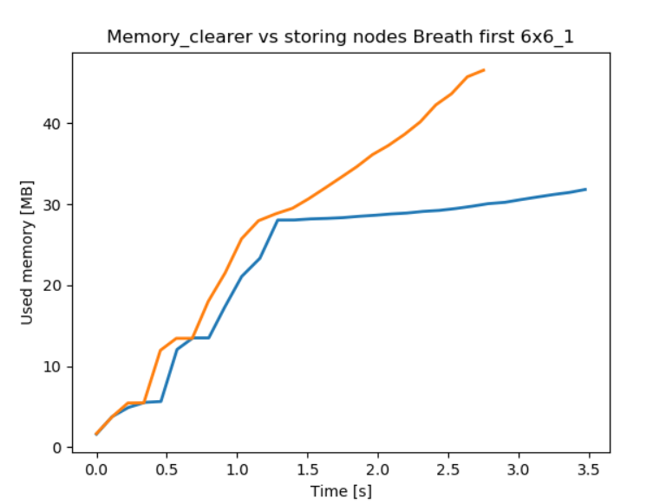
Not storing nodes saves memory but uses extra processing time
Standard
Memory saver
Working principle
Stores objects
Computes objects every time
Resuls
Plots

Slide 3
Due to the nature of the problem we choose Random and Iterative algorithms
selected
not selected
Class
Algorithm
Rationale
Selected
Random
Random
Simple algorithm
Greedy
?
Constructive
Breadth first
Able to find the most optmal solution in the shortest amount of time
Depth first
Able to find a quick solution
Iterative deepening
?
Iterative
Hill climber
No clear score of state possible therefore we didn’t use iterative algorithms
Simulated anealing

Slide 4
Rushhour

Slide 5
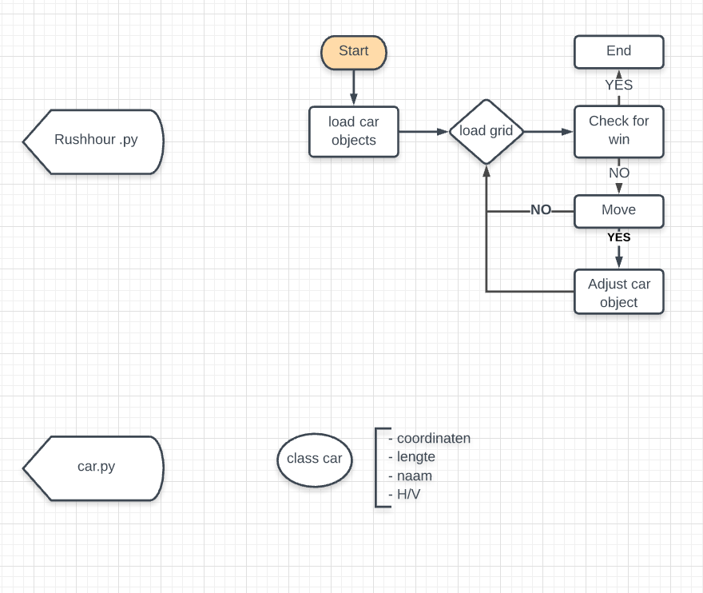
Game setup

Slide 6
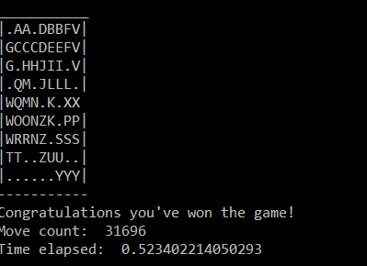
Visualization
Simple graphical

Slide 7




Random algorithm is able to give a valid solution for first 6 games
Description
Take-aways
First 6 boards solved with a max of 9x9
Efficiency very low algorithm does a lot of similar steps
Room for improvement
Check if won
Continue if not won
Pick a random car
From all the cars
4
1
Random algorithm
Input the move in the game
If possible perform the move
3
2
Pick a random move
From the list [-1, 1]

Slide 8
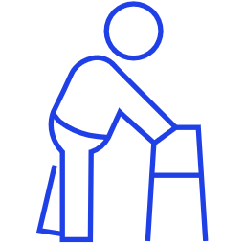
Project planning
2
Current state
Advanced (optional)
4
3
Create random boards
Solve the random created boards and determine what is the difficulty in solving them
2
Advanced algorithms
Algorithms with higher performance able to solve all boards
1
Random algorithm
Simple algorithm able to solve the simple boards
Simple gameplay possible
Game playable by hand
Notes:
8

Slide 9
Possible advanced algorithm
1.0
New board state
1.1.0
Similar board state (shut off node)
Not exhaustive
Visualization
Description
Nodes represent board states
Branches represent moves
Level represents number of moves
0.0.0
0: A-1
0.0
1: B-1
Algorithm
Take the node highest up the tree
Identify all possible moves
Create the corresponding nodes
Compare the new nodes with nodes earlier up the tree
Check if the game is won
Shut of nodes that represent a board state that was achieved before
Repeat
0: A-1
0.1.0
0
1: B-1
0.1
1: B+1
1.1.0
1.2.0
2: K+1
0: B-1
0.2
1: A-1
1.2.1
Notes:
9

Slide 10
Algorithm overview
Title
Title
Title
Title
Title
Title
Title
Title
Text
Text
Text
Text
Text
Text
Text
Text
Text
Text
Text
Text
Text
Text
Text
Text
Text
Text
Text
Text
Text
Text
Text
Text
Text
Text
Text
Text
Text
Text
Text
Text

