Slide 1


Espionage Unbound
Official Box Art

Slide 2
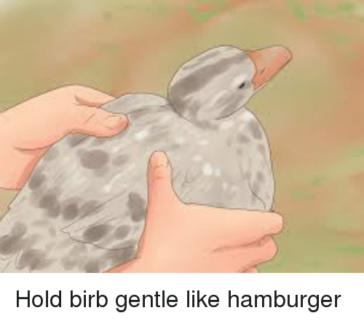
The Ornithologists
Eduardo Saenz (Team Leader)
Jacob Chong
Lance Dall
Bumjoong Kim
Corey Perez
Grant Posner

Slide 3
The Project
To create a relatively simple game using object-oriented design philosophy
Needs to be able to save/load using Serialization and FileInput/OutputStream

Slide 4
Architecture / Implementation
13 Total Classes
One class (powerup) is abstract, extending into 3 powerups: bullet, invincibility, and radar
7 classes representing objects placed on the game board
Briefcase, Ninja, Player, Rooms, Power ups
1 Game board, which prints out the grid, ninjas, power ups, etc.
1 GameEngine to contain all the logic for the game
Checking if Ninja is next to the player, win/game over conditions, etc.
1 UserInterface to print menus, grid and take in input
Save/Load logic implemented here (serialization / FileInput/OutputStream)

Slide 5
Approach
Divide into three subteams:
User Interface Team (Eduardo, Bumjoong)
Game Engine Team (Jacob, Grant)
Miscellaneous Team (Corey, Lance)
PowerUps, Briefcase, Player, Ninja, etc.
Upload code to BitBucket for easier sharing
Communication through Discord

Slide 6
How we worked “together”
Subteam approach quickly became independent work
Multiple people working on things independent from each other
Some people working on the same thing without knowing it

Slide 7
Bugs Found
No collision detection
Ninjas erasing marks for powerups
Testing
Repeatedly ran code
Tested logic implemented in GameEngine
Make sure:
Shooting guns killed Ninjas
Looking was working properly (using debug mode)
Ninjas were killing the player

Slide 8
Other Issues
Code is somewhat messy
Brute force methods (hard coding numbers)
Could’ve added an ActiveAgents class to extend into player/ninjas
Didn’t communicate as frequently/ effectively as we should’ve
Abandoned team system slowed down workflow

Slide 9
Lessons
Communicate more both in person and online
Stick better to team structure
Take time to optimize code
Think code through more before coding things/ have a better order-of-operations
Should’ve had a less “do it as we go” approach

Slide 10

Have a Happy Wednesday

