Slide 1
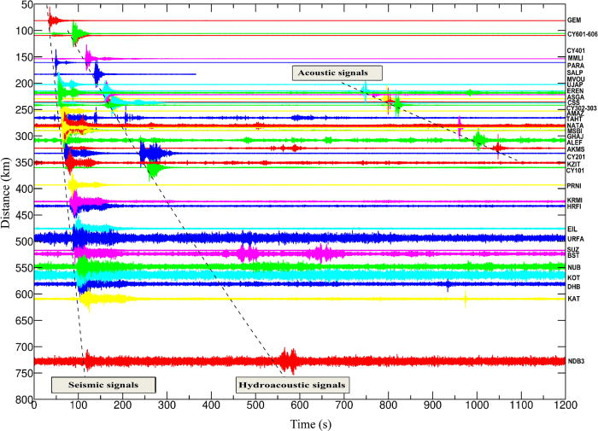
From: Investigation of near-surface chemical explosions effects using seismo-acoustic and synthetic aperture radar analyses
J. Acoust. Soc. Am.. 2022;151(3):1575-1592. doi:10.1121/10.0009406
^{Date of Download: 12/31/2023}
Copyright © 2023 . All rights reserved.
Notes:
Figure Legend: (Color online) The seismic waveforms in the Eastern Mediterranean (Israel, Jordan, Cyprus, and Egypt) are shown.

