Slide 1


Placement of Artificial Plasma in the Ionosphere
Keith Groves and Vadym Paznukhov
keith.groves@bc.edu

Slide 2
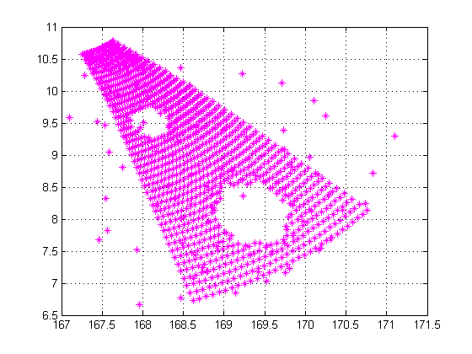
Overview
Guidance is needed on where to place artificial plasma to modify propagation as desired.
Typically the objective is to position the plasma to shadow a specific target region.
Fortunately for us, it’s not rocket science.
6.75 MHz

Slide 3
Atmospheric Constraints
The choices for where the plasma can be injected are relatively constrained.
For maximum effect it should be placed in the so-called valley region, between the E and F-layers of the ionosphere where the background plasma density is low.
Additionally, the lower it is placed the more complex the chemistry becomes and the more rapidly it will dissipate.
The practical altitude range is somewhere between 150 – 200 km, more ideally 170-190 km. Keep in mind that the cloud diffuses in all directions from the injection altitude.

Slide 4
Geometric Constraints
Large
effect
Easier
access
U
D
A
B
The geometry constrains the problem even more. Although the effects will be maximized for a release on the upleg, access may be restricted to the downleg of the ray.
For maximum effect it should be placed in the so-called valley region, between the E and F-layers of the

Slide 5
Potential Algorithm: Spiral 0
1.
2.
?
3.
4.
A
B
Home rays for frequencies of interest from A to B.
Determine which portion of the homed rays is accessible prioritizing upleg if possible.
Center cloud on trajectory at optimal altitude based on chemistry and dynamics (~180 km)
Trace cone of rays around central homed ray angles to determine shadow region.

