Slide 1


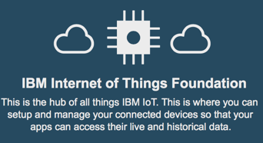

Bluemix
Hands-on Lab - IoT
Hands-on Lab - Analytics
Simulate Taxis and have a WebUI with Node-RED
Design Taxi Data visualization and Taxi data anomaly detection with IBM Data Science Experience
Send data
Receive data
Store data
Get data
IBM Watson IoT
IBM ObjectStorage

