Slide 1

Implementing the Popularity Based Recommender System and the Collaborative Filtering Recommender System
Group Members:
Wenyun Yuan
Haoyang Chen

Slide 2

1. Problem Understanding and Definition
2. Data Collection and Preprocessing
3. Popularity Based Recommender System
4. Collaborative Filtering Recommender System
Contents
5. GUI

Slide 3
1.1 Definition of the Problem
The Popularity Based Recommender system recommends items based on their popularity, assuming that highly rated or frequently purchased items will appeal to more users. It's straightforward, easy to implement, and suitable for scenarios with limited user preference data or new users.
Collaborative Filtering Recommender System predicts user preferences by analyzing similarities between users or items, offering personalized recommendations based on historical behavior. It's effective in large user bases with ample interaction data, providing more accurate suggestions.
Unsupervised Learning
The above two models belong to unsupervised learning. This type of learning does not rely on labeled data but instead learns representations of the data by analyzing its structure and patterns within the dataset.
Notes:
This study implemented two recommendation system models: the Popularity Based Recommender System and the Collaborative Filtering Recommender System.
The Popularity Based Recommender System provides recommendations based on the popularity of items (such as books, movies, products, etc.). This type of recommendation system assumes that items that are most popular or most frequently purchased or rated will be liked by more people. It is typically used in scenarios where there is not much historical user preference data available or as a starting point when recommending to new users. The core idea of this recommendation system is that "the choice of the masses is not wrong," based on the popularity of items (such as the number of ratings and average ratings). It is simple, intuitive, easy to implement, and can quickly provide users with universally popular options.
Collaborative filtering is a widely used technique in recommendation systems. This technique predicts content that users may be interested in and recommends it to them by analyzing the similarity between users or items ("collaboration"). This method can provide more personalized recommendations because it considers users' personal preferences and historical behavior. In cases where there is a large user base and a significant amount of interaction data, collaborative filtering can effectively identify similarities between users, thus providing more accurate recommendations.

Slide 4
1.2 Target Variable and Relevant Features
For the Popularity Based Recommender System, the target variable is the popularity of books, indicated by the number of ratings and the average rating. Relevant features include the number of ratings, average rating, and book title.
For the Collaborative Filtering Recommender System, the target variable is the ratings given by users to books. Relevant features comprise user ID and book ID or title, used to construct a user-item interaction matrix. The goal is to predict ratings for books that users haven't interacted with by filling in missing values in this matrix.
Notes:
The target variable for the Popularity Based Recommender System is the popularity of books, represented by the number of ratings and the average rating.
Relevant features for the Popularity Based Recommender System:
Number of ratings for books (num_ratings): This is a direct indicator of popularity, representing the number of ratings received by each book.
Average rating for books (avg_rating): It reflects the average rating given by users to the books, indicating both the popularity of the books and user satisfaction.
Book title (Book-Title): Although this is a categorical feature, it is a key feature for associating ratings with books in the recommendation system.
The target variable for the Collaborative Filtering Recommender System is the ratings that users give to books (aiming to predict these ratings).
Relevant features for the Collaborative Filtering Recommender System:
User ID (User-ID): Used to identify different users and their rating behavior.
Book ID or Book title (Book-Title): Used to identify the books being rated.
These features are used to build a user-item interaction matrix, which forms the basis of collaborative filtering algorithms. The purpose of the algorithm is to fill in missing values in this matrix, i.e., to predict the ratings that users might give to books they haven't interacted with.

Slide 5
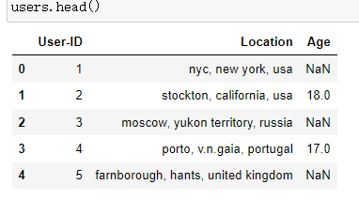
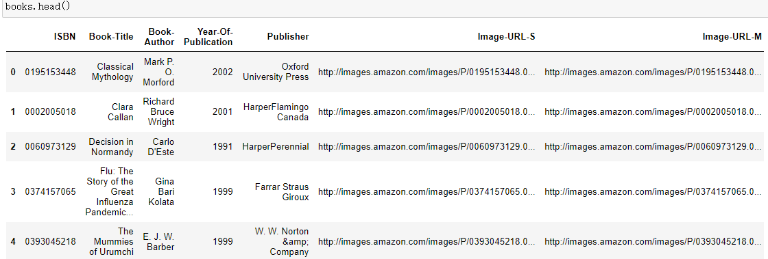
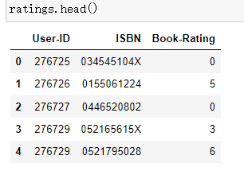
2.1 Data Sources
The data sources is The Book-Crossing dataset consists of 3 files: Users, Books, and Ratings:
Notes:
Users: Includes anonymized user IDs mapped to integers. Demographic data like Location and Age are provided if available, otherwise NULL-values.
Books: Identified by ISBN. Invalid ISBNs are already removed. Content-based info such as Book-Title, Book-Author, Year-Of-Publication, and Publisher is obtained from Amazon Web Services. For books with multiple authors, only the first is provided. URLs to cover images come in three sizes (small, medium, large), linking to Amazon's website.
Ratings: Contains book rating information. Ratings (Book-Rating) range from 1 to 10, with higher values indicating higher appreciation, or are implicit, represented by 0.

Slide 6
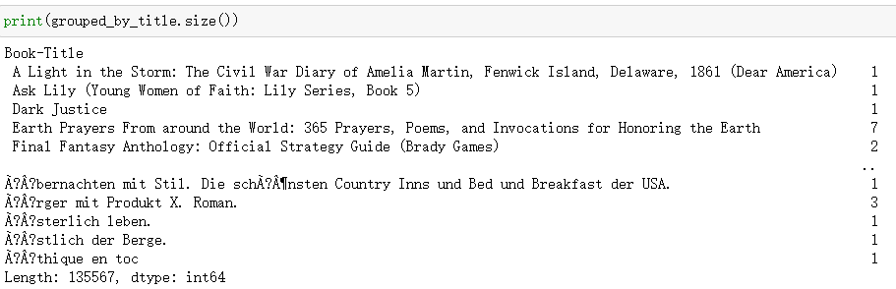
2.2 Data Preprocessing Steps
Reading Data: Three CSV files (Books.csv, Users.csv, and Ratings.csv) are read into pandas DataFrames
Identifying Data Quality Issues: The code identifies and counts missing values in each DataFrame to assess the quality of the datasets. This helps in understanding the completeness of the data.
Merging Datasets: The ratings DataFrame is merged with the books DataFrame on the ISBN column. This merged DataFrame allows for the association of user ratings with detailed book information.

Slide 7
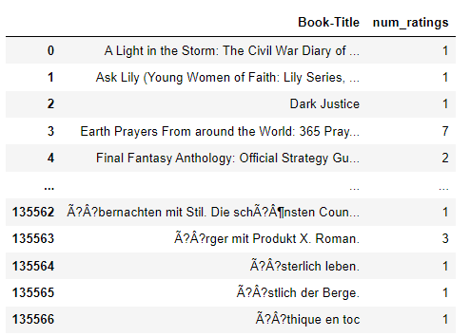
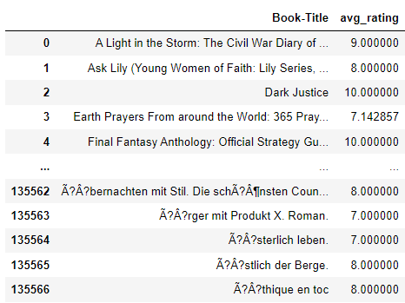
2.2 Data Preprocessing Steps
Analyzing Ratings:
The merged DataFrame is grouped by book titles to aggregate ratings.
The number of ratings per book is calculated to assess the popularity of each book.
The average rating for each book is also calculated, providing insights into how users perceive different books.
2 DataFrames are created as a result:
num_rating, which contains each book title alongside its count of ratings.
avg_rating, which lists each book title alongside its average rating.

Slide 8
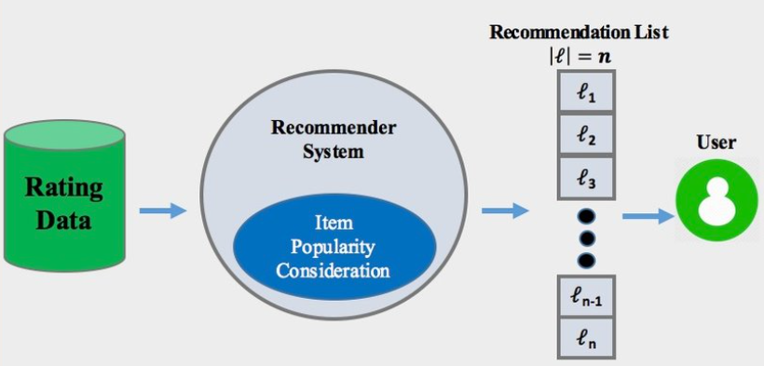
3. Popularity Based Recommender System
Popularity Based Recommender System can be used to recommend books that are both popular and highly regarded within the community.

Slide 9
3. Popularity Based Recommender System
Merge Data: Combines the num_rating DataFrame, which contains the number of ratings per book, with the avg_rating DataFrame that provides the average rating of each book. This ensures each book's title, number of ratings, and average rating are included.
Filter and Sort: Filters the merged data to include only books with at least 100 ratings, then sorts these books by average rating in descending order, placing the highest-rated books at the top.
Select Top Books: Extracts the top 50 books based on average ratings from the sorted list.
Merge Detailed Information: Re-merges this top 50 list with the original books DataFrame to append additional information like author and image URLs, and removes any duplicate entries.
Output Results: The final, filtered, and organized data is saved to a CSV file and displayed in the notebook for further use or review.

Slide 10
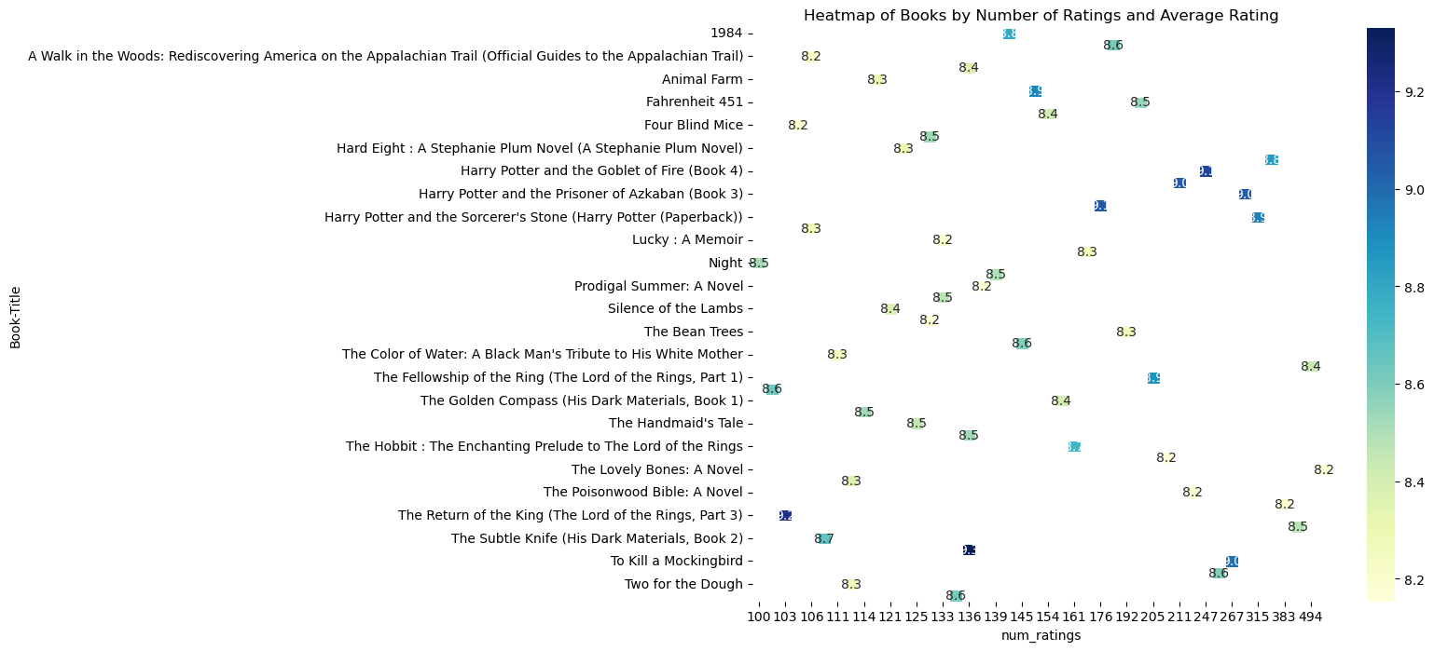
3. Popularity Based Recommender System
Notes:
This heatmap displays a range of books by the number of ratings they've received (horizontal axis) and their average rating (vertical axis). The color intensity represents the average rating level, with darker colors indicating higher average ratings. For example, "Harry Potter and the Prisoner of Azkaban (Book 3)" shows a higher number of ratings coupled with a high average rating. Most books have around 100 ratings, with average ratings mostly falling between 8.2 and 8.6.

Slide 11
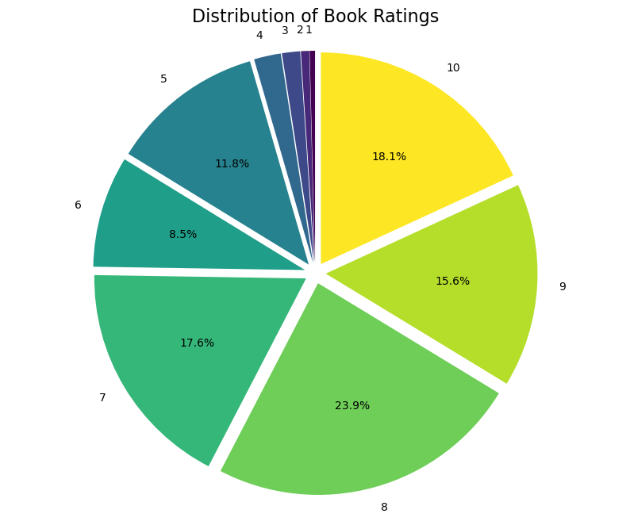
a
3. Popularity Based Recommender System
Notes:
This pie chart illustrates the distribution of book ratings. The largest segment, colored green and making up 23.9%, corresponds to a rating of 8. The next largest segment is yellow, representing a 10 rating with 18.1%. The smallest visible segment, at 8.5%, represents a rating of 6. The chart indicates that ratings of 7 and above are the most common, suggesting a trend towards higher ratings in the dataset.

Slide 12
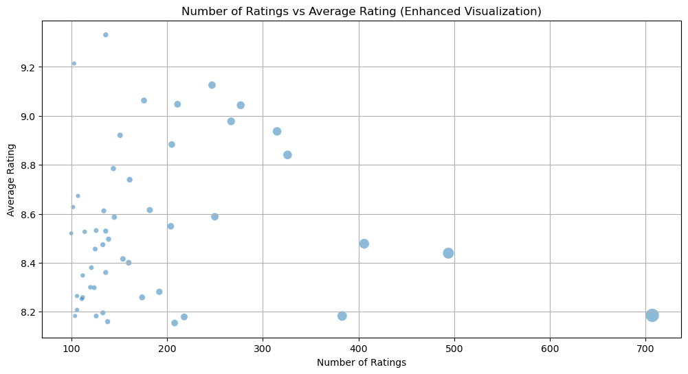
3. Popularity Based Recommender System
Notes:
The scatter plot maps books' average ratings against their number of ratings. Most books with many ratings have average ratings between 8.4 and 8.6, and books with the highest average ratings tend to have fewer ratings.

Slide 13
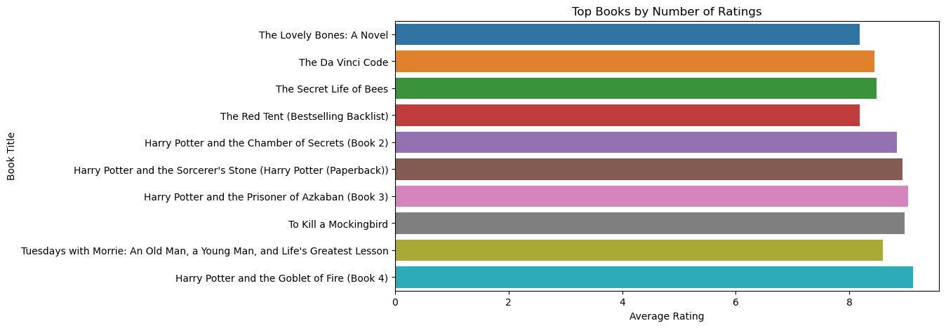
a
3. Popularity Based Recommender System
Notes:
This bar chart shows top-ranked books by the number of ratings received, with their average ratings displayed as the length of the bars. "Harry Potter and the Goblet of Fire" has the most ratings, and ratings range up to 8.

Slide 14
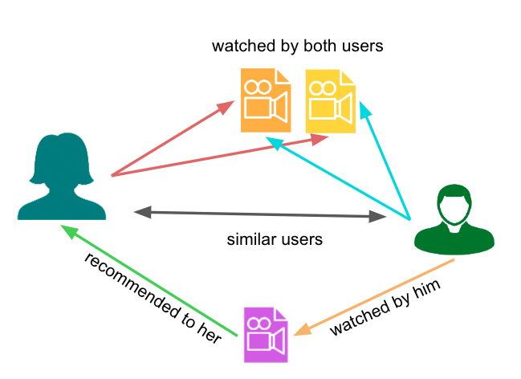
4. Collaborative Filtering Recommender System
A Collaborative Filtering (CF) recommender system can be used to suggest new books to users based on the preferences and ratings of similar users.

Slide 15
4. Collaborative Filtering Recommender System
Active Users Filtering: We identified active users who have given more than 20 reviews, creating a new DataFrame with ratings from these active users.
2. Famous Books Filtering: We generated a list of book titles that have received 20 or more ratings from these active users, and a new DataFrame is created containing ratings of only the famous books.
3. Pivot Table Creation: A pivot table is created from this filtered data, with book titles as rows, user IDs as columns, and the ratings as values.
4. Missing Values Handling: The missing values in the pivot table (representing unrated cases) are filled with 0.
5. Cosine Similarity Calculation: The system calculates the cosine similarity scores between rows of the pivot table to determine the similarity between different books.

Slide 16
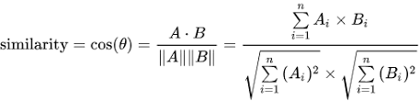
4. Collaborative Filtering Recommender System
Cosine Similarity Calculation:
Cosine similarity is a metric used to evaluate the degree of similarity between two books based on user ratings. Each book is represented by a vector of user ratings, and by calculating the cosine of the angle between these vectors, we determine the books' similarity. A value closer to 1 indicates higher similarity in ratings. In a recommender system, this method helps us identify other books with rating patterns similar to a target book to suggest to readers.

Slide 17
4. Collaborative Filtering Recommender System
Performance Metrics:
Top-N Accuracy: This is extremely low at approximately 0.000012536, almost zero. It suggests that the model is almost never accurate when recommending the top N items.
Coverage: The value of 2.38%, indicates the model's ability to recommend a diverse set of items. In this case, the model covers about 2.38% of the total possible recommendations, which suggests that it has a very low diversity in its recommendations.
Possible issues:
Most books have very few ratings.
Relying solely on basic similarity metrics (such as cosine similarity) may not be enough to capture complex user preferences.
Lack of diversity.
Notes:
Most books have very few ratings, inferring user preferences from their behavior will be very difficult. This directly affects recommendation accuracy.
Relying solely on basic similarity metrics (such as cosine similarity) may not be enough to capture complex user preferences. More advanced models such as matrix factorization, deep learning, or model-based collaborative filtering may provide better results.
Lack of diversity: The recommendation system tends to recommend only a few highly popular books, which may lower the system's coverage.

Slide 18
6. Scope for Future Work
Enhanced Machine Learning Models:
Incorporate more sophisticated machine learning techniques, such as deep learning, to enhance feature extraction and refine user profiling capabilities.
Dataset Expansion:
Broaden the dataset to encompass a wider array of user interactions, which will enhance the model's accuracy and extend its applicability.
Dynamic User Interface Development:
Design a more interactive user interface that supports real-time recommendations and enables immediate user feedback.

Slide 19


