Slide 1

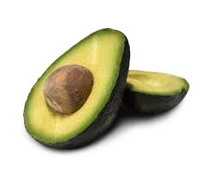
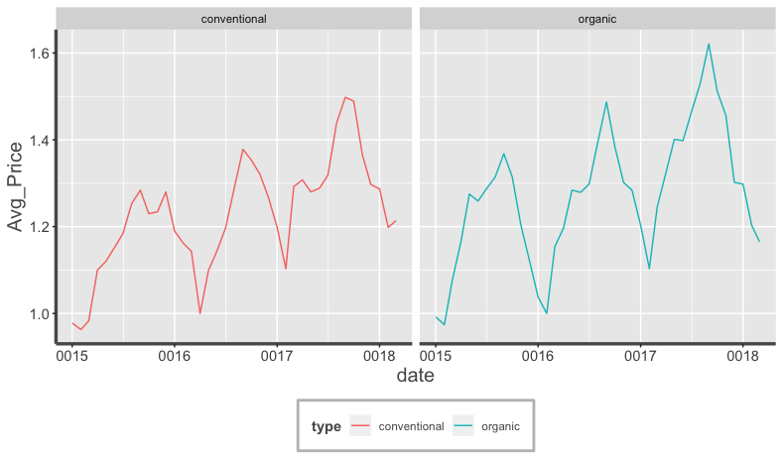
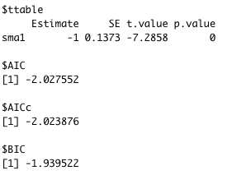
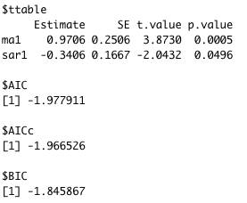
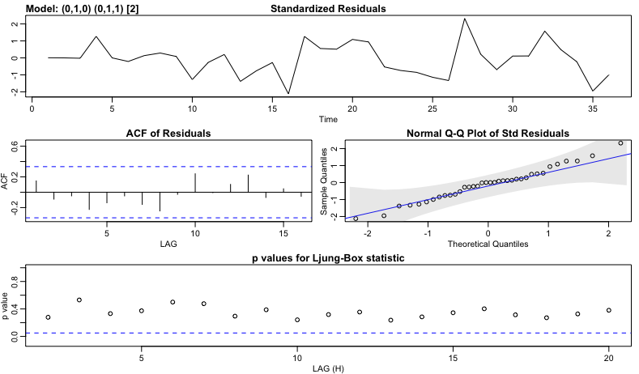
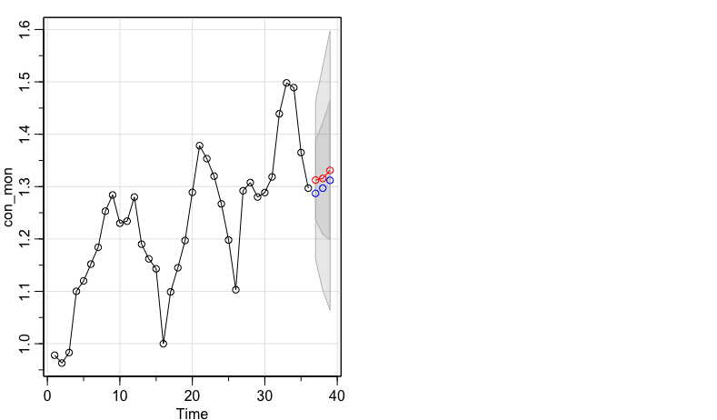

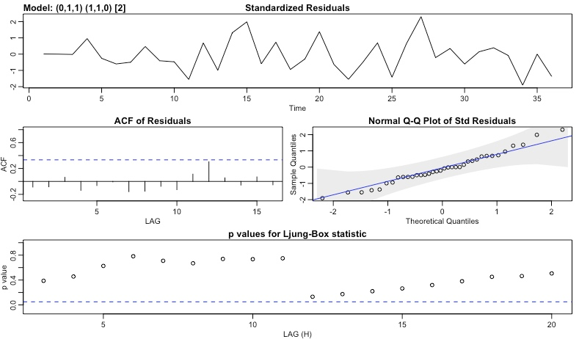
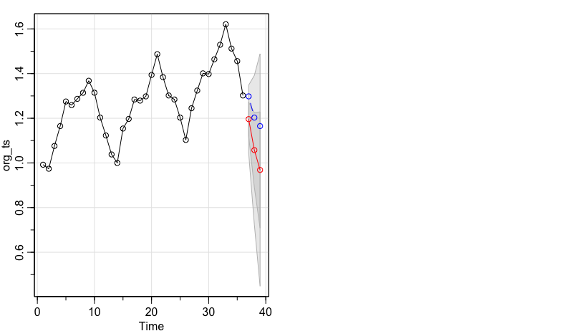

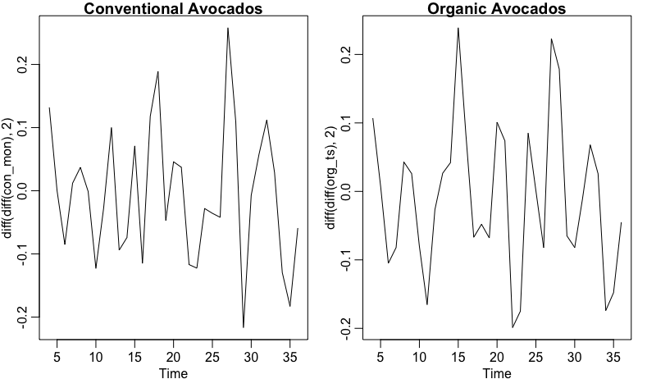


Time Series Analysis of Avocado Price
Shulei Yang (sy8uu)
Department of Statistics , University of Virginia
Introduction
The specific time series models I am using here are Seasonal Autoregressive Integrated Moving Average (SARIMA) models. To find the right parameters for the SARIMA model, I first looked at the ACF plot and the PACF plot to decided all the possible models. Then I run the model diagnostics on all of the models to find the best one. The final SARIMA model I chose for conventional avocados is ARIMA(0,1,0) x (0,1,1)₂ . And the final SARIMA model I chose for organic avocados is ARIMA(0,1,1) x (1,1,0)_{2 .} The model diagnostic plot for these two models are shown below:
Avocados, which have been a meme for the Millennial generation, have exploded in popularity in the United States over the last few decades. In 1985, domestic consumption was around 436 million pounds. This number has increased to over 2.6 billion pounds of avocados being consumed by Americans in 2019.¹
But, have you noticed that the avocado on your toast is costing more and more? Avocado prices have rocketed by up to 129% just from 2018 to 2019.² Therefore, in this project, I wish to find a way to predict the price of avocado, so we can buy avocados at just the right time!
Forecasting
Conventional Avocados:
I plotted the forecasted value based on the two models. The red dots indicate the forecast values and the blue dots present the actual values. On the right of the forecast plots, are the 95% confidence intervals.
From the above plot, we can see that organic avocados are more expensive. Also, although these two types of avocados have a very similar pattern in monthly average price, their price’s peak and valley exist in different months. Therefore, I decided to perform two separate time series analysis on conventional avocados and organic avocados.
Conventional Avocados:
Objective
The goal of this project is to try to use SARIMA time series models to forecast the future avocado prices.
Time Series Exploratory Data Analysis
The Data
From the above plot, we can see an overall increasing trend in the monthly average price for both conventional avocados and organic avocados. Therefore I applied a linear differencing on both data. However, the time series plots after linear differencing still show a seasonal pattern. Therefore I also applied a season differencing with s = 2 (half-year). The time series plots after linear and seasonal differencing are shown below. From these two plots, we can see our time series data are approximately station.
Organic Avocados:
Organic Avocados:
The data used in this project comes from “Hass Avocado Board (HAB) ”. The detailed data description is shown below:
Month: the month of the observation. Ranging from Jan 2015 to Mar 2018.
AveragePrice: the monthly average price of a single avocado.
TotalVolume: total number of avocados sold.
Type: conventional or organic
Region: the city or region of the observation.
Note: Since many regions’ data are not complete, for instance, there are cities with only two month’s records. Therefore, I did not consider ’Region’ in my analysis. For my analysis, I averaged the ‘AveragePrice’ variable of all the regions within one month. And I summed up all the regions’ ‘TotalVolumn’ within a month
Conclusion
These two diagnostic plots show that both of the models are performing well.
Standardized Residuals: no clear pattern.
ACF of Residuals: all lags are within the critical lines.
Normal QQ plot: all residuals lies within the grey area.
Ljung-Box statistics: the p-value of all lags lie above the critical line.
We can see that all the true values fall into the 95% confidence interval. Also, from the two forecasting plot, the forecasted value correctly capture the overall trend of the true observations. Therefore, in conclusion, I successfully predict the future price of avocados with SARIMA time series models.
Exploratory Data Analysis
Future Work.
Types of avocados and their average prices.
Model Diagnostics
The detailed information of these two fitted models is shown below. We can see that all coefficients in the models are statistically significant. Also, the AIC and BIC look fine. Therefore I think these two models fit the data well, and I decide to use them for forecasting.
Although the “Region” data is not complete for many cities and regions, I suspect that the time series patterns for different regions will be very different. Therefore, in the future, if I can get more detailed data, I think I should perform the time series analysis separately in different regions to further increase the accuracy.
References:
1: https://www.statista.com/statistics/591263/average-avocado-consumption-us-per-week/
2: https://people.com/food/avocado-prices-double-from-last-year-high-demand-shortage/

