Slide 1
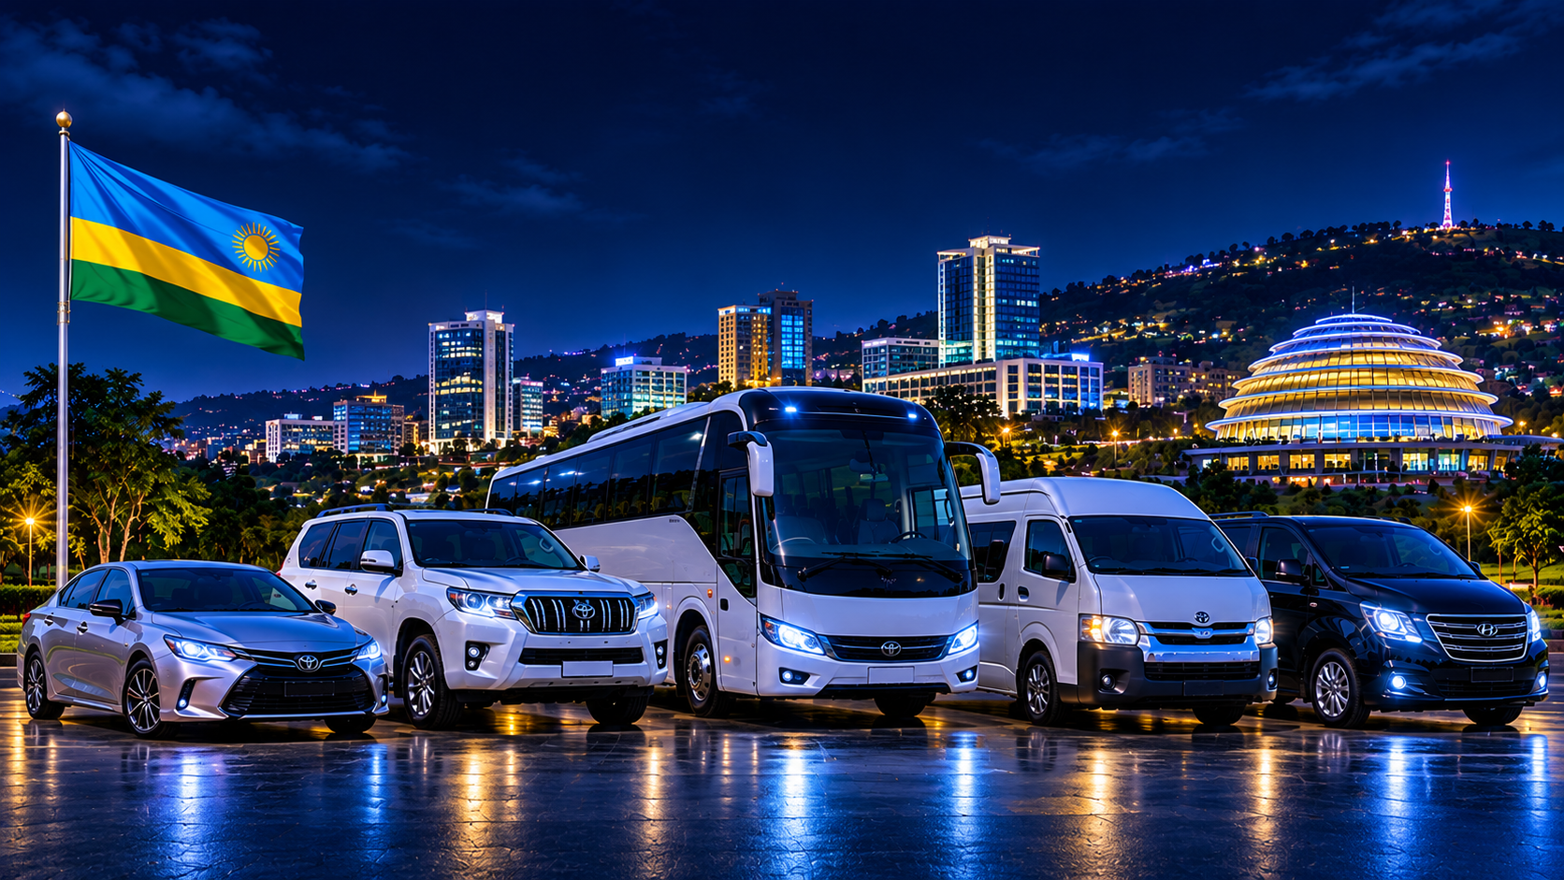
Tourist Transport and
Trip Management System
PROJECT PRESENTATION
Name: Ishimwe Florence Student ID: 20251SEN040
Course: Database development with PL/SQL Instructor: Eric Maniraguha
GitHub: https://github.com/florence-ishimwe/Florence_20251SEN040_Tourist_transport_management_system

Slide 2
Background and Problem
Project context
Who is affected?
Rwanda Explorer Travel Ltd is a proposed transport company scenario serving individual customers and groups. It manages trips to different destinations using cars, SUVs and passenger vans.
Customers
Booking staff
Drivers
Company managers
Problem statement
Many transport companies face challenges managing customer bookings, vehicle availability, driver assignments, trip schedules and payments using manual methods. This can lead to booking conflicts, assigning multiple trips to the same driver or vehicle, scheduling difficulties, delays and poor record management. Customers may experience poor service, drivers may receive unclear or conflicting assignments, and company staff may struggle to coordinate daily transport operations efficiently.
Tourist Transport and Trip Management System | 2/12

Slide 3
Motivation
Why this project was chosen
This project was chosen because transport management plays an important role in serving individuals and groups who need reliable transportation. Managing customers, drivers, vehicles, bookings and payments efficiently is essential for smooth daily operations.
We are motivated to develop a database system that can organize transport information, reduce manual work and make it easier for company staff to coordinate trips.
Project focus
The project focuses on developing a centralized database system for managing transport operations, including customer information, driver assignments, vehicle availability, trip bookings, destinations and payments. It aims to support both individual and group transportation services.
Tourist Transport and Trip Management System | 3/12

Slide 4
Project Objectives
Main objective
To develop a centralized database system for managing the transport operations of Rwanda Explorer Travel Ltd, including customers, drivers, vehicles, bookings, destinations and payments.
Specific objectives
1
To manage customer information by storing and organizing customer details in a centralized database.
To manage drivers and vehicles by maintaining their records and supporting appropriate driver and vehicle assignments.
To manage bookings and destinations by recording trip details, scheduling transportation and reducing booking conflicts.
To manage payments by recording customer payments and tracking booking payment status.
To apply SQL and PL/SQL features to improve data management, accuracy and consistency.
2
3
4
5
Tourist Transport and Trip Management System | 4/12

Slide 5
Research: Existing Solutions and Gaps
Research source | What it contributes | Gap / relevance to our project
Hartleb et al. (2022) | Studies vehicle scheduling for on-demand transport fleets. | Focuses on fleet scheduling models rather than a small company's integrated booking database.
Al-Hawari et al. (2020) | Examines a bus location tracking information system. | Focuses on bus tracking, while our project focuses on bookings, driver and vehicle assignments, and payments.
Distinctive Systems – Coach Manager | Provides commercial coach booking, scheduling and administrative features. | A commercial solution; our project will develop a smaller, learning-focused database system for Rwanda Explorer Travel Ltd.
NISR Rwanda (2024) | Provides statistical information about Rwanda's transport and tourism sectors. | Provides background evidence rather than operational booking records for our proposed system.
Research gap: There is an opportunity to develop a focused database system that integrates customer, driver, vehicle, destination, booking and payment management for a transport company..
Tourist Transport and Trip Management System | 5/12

Slide 6
Data Source
Dataset
Dataset size and sample
NYC Taxi and Limousine Commission (TLC)
January 2023 Yellow Taxi Trip Records
The January 2023 file contained 3,066,766 original records. A 1,000-record sample with 19 columns was used for preliminary analysis.
Example fields in the dataset
Sample Dataset Records
Field | Example meaning
tpep_pickup_datetime | Date and time trip began
tpep_dropoff_datetime | Date and time trip ended
passenger_count | Number of passengers
trip_distance | Trip distance in miles
fare_amount / total_amount | Fare and total charged
Pickup datetime | Drop-off datetime | Passengers | Distance (miles)
1/1/2023 0:32 | 1/1/2023 0:40 | 1 | 0.97
1/1/2023 0:55 | 1/1/2023 1:01 | 1 | 1.10
1/1/2023 0:25 | 1/1/2023 0:37 | 1 | 2.51
Source: https://www.nyc.gov/site/tlc/about/tlc-trip-record-data.page
Tourist Transport and Trip Management System | 6/12

Slide 7
Proposed Solution and Innovation
Proposed database solution
Planned innovation: user interface
An Oracle relational database will centralize customer details, bookings, driver assignments, vehicle information, destinations and payments.
Oracle APEX is the planned tool for building an interactive web interface connected to the Oracle database.
How it will work
• Staff use APEX forms to enter and update records.
• Reports allow staff to view bookings, vehicle assignments and payments.
• APEX pages call PL/SQL procedures where appropriate; database rules remain in PL/SQL.
• The working application will be demonstrated live during the final presentation.
Tourist Transport and Trip Management System | 7/12

Slide 8
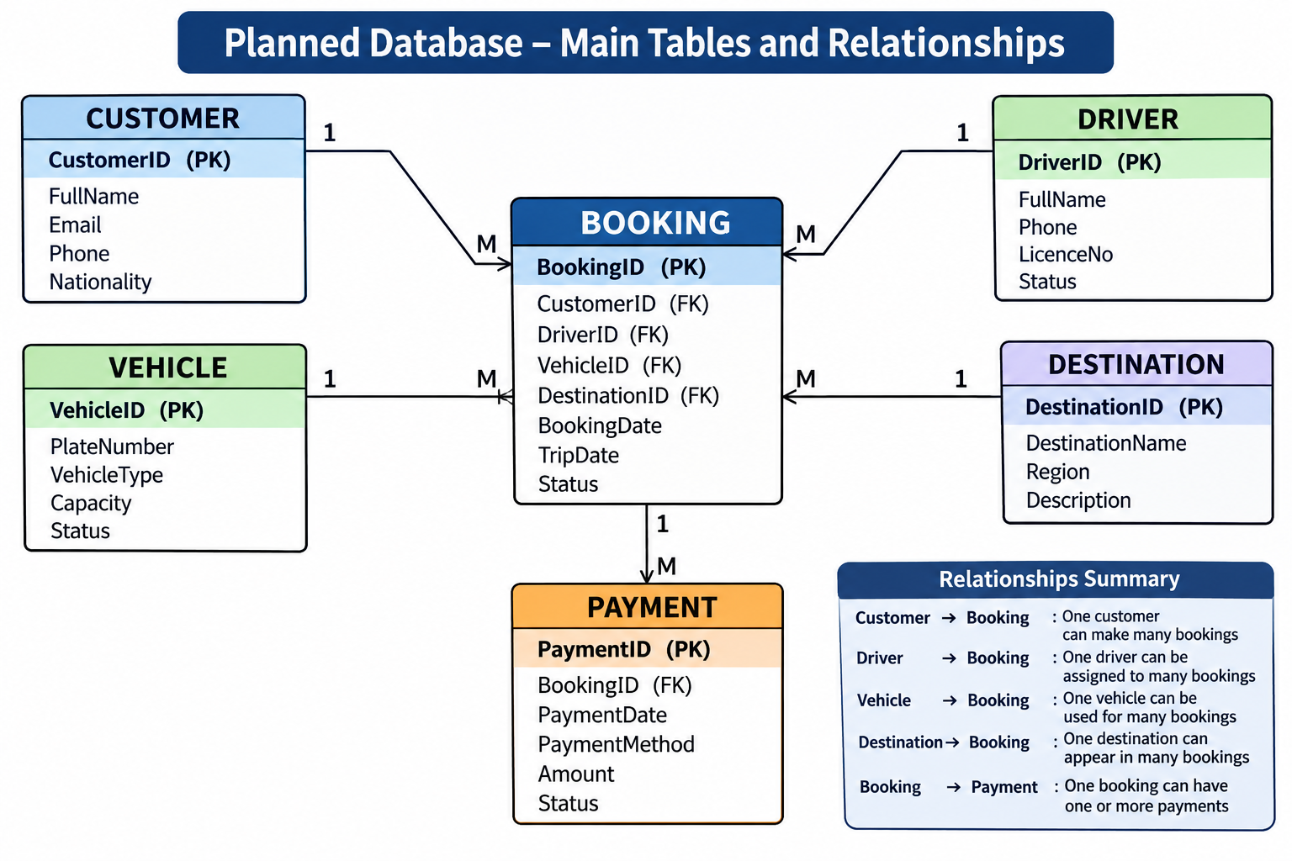
Planned Database Design
Six main tables and their planned relationships
Tourist Transport and Trip Management System | 8/12

Slide 9
PL/SQL Approach
Feature | Planned use in this system
Procedures | Create or update bookings; record a payment; assign a driver and vehicle.
Functions | Calculate the booking total or return the outstanding balance.
Cursors | Process and display a customer's bookings or a list of scheduled trips.
Triggers | Validate changes and automatically update a related status when a payment is recorded.
Packages | Group related booking and payment procedures/functions into reusable modules.
Exception handling | Handle invalid booking IDs, unavailable vehicles and invalid payment amounts.
Tourist Transport and Trip Management System | 9/12

Slide 10
Expected Results
By the end of the project, we expect to demonstrate:
• An Oracle database containing the six planned tables and their relationships.
• Working SQL constraints and PL/SQL program units.
• A booking workflow that records a customer, destination, assigned vehicle and driver.
• Payment recording and retrieval of booking/payment information.
• An Oracle APEX interface connected to the real database, with forms and reports.
• Test cases showing valid operations and handling of invalid data.
Demonstration goal
Show a staff member creating a booking, viewing it in a report and recording its payment.
Tourist Transport and Trip Management System | 10/12

Slide 11
Future Improvements and Limitations
Limitations
Future improvements
• The TLC dataset comes from New York taxi trips, not a Rwandan tourism company.
• It is useful as a transport-data reference, but it does not supply our actual customer, driver or vehicle records.
• The first version will focus on core booking and payment management rather than live GPS tracking.
• Add GPS tracking and live vehicle location.
• Add customer notifications by SMS or email.
• Integrate online payment services.
• Develop a mobile application.
• Add analytics for demand, vehicle utilization and revenue trends.
Tourist Transport and Trip Management System | 11/12

Slide 12
References (APA)
Al-Hawari, F., Al-Sammarraie, M., & Al-Khaffaf, H. (2020). Design, validation, and comparative analysis of a private bus location tracking information system. Journal of Advanced Transportation. https://doi.org/10.1155/2020/8895927
Distinctive Systems. (n.d.). Coach Manager. https://www.distinctive-systems.com/
Hartleb, P., Friedrich, M., & Richter, B. (2022). Vehicle scheduling for on-demand vehicle fleets in macroscopic travel demand models. Transportation. https://doi.org/10.1007/s11116-021-10205-4
National Institute of Statistics of Rwanda. (2024). Rwanda statistical yearbook 2024.
New York City Taxi and Limousine Commission. (2023). TLC trip record data. https://www.nyc.gov/site/tlc/about/tlc-trip-record-data.page
Oracle. (n.d.). Oracle Database SQL language reference: Constraints. https://docs.oracle.com/en/database/
Thank you
Tourist Transport and Trip Management System | 12/12

