Slide 1

Web Scraping & Data Visualization

Slide 2
Introduction
Site: https://www.beforward.jp
Data:
Car makes: Honda, Toyota, Mitsubishi & Nissan
Year range: From 2015 to 2019

Slide 3
Introduction
Analysis of Vehicle attributes
Price, Registration Year, Engine Capacity, Mileage
External Color, Car make, Steering, Drive, location, transmission & fuel

Slide 4
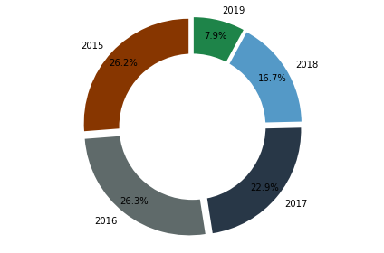
Vehicles Per Year

Slide 5
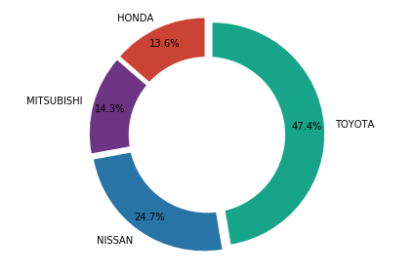
Vehicles Per Make

Slide 6

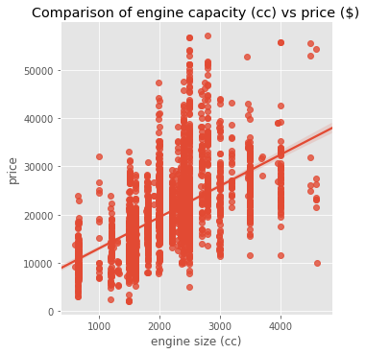

Slide 7
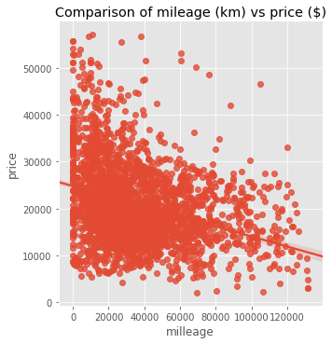

Slide 8
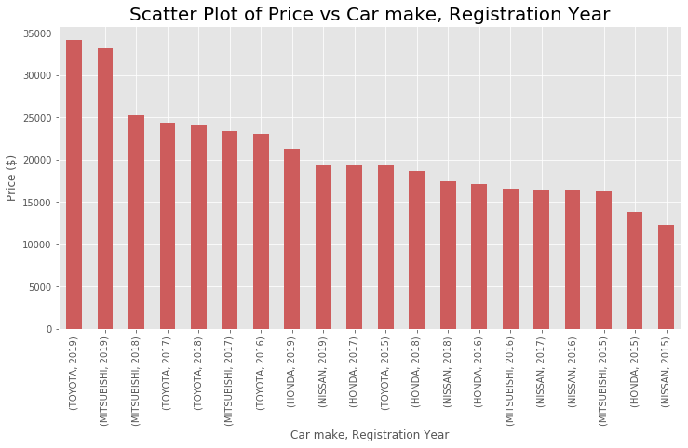

Slide 9
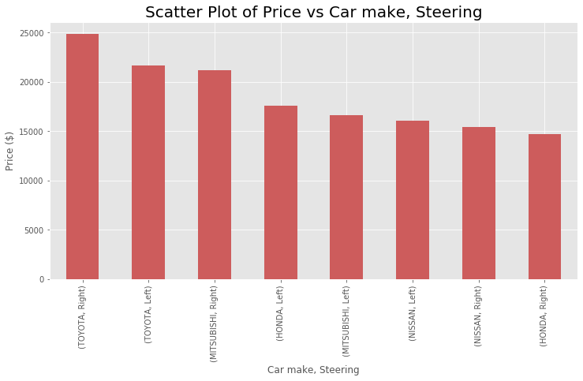

Slide 10
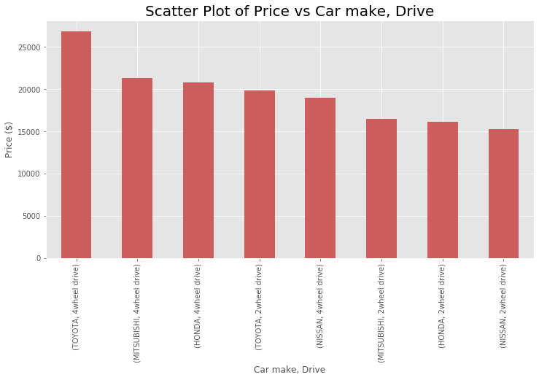

Slide 11
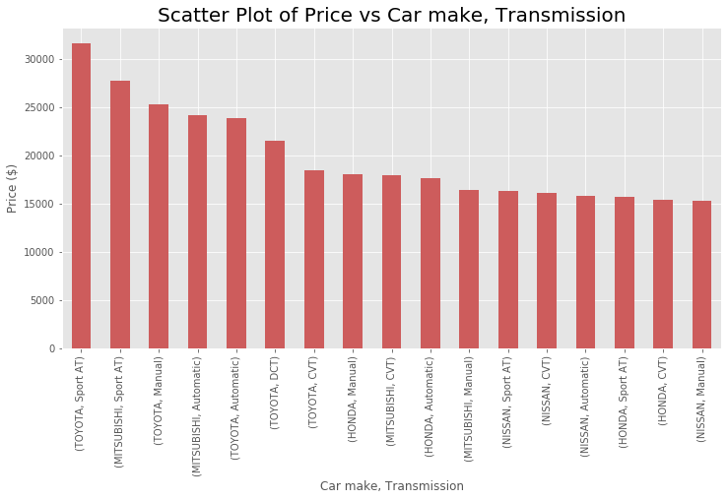

Slide 12
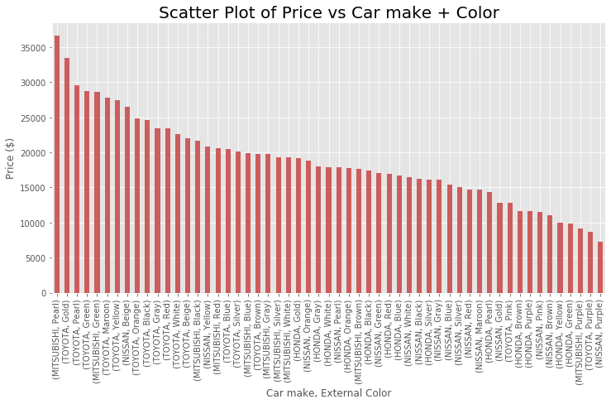

Slide 13
Conclusion
Vehicle’s price depends highly on:
Car’ make : Toyota > Mitsubishi > Honda/Nissan
Steering: Right > Left
Year of Registration: 2019 --→ 2015 (Obvious)
External Color, Car make, Steering,
Drive: 4Wheel > 2Wheel.
Mileage: Low to High

Slide 14
Final
- the end -
- Thank You..! -

