Slide 1

Web Scraping & Data Visualization

Slide 2
Introduction
Site: https://www.beforward.jp
Data:
Car makes: Honda, Toyota, Mitsubishi & Nissan
Year range: From 2015 to 2019

Slide 3
Introduction
Analysis of Vehicle attributes
Price, Registration Year, Engine Capacity, Mileage
External Color, Car make, Steering, Drive, location, transmission & fuel

Slide 4
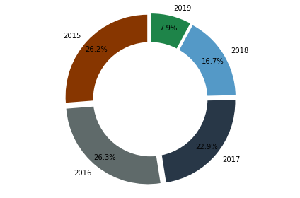
Vehicles Per Year

Slide 5
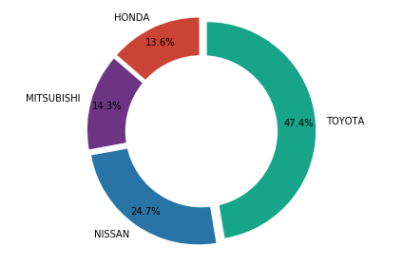
Vehicles Per Make

Slide 6
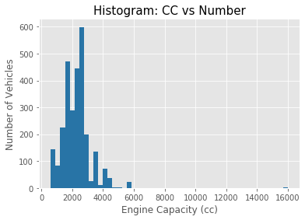
CC vs Number of Vehicles

Slide 7
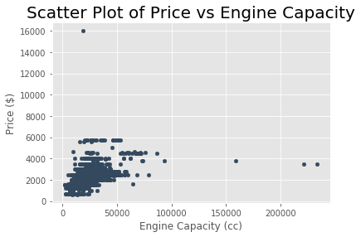
Price vs Engine Capacity

Slide 8
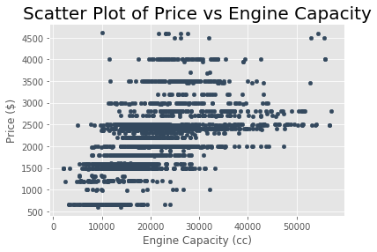
Price vs Engine Capacity

Slide 9
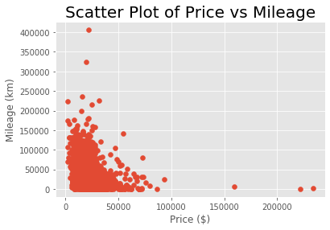
Price vs Mileage

Slide 10
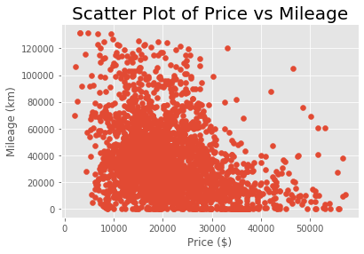
Price vs Mileage

Slide 11

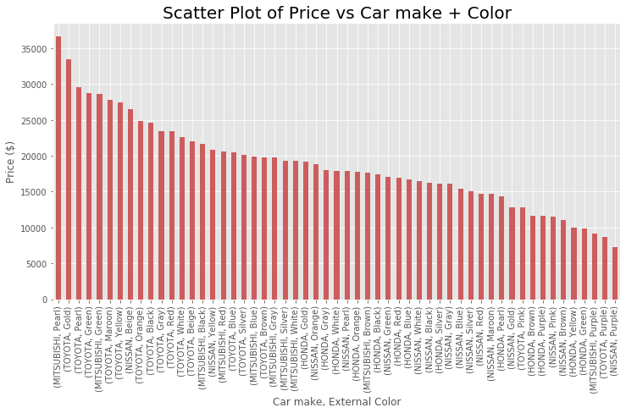

Slide 12
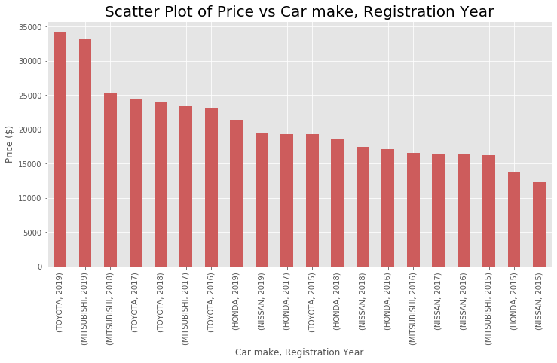

Slide 13
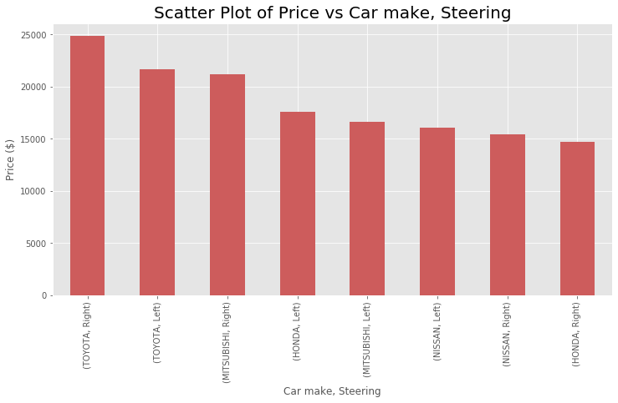

Slide 14
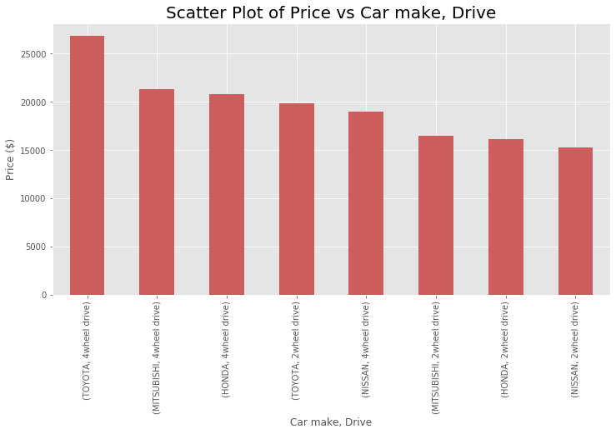

Slide 15
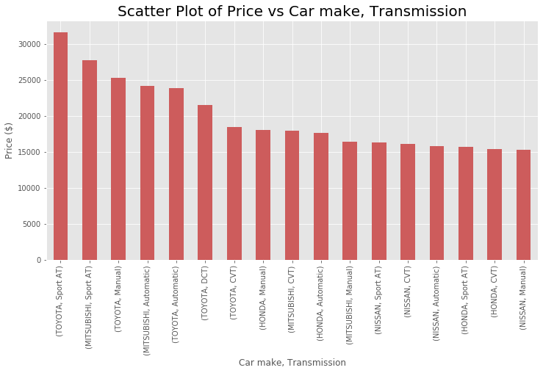

Slide 16
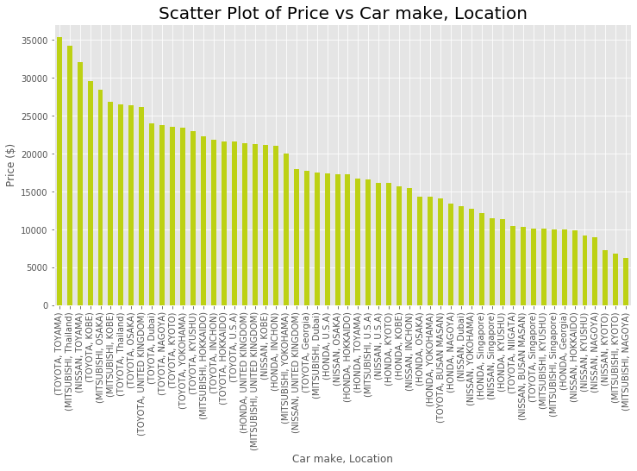

Slide 17
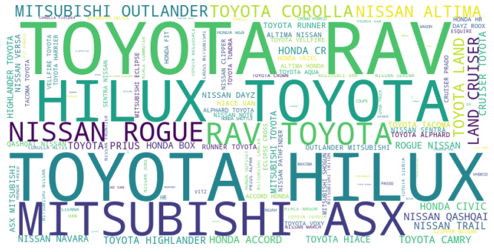

Slide 18
Final
- the end -
- Thank You..! -

