Slide 1
EVENT REGISTRATION
& TICKETING SYSTEM
LIVE DEMO
https://d1cm5g5okmu6ix.cloudfront.net
A serverless AWS capstone product that replaces manual registration with a secure, scalable REST API.
SOURCE CODE
GitHub Repository
AWS Lambda
API Gateway
DynamoDB
CloudFront + S3
GitHub Actions
https://github.com/florenceodoi/aws-serverless-event-registration-system
Final presentation

Slide 2
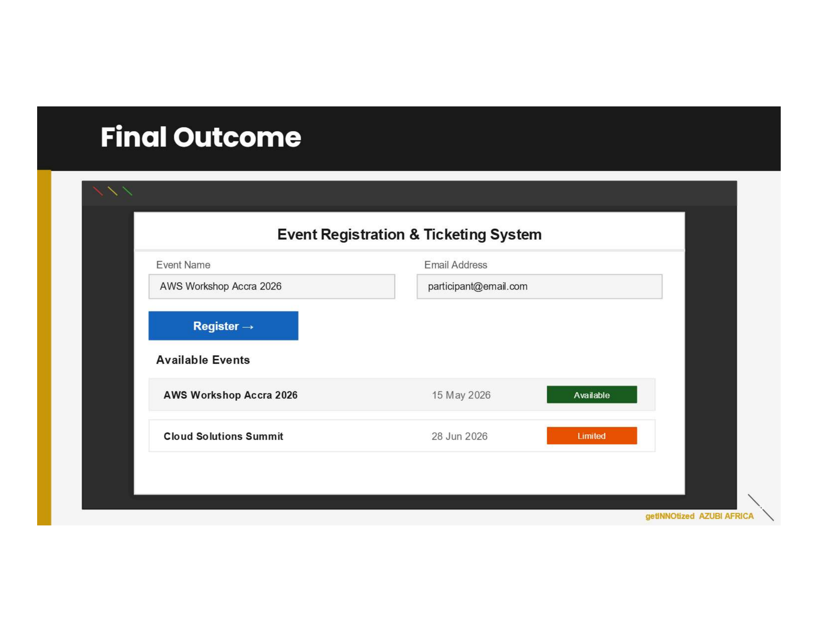
Product Brief
What the system does and why it matters
PRODUCT
The product is a cloud-hosted event registration platform for creating events, displaying available events, accepting participant registrations, and listing registrations for follow-up.
CORE USERS
Event organizers create and manage events
Participants register through the frontend
Administrators review registration records
EVIDENCE
The deployed frontend is delivered through CloudFront with a private S3 origin.
Project brief mock-up of the final user experience
AWS Capstone • Serverless Event Registration System
02

Slide 3
Problem the System Solves
Manual registration is workable at small scale but weak under pressure
LEGACY PROCESS
Data quality gaps
Limited visibility
Microsoft Forms + Excel
Missing fields, duplicate entries, inconsistent event records
No automatic logs, alarms, or operational monitoring
The existing approach relies on form entries, manual exports, and spreadsheet-based tracking. It creates delays and makes validation, duplicate control, monitoring, and automation difficult.
Weak scalability
Deployment risk
Manual follow-up becomes harder as registration volume grows
Changes depend on people repeating manual steps accurately
Design response: replace manual tracking with a serverless API, managed data storage, automated deployment, and AWS-native monitoring.
AWS Capstone • Serverless Event Registration System
03

Slide 4
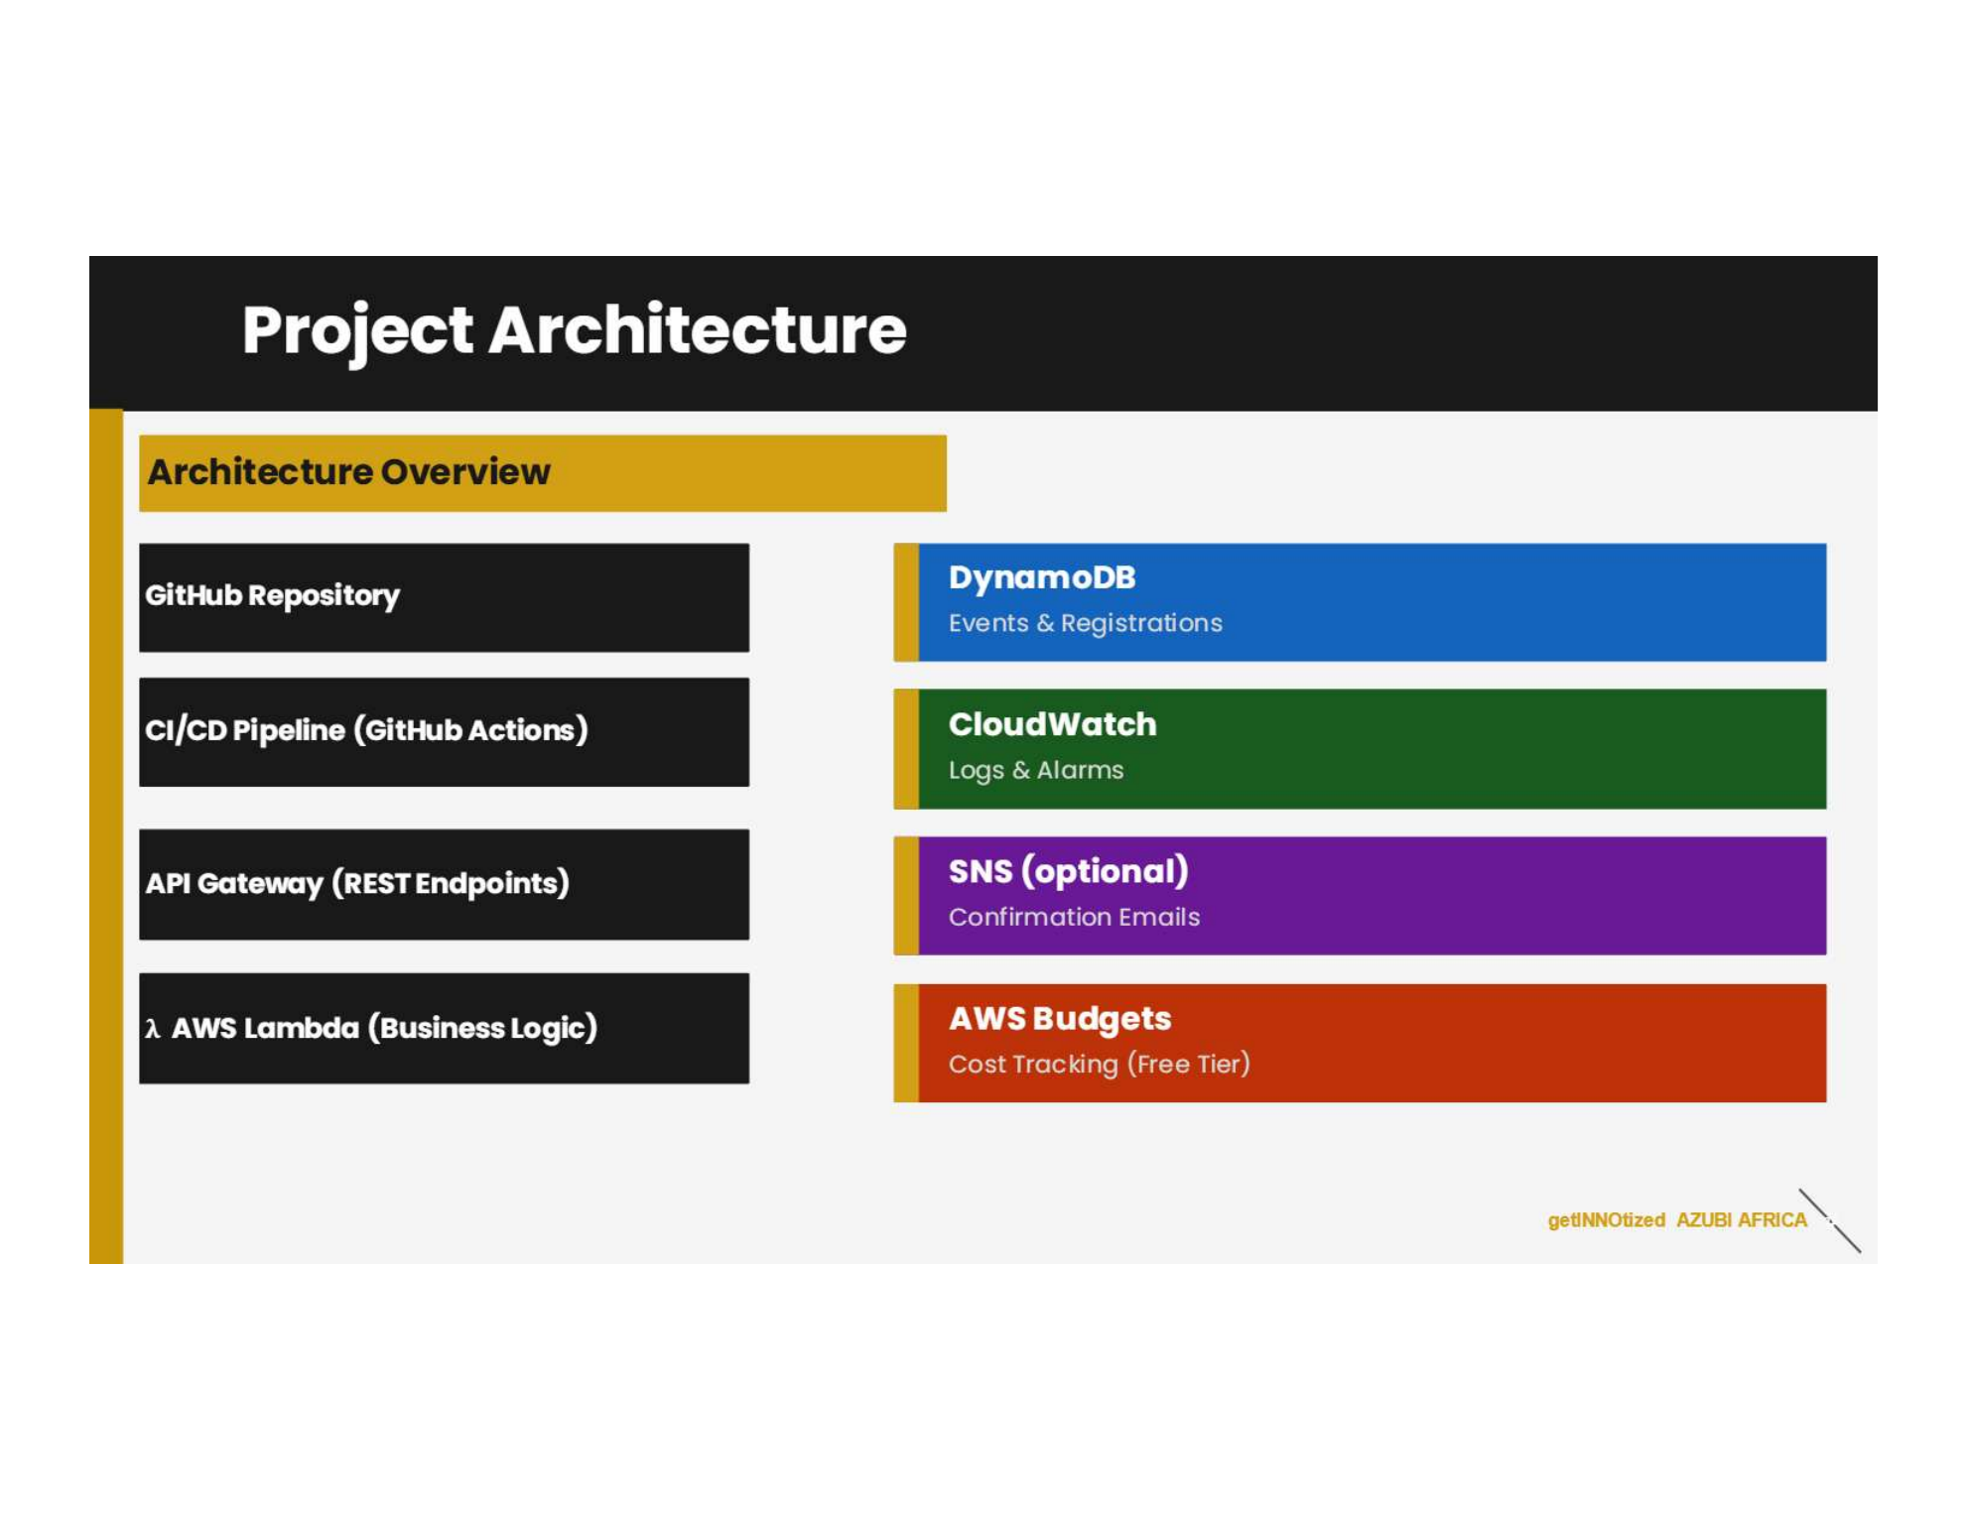
Solution Architecture
A managed, serverless design aligned with the capstone brief
RUNTIME PATH
User
CloudFront
+ Private S3
API Gateway
Lambda
Business Logic
DynamoDB
Data Store
→
→
→
→
OPERATIONAL CONTROLS
CloudWatch
Logs + Alarms
GitHub Actions
CI/CD
OIDC + IAM
Least Privilege
AWS Budgets
Cost Monitor
ARCHITECTURE BRIEF
The capstone brief called for GitHub/GitHub Actions, API Gateway, Lambda, DynamoDB, CloudWatch, optional SNS and AWS Budgets. The final solution extends this with private S3 + CloudFront and OIDC authentication.
AWS Capstone • Serverless Event Registration System
04

Slide 5
How the Product Works
A practical workflow from event setup to monitored registration
1
→
2
→
3
→
4
→
5
Create event
List events
Register participant
Prevent duplicates
Monitor operations
Organizer creates a new event through the API.
Frontend retrieves available events from DynamoDB.
Participant submits registration with validation.
Backend blocks repeated registration records.
CloudWatch logs and alarms support troubleshooting.
Core API operations
POST /events GET /events POST /registrations GET /registrations
AWS Capstone • Serverless Event Registration System
05

Slide 6
Final Deliverables
What has been produced and where it is located
GitHub repo with API code
Repository contains SAM template, Lambda code, events and README
CI/CD pipeline
.github/workflows/sam-ci.yml plus successful GitHub Actions run
Lambda functions
create-event, list-events, register-event, list-registrations
DynamoDB definitions
Defined in template.yaml as Infrastructure as Code
CloudWatch monitoring
Logs, monitoring checks and alarm configuration evidence
README file
Complete project documentation and deployment notes
Clickable evidence pack
Repository • Actions • README • Template • Live Demo
AWS Capstone • Serverless Event Registration System
06

Slide 7
Strengths of the Solution
The project demonstrates more than a working application
Serverless by design
Secure delivery
Automated pipeline
No always-on application server; compute runs when requests are processed.
Private S3 origin with CloudFront Origin Access Control.
GitHub Actions supports repeatable validation, build and deployment.
OIDC authentication
Operational visibility
Cost-aware architecture
Avoids long-lived AWS keys in GitHub secrets.
CloudWatch logs and alarms support debugging and monitoring.
PAY_PER_REQUEST DynamoDB, Lambda and budget monitoring.
Strongest overall value: a small learning project was implemented using patterns common in real cloud delivery, including Infrastructure as Code, CI/CD, IAM controls, monitoring, and cost discipline.
AWS Capstone • Serverless Event Registration System
07

Slide 8
Challenges Faced
Each challenge strengthened the final implementation
IAM and trust policies
Private frontend hosting
OIDC required precise trust relationships and least-privilege permissions.
S3 could not simply be public; CloudFront OAC was required for secure delivery.
API + Lambda integration
Repository readiness
Request formats, validation rules and error responses had to be tested carefully.
README, Git history, .gitignore and sensitive-value checks had to be cleaned before submission.
CloudWatch debugging
Cost discipline
Logs were essential for identifying backend failures and confirming API execution.
The build had to remain within Free Tier / Free Plan thinking and avoid always-on compute.
Main lesson: cloud engineering is not only about deploying services; it is about connecting security, automation, observability and cost control into one working system.
AWS Capstone • Serverless Event Registration System
08

Slide 9
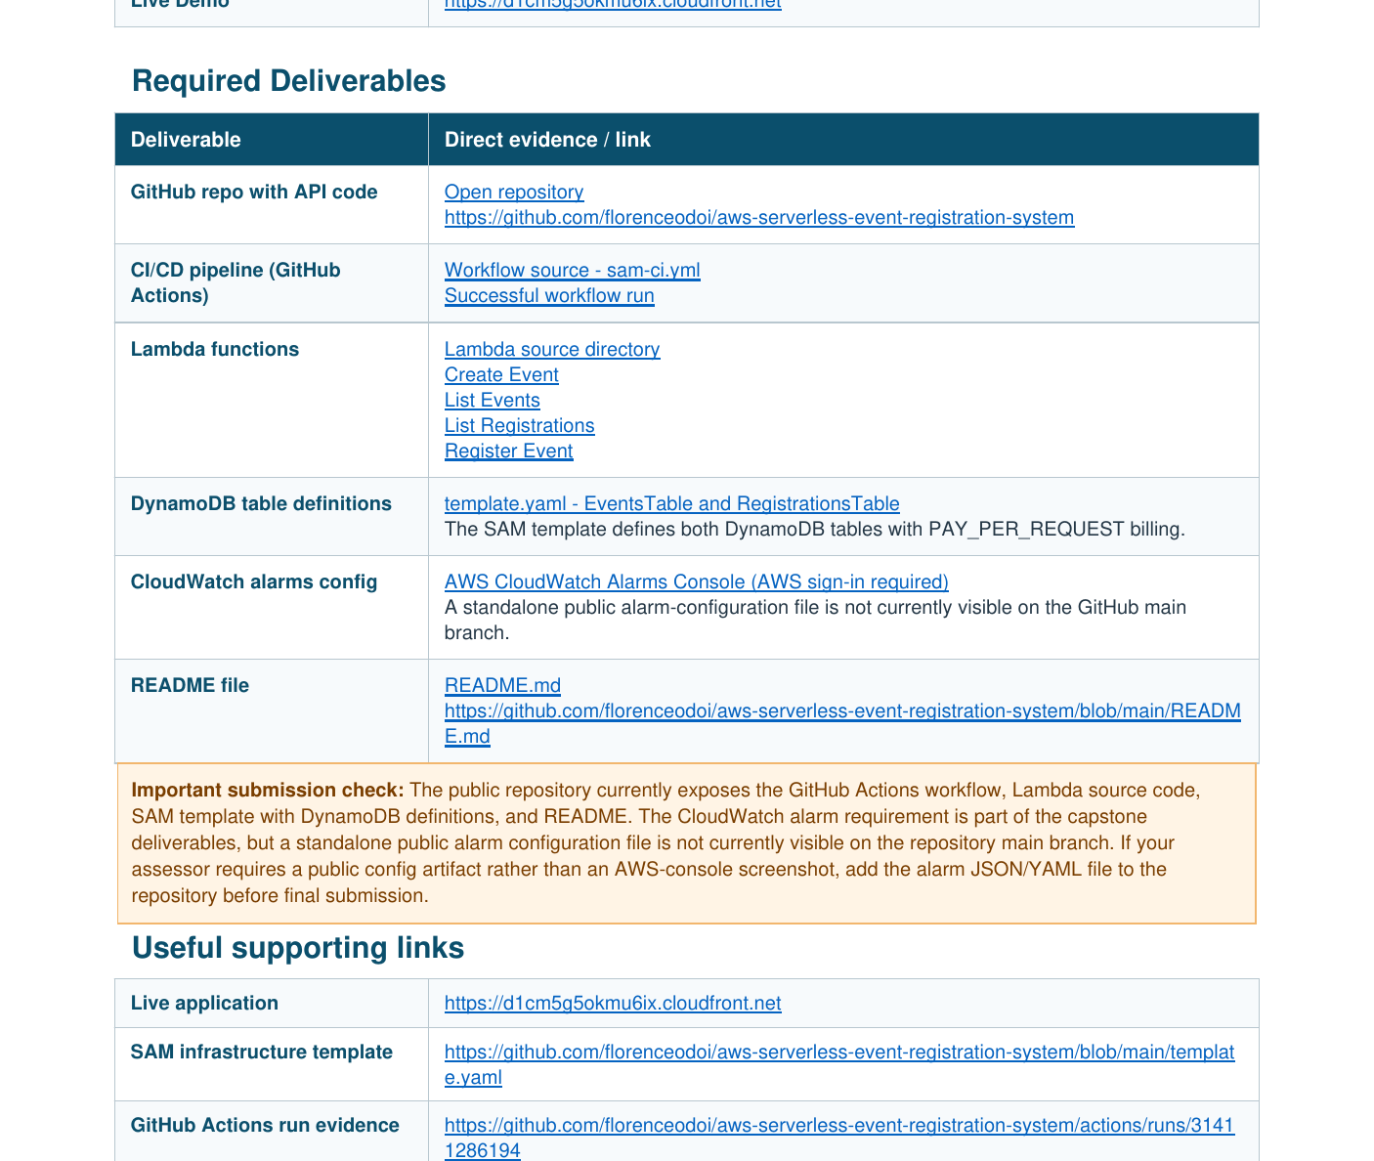
Submission Evidence & Links
Final deliverables are documented with clickable references
SUBMISSION URLS
Live Demo
https://d1cm5g5okmu6ix.cloudfront.net
GitHub Repository
https://github.com/florenceodoi/aws-serverless-event-registration-system
CI/CD Evidence
https://github.com/florenceodoi/aws-serverless-event-registration-system/actions/runs/31411286194
README and Template
README.md • template.yaml
All required deliverables are traceable from the repository and final evidence PDF.
AWS Capstone • Serverless Event Registration System
09

Slide 10
Final Outcome
A complete serverless event registration product with frontend delivery, REST API, Lambda business logic, DynamoDB storage, CI/CD, security controls, monitoring and cost awareness.
Ready for demonstration
Ready for repository review
Ready for final submission
Recommended future enhancements
Live demo
Confirmation emails using SNS or SES
Cognito authentication for administrators
Event capacity enforcement and QR-code tickets
CloudWatch dashboard and additional alarms
https://d1cm5g5okmu6ix.cloudfront.net
GitHub
https://github.com/florenceodoi/aws-serverless-event-registration-system

