Slide 1
London Airbnb Listing Price Prediction
STA 9890, Statistical Learning for Data Mining
Spring 2021
Group 8
Patrick Parham
Florend Xhani

Slide 2
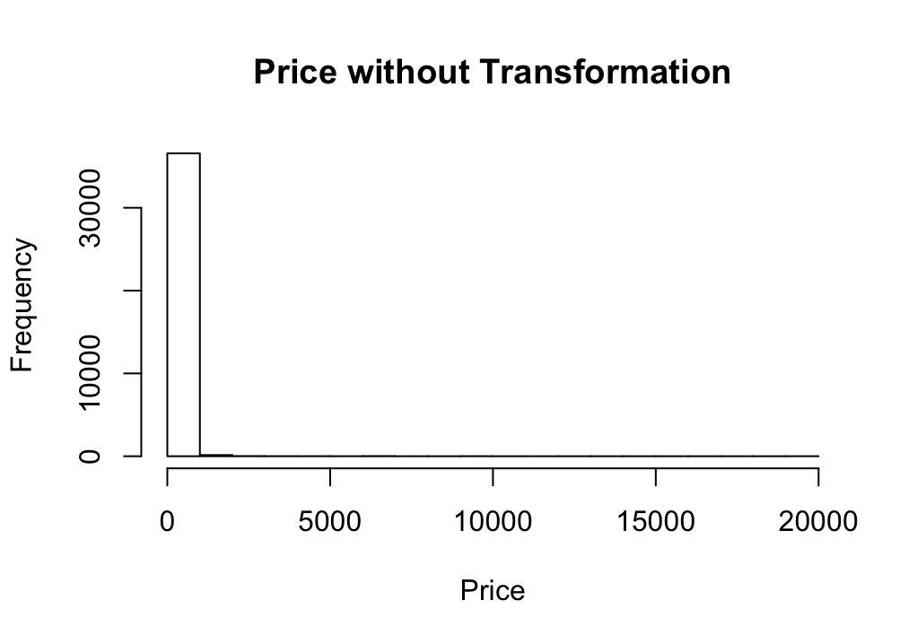
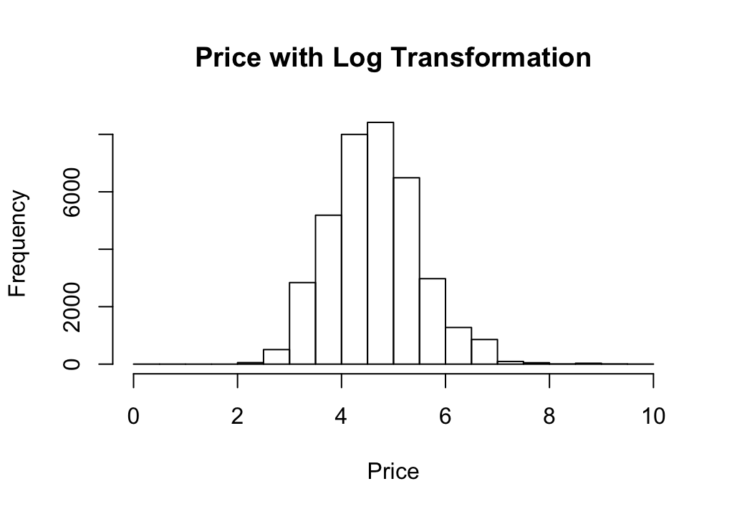
Data
Overview
Based on Airbnb’s popularity, one might be interested to know what is driving the typical nightly price point for a unit listing. By looking at features advertised, we can understand how units are priced and (1) if as hosts we are correctly pricing a unit; (2) as patrons if we are overpaying; or (3) as casual observers if we understand the phenomenon. The aim of this exercise is to predict the price per night of Airbnb units using various methods and comparing the performance of the methods used for prediction.
About the Dataset:
There are 43 features which are the explanatory variables and one response variable. Each feature represents an attribute of a listing scraped from the listing instance page (Ex.: # Bedrooms, Host Ratings, Room Type, etc). The data is limited to listings in the city of London.
Post-Cleaning Instances and Variables
n = 36,785
p = 44 (Numerical: 25, Categorical: 19)
Outcome
Listing Price for a Single Night (Mean: $161)
The dataset and more information on the predictors can be found at:
https://www.kaggle.com/jinxzed/londonairbnb

Slide 3
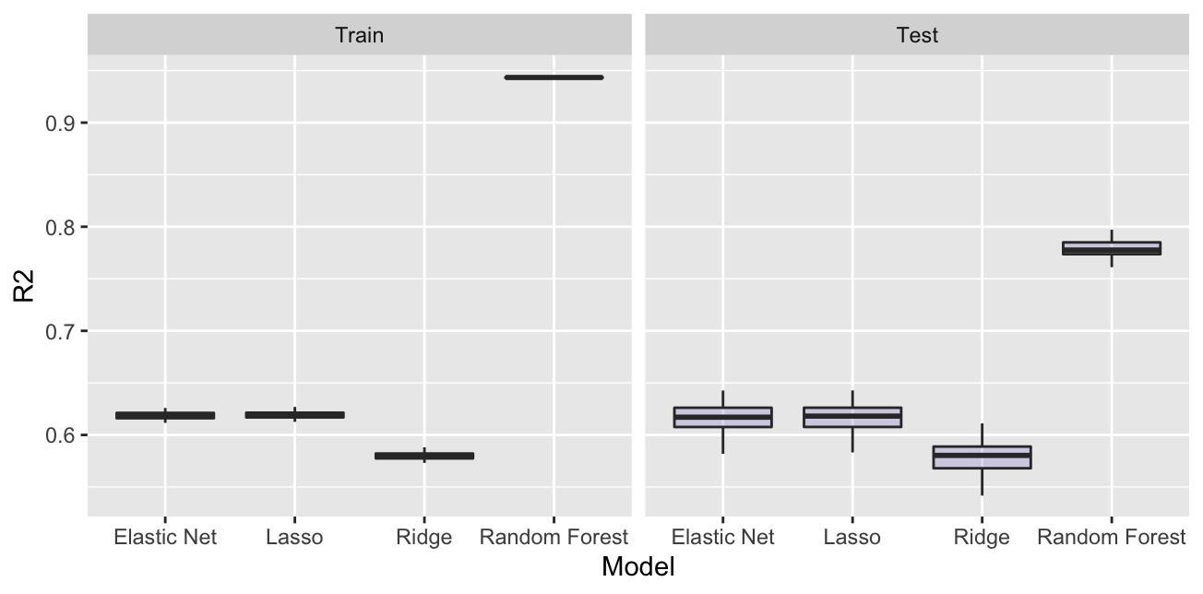
R-Squared by Split and Model
Median
Model | Train* | Test*
Elastic-Net | 0.618 | 0.617
Lasso | 0.619 | 0.618
Ridge | 0.579 | 0.580
Random Forest | 0.943 | 0.778
Random Forest is the top performer based on Test R-Squared (0.778)
Drop-off from Train to Test might signal overfitting of the data
Ridge is the lowest performer by Test R-Squared (0.58) and has the largest variance
Minimal difference between Train and Test is an indicator of the benefit of cross-fold validation
*Data: Split 80% Train/20% Test for 100 Samples

Slide 4
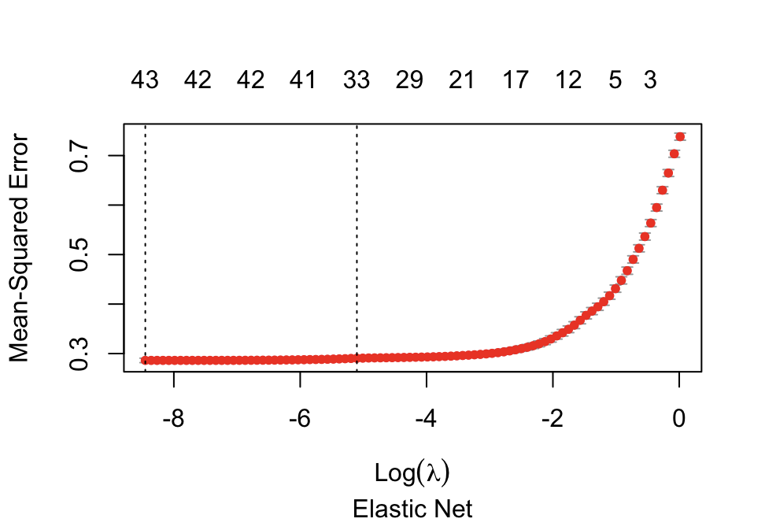
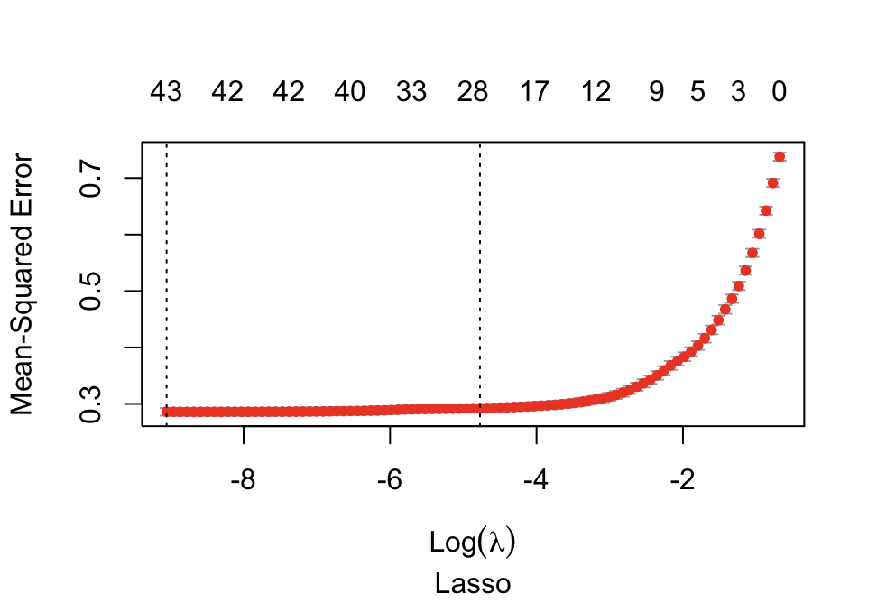
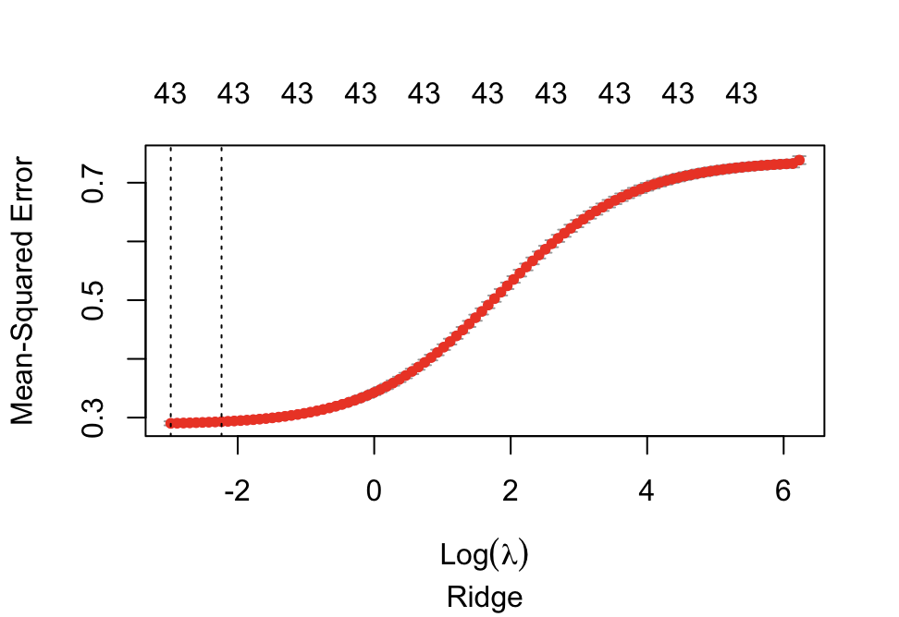
10-Fold Cross-Validation Curves
Model | Time
Elastic-Net | 1.025 Seconds
Lasso | 1.022 Seconds
Ridge | 1.021 Seconds
All regression models took 1.02 secs to cross-validate (Elastic-Net > Lasso > Ridge) and each leveraged all 43 features for tuning and have similar MSE values.
Data: One of the 100 Samples

Slide 5
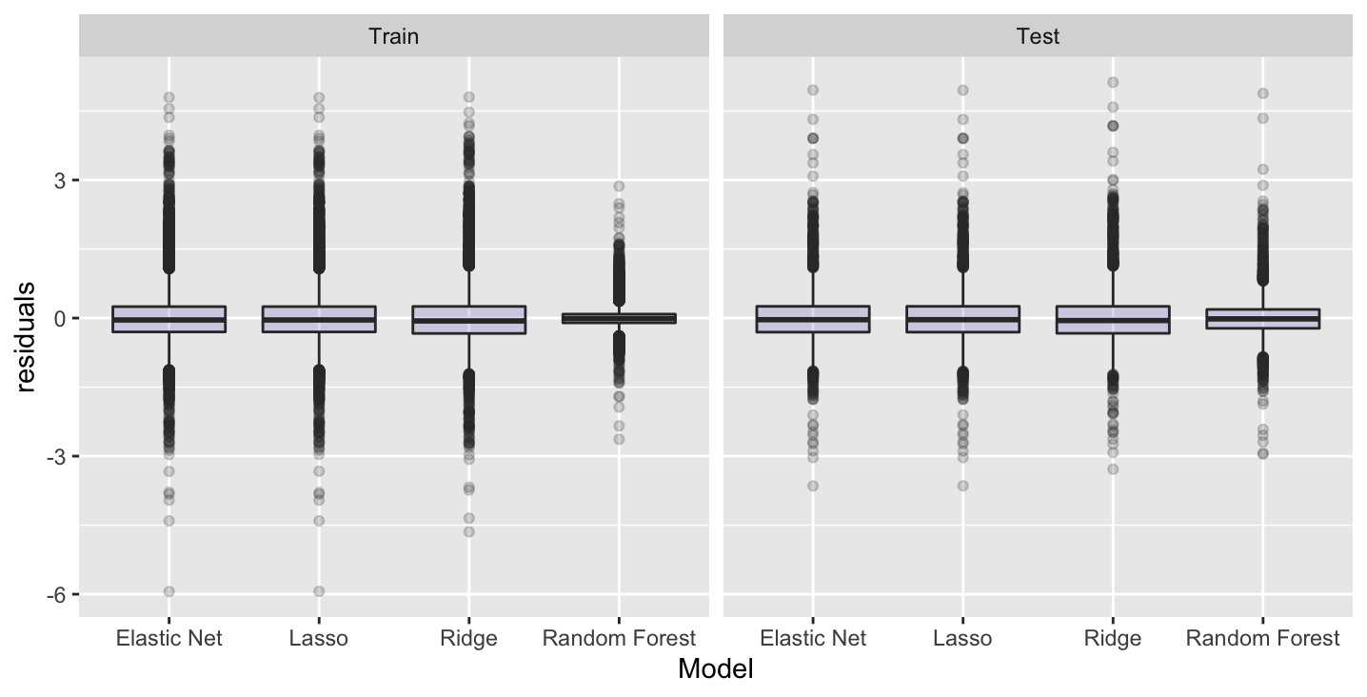
Residuals by Split and Model
The differences between the Train and Test splits are minimal.
Random Forest residuals are more concentrated around 0 and have less variance than the other models.
This further confirms our confidence in this method as our top predictor.
Overall, the residuals are skewed to the negative side, indicating that the models tend to predict higher listing prices.
Data: One of the 100 Samples

Slide 6
Trade-off? Training a Model and Performance
Model | Test R-Sq* | Time**
Elastic-Net | 0.589 - 0.635 | 1.59 Seconds
Lasso | 0.590 - 0.636 | 1.58 Seconds
Ridge | 0.553 - 0.600 | 1.67 Seconds
Random Forest | 0.765 - 0.791 | 540.91 Seconds
With a high-level evaluation based on the Test R-Squared value, the sacrifice in Time for Random Forest is outweighed based on the ~20% point difference in the Test R-Squared value.
*90% Test R-Squared confidence interval based on the 100 samples
** The time it takes to fit the model on all the data

Slide 7
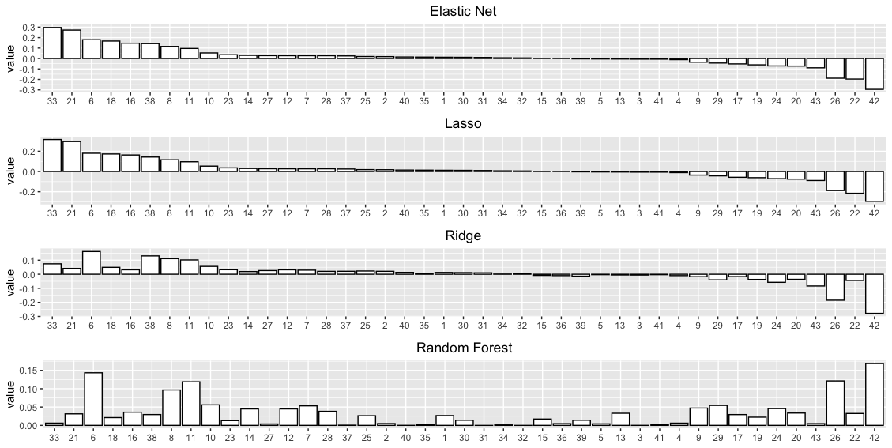
Estimated Coefficients
In comparing all methods used, certain features maintain importance across each of the methods, while Random Forest feature prominence is noticeably different than the alignment we see across Elastic-Net, Lasso and Ridge.
Overall Important Features
Positive
X6 - Accommodates
X8 - Bedrooms
X11 - Cleaning fee
Negative
X42 - Room Type - Private Room
X26 - Distance
Therefore, size and location are highly determinant of price
Data: Full data

Slide 8
Takeaways
The R-Squared results for the Elastic-Net, Lasso, and Ridge Regression were similar. The Random Forest was the top performer with a 90% confidence interval of 0.765 - 0.791 for the Test R-Squared.
Further proof of Random Forest’s strength as a predictor can be seen in the plotting of the Residuals, as the residuals were more concentrated around 0.
Based on the plotting the estimated coefficients in order of importance by the Elastic-Net estimation, we found feature importance that both positively and negatively impacts the prediction across all models:
Positive: X6 - Accommodates, X8 - Bedrooms, X11 - Cleaning fee
Negative: X42 - Room Type - Private Room, X26 - Distance
Overall, while Random Forest does require a significant amount of time to fit compared to the other models, the difference in the Test R-Squared is worth the added precision.

