Slide 1

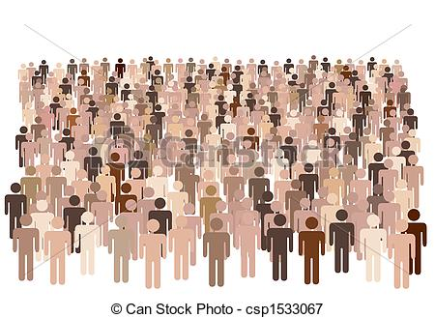

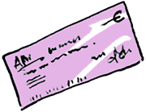

Before
After
http://sd-21725.dedibox.fr/cleverTaxes/code/client/

