Slide 1

Project Forecast
Predicting the future of energy consumption.
December 2020
YNOV - Master Data Scientist & Data Engineer - Bonneville Paul, Chicha Tilan, Dieng Mamadou, Haffner Florent, Puglisi Axel

Slide 2


Accurate and timely forecasting is now more important than ever !
Since mid-2000s we live in a big-data world where everything is stored in gigantic database to be analyzed and optimized,
The importance of efficiency in energy management is growing,
To follow customer expectations, it requires us to use precise data analytics techniques such as time series forecasting.
Those challenges can be combined thanks to tools such as :
Apache Spark, a very fast data analysis and treatment framework,
Facebook Prophet, a procedure for forecasting time series data based on an additive model.

Slide 3
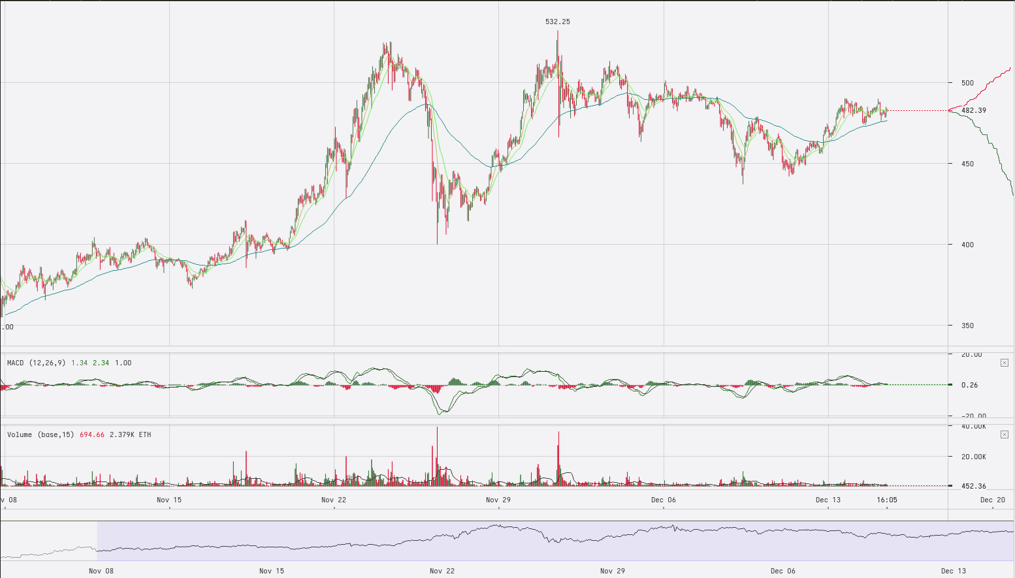
What are time series data ?
From trading to medical, health and medicine to chemistry, energy consumption, etc…
Time series are everywhere !

Slide 4
What is forecasting ?
How many sodas from a specific brand will be sell the next summer in Paris ?
How many blue smartphones of the next generation will I be sell in my e-commerce website ?
Forecasting is a timeseries analysis process that build prediction and is able to solve those questions.

Slide 5
Context
One of Engies’s main activities is the purchase and resale of electricity.
It can be done in 2 ways. :
Provisioned
Live
ENGIE want to minimize the energy purchased directly.
To do so, they want to predict the demand of their customers.

Slide 6
Goal
Set up a forecast model with a 30-day horizon.
We combine 2 models :
A first one clustering similar clients (similar curves) -> to smooth them,
A second one to predict the future consumption.

Slide 7
Datas
Our raw datas : a 21 millions lines of ENGIE’s clients measurements
5 columns :
Id Client
Date
Hours
Minutes
Power (kW)
Each measurement is taken every 10 minutes.

Slide 8
Datalake
We are very dependant of our 1 gigabyte datalake, everything is built around it !
First major issue
7 hours of network crash during data upload
Solution
Using Google Drive to store our data (now rebuilding our datalake tooks us less than 3 minutes).

Slide 9

Datalake
From Data Frame to Parquet
Repartition = 3 -> 230 mo Files (between 50 and 300mo are optimal),
Partition by date : because we are working with time-series.
From Parquet to SQL so we can explore easily.

Slide 10
P1 - Shaping hour from UTC to local time
Building a properly form string
Cast it as a Timestamp (number of second since 01/01/1970)
Add 3600 seconds to it in order to get the local time

Slide 11
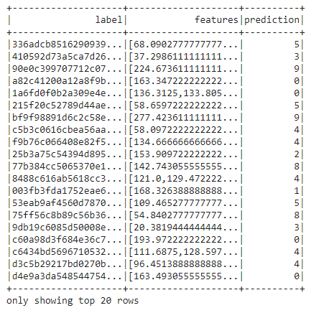
P1 - Clustering overview
We first divide our consumer consumption in different categories called clusters.
This will help us generalize forecasting and predict individual average consumption.

Slide 12
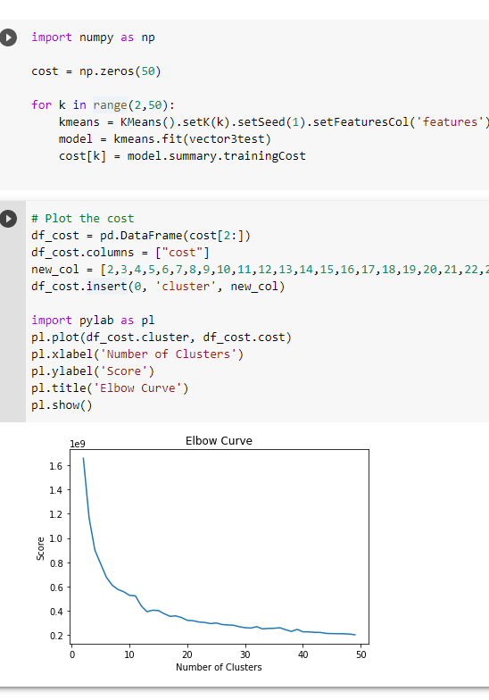
P1 - Clustering - loss function
How many cluster ?
The Elbow method :
The optimal number of clusters is 12.

Slide 13
P2 - Forecasting individual consumption
Get cluster id by client
Get cluster dataframe by cluster_id
Normalized clients consummation
Make prediction based on time-series
Show plot figure

Slide 14
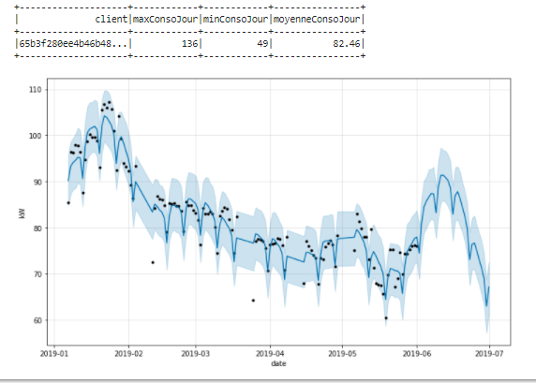

P3 - Final Product : Dashboard 1
Two dashboards are currently available on the consumption of a targeted customer.
The first dashboard displays descriptive customer statistics:
The customer's maximum daily consumption
The minimum daily consumption of the customer
Average daily customer consumption
Prediction of consumption over a chosen number of days

Slide 15
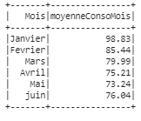
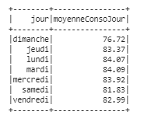
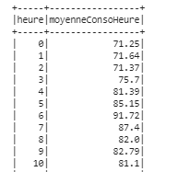
P3 - Final Product : Dashboard 2
The second dashboard displays the average consumption per hour on a temporal filter:
The average consumption per hour over the months of the chosen customer
The average consumption per hour on the days of the week of the chosen customer
The customer's average consumption per hour

Slide 16

P3 : Prediction's model loss function
We have used the "Root Mean Squared Error" as loss function on our datas
Client_id | Cluster_id | RMSE
70079c4dff9f801c341b0a74d6ff22f8 | 9 | 25,72
336adcb85162909390c8ef800ec9bea7 | 5 | 20,92
236bb8209514bdd27b04d3ec7b19e410 | 10 | 147,13

Slide 17
Improvements
Forecasting : Loss function
Forecasting : Compute a coefficient based on the cluster and apply it on the client prediction.i
Make a cache of our calculation on the dashboard
Create a table with the dashboard’s data
Create a function that manage the data from table to dashboard
Make a colorful visualisation of our client through the clusters

Slide 18
Merci pour votre attention :D

