Slide 1
“Code is the lifeblood of technology.”
“Code is art, and you are the artist.”
CODING HYGIENE

Slide 2
This powerpoint is based on:
https://medium.com/@anishmahapatra/code-hygiene-dont-laugh-it-off-2a5aebcdd84b
https://stat.ethz.ch/Teaching/maechler/R/useR_2014/Maechler-2014-pr.pdf
https://style.tidyverse.org/syntax.html
← Very detailed with Good and Bad examples
https://waterdata.usgs.gov/blog/intro-best-practices/
https://www.r-bloggers.com/r-best-practices-r-you-writing-the-r-way/
https://swcarpentry.github.io/r-novice-inflammation/06-best-practices-R/
And based on the use of Rstudio!
Search: « Best coding practices » or « Best coding practices in R »

Slide 3
The main idea is that your code should be reproductible!
Someone should be able to re-run your code and understand what and why you did what you did.
SPOILERS: This someone could be YOU!
… getting lost with your own code… #fail

Slide 4
MAIN RULE # 1
COMMENT
#### Section 1 #### (or … # Section 1 ####) Will make the section foldable!
### Major « sectioning » comments or for section subtitles
## For usual comments
# For end-of-line comments

Slide 5
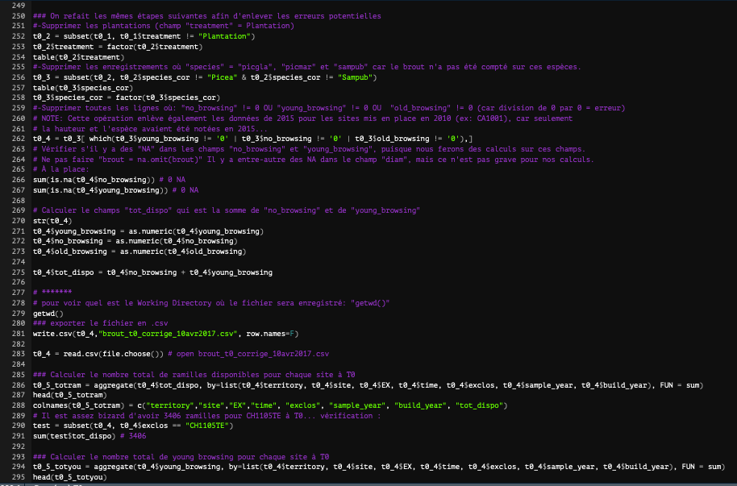
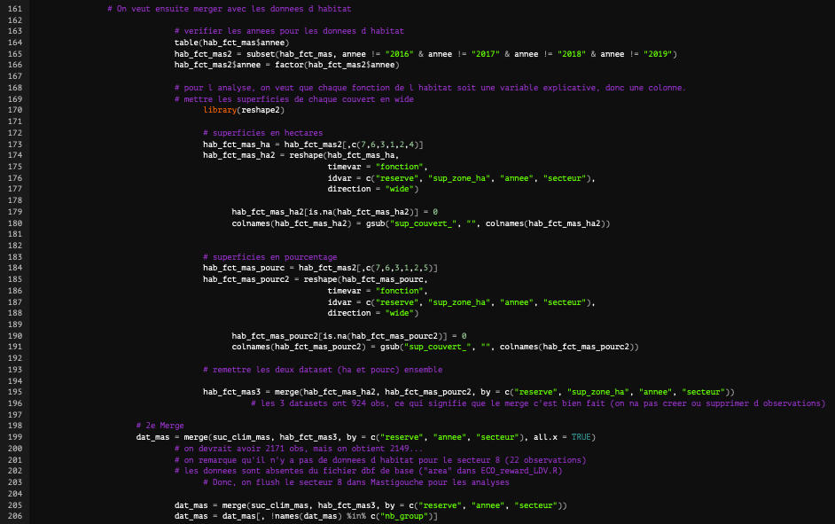
To indent blocks of lines, select lines and press “Tab”
To remove indent, select lines and press “Shift + Tab”
MAIN RULE # 2
Indent
Bad
Good

Slide 6
MAIN RULE # 3
Nomenclature
Do not name variables with letters or weird names: a, b, c, final, final1, …
Do not name variables with names frequently seen in functions
Use names that make sense !
Even if they get longer, at least you understand what you ar working with… and with the assist name thing, it is not so bad!

Slide 7
MAIN RULE # 4
Use spaces!!!
https://style.tidyverse.org/syntax.html

Slide 8
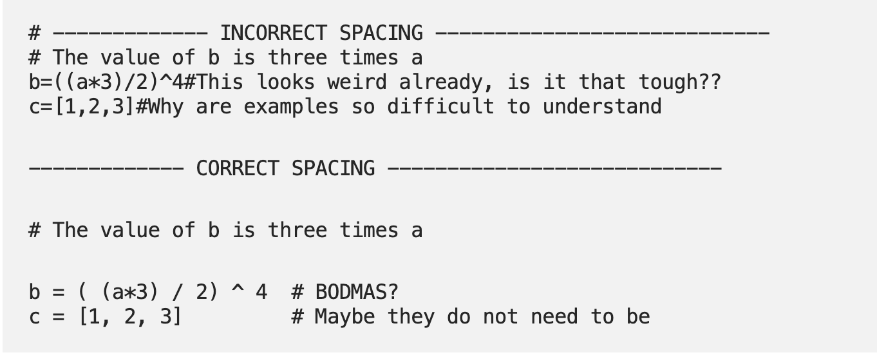
MAIN RULE # 4
https://medium.com/@anishmahapatra/code-hygiene-dont-laugh-it-off-2a5aebcdd84b

Slide 9
MAIN RULE # 5
Take the time
Be nice to your code
Choose a standard and stick to it!

Slide 10
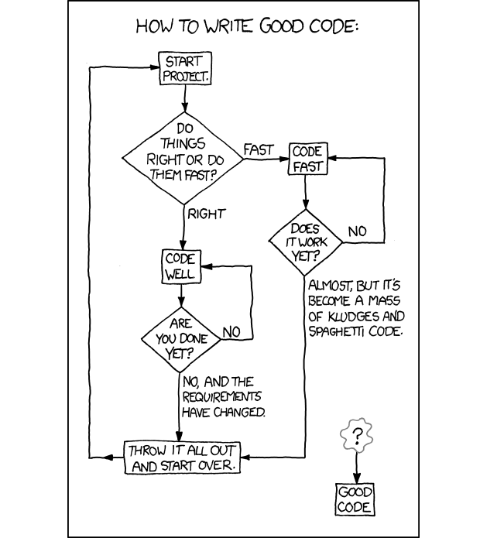
MAIN RULE # 5
https://medium.com/@anishmahapatra/code-hygiene-dont-laugh-it-off-2a5aebcdd84b

Slide 11
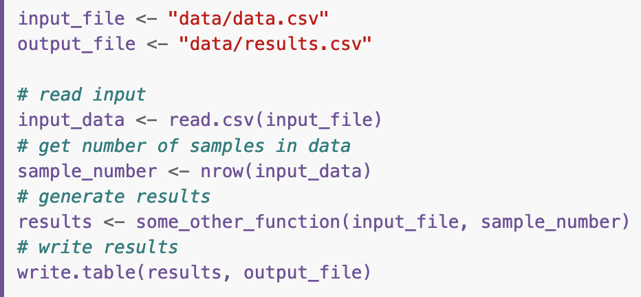
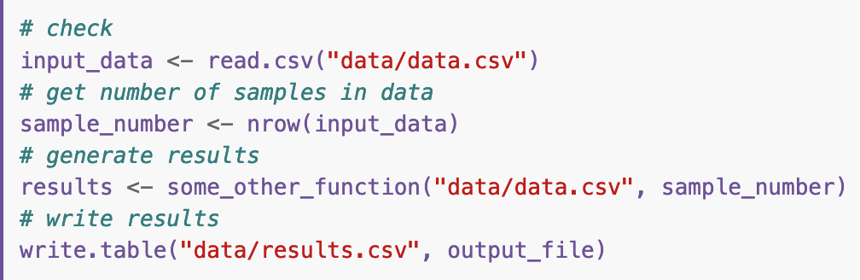
Others advices/tricks found
Start the code by describing who wrote the code and what it intent to do. Add date.
Put all library(packages) at the beginning
Frustrating to run a code and realize at the end that a package was missing…
Set/create directory/source at the beginning:
Good
Bad
BE CAREFUL WITH SETWD()
Nobody has the same repository path….

Slide 12

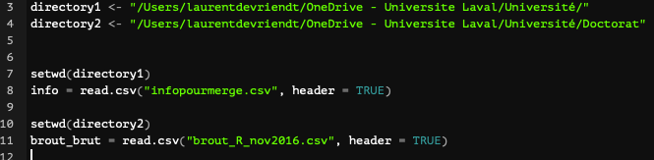
Set/create directory/source at the beginning:
Disadvantage: cannot run the whole code without choosing each file one-by-one
Better? Someone else can change the path at the beginning of the code and then run the whole code…
What do you think?

Slide 13
Others advices/tricks found
Include arguments names when using functions
Except for very frequent arguments…
Use “<-”, not “=”
Alt + space = “<-” (the assignment operator is configurable)
If you use temporary code, delete it after or indent and state clearly that this is temporary-code
Make sure that the temporary code can’t interfere with the main code (use different names, like “test” or “temp”)
Do wrap long lines!
You should never scroll left-right
Try to limit your code to 80 characters per line
Soft-wrap R tool…

Slide 14
Others advices/tricks found
Don’t save session history/environment!
“Start in a clean environment so that older objects don’t remain in your environment any longer than they need to. If that happens, it can lead to unexpected results.”
Avoid Copy & Paste of codes lines
Less possible errors
By rewriting your code, you will get better at coding
Be flexible though…
Use png(), tiff(), jpg(), etc. Not plot-viewer – export
Better control on parameters, better reproducibility!
Working on somebody else’s code? Put your initials in comments to identify added/modified code
See main rule #6…

Slide 15
MAIN RULE # 6
Write Functions
and loops!
Who’s next? I am bad at writing functions…

Slide 16
Extra L. De Vriendt
Keep a script of « useful codes »
Include the date in final files/figures (“Figure_prc_browsing_classes_2020_01_05”)
ALWAYS write date as YEAR-MONTH-DAY (for everything, everywhere!)
Adding new code to old code? Write “UPDATE + date” and indent
Add the url of the reference code in comments
Indent by multiple of 3
Always double-check data transformation/selection, especially in complex data manipulations
Verify that the values haven’t changed or changed in the desired way, count the number of lines/columns you should have and compare with what you have. Data get lost so easily…

Slide 17
Extra L. De Vriendt
Avoid capitalization!
Can only be a source of problems. In code, in assignations, in file/figure names, etc. just DON’T
Avoid spaces in names (use “_ ”)
Write results of analyses in end-of-line comments
When rerolling the stats, you will see if an error slipped in
Find & Replace
Save time! But be careful and resist the temptation to “Replace all”
Keep a “Trash” section at the end of your code

Slide 18
Everybody knows tricks! What is yours?
When using {} for loops and function, put { alone in first line and } on the last line to allow folding.
When working on an already existing code, start by saving into a new file to avoid overwriting the original code file.

