Slide 1
Today’s Material
Iterative Algorithms and their Analysis
Asymptotic Notations
Big-O Notation
Review of Discrete Math
Summations
Logarithms

Slide 2
Finding the sum of an array of numbers
[3, 9, 6, 5, 2]
Sum
25

Slide 3
Finding the sum of an array of numbers
int Sum(int A[], int N) {
int sum = 0;
int i=0;
while (i<N){
sum += A[i];
i++;
} //end-for
return sum;
} //end-Sum
Time Complexity T(n):
How many steps does this algorithm take to finish?
We define a step to be a unit of work that can be executed in constant amount of time in a machine.

Slide 4
Finding the sum of an array of numbers
Times Executed
1
1
N
N
N
1
---------
int Sum(int A[], int N) {
int sum = 0;
int i=0;
while (i<N){
sum += A[i];
i++;
} //end-while
return sum;
} //end-Sum
Total: 2 + N + N + N + 1 = 3N + 3
Running Time: T(N) = 3N+3

Slide 5
Example 2: Linear Search
You are given an array of numbers and a key
Implement an algorithm that returns the index of the array where the key is stored
If the key does not exist in the array, return -1
0
1
2
3
4
5
6
7
8
9
10
11
12
13
14
15
9
4
10
1
20
12
3
99
65
52
25
11
91
34
62
55
Key = 12 ➔ Return 5, which is the index of the array where 12 is stored
Key = 77 ➔ Return -1 because 77 is NOT in the array

Slide 6
Example II: Linear Search
Times Executed
1
1<=L<=N
1<=L<=N
0<=L<=N
1
1
---------
int LinearSearch(int A[], int N,
int key) {
int i = 0;
while (i < N){
if (A[i] == key) break;
i++;
} //end-while
if (i < N) return i;
else return -1;
} //end-LinearSearch
Total: 1+3*L+1 = 3L+2

Slide 7
Example II: Linear Search
What’s the best case?
Loop iterates just once =>T(n) = 5
What’s the average (expected) case?
Loop iterates N/2 times =>T(n)=3*n/2+2 = 1.5n+2
What’s the worst case?
Loop iterates N times =>T(n) = 3n+2

Slide 8
Worst Case Analysis of Algorithms
We will only look at WORST CASE running time of an algorithm. Why?
Worst case is an upper bound on the running time. It gives us a guarantee that the algorithm will never take any longer
For some algorithms, the worst case happens fairly often. As in this search example, the searched item is typically not in the array, so the loop will iterate N times
The “average case” is often roughly as bad as the “worst case”. In our search algorithm, both the average case and the worst case are linear functions of the input size “n”

Slide 9
Example III: Nested for loops
for (i=1; i<=N; i++){
for (j=1; j<=N; j++){
printf(“Foo\n”);
} //end-for-inner
} //end-for-outer
How many times is the printf statement executed?
Or how many Foo will you see on the screen?

Slide 10
Matrix Multiplication
You are given two NxN matrices A & B
Compute C = A x B
5
1
2
1
2
2
12
13
1
2
4
x
3
1
3
=
6
2
7
2
1
4
A
B
C
C[0][0] = A[0][0]*B[0][0] + A[0][1]*B[1][0] + A[0][2]*B[2][0]
C[0][0] = 5*1 + 1*3 + 2*2 = 5+3+4 = 12

Slide 11
Matrix Multiplication
/* Two dimensional arrays A, B, C. Compute C = A*B */
for (i=0; i<N; i++) {
for (j=0; j<N; j++) {
C[i][j] = 0;
for (int k=0; k<N; k++){
C[i][j] += A[i][k]*B[k][j];
} //end-for-innermost
} //end-for-inner
} //end-for-outer

Slide 12
Example V: Binary Search
Problem: You are given a sorted array of integers, and you are searching for a key
Linear Search – T(n) = 3n+2 (Worst case)
Can we do better?
E.g. Search for 55 in the sorted array below
0
1
2
3
4
5
6
7
8
9
10
11
12
13
14
15
3
8
10
11
20
50
55
60
65
70
72
90
91
94
96
99

Slide 13
Example V: Binary Search
Since the array is sorted, we can reduce our search space in half by comparing the target key with the key contained in the middle of the array and continue this way
Example: Let’s search for 55
0
1
2
3
4
7
8
11
15
3
8
10
11
20
50
55
60
91
94
96
99
60
65
70
72
90
left
right
0
1
2
3
4
6
7
8
11
15
3
8
10
11
91
94
96
99
11
20
50
55
60
65
70
72
90
left
middle
right
Eliminated

Slide 14
Binary Search (continued)
0
1
2
3
4
5
6
7
8
11
15
3
8
10
11
20
50
91
94
96
99
50
55
60
65
70
72
90
Eliminated
left
middle
right
0
1
2
3
4
5
6
7
8
11
15
3
8
10
11
20
50
55
60
91
94
96
99
55
65
70
72
90
left
right
Eliminated
middle
Now we found 55→ Successful search
Had we searched for 57, we would have terminated at the next step unsuccessfully

Slide 15
Binary Search - Algorithm
// Return the index of the array containing the key or –1 if key not found
int BinarySearch(int A[], int N, int key){
left = 0;
right = N-1;
while (left <= right){
int middle = (left+right)/2; // Index of the key to test against
if (A[middle] == key) return middle; // Key found. Return the index
else if (key < A[middle]) right = middle – 1; // Eliminate the right side
else left = middle+1; // Eliminate the left side
} //end-while
return –1; // Key not found
} //end-BinarySearch
Worst case running time: T(n) = 3 + 5*log2N. Why?

Slide 16
Binary Search Running Time Analysis
N →N/2 ->N/4 ->N/8 ->N/16 ->…… ->N/2^{k}
N →N/2¹ ->N/2² ->N/2³ ->N/2⁴ ->……->N/2^{k}
N/2^{k} = 1
2^{k} = N
k = log2(N)
T(n) = 3 + 5*k = 3 + 5*log2N

Slide 17
Asymptotic Notations
Summation: T(N) = 3N + 3
Linear Search: T(N) = 3N + 2
Binary Search: T(N) = 5*log2N + 3
Matrix Multiplication: T(N) = N³ + N²
Given two algorithms that solve a problem, we want a way to compare their running times, and pick the one that has the better performance
Asymptotic notations let us express the running times more succinctly and then pick the best one

Slide 18
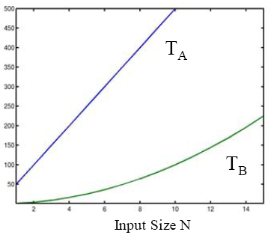
Motivation for Asymptotic Notation
Suppose you are given two algorithms A and B for solving a problem
Here is the running time TA(N) and TB(N) of A and B as a function of input size N:
Which algorithm would you choose?
Running Time

Slide 19
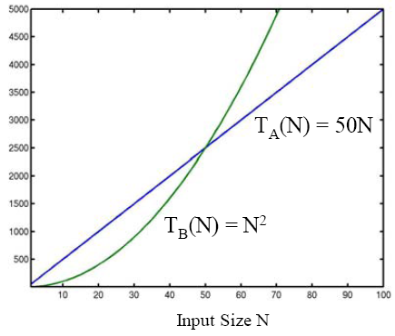
Motivation for Asymptotic Notation
For large N, the running time of A and B is:
Which algorithm would you choose now?
Running Time

Slide 20
Motivation for Asymptotic Notation
In general, what really matters is the “asymptotic” performance as N → ∞, regardless of what happens for small input sizes N
Performance for small input sizes may matter in practice, if you are sure that small N will be common
This is usually not the case for most applications
Given functions T1(N) and T2(N) that define the running times of two algorithms, we need a way to decide which one is better (i.e. asymptotically smaller)
Big-O notation

Slide 21
Big-O Notation: Asymptotic Upper Bound
T(n) = O(f(n)) [T(n) is Big-O of f(n) or order of f(n)]
If there are positive constants c & n0 such that
T(n) <= c*f(n) for all n >= n0
c*f(n)
Running Time
T(n)
n0
Input size N
Example: T(n) = 50n is O(n). Why?
Choose c=50, n0=1. Then 50n <= c*n for all n>=1
many other choices work too!

Slide 22
Big-Oh Notation: Asymptotic Upper Bound
T(n) = O(f(n))
If there are positive constants c & n0 such that
T(n) <= c*f(n) for all n >= n0
Example: T(n) = 2n+5 is O(n) why?
We want T(n) = 2n+5 <= c*n for all n>=n0
2n+5 <= 7n for all n>=1
c = 7, no = 1
2n+5 <= 3n for all n>=5
c = 3, no=5
Many other c & n0 values would work too

Slide 23
Big-Oh Notation: Asymptotic Upper Bound
T(n) = O(f(n))
If there are positive constants c & n0 such that
T(n) <= c*f(n) for all n >= n0
Example: T(n) = 2n+5 is O(n²) why?
We want T(n) = 2n+5 <= c*n² for all n>=n0
2n+5 <= 1*n² for all n>=4
c = 1, no = 4
2n+5 <= 2*n² for all n>=3
c = 2, no = 3
Many other c & no values would work too

Slide 24
Big-Oh Notation: Asymptotic Upper Bound
T(n) = O(f(n))
If there are positive constants c & n0 such that
T(n) <= c*f(n) for all n >= n0
Example: T(n) = n(n+1)/2 is O(?)
T(n) = n²/2 + n/2 is O(N²). Why?
n²/2 + n/2 <= 1*n² for all n >=1
So, T(n)=n*(n+1)/2 <= 1*n² for all n >=1
c=1, no=1
Note: T(n) is also O(n³). Why?

Slide 25
Common running times we will encounter
Name | Big-Oh | Comment
Constant | O(1) | Can’t beat it!
Log log | O(loglogN) | Extrapolation search
Logarithmic | O(logN) | Typical time for good searching algorithms
Linear | O(N) | This is about the fastest that an algorithm can run given that we need O(N) just to read the input
NLogN | O(NlogN) | Most sorting algorithms
Quadratic | O(N²) | Acceptable when the data size is small (N<1000)
Cubic | O(N³) | Acceptable when the data size is small (N<1000)
Exponential | O(2^{N}) | Only good for really small input sizes (n<=20)
Factorial | O(N!) | Only good for really small input sizes (n<=15)
Increasing cost
Polynomial time

Slide 26
Some Math
S(N) = 1 + 2 + 3 + 4 + … N =
Sum of Squares:
Geometric Series: A > 1
A < 1

Slide 27
Some More Math
Linear Geometric Series:
Harmonic Series:
Logs:

Slide 28
More on Summations
Summations with general bounds:
Linearity of Summations:

Slide 29
LeetCode 771: Jewels and Stones
You are given strings J representing the types of stones that are jewels, and S representing the stones you have.
Each character in S is a type of stone you have
You want to know how many of the stones you have are also jewels
The letters in J are guaranteed distinct, and all characters in J and S are letters
Letters are case sensitive, so "a" is considered a different type of stone from "A"

Slide 30
LeetCode 771: Example
Input: J = "aA", S = "aAAbbbb"
Output: 3
Input: J = "z", S = "ZZ"
Output: 0

Slide 31
LeetCode 771: Brute-force solution
Input: J = "aA", S = "aAAbbbb"
Output: 3
int numJewelsInStones(String J, String S){
int count = 0
For each char ch1 in S:
Search if ch1 exists in J
If ch1 exists in J then count++
return count
}
Running Time? T(n, m) = O(nxm)

Slide 32
LeetCode 771: Efficient Solution with a LUT
Input: J = "aA", S = "aAAbbbb"
Output: 3
1
0
0
0
0
0
0
1
0
0
0
0
0
0
A
B
C
Z
a
b
z
int numJewelsInStones(String J, String S){
for each ch in J: Mark it in a look up table (LUT)
int count = 0
for each ch in S: If LUT[ch] is true, count++
return count
}
Running Time? T(n, m) = O(n+m)

Slide 33
LeetCode 2784: Check if Array is Good
You are given an integer array nums. We consider an array good if it is a permutation of an array base[n].
base[n] = [1, 2, ..., n - 1, n, n] (in other words, it is an array of length n + 1 which contains 1 to n - 1 exactly once, plus two occurrences of n). For example, base[1] = [1, 1] and base[3] = [1, 2, 3, 3].
Return true if the given array is good, otherwise return false.
Note: A permutation of integers represents an arrangement of these numbers.

Slide 34
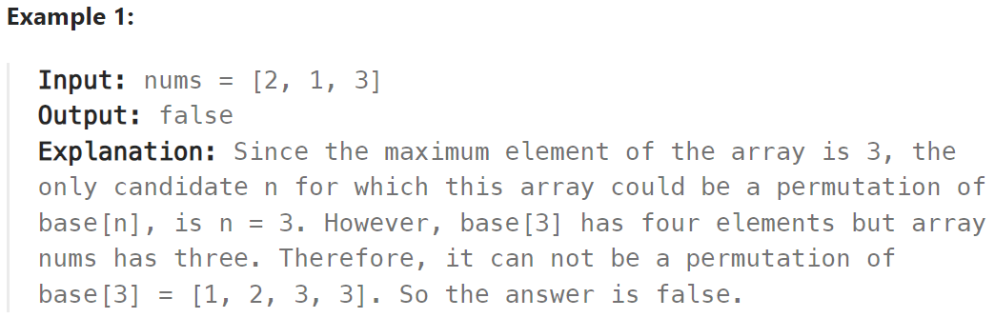
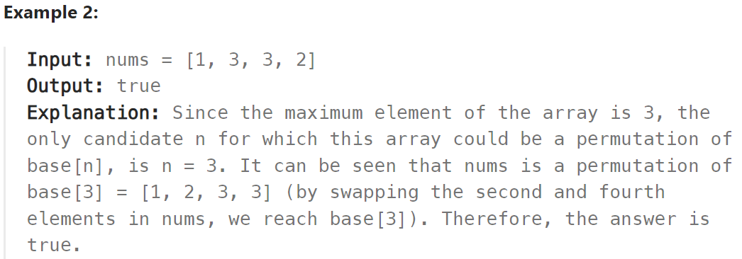
LeetCode 2784: Example

Slide 35
LeetCode 2784: Check if Array is Good
Three solutions:
Brute-force O(n²) solution
O(nlogn) solution using sorting
O(n) solution with O(n) extra space (time-vs-space tradeoff)

