Slide 1
Today’s Material
Contiguous Allocation
Arrays: Representation & Layout in memory
Non-contiguous (linked) Allocation
Linked Lists: Representation & Manipulation

Slide 2
DS Allocation Strategies
There are two types of allocation strategies in computer science
Contiguous allocation: Arrays
Non-contiguous (linked) allocation: Linked lists, trees, tries, graphs etc.

Slide 3
Contiguous Allocation
Memory
Items (elements) of the DS are stored contiguously one after the other in memory
int A[] = new int[5];
You can access any element of the array in O(1) time using indexing
A[3]
B[4]
0
1
2
Address
L0
A[0]
c bytes
L0 + c
A[1]
L0 + 2c
A[2]
L0 + 3c
A[3]
L0 + 4c
A[4]
Contiguous

Slide 4
Contiguous Allocation
Memory
Memory
Memory
0
0
0
1
1
1
2
2
2
Address
Address
Address
100
A[0]
1 byte
100
B[0]
4 bytes
100
C[0]
8 bytes
101
A[1]
104
B[1]
108
C[1]
102
A[2]
108
B[2]
116
C[2]
103
A[3]
112
B[3]
124
C[3]
104
A[4]
116
B[4]
132
C[4]
byte A[] = new byte[5]
int B[] = new int[5]
double C[] = new double[5]

Slide 5
Contiguous Allocation: 2D Arrays
Memory
Consider the following 2D array:
byte D[][] = new byte[3][4];
Most PLs store this array in row-major order in memory
All elements of row 0
All elements of row 1
All elements of row 2
0
1
2
Address
100
D[0][0]
101
D[0][1]
Row 0
D[0][0]
D[0][1]
D[0][2]
D[0][3]
102
D[0][2]
D[1][0]
D[1][1]
D[1][2]
D[1][3]
103
D[0][3]
D[2][0]
D[2][1]
D[2][2]
D[0][3]
104
D[1][0]
105
D[1][1]
Row 1
106
D[1][2]
107
D[1][3]
108
D[2][0]
109
D[2][1]
Row 3
110
D[2][2]
111
D[2][3]

Slide 6
Contiguous Allocation: Multi-dimensional arrays
In general, if you have an array E with 3 dimensions:
E[][][] = new int[5][2][3];
&E[i][j][k] = &E[0][0][0] + i*(2*3) +j*3 + k
Notice that the elements are stored in the following order:
E[0][0][0], E[0][0][1], E[0][0][2],
E[0][1][0], E[0][1][1], E[0][1][2],
E[1][0][0], E[1][0][1], E[1][0][2],
E[1][1][0], E[1][1][1], E[1][1][2],

Slide 7
Contiguous Allocation: C/C++ Structures - 1
We should also mention that structures in C/C++ are also stored contiguously in memory
Since 4-byte variables are 4-byte aligned, and 8-byte variables are 8-byte aligned, you should place the member variables of a C structure wisely.
Address
struct Foo1 {
int a;
char b;
float c;
char d;
};
100
a
4 bytes
104
b
1 byte
108
c
4 bytes
112
d
1 byte
How Foo1 is laid out in memory:
Total structure size: 16 bytes

Slide 8
Contiguous Allocation: C/C++ Structures- 2
We should also mention that structures in C are also stored contiguously in memory
Since 4-byte variables are 4-byte aligned, and 8-byte variables are 8-byte aligned, you should place the member variables of a C structure wisely.
Address
struct Foo2 {
int a;
float c;
char b;
char d;
};
100
a
4 bytes
104
c
4 bytes
108
b
1 byte
109
d
1 byte
How Foo2 is laid out in memory:
Total structure size: 12 bytes

Slide 9
Contiguous Allocation: Array of C/C++ Structures
Memory
0
1
struct Foo2 {
int a;
float c;
char b;
char d;
};
2
Address
100
F[0]
12 bytes
112
F[1]
124
F[2]
When we declare an array of structures, array elements are also allocated contiguously
Foo2 F = new Foor2[5];
136
F[3]
148
F[4]
Foo2 F = new Foo2[5]

Slide 10
Linked Allocation
An alternative to contiguous allocation is linked allocation
The elements of the DS are dispersed over the memory (i.e., they are NOT contiguously stored), and can be anywhere in memory
This creates two requirements:
We need a starting element to visit (traverse) the elements of the DS (called the head, the root, the source node, etc.)
Each element must store the address of the element(s) that come after it in the DS
All non-trivial DSs use linked allocation
Linked Lists, Trees, Tries, Graphs, etc.

Slide 11
Singly Linked Lists
A singly linked list is a DS, where the elements of the DS are linked one after the other into a single line of elements
There must be a head node that indicates the first element (the starting element) of the linked list
Each element must store the address of the next element that comes after it in the list
It is also good practice to keep track of the address of the LAST element of the list (called the tail of the list) so that we can easily APPEND a new element to the list
head = T
tail = W
I1
Y
I2
X
I3
Z
I4
W
I5
null
T, W, X, Y and Z are arbitrary locations in memory

Slide 12
Contiguous vs Linked Allocation
Memory
Address
Memory
0
0
1
1
2
2
List Head = T
T
I1
Y
Address
L0
I1
c bytes
L0 + c
I2
W
I5
null
L0 + 2c
I3
L0 + 3c
I4
X
I3
Z
L0 + 4c
I5
Y
I2
X
Z
I4
W
Contiguous
allocation
Non-contiguous (Linked)
allocation

Slide 13
Singly Linked Lists: Pictorial View
class SinglyLinkedListNode {
int value;
SinglyLinkedListNode next;
public LinkedListNode(int v){value = v;}
};
node
value
next
Pictorial view of a list node
SinglyLinkedListNode head;
SinglyLinkedListNode tail;
head = T
tail = W
I1
Y
I2
X
I3
Z
I4
W
I5
null
Pictorial view of the list shown on the previous page
Notice that T, W, X, Y and Z are arbitrary locations in memory

Slide 14
Singly Linked Lists Operations: find
find(X)
How can you find an element?
Not possible to access an arbitrary element in O(1)
You have to traverse the list starting from the head of the list. If you find a node that contains X return true (or a pointer to the node containing X)
If you reach the end of the list and X does not exist, return false (or null)
List
Head
I1
next
I2
next
next
I3
I4
null

Slide 15
Singly Linked Lists Operations: find
find(X)
How do we go to the next element?
p = p.next
List
Head
I1
next
I2
next
next
I3
I4
null
p
p
boolean find(int X){
SinglyLinkedListNode p = head;
while (p != null){
if (p.value == X) return true;
p = p.next;
} // end-while
return false;
} // end-find

Slide 16
Singly Linked List Operations: add
add(X):
(1) Find where X needs to be inserted (after p in this example)
(2) Create a new node containing X
(3) Update next pointers
List
Head
I1
next
next
I2
I3
null
p
new node
node = new SinglyLinkedListNode(X);
node.next = p.next;
p.next = node;
X
next
node

Slide 17
Singly Linked Lists Operations: add
How can we add the new node before the node pointed to by p?
We want to add the new node in between I1 and I2
List
Head
I1
next
next
I2
I3
null
q
p
node = new SinglyLinkedListNode(X);
node.next = p;
q.next = node;
new node
X
next
node
You need a pointer to the previous node!

Slide 18
Caveats with Linked Lists
Whenever you break a list, your code should fix the list up as soon as possible
Draw pictures of the list to visualize what needs to be done
Pay special attention to the corner cases (special cases):
Empty list
Single node– same node is both first and last
Two nodes– first, last, but no middle nodes
Three or more nodes– first, last, and middle nodes

Slide 19
Add X as the first element
List
Head
I1
next
next
null
I2
I3
null
p
q
new node
node.next = p;
if (q == null){
head = node;
} else {
q.next = node;
} // end-else
X
next
node

Slide 20
Example: Sorted Singly Linked List
As an example, we will implement a singly linked list that stores integers in sorted order
When we add a new number to the linked list, we will find its place in sorted order and add the new number in its correct place
Here is how the linked list will look like after we add 9, 15, 5, 12, 9
Notice that the numbers are stored in sorted order in the linked list
head
next
5
9
next
9
next
12
next
null
15

Slide 21
Sorted Singly Linked List: Declaration
class SinglyLinkedListNode {
int value;
SinglyLinkedListNode next;
public SinglyLinkedListNode(int value){
this.value = value;
}
};
class SortedSinglyLinkedList {
private SinglyLinkedListNode head = null;
public boolean find(int X); // Find X in the list
public void add(int X); // Add X to the list
public void remove(int X); // Remove X (if it exists)
public void print(); // Print the list elements
};
head
next
5
9
next
9
next
12
next
null
15

Slide 22
Sorted Singly Linked List: add
head
5
next
next
9
15
null
null
p
public void add(int X){
SinglyLinkedListNode node = new SinglyLinkedListNode(X);
SinglyLinkedListNode q = null; // q trails p
SinglyLinkedListNode p = head;
while (p != null && X > p.value){
q = p;
p = p.next;
} // end-while
if (q == null){
node.next = head;
head = node;
} else {
node.next = q.next;
q.next = node;
} // end-else
} // end-add
q
12
null
node

Slide 23
Sorted Singly Linked List: remove
remove(X)
First find the node to delete
Can we delete the node pointed to by p?
Need a pointer to the previous node
While finding the node to delete, keep track of the previous node (q trails p as we go over the list)
Now adjust the next pointers – How?
q.next = p.next
List
Head
I1
next
I2
next
next
I3
I4
NULL
q
p

Slide 24
Sorted Singly Linked List: remove
public void remove(int X){
// Walk over the list until we find the node that contains X
SinglyLinkedListNode q = null; // q trails p
SinglyLinkedListNode p = head;
while (p != null && p.value != X) {
q = p;
p = p.next;
} // end-while
if (p == null) return; // X does not exist
// Remove p from the list
if (q == null) head = p.next;
else q.next = p.next;
} // end-remove

Slide 25
Doubly Linked Lists
What if you already have a pointer to the node to delete?
remove(LinkedListNode p);
Still need a pointer to the previous node
Can we make this operation possible without requiring a pointer to the previous node?
Yep: Also keep a pointer to the previous node!
Called a doubly linked list
List
Head
I1
next
I2
next
next
I3
I4
null
p

Slide 26
Doubly Linked Lists: Java Declarations
List
Head
List
Tail
I1
prev
next
I2
prev
next
I3
prev
next
null
null
class DoublyLinkedListNode {
int value;
DoublyLinkedListNode prev;
DoublyLinkedListNode next;
public DoublyLinkedListNode(int value){
this.value = value;
}
};
DoublyLinkedListNode head = null;
DoublyLinkedListNode tail = null;

Slide 27
Doubly Linked Lists
List
Head
List
Tail
I1
prev
next
I2
prev
next
I3
prev
next
null
null
Advantages:
remove(LinkedListNode p) becomes O(1)
previous(LinkedListNode p) becomes O(1)
Allows going over the list forward & backwards
Disadvantages:
More space (double the number of pointers at each node)
More book-keeping for updating two pointers at each node

Slide 28
Sorted Doubly Linked List: Declaration
class DoublyLinkedListNode {
int value;
DoublyLinkedListNode prev;
DoublyLinkedListNode next;
public SinglyLinkedListNode(int value){this.value = value;}
};
class SortedDoublyLinkedList {
private DoublyLinkedListNode head = null;
private DoublyLinkedListNode tail = null;
public boolean find(int X); // Find X in the list
public void add(int X); // Add X to the list
public void remove(int X); // Remove X (if it exists)
public void print(); // Print the list elements
public void printInReverseOrder(); // Print the list elements in reverse order
};
head
tail
tail
tail
tail
5
9
9
12
15
null
prev
prev
prev
prev
next
next
null
null
null

Slide 29
Recap
Contiguous Allocation (Arrays)
+ O(1) access to any element of the array
Fixed size (arrays cannot be made bigger)
You have to know the size of the data you will store in the array in advance
Non-contiguous Allocation (Linked Lists)
+ You don’t have to know the size of data you will store in the Linked List. The size grows dynamically as you add/remove elements
Cannot access elements randomly
Need extra space to store the address of the element that comes before or after a node

Slide 30
LeetCode 206: Reverse List
head
next
next
5
9
3
1
NULL
ReverseList(head)
head
next
next
1
3
9
5
NULL

Slide 31
LeetCode 206: Reverse List-1
5
next
9
next
3
1
NULL
p
q
r
5
next
9
next
3
1
NULL
p
q
r

Slide 32
LeetCode 206: Reverse List-1
5
next
9
next
3
1
NULL
p
q
r
ListNode reverseList(ListNode head){
if (head == null || head.next == null) return head;
ListNode p = null;
ListNode q = head;
ListNode r = head.next;
while (q != null){
q.next = p;
p = q;
q = r;
if (r != null) r = r.next;
} //end-while
return p;
} // end-reverseList

Slide 33
LeetCode 206: Reverse List-2
// Avoids r!=null check
ListNode reverseList(ListNode head){
ListNode p = null;
ListNode q = head;
ListNode r = head;
while (q != null){
r = r.next;
q.next = p;
p = q;
q = r;
} //end-while
return p;
} // end-reverseList

Slide 34
LeetCode 206: Reverse List-3
// Model the problem as moving nodes
// from head to the beginning of a newHead
ListNode reverseList(ListNode head){
ListNode newHead = null;
while (head != null){
ListNode next = head.next;
head.next = newHead;
newHead = head;
head = next;
} //end-while
return newHead;
} // end-reverseList

Slide 35
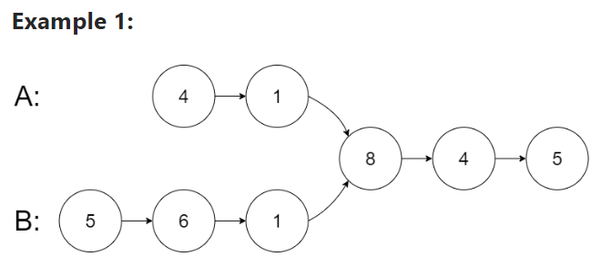
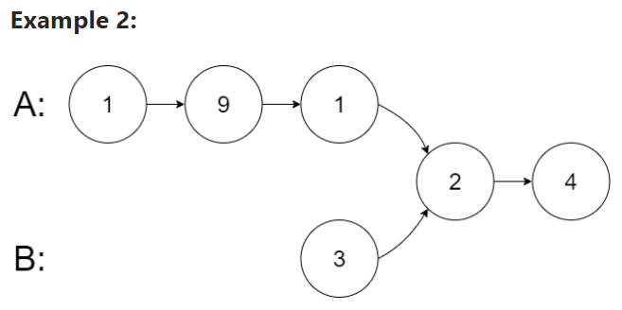
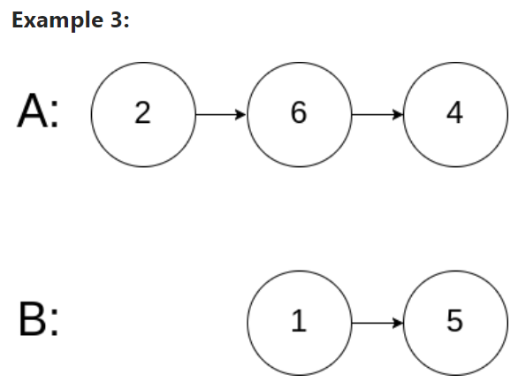
LeetCode 160: Intersection of Two Linked Lists

Slide 36
LeetCode 160: Intersection of Two Linked Lists
1
9
1
2
4
3
2
4
A + B
3
2
4
1
9
1
2
4
B + A

Slide 37
LeetCode 160: Intersection of Two Linked Lists
/// O(n+m) algorithm with O(1) extra space
public ListNode getIntersectionNode(ListNode headA, ListNode headB) {
ListNode p = headA;
ListNode q = headB;
while (p != q){
p = p == null? headB: p.next;
q = q == null? headA: q.next;
} // end-while
return p;
} // end-getIntersectionNode

