Slide 1
Today’s Material
What is an Abstract Data Type (ADT)
  Definition & Operations
Bag ADT & its implementations
  ArrayBag
  ListBag
Iterator Design Pattern
  Java Iterable and Iterator interfaces

Slide 2
Bag: A container for duplicate elements
Let us consider the problem of designing a container (collection) for any type of elements
  The container should be generic (we should be able to store any one type of element specified during the container creation)
  We should be able to store duplicate elements
    The same element can be added multiple times

Slide 3
Bag: Operations
Our Bag container should support the following operations
void add(E e); // Add the element to the Bag
void remove(E e); // Remove “e” from the Bag (if it exists)
boolean contains(E e); // Return true if “e” is in the Bag
boolean isEmpty() // Returns true if the Bag is empty
int size(); // # of elements in the Bag
void clear(); // Remove all elements
Iterator<E> iterator(); // Get an iterator to iterate (walk)
// over the elements in the Bag in a
// data structure independent way

Slide 4
Bag operations: add
Bag of Integers
(Initially empty)
add(2)
2
add(5)
add(7)
5
5
5
7
7
Notice that we did NOT specify how the Bag internally stores the elements, just specified what is stored in the Bag
The Bag is a black-box as far as the client is concerned

Slide 5
Bag operations: remove
2
remove(7)
2
remove(2)
remove(5)
5
5
5
7

Slide 6
Bag operations: contains
2
contains(7)
5
true
7
2
contains(9)
5
false
7

Slide 7
Bag operations: isEmpty
2
isEmpty()
5
false
7
isEmpty()
true

Slide 8
Bag operations: size
2
size()
5
3
7
size()
0

Slide 9
Bag operations: clear
2
clear()
5
7

Slide 10
Bag Abstract Data Type (ADT)
So far we have defined how each Bag operation should behave without specifying how they should be implemented
  Such containers are called Abstract Data Types (ADT)
An ADT is a container (a.k.a. collection) with a set of operations
  Operations specify how the ADT behaves, but does not reveal how they are implemented (encapsulation)
  In many cases, there are more than one way to implement an ADT
  An ADT is a very good example of OOP principles encapsulation & information (data) hiding (and usually inheritance & polymorphism)

Slide 11
Bag ADT Declaration
interface Bag<E> extends Iterable<E>{
public void add(E e); // Add the element to the Bag
public void remove(E e); // Remove “e” from the Bag (if it exists)
public boolean contains(E e); // Return true if “e” is in the Bag
boolean isEmpty() // Returns true if the Bag is empty
public int size(); // # of elements in the Bag
public void clear(); // Remove all elements
}
An ADT is typically declared as an interface with a set of operations
  We need a concrete class that implements the Bag ADT interface
  We need to use a data structure to implement the ADT

Slide 12
Using the Bag ADT
main(){
// Create an empty Bag of Integers
Bag<Integer> bag = new …;
bag.add(5); // {5}
bag.add(7); // {5, 7}
bag.add(2); // {5, 7, 2}
bag.size(); // Returns 3
bag.contains(7); // Returns true
bag.contains(9); // Returns false
bag.remove(7); // {5, 2}
bag.remove(2); // {5}
bag.clear(); // {}
bag.size(); // Returns 0
}/* end-main */

Slide 13
Implementing the Bag ADT
Let’s think about how we can implement the Bag ADT
  Obviously we have to use a Data Structure to implement the Bag ADT
  So far we have seen only two DSs: Arrays and Linked Lists
  It turns out that we can use either an array or a singly/doubly linked list to implement the Bag ADT
  Let’s call the array based implementation ArrayBag
  The singly linked list based implementation ListBag

Slide 14
ArrayBag: Bag Implementation using an Array
Basic Idea:
  Pre-allocate an array of MAX_SIZE (4 initially?)
  Keep track of the first free cell using a variable “size”
  Empty list has size = 0
size
0
1
2
3
………
size-1
MAX_SIZE
e1
e2
e3
e4
………
e_size

Slide 15
ArrayBag Declaration
class ArrayBag<E> implements Bag<E>{
private int size = 0;
private E[] arr = (E[])new Object[4];
public void add(E e); // Add the element to the Bag
public void remove(E e); // Remove “e” from the Bag (if it exists)
public boolean contains(E e); // Return true if “e” is in the Bag
boolean isEmpty() // Returns true if the Bag is empty
public int size(); // # of elements in the Bag
public void clear(); // Remove all elements
}

Slide 16
ArrayBag: add
add(E e)
Basic Idea: Simply append the new element to the end
Here is the final list. Running time: O(1)
size
0
1
2
3
………
size-1
MAX_SIZE
e1
e2
e3
e4
………
e_size
size
0
1
2
3
………
size-2
size-1
MAX_SIZE
e1
e2
e3
e4
………
e_size
e

Slide 17
ArrayBag add – Full Array
What if the array is already full? We will do the following:
  Allocate a bigger array (usually double the capacity)
  Copy all elements from the old array to the new one
  Start using the new array

Slide 18
ArrayBag: remove
remove(E e)
  Example: remove(e2): Delete e2
Basic Idea:
  Find the index where e2 is stored and copy the last element to this index
Running time: O(N) to find the element, O(1) to remove it
0
1
2
3
………
size-1
MAX_SIZE
e1
e2
e3
e4
………
e_size

Slide 19
ListBag: Bag Impl. using a Singly Linked List
Basic Idea:
  Use a singly linked list to store the Bag elements
  Use a “size” variable to keep track of the number of elements in the Bag
e1
next
e2
next
e3
next
e4
null
head

Slide 20
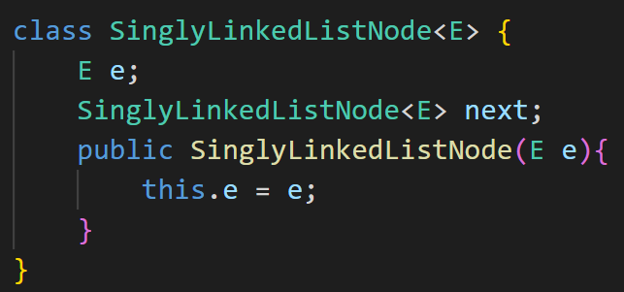
ListBag Declaration
class ListBag<E> implements Bag<E>{
private int size = 0;
private SinglyLinkedListNode<E> head = null;
public void add(E e); // Add the element to the Bag
public void remove(E e); // Remove “e” from the Bag (if it exists)
public boolean contains(E e); // Return true if “e” is in the Bag
boolean isEmpty() // Returns true if the Bag is empty
public int size(); // # of elements in the Bag
public void clear(); // Remove all elements
}

Slide 21
ListBag: add
add(E e)
Basic Idea: Simply prepend the new element to the beginning
Here is the final list. Running time: O(1)
e1
next
e2
next
e3
next
e4
null
head
head
e
next
e1
next
e2
next
e3
next
e4
null

Slide 22
ListBag: remove
remove(E e)
  Ex: remove(e2)
Basic Idea: Simply find the element & remove it from the list
Here is the final list. Running time: O(N) to find, O(1) to remove
e1
next
e2
next
e3
next
e4
null
head
e1
next
e3
next
e4
null
head

Slide 23
Bag ADT Operation Running Times
Operation | ArrayBag | ListBag
add | O(1) | O(1)
remove | O(N) to find/O(1) to remove | O(N) to find/O(1) to remove
contains | O(N) | O(N)
isEmpty | O(1) | O(1)
size | O(1) | O(1)
clear | O(N) | O(N)

Slide 24
Iterating over the Elements in the Bag
We have seen that our Bag ADT is a black box
  We know how it behaves but we have NO idea how it is implemented
  We do NOT know how the data is stored inside the Bag
Question: How to iterate over the elements stored in a Bag in a data structure independent way
  This is where the Iterator pattern comes into play

Slide 25
Iterator Design Pattern
A behavioral design pattern that lets you traverse elements of a collection without exposing its underlying representation (array, linked list, tree, hash table, trie, graph, etc.)
The main idea of the Iterator pattern is to extract the traversal behavior of a collection into a separate object called an iterator
An iterator object encapsulates all of the traversal details, such as the current position and how many elements are left till the end

Slide 26
Java Iterable & Iterator interfaces
Iterable interface
Iterator interface
public Iterator<E> iterator();
public boolean hasNext();
public E next();
public void remove(); // optional
implements
implements
ArrayBag
ArrayBagIterator
ArrayBagIterator is implemented as an inner class of ArrayBag

Slide 27
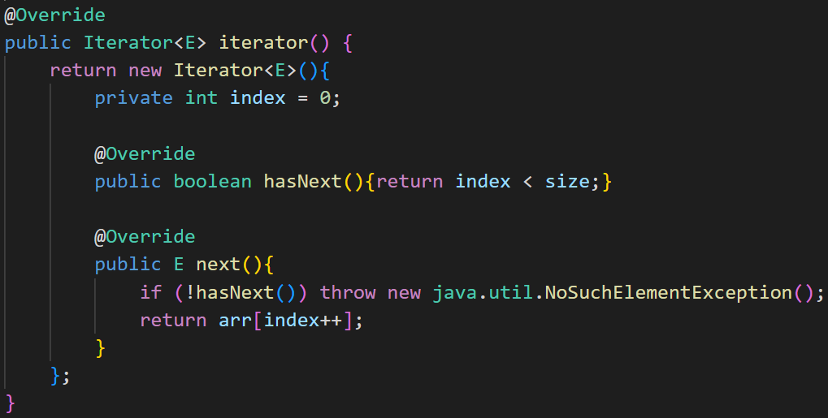
ArrayBag Iterator

Slide 28
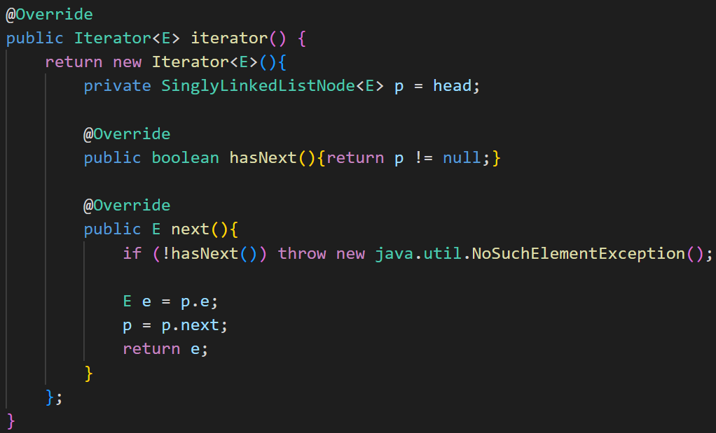
ListBag Iterator

Slide 29
Interview Question on the Iterator Pattern
The Iterator pattern comes up frequently in many designs and is therefore the subject of many interview questions
Here is an interview question from Google:
  Consider a string that was encoded using the Run-Length-Encoding
  Assume that each character occurs less than 10 times, so that we do not have to deal with number conversion. i.e., number > 0 and number < 10
  Implement a RLIterator class that returns one character of the decoded message until the whole message is exhausted
  Ex: str=”a3b5c1d7a6” → Returned values: “aaabbbbbcdddddddaaaaaa”
  RLIteratorTest.java: This code assumes that a number always comes after a char and that the number is > 0 and < 10

Slide 30
LeetCode Questions on Iterator Pattern
284. Peeking Iterator
900. RLE Iterator
1286. Iterator for Combination
173. Binary Search Tree Iterator (to be solved after we cover BSTs)

